Slide 1

OOP as it Should Be
Level 1
Up Casting
Vs
Down Casting

Slide 2

OOP as it Should Be
Level 1
Up Casting Vs Down Casting
2

Slide 3
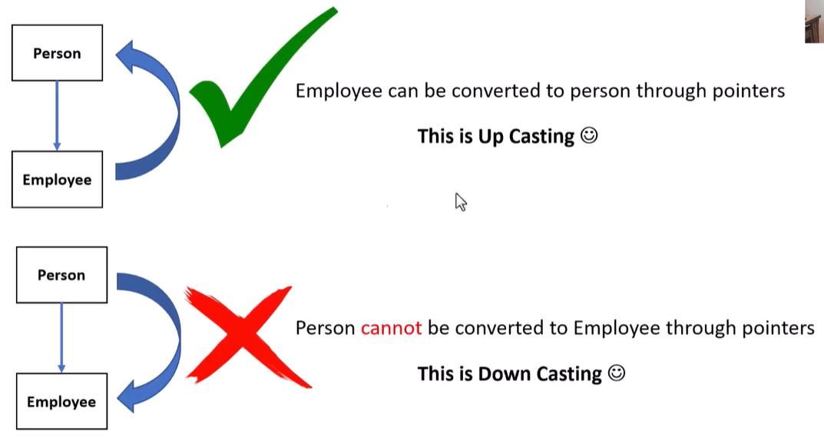
Up Casting vs Down Casting

Slide 4
🔎 Definition
Casting is the process of converting one data type or object type into another
In inheritance, casting happens between base and derived classes

Slide 5
📖 Explanation
🔹 This example demonstrates how object pointers behave when converting between:
Base class (clsPerson)
Derived class (clsEmployee)
🔹 Only pointer/reference casting is involved, not object copying

Slide 6
🟨 Class Structure
🔹 Base clsPerson
🟩 Member Visibility
🟨 Public member
🟩 FullName

Slide 7
🟨 Class Structure
🔹 Derived Class: clsEmployee : public clsPerson
🟩 Inherits all public members of clsPerson
🟨 FullName
🟩 Adds its own member
🟨 Title

Slide 8
🔎 Up Casting
🔹 Up casting converts a derived-class object into a base-class pointer or reference
🟨 Characteristics
🟩 Happens automatically
🟩 Safe and implicit
🟩 No explicit cast required
💡 Example from code
🟨 clsPerson* Person1 = &Employee1;
🔹 Employee1 is treated as a clsPerson

Slide 9
🔎 Down Casting
🔹 Down casting attempts to convert a base-class object into a derived-class pointer 🟨 Characteristics
🟩 Not allowed implicitly
🟩 Unsafe without runtime checking
🟩 Can cause undefined behavior
💡 Example from code
🟨 clsEmployee* Employee2 = &Person2;
🔹 This conversion is not valid

Slide 10
🟦 Steps in main()
1️⃣ Create an object of clsEmployee
2️⃣ Access inherited member directly
3️⃣ Perform up casting
4️⃣ Access base-class member through base pointer
5️⃣ Attempted down casting is commented out (invalid)

Slide 11
➡️ Expected Output
🔹 Up casting works correctly
🔹 Base-class pointer can access only base-class members
🔹 Down casting is not allowed without explicit and safe mechanisms

Slide 12
⚖️ Comparison
🟩 Up Casting
✔️ Derived → Base
✔️ Safe
✔️ Automatic
✔️ Supported by C++
🟥 Down Casting
✔️ Base → Derived
✔️ Unsafe
✔️ Not automatic
✔️ Requires extra checks

Slide 13
🚫 Warning
🔹 Down casting without validation can:
🟩 Cause runtime errors
🟩 Lead to undefined behavior
🟩 Access memory incorrectly
🔹 Use runtime checks (e.g. dynamic_cast) when necessary

Slide 14
✨ Summary
✅ Demonstrates up casting using pointers
✅ Explains why down casting is unsafe
✅ Shows how inheritance affects pointer behavior
✅ Reinforces safe object-oriented design principles

Slide 15
Thank you ☺

