Slide 1

Programming Foundations
Level 1

Slide 2

Programming Foundations
Level 1
Data, Information,
Knowledge, and Wisdom
2

Slide 3
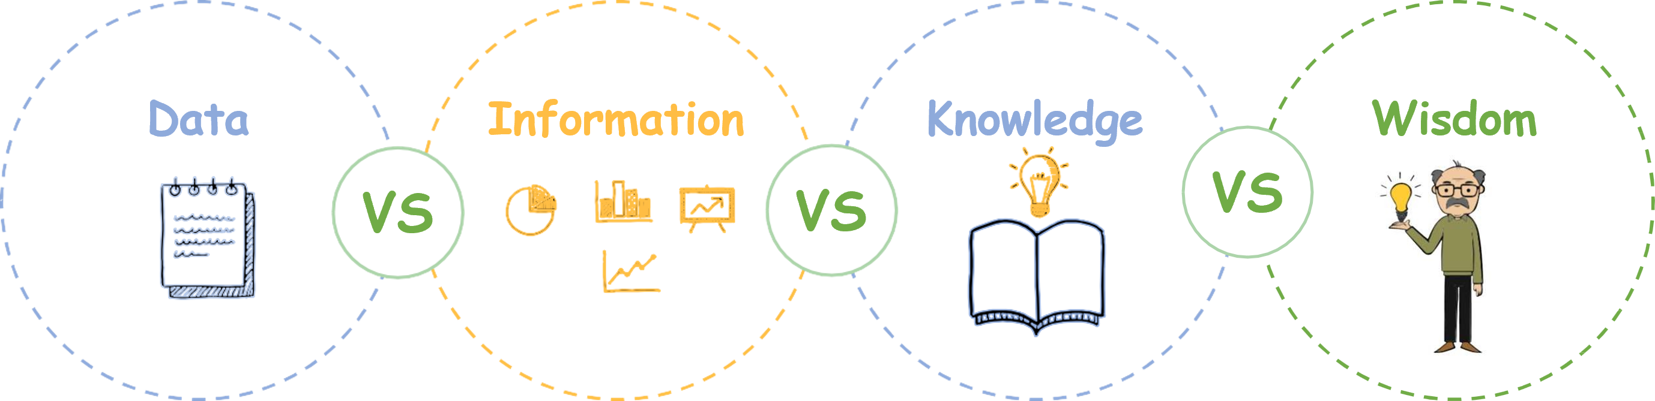
What is the difference between…

Slide 4

We will start with..

Slide 5
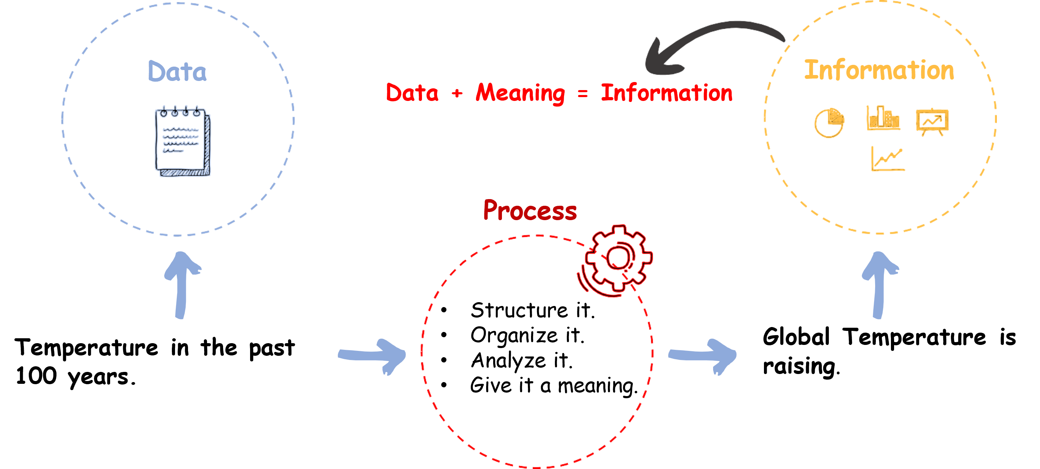
Example:

Slide 6
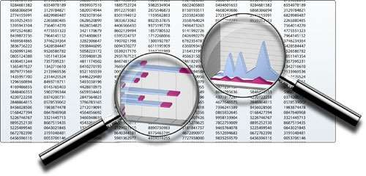

Slide 7




Data
Information
VS
Raw Facts
Driven from data
Unstructured/Unorganized
Structured/Organized
Unanalyzed
Diffrences
Analyzed
Unprocessed
Processed
Has no meaning
Has meaning

Slide 8
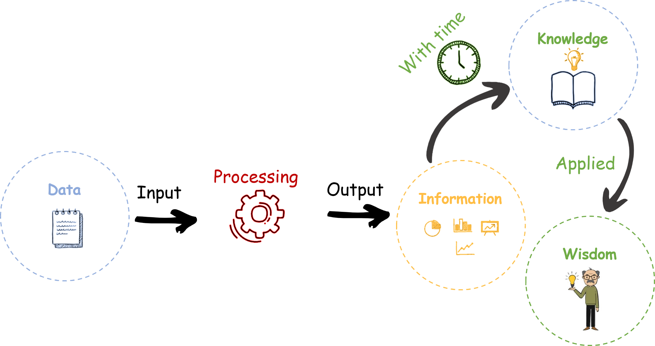
Knowledge and Wisdom:

Slide 9
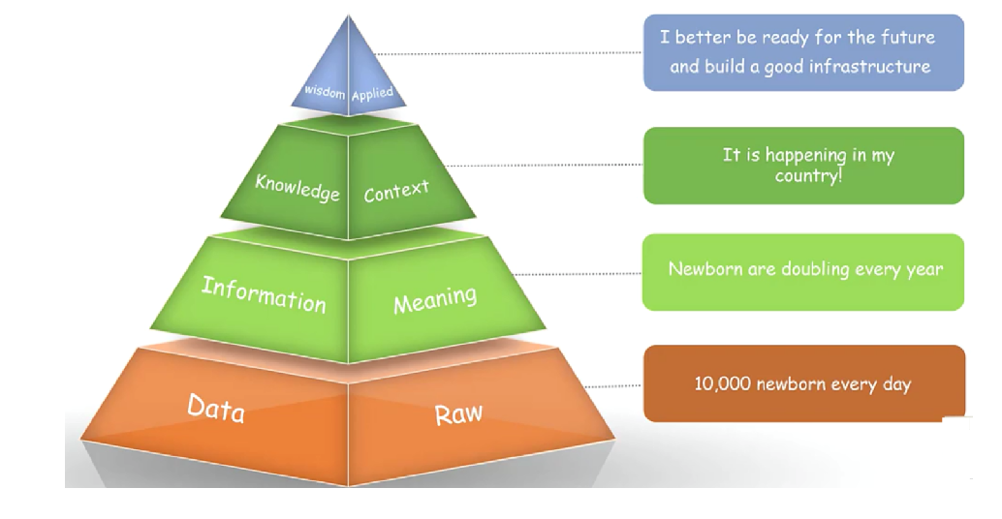
Knowledge and Wisdom:

Slide 10
🧐 Activity
📋 Instructions:
1️⃣ Identify one example of data from your daily life.
2️⃣ Transform that data into information by adding context or analysis.
3️⃣ Derive knowledge by finding a pattern or relationship.
4️⃣ Suggest a wise action you could take based on that knowledge.

Slide 11
🧐 Activity Solution
📋 Solution:
1️⃣ Data: 1500 website visitors in the last week.
2️⃣ Information: 65% of visitors came from mobile devices.
3️⃣ Knowledge: Mobile users leave after 5 seconds more often than desktop users.
4️⃣ Wisdom: Optimize the mobile homepage for faster loading and simpler layout.

Slide 12
🏁 Conclusion
✅ Data is the foundation — raw, unstructured, and meaningless alone.
✅ Information gives that data structure and meaning.
✅ Knowledge adds understanding and relationships.
✅ Wisdom applies knowledge in real-life decisions.
🧩 By climbing the DIKW ladder, you move from knowing facts → understanding patterns → applying insight — which is the essence of true learning, decision- making, and intelligence. 🌟.

Slide 13
Thank you ☺

