Slide 1

Programming Foundations
Level 1

Slide 2

Programming Foundations
Level 1
What is Computer
2

Slide 3
Before we know what is computer?
Let us remember...

Slide 4
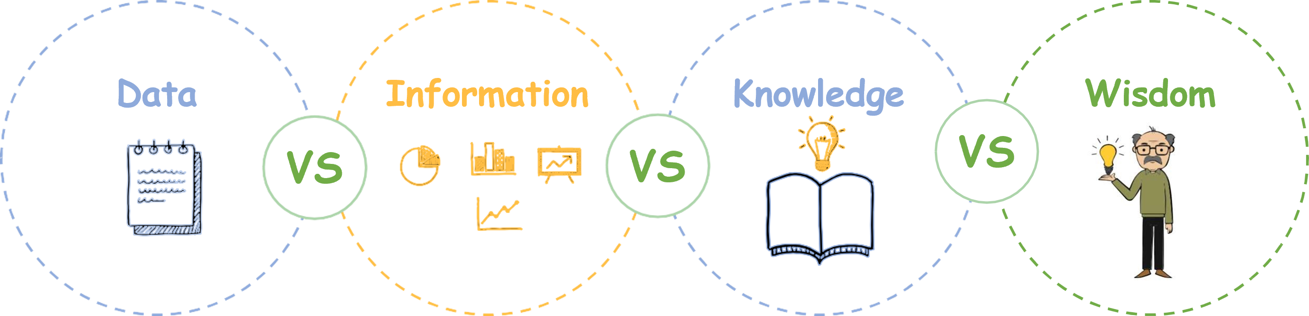
What is the difference between…

Slide 5
Computer is:
A computer is more than a box on a desk—it’s an electronic device that accepts data (input), processes it under control of instructions, produces information (output), and stores that information for future use.
We’ll unpack what that means, then tour the core units (Input, Output, Memory, CPU), explain software vs hardware, compare CPU vs GPU, and demystify 32-bit vs 64-bit.

Slide 6
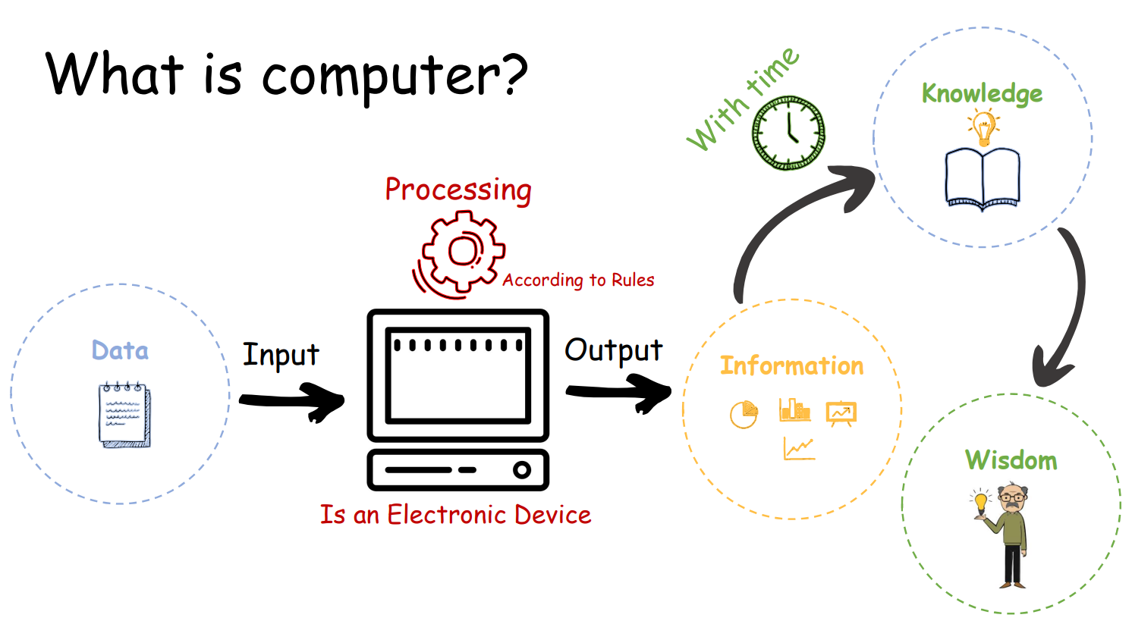
What is computer?

Slide 7
Computer is:
A computer is:
  an Electronic Device 🧲
  operating under the control of instructions (programs) 📜
  that accepts data (input), processes data according to rules, produces information (output), and stores information for future use 💾.
Processing Model: Input → Processing → Output (Data → Information → Knowledge → Wisdom perspective).

Slide 8
Programming Foundations
Level 1
Computer Functions
2

Slide 9
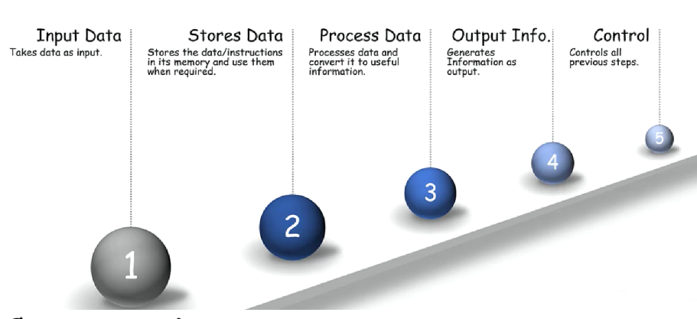
Functionalities of Computer

Slide 10
Computer is:
1️⃣ Input data – Takes data in.
2️⃣ Stores data – Keeps data/instructions in memory for later.
3️⃣ Process data – Converts data into useful information.
4️⃣ Output information – Presents results.
5️⃣ Control – Coordinates and controls all previous steps.

Slide 11
Computer is:
🟨 Electronic Device.
🟨 Operating under the control of instructions.
🟨 Accepts Data (Input).
🟨 Processes Data according to certain rules.
🟨 Produces Information (Output).
🟨 Stores information for future use.

Slide 12
Programming Foundations
Level 1
Computer Components
2

Slide 13
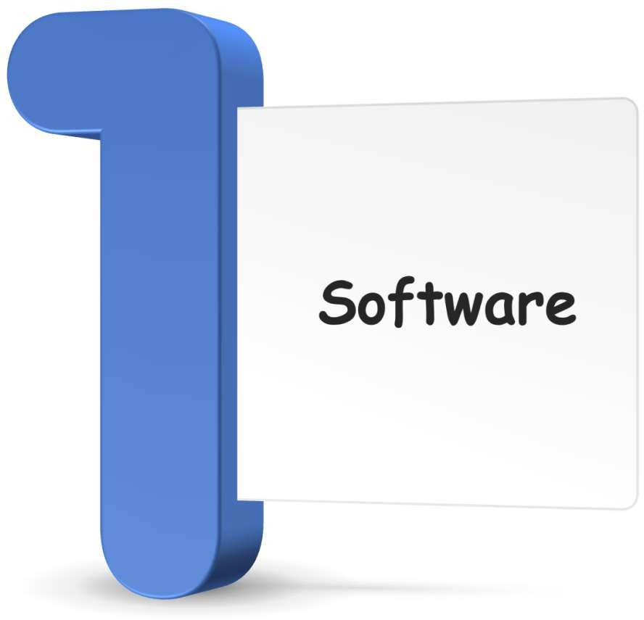
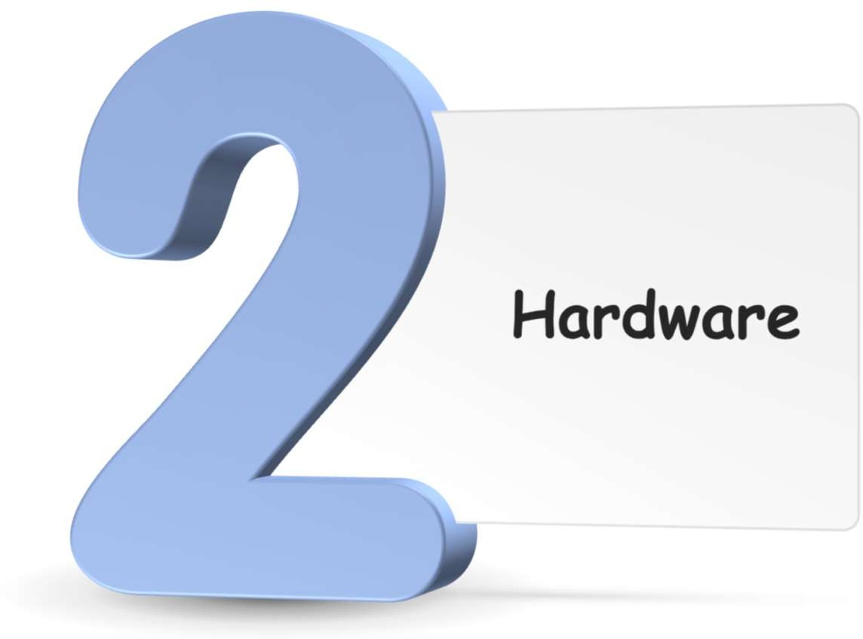
Functionalities of Computer

Slide 14
Programming Foundations
Level 1
Computer Components
Software
2

Slide 15
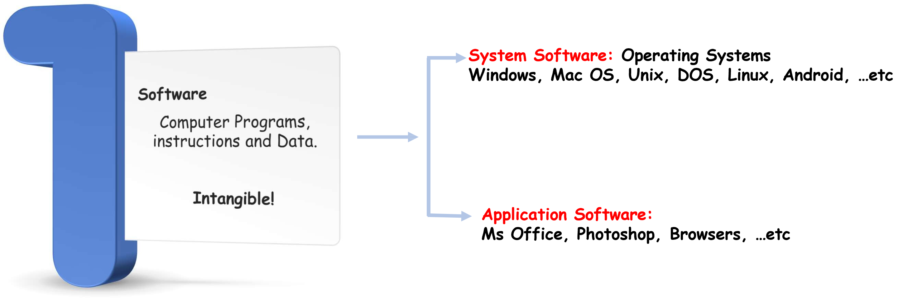
Software

Slide 16
Programming Foundations
Level 1
Computer Components
Hardware
2

Slide 17
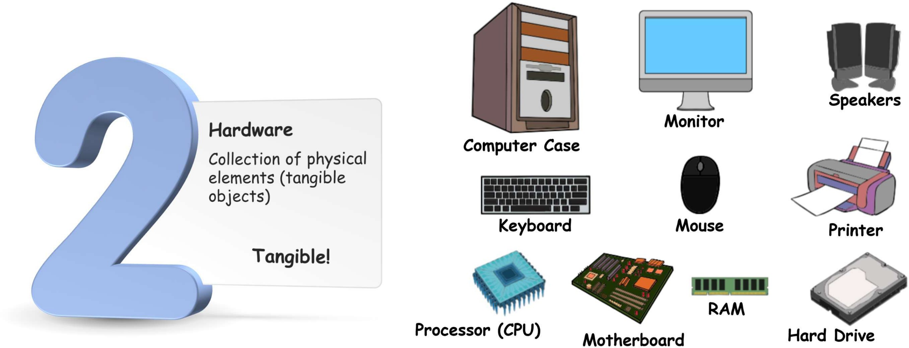
Hardware

Slide 18
Programming Foundations
Level 1
Computer Units
2

Slide 19
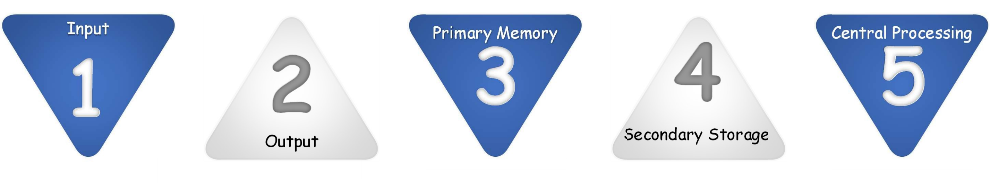
Computer Units

Slide 20
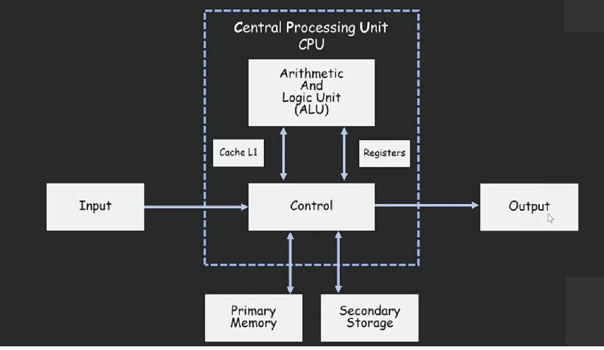
Computer Units

Slide 21
Computer Units:
🟨 Input
🟨 Output
🟨 Primary Memory (RAM/ROM)
🟨 Secondary Storage (long-term)
🟨 Central Processing Unit (CPU) (ALU, Control, Cache & Registers)
A more detailed view shows CPU at the center with ALU, Control Unit, Cache/Registers, connected to Input/Output and Primary/Secondary Memory.

Slide 22
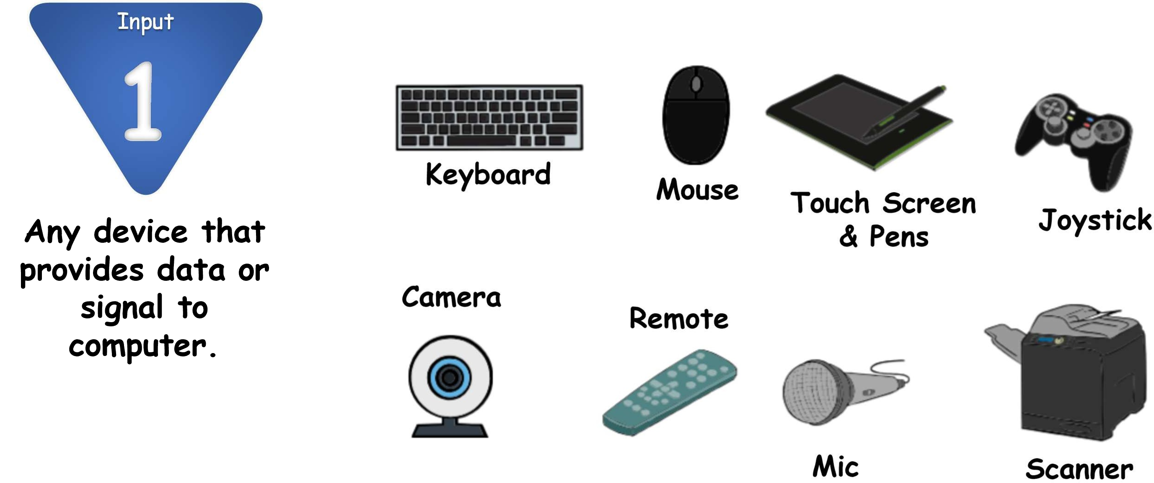
Computer Units Input
🎙️ Input: any device that provides data or signals to the computer.

Slide 23
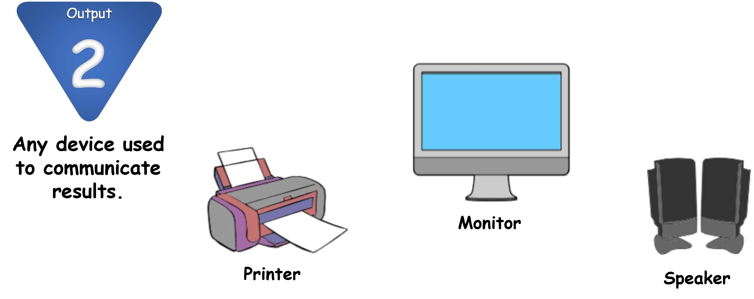
Computer Units Output
🖥️ Output: any device used to communicate results (monitor, printer, speakers).

Slide 24
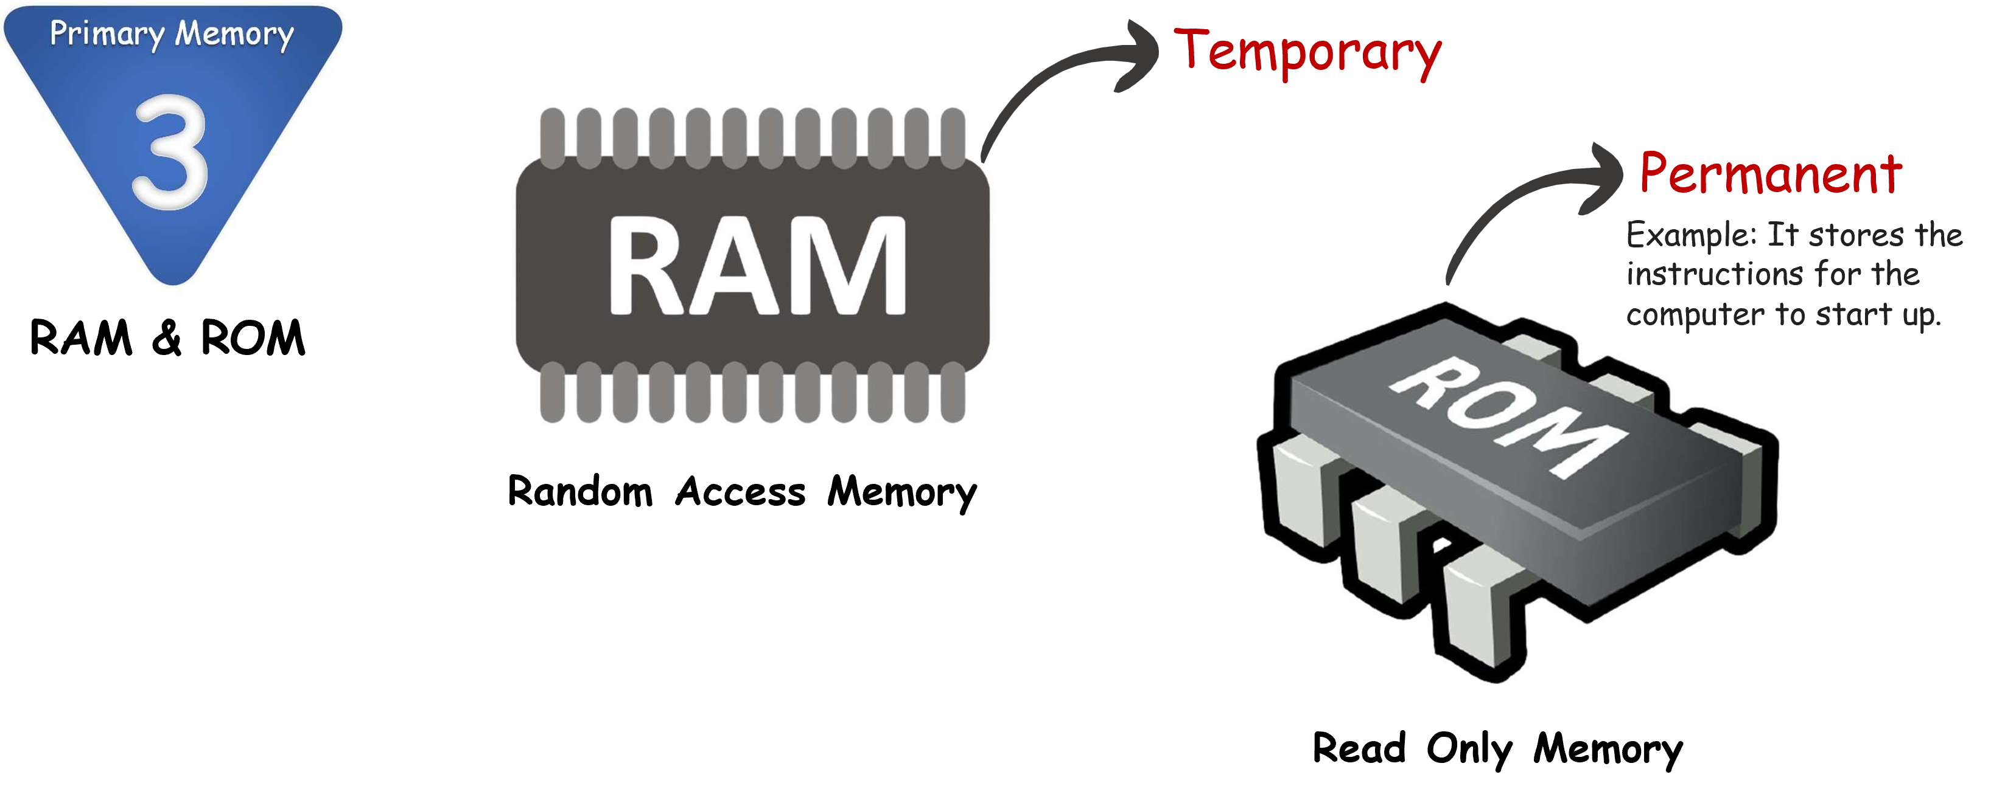
Computer Units Primary Memory
🟨 RAM (Random Access Memory): temporary working memory.
🟨 ROM (Read-Only Memory): permanent—stores startup/boot instructions

Slide 25
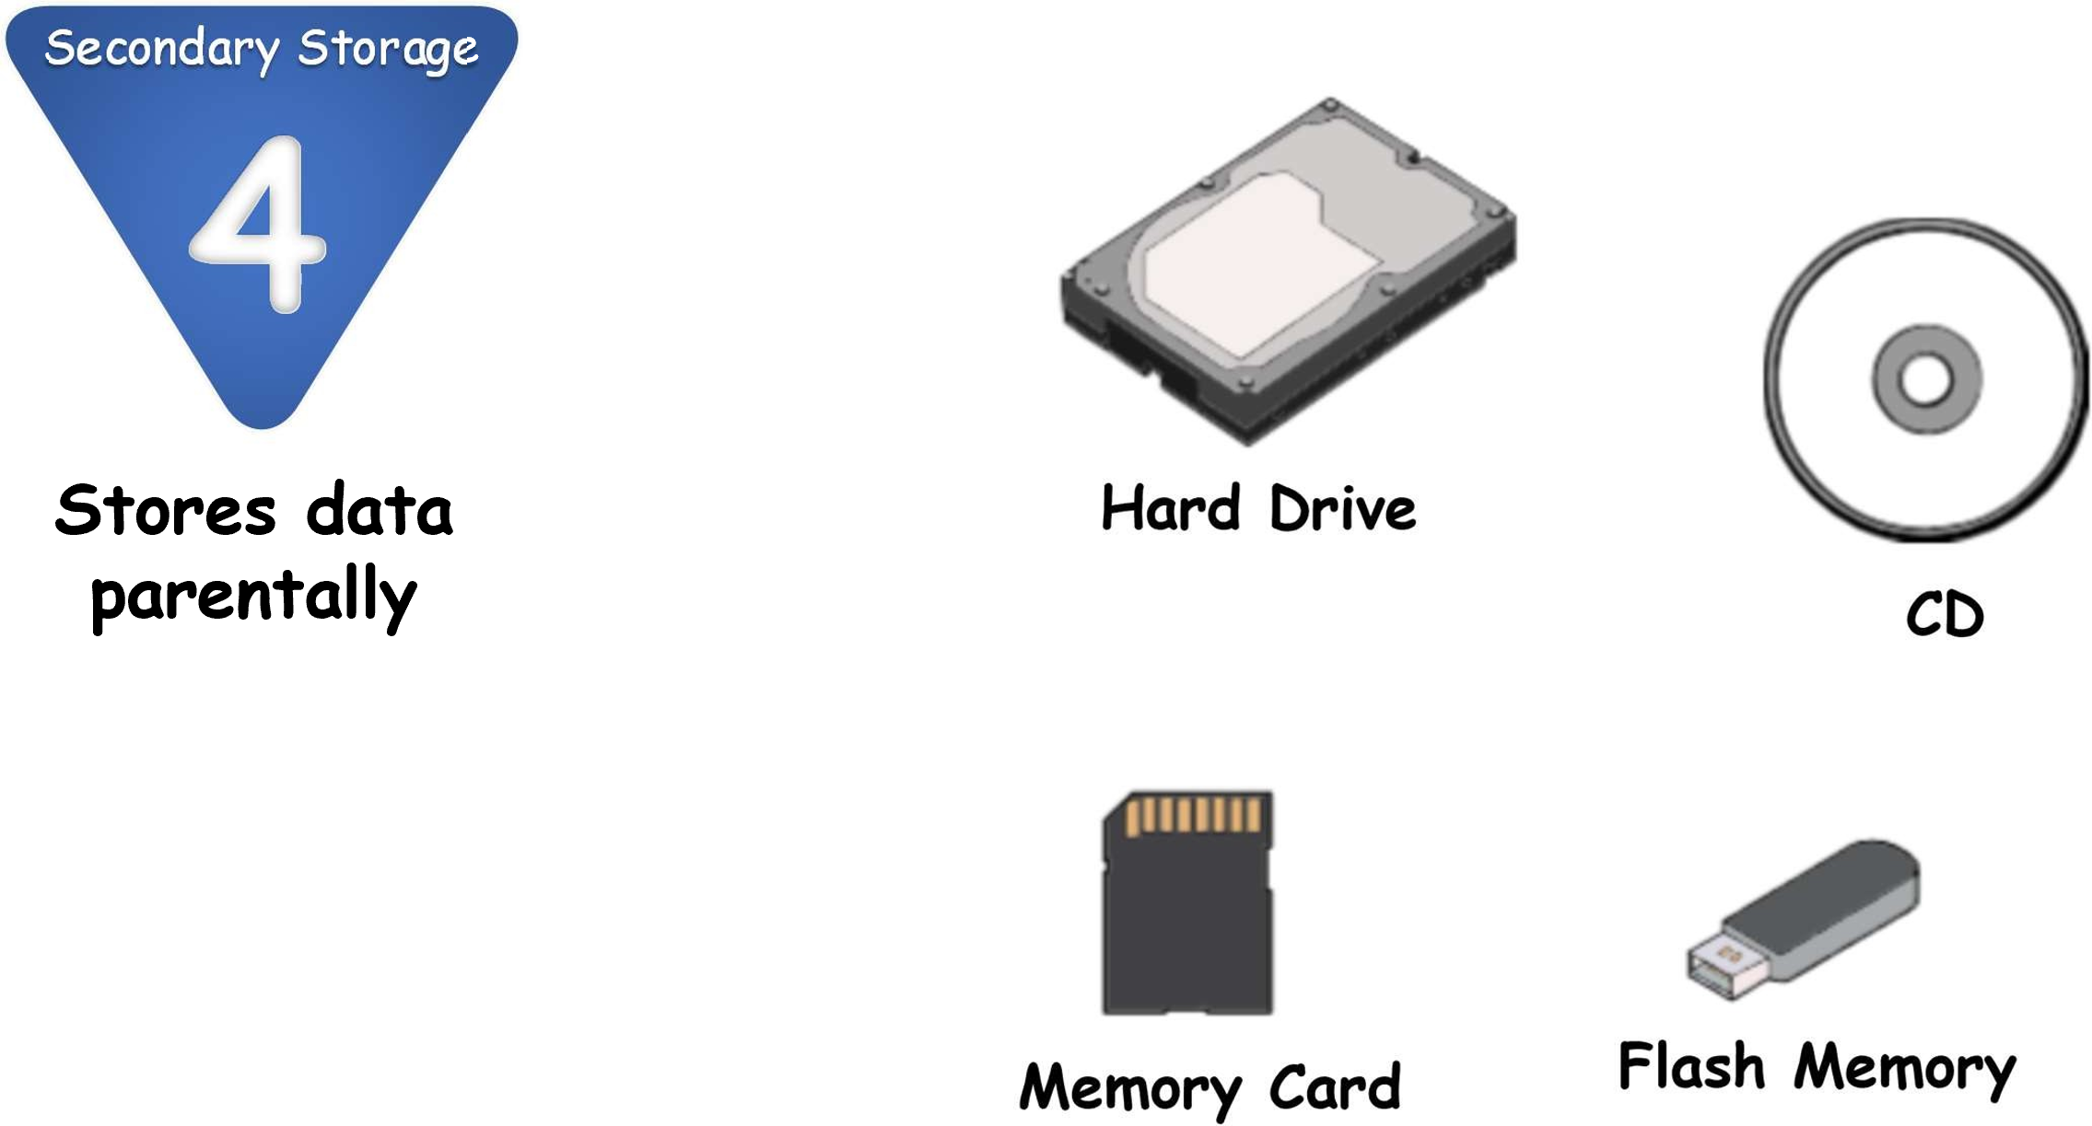
Computer Units Secondary Storage
🟨 Long-term storage; stores data permanently (e.g., SSD/HDD).

Slide 26
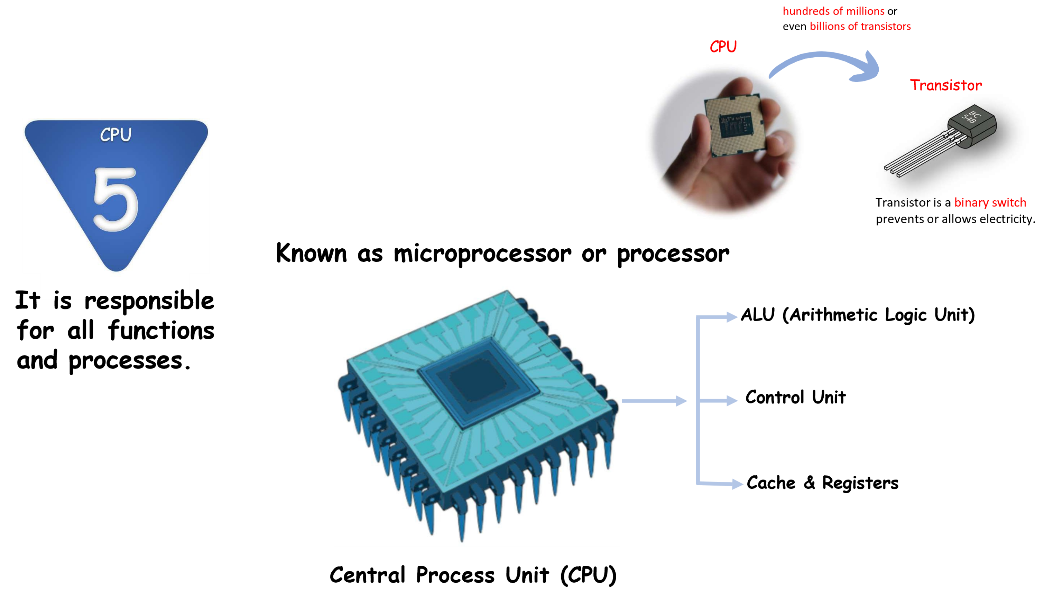
Computer Units CPU

Slide 27
Computer Units
🟨 Also called microprocessor/processor; responsible for all functions and processes at the instruction level.
🟨 ALU (Arithmetic Logic Unit): arithmetic (add, sub, mul, div) + logical operations (compare numbers/letters/characters).

Slide 28
Arithmetic and logical Unit - ALU:
🟨 Executes Arithmetic and logical operations.
🟩 Arithmetic calculations (Addition, Subtraction, Multiplication, Division).Logical
🟩 Operations ( Compare numbers, letters, characters).
🟨 Control Unit (CU): controls & coordinates components, reads data from memory, sends to ALU/registers, instructs hardware to perform operations.

Slide 29
Control Unit - CU:
🟨 Controls and coordinates computer components.
🟩 Reads data from memory
🟩 Sends data to ALU or register
🟩 Instructs hardware to perform the requested operation
🟨 Cache & Registers: high-speed memory locations inside the CPU, directly accessible by the processor.

Slide 30
Cache & Registers:
🟨 Cache is a Highigh-Speed memory inside the CPU chip.
🟨 Registers are Highigher-Speed memory inside the CPU chip.
These are memory locations that can be directly accessible by processor.

Slide 31
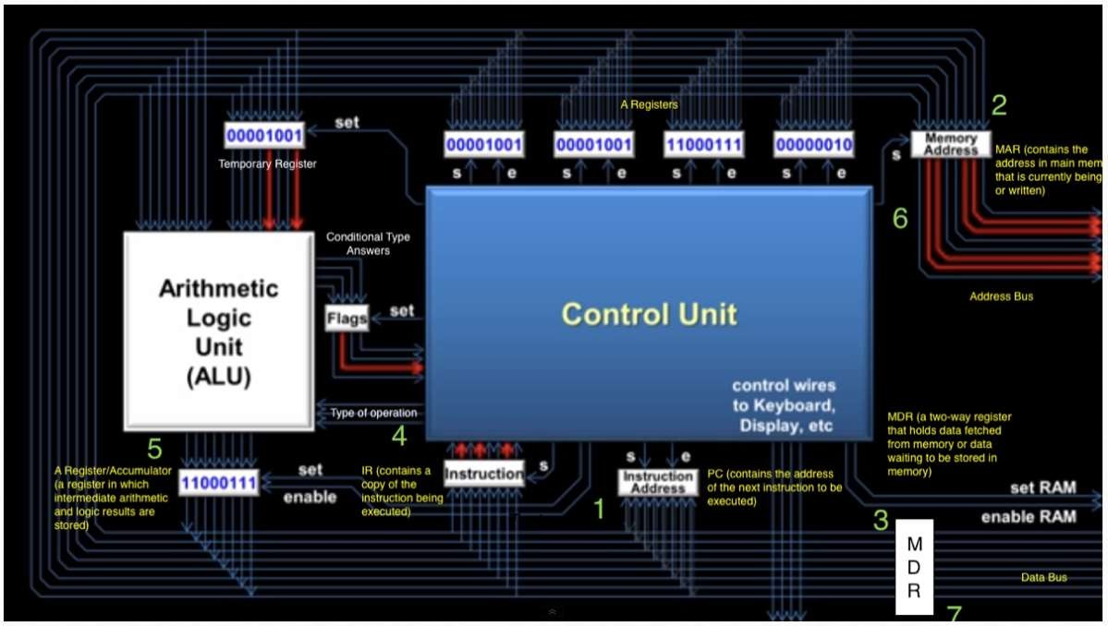
CPU internal architecture:
at this level of your learning journey just take a look on this picture, don't dive into details.

Slide 32
Programming Foundations
Level 1
CPU Access to Memory
2

Slide 33
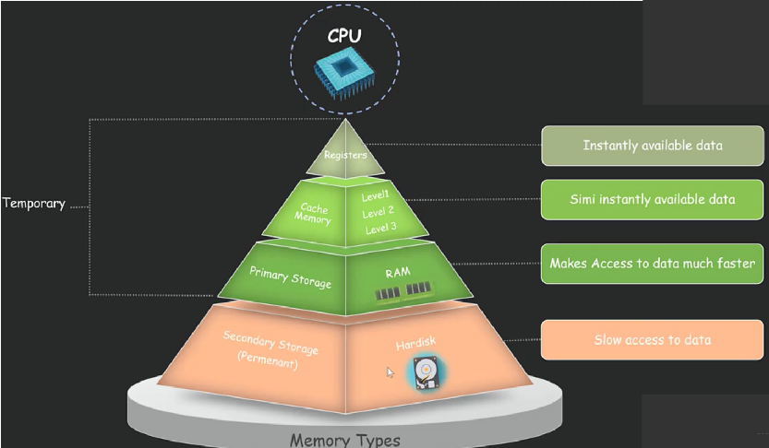
CPU Access to Memory: Types & Speed

Slide 34
CPU Access to Memory: Types & Speed
🟨 Registers (inside CPU) → instant data
🟨 Cache (L1…) → very fast
🟨 Main Memory (RAM) → fast
🟨 Secondary Storage → slower
“Instantly/simi-instantly” available data increases as you move closer to the CPU (Registers/Cache).

Slide 35
Programming Foundations
Level 1
GPU Graphics Processing Unit
2

Slide 36
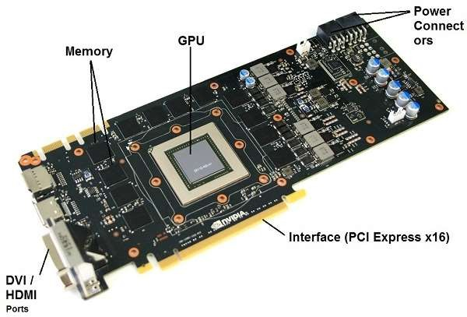
What is GPU?
🟨 GPU stands for graphics processing unit.
🟨 You'll also see GPUs commonly referred to as graphics cards or video cards!
🟨 But it is not graphic card, it’s only one part of it.
GPU (Graphics Processing Unit): often called “graphics/video card,” but the GPU is just one part of the card.

Slide 37
GPU vs CPU
🟨 CPU is designed to handle tasks quickly but are limited in the concurrency of tasks that can be running.
🟨 A GPU is designed to quickly render high-resolution images and video concurrently.
🟨 CPU: designed to handle tasks quickly but with limited concurrency.
🟨 GPU: designed to render high-resolution images/video concurrently (high parallelism).

Slide 38
Programming Foundations
Level 1
How Computer Deals with data?
2

Slide 39
Computers Come in 32-bit and 64-bit Versions (x86 vs x64)
Modern computers are designed with different architectures that define how much data they can handle at once and how much memory they can address. The two most common are 32-bit and 64-bit.
💡 Address Space Capacity
🧮 2³² = 4,294,967,296 bytes ≈ 4 GB
👉 This is the maximum memory (RAM) a 32-bit system can address.
🧮 2⁶⁴ = 18,446,744,073,709,551,616 bytes ≈ 16 Exabytes (EB)
👉 This shows the massive difference in capacity between 32-bit and 64-bit systems
🏷️ Naming Conventions
🟨 32-bit → often called x86 or x86-32
🟨 64-bit → often called x64 or x86-64
⚙️ Performance Difference
🟨 A 64-bit CPU can process twice as many bits per instruction cycle as a 32-bit CPU.
🟨 It can handle larger data types, larger files, and more RAM efficiently.

Slide 40
📌 Note:
If you install a 32-bit Operating System on a 64-bit CPU, the system will still work — but you’ll be limited to running 32-bit software only, and your system can’t use all available memory.

Slide 41
💾 RAM Limitations
🧠 32-bit OS: can address up to 2³² = 4,294,967,296 bytes ≈ 4 GB
🚀 64-bit OS: can theoretically address 2⁶⁴ bytes ≈ 16 Exabytes
📌 If your computer has 4 GB RAM or more, you must use a 64-bit CPU and 64-bit OS to utilize it fully.

Slide 42
✨ Summary
✅ Computers are built on either 32-bit (x86) or 64-bit (x64) architecture.
✅ 64-bit systems support more RAM, larger files, and faster performance.
✅ Compatibility matters — choose your OS and apps according to your CPU type

Slide 43
🧐 Activity
📋 Instructions:
1️⃣ Draw a block diagram with Input, Output, Primary Memory, Secondary Storage, CPU (ALU, CU, Cache/Registers) and label each.
2️⃣ Given: “Load image from SSD → process filter → display on monitor.” Map each step to units and indicate where the data resides at each step.
3️⃣ Your PC has 8 GB RAM—explain why a 64-bit OS is recommended and what happens if a 32-bit OS is installed.

Slide 44
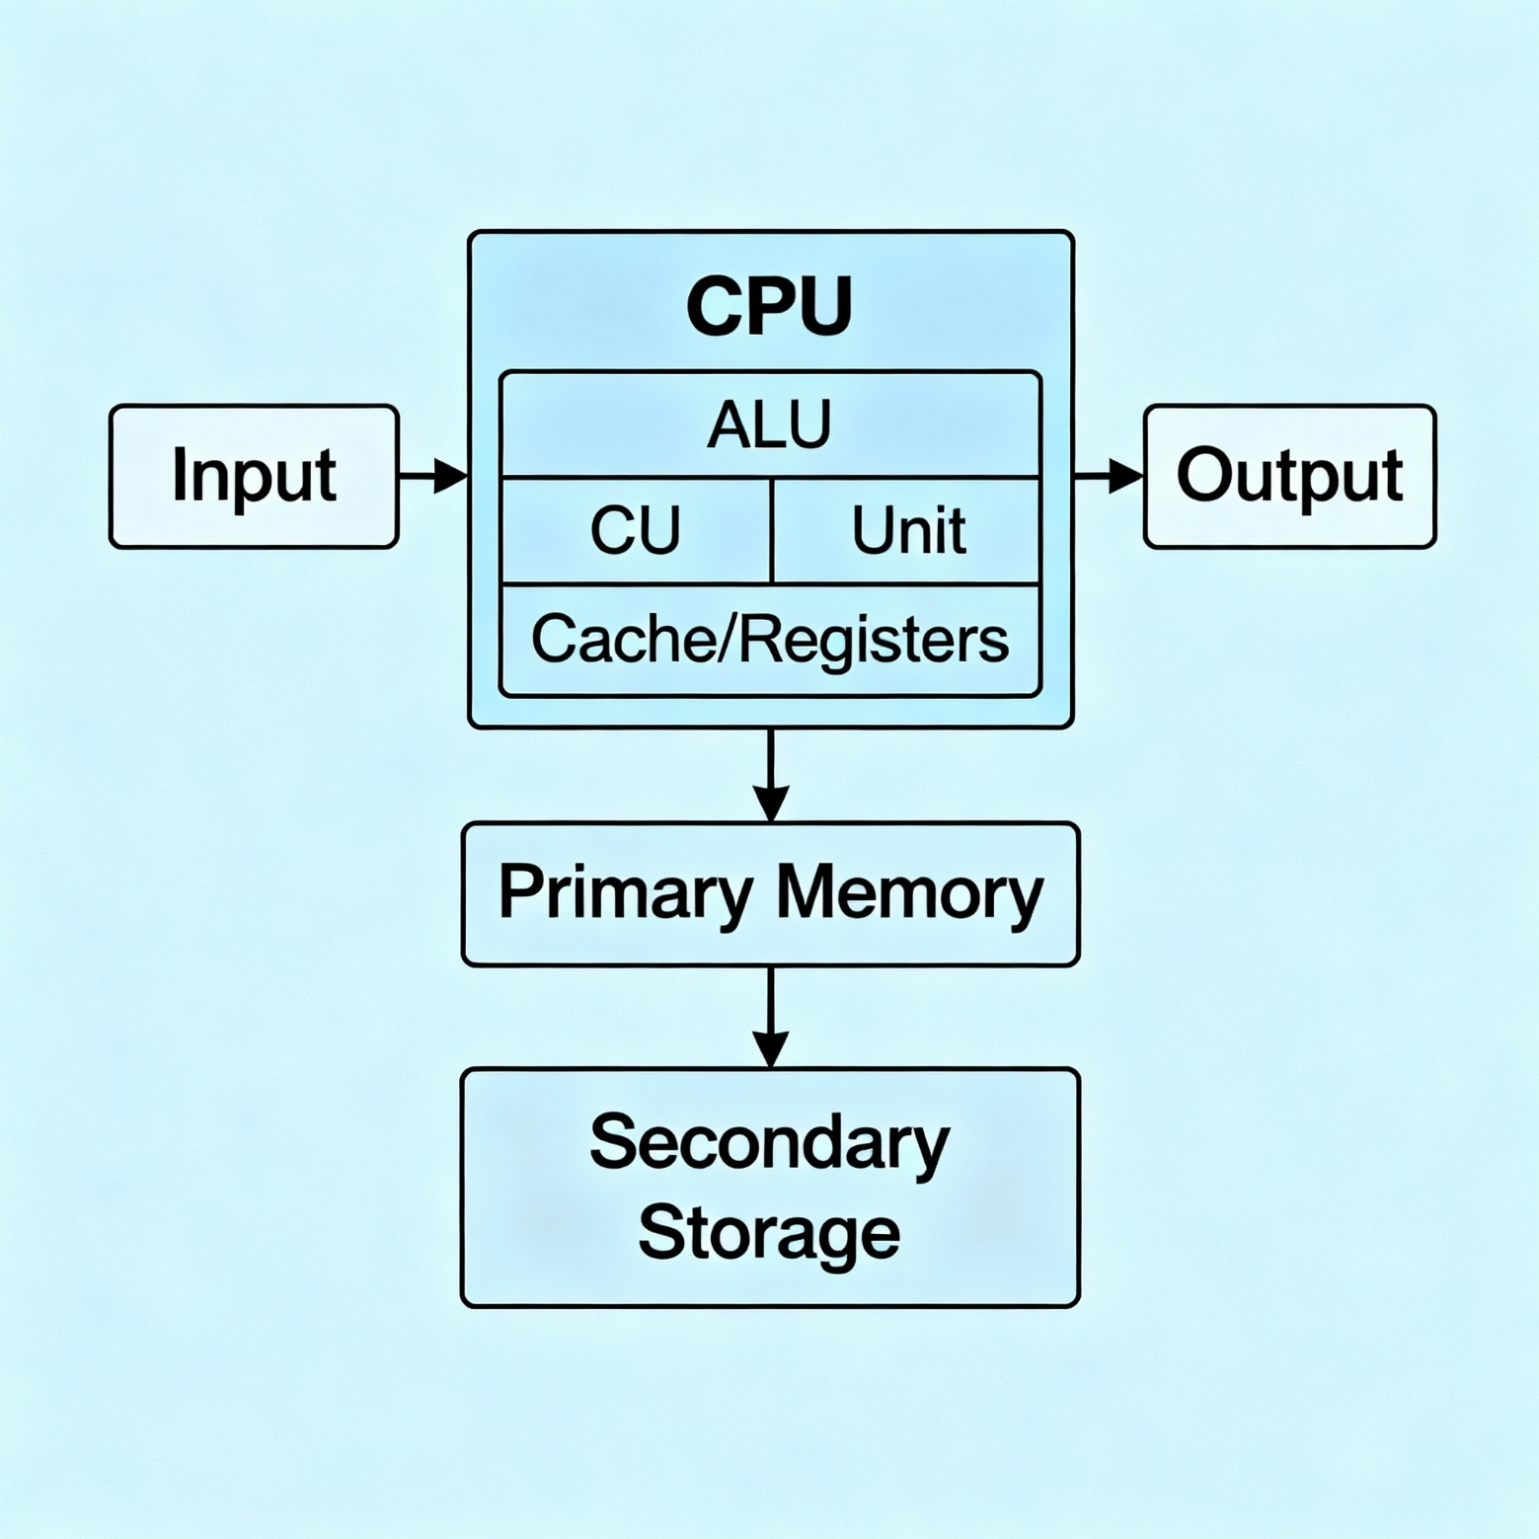
🧐 Activity Solution
📋 Solution:
1️⃣ Draw a block diagram with Input, Output, Primary Memory, Secondary Storage, CPU (ALU, CU, Cache/Registers) and label each.

Slide 45
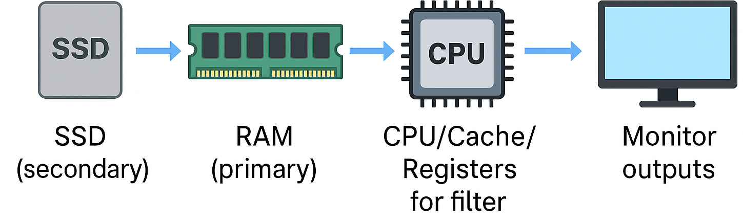
🧐 Activity Solution
📋 Solution:
2️⃣ Given: “Load image from SSD → process filter → display on monitor.” Map each step to units and indicate where the data resides at each step.
🟨 SSD (secondary) → RAM (primary) → CPU/Cache/Registers for filter → GPU/CPU renders → Monitor outputs.

Slide 46
🧐 Activity Solution
📋 Solution:
3️⃣ Your PC has 8 GB RAM—explain why a 64-bit OS is recommended and what happens if a 32-bit OS is installed.
🟨 64-bit OS: can address >4 GB; 32-bit OS limited to ~4 GB, so it can’t fully utilize 8 GB. A 64-bit CPU + 64-bit OS uses the memory effectively.

Slide 47
🏁 Conclusion
✅ A computer is an electronic device guided by programs to convert input data into useful output information and store it.
✅ Its units—Input, Output, Memory (RAM/ROM), Storage, CPU (ALU, CU, Cache/Registers)—work together under control.
✅ Software directs hardware; GPU complements CPU for parallel graphics.
✅ 64-bit architectures deliver larger address spaces and higher throughput vs 32- bit.

Slide 48
Thank you ☺

