Slide 1

Programming Foundations
Level 1

Slide 2

Programming Foundations
Level 1
Binary System
2

Slide 3
Understanding the Binary System in Computers
Computers are electronic devices that work entirely using electricity — signals that are either ON or OFF.
Because of this, they can only understand two states: 1 (ON) and 0 (OFF).
This fundamental concept is the basis of everything a computer does — numbers, letters, images, and sounds are all represented in binary form.
Understanding the binary system is the first step toward mastering computer logic and programming.

Slide 4
How Computer Works?
🟨 A computer processes information using electrical signals.
🟨 It understands only 0s and 1s (binary digits).
🟨 These digits represent electrical states — Off (0) or On (1).
🟨 Billions of these tiny electrical switches called transistors form the CPU and handle all computations.
🟨 Inside the CPU (Central Processing Unit), there are hundreds of millions — or even billions — of transistors.
🟨 A transistor is a microscopic binary switch that either allows or blocks the flow of electricity.
🟨 Every calculation, text, sound, or image you see on your screen is made possible by these transistors switching ON and OFF billions of times per second.
💡 Example:
When you press a key on your keyboard, your CPU processes the electrical signal (a pattern of 0s and 1s) to decide what to display.

Slide 5
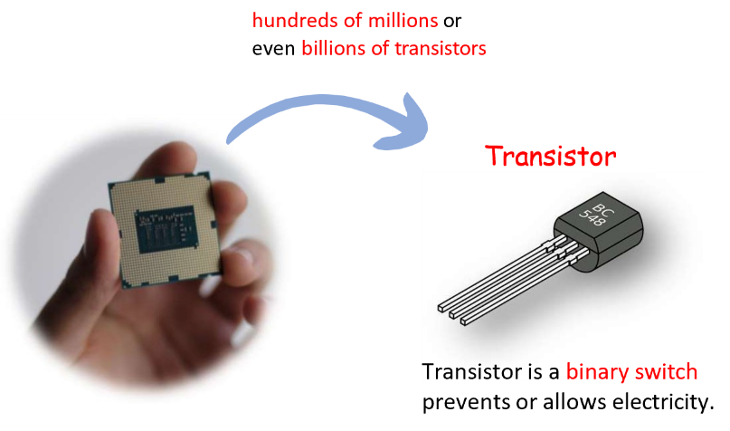
How Computer Works?
🟨 Computer is an electronic device.
🟨 It deals with electricity On/Off
🟨 It only understands 0’s (Off) and 1’s (On).
🟨 Everything you see, hear and read on the screen reaches you as the result of “on” or “off” billions of times.
🟨 Computer uses Binary System to represent numbers, letters, commands, images and sounds.

Slide 6
Programming Foundations
Level 1
Binary System
2

Slide 7
The Binary System
🟨 The binary system is a base-2 numbering system.
🟨 It uses only two digits: 0 and 1.
🟨 Every binary position represents a power of 2 (1, 2, 4, 8, 16, 32, 64, 128 …).

Slide 8
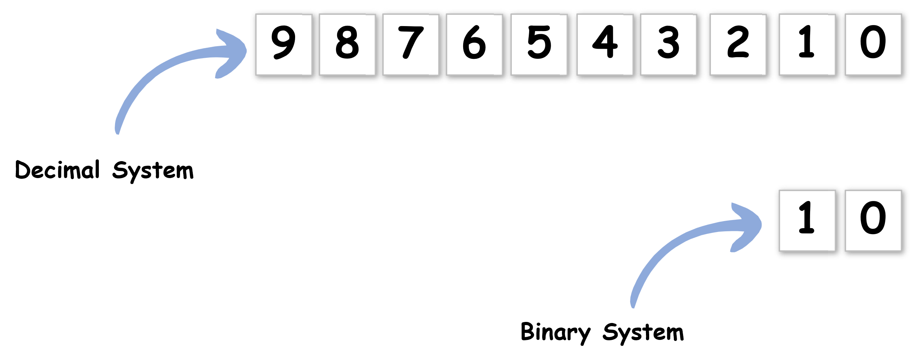
Decimal vs Binary?

Slide 9
Programming Foundations
Level 1
What is bit?
2

Slide 10
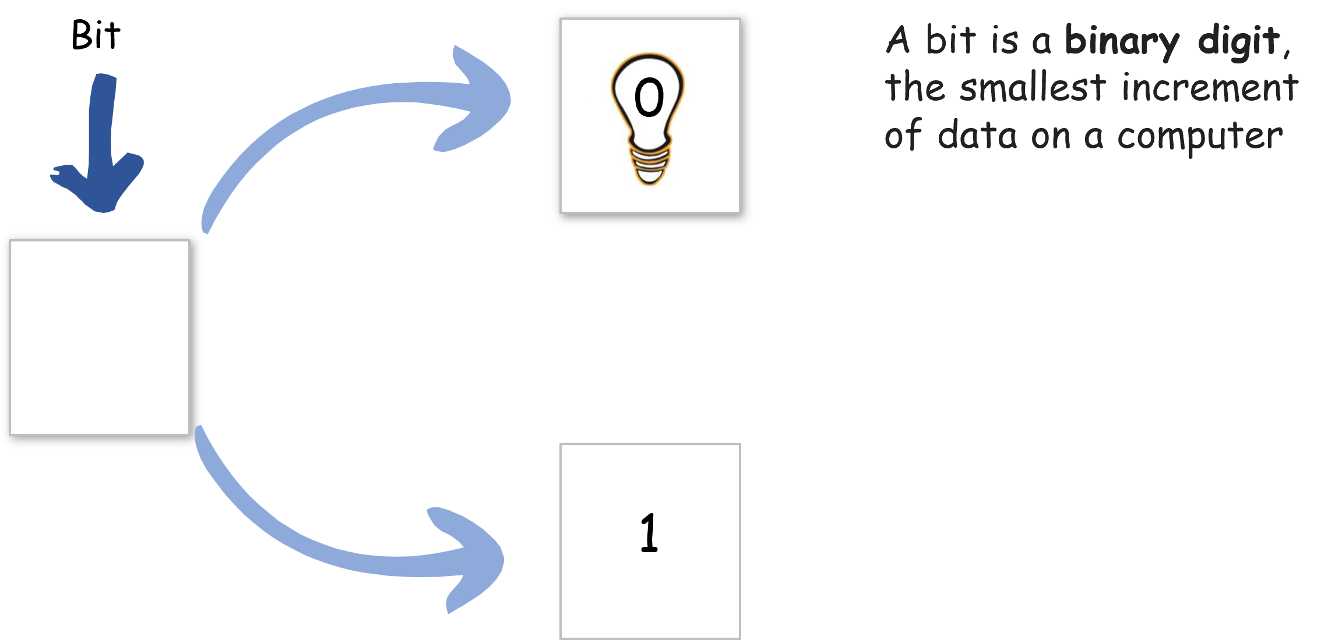
What is Bit?
Remember! .. Computer is an electronic device…it deals with electricity only.
Bit = “Binary Digit” → the smallest piece of information (either 0 or 1).

Slide 11
Programming Foundations
Level 1
What is byte?
2

Slide 12
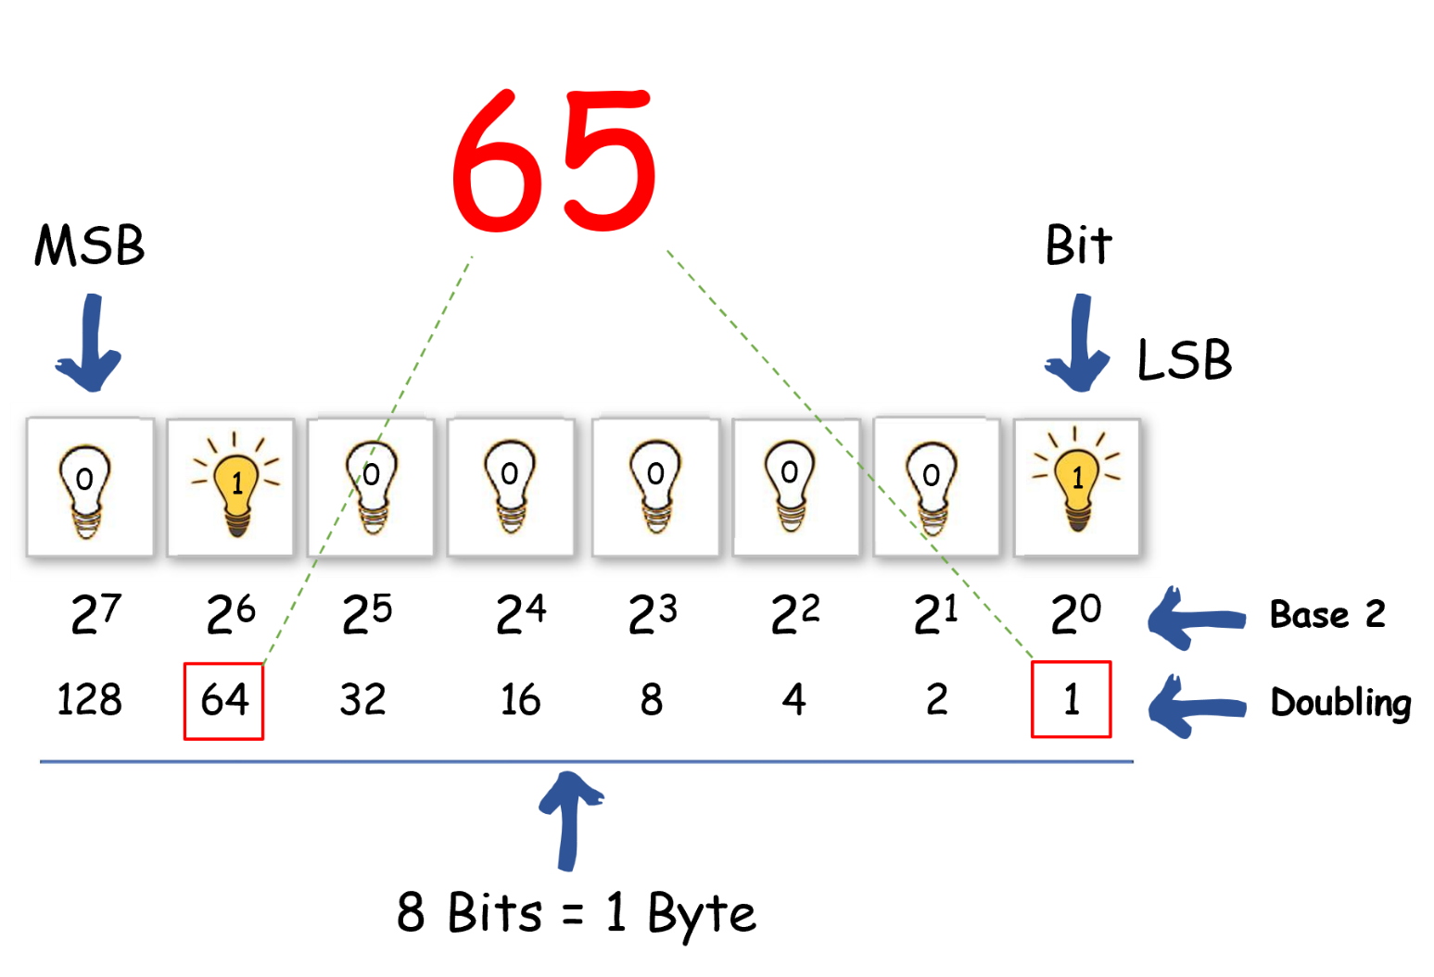
What is Byte?
Byte = group of 8 bits.
Each bit in a byte has a positional value:

Slide 13
Programming Foundations
Level 1
Decimal to Binary
2

Slide 14
Converting Between Decimal and Binary
Decimal → Binary:
Divide the decimal number by 2 repeatedly and note the remainders (bottom to top).

Slide 15
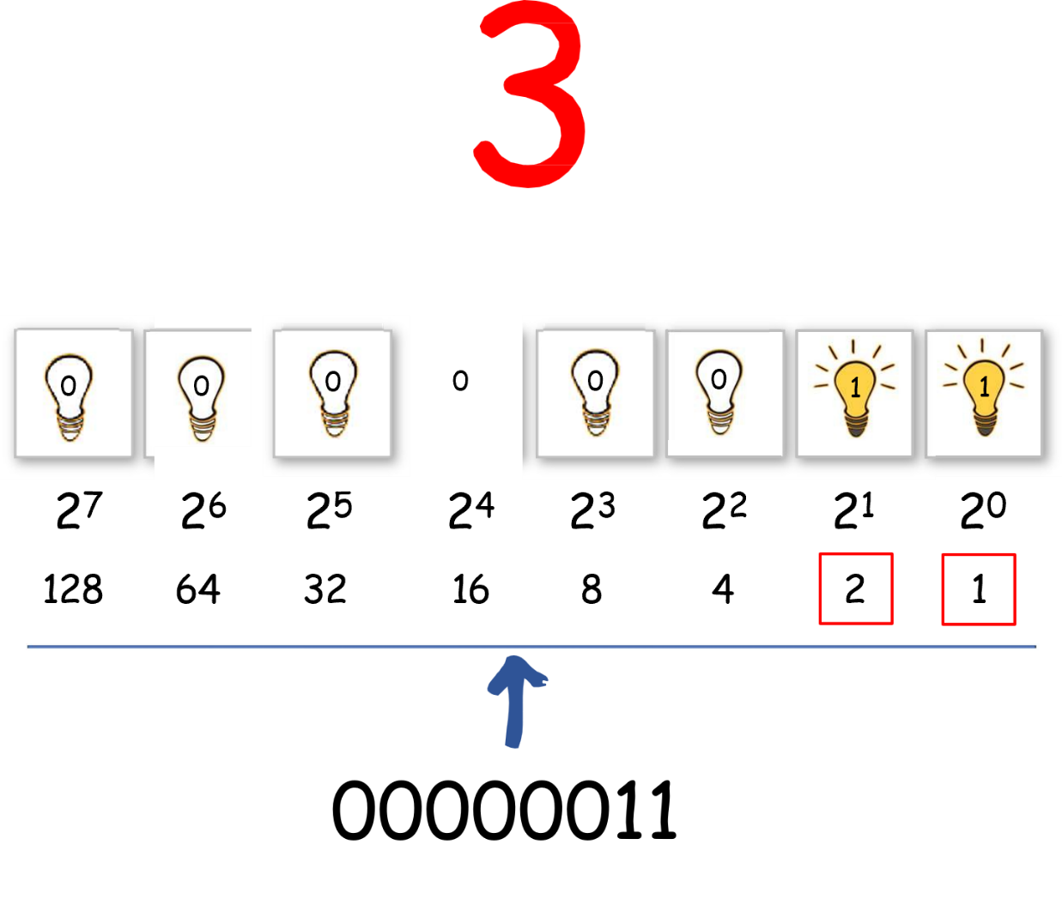
Represent this in binary…

Slide 16
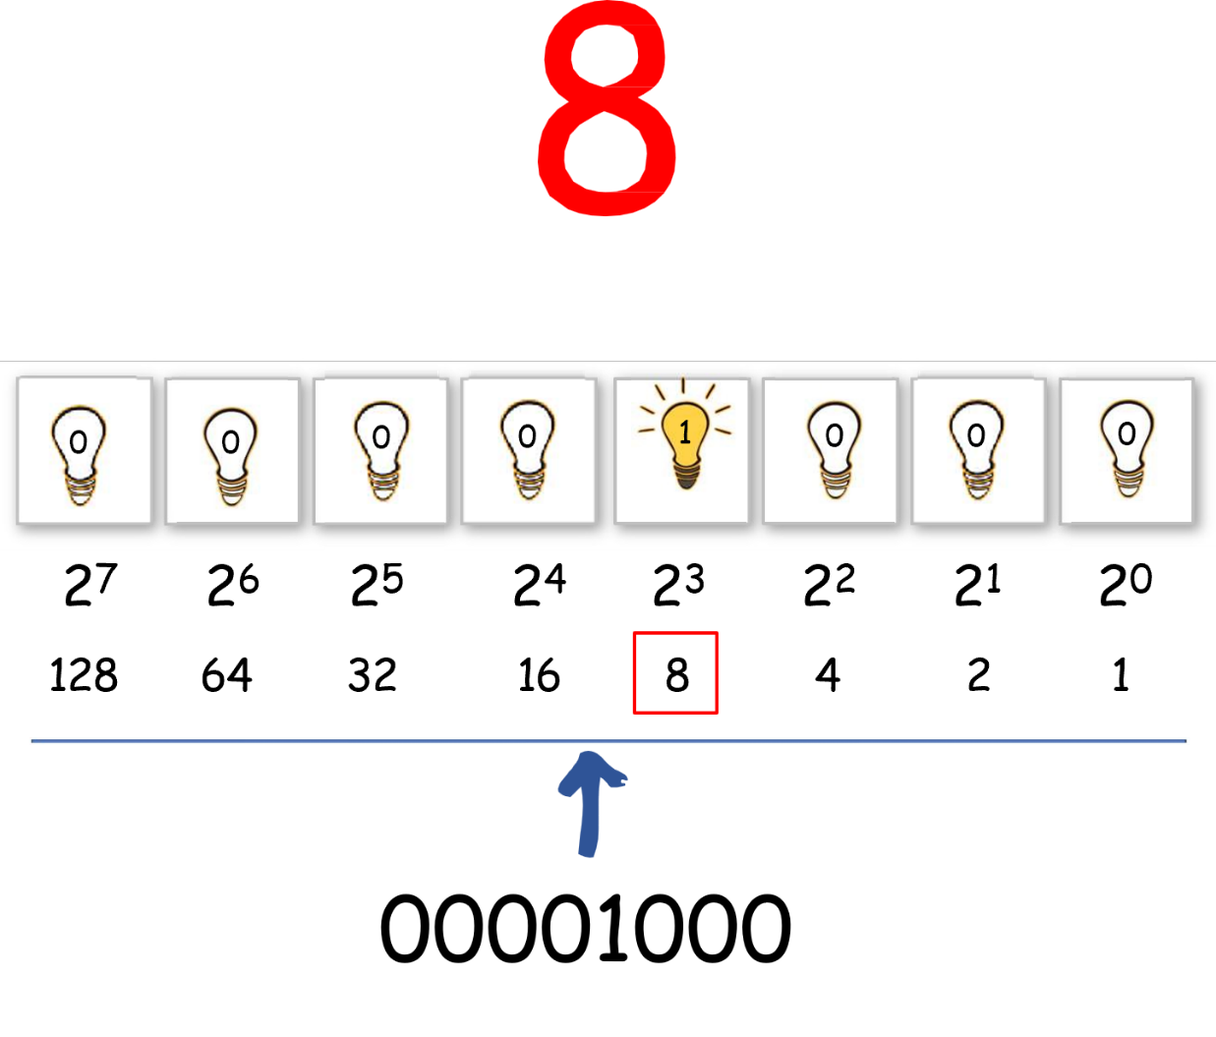
Represent this in binary…

Slide 17
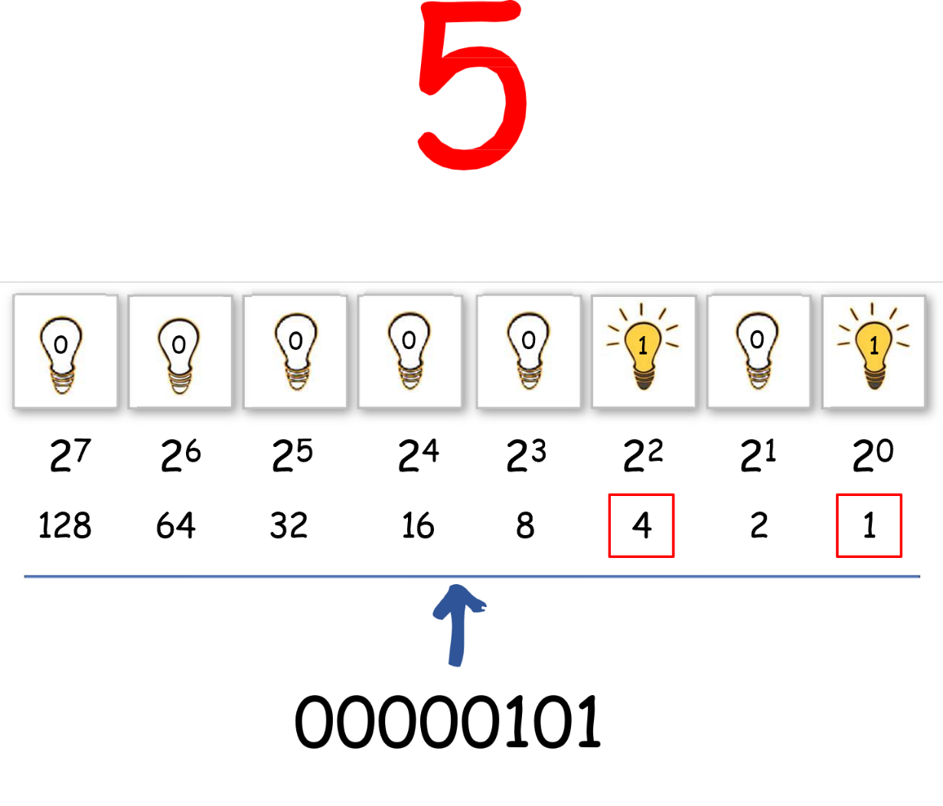
Represent this in binary…

Slide 18
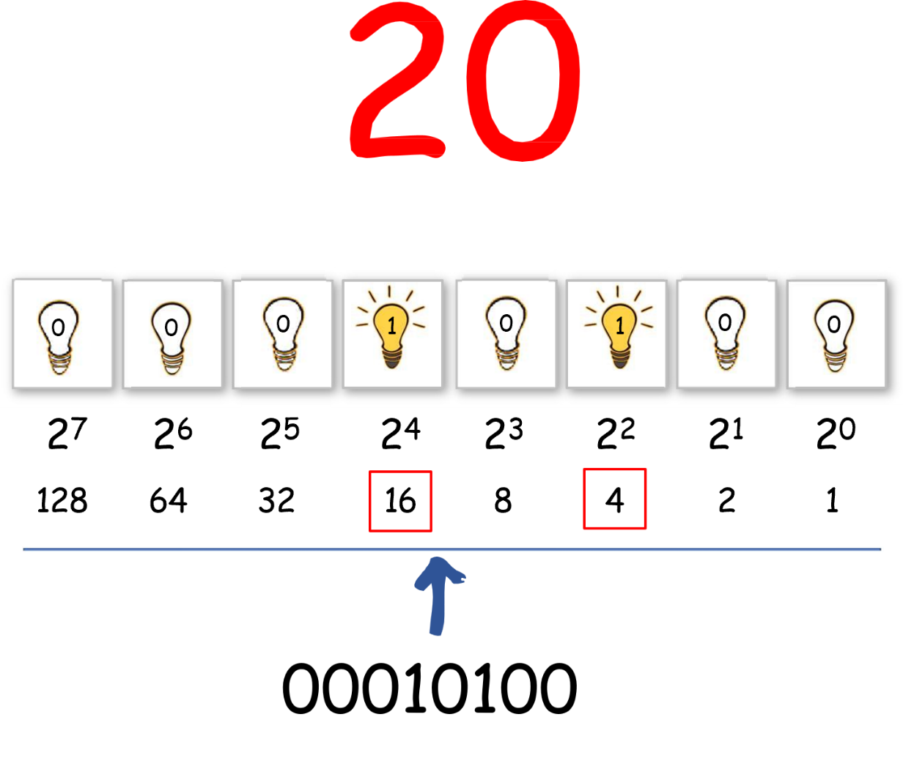
Represent this in binary…

Slide 19
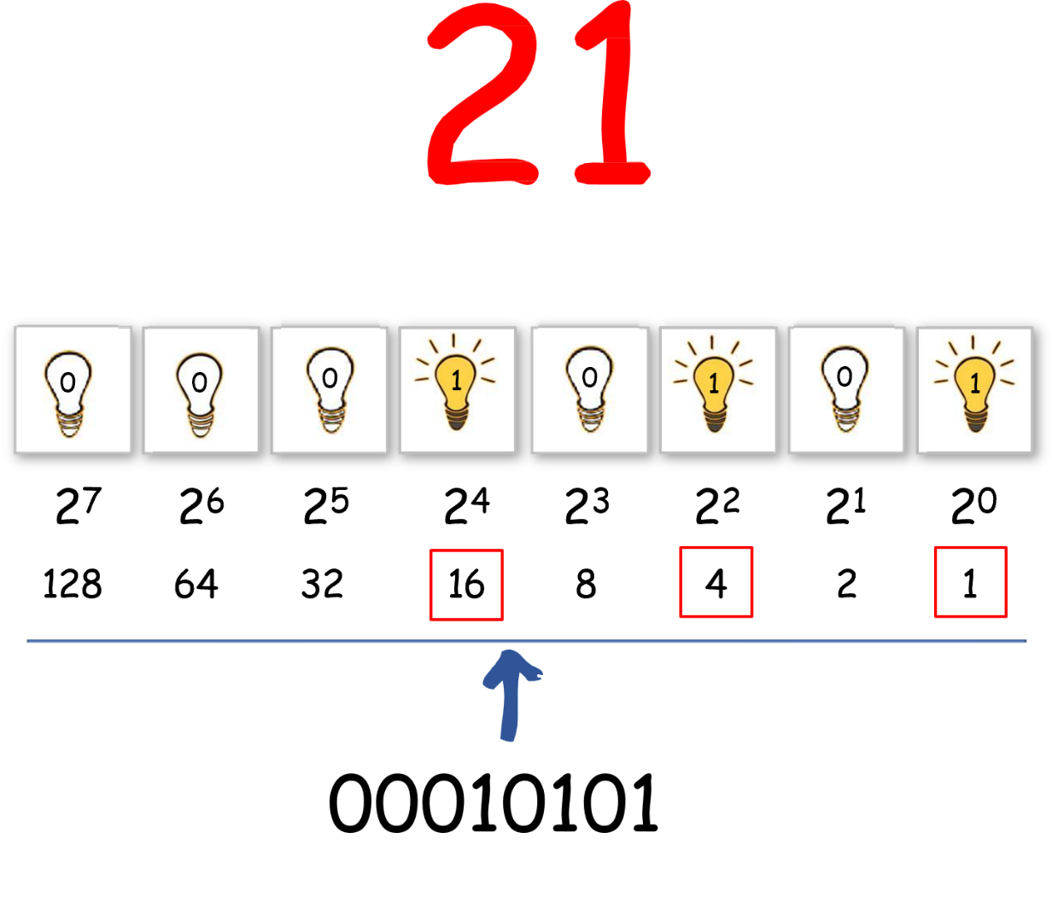
Represent this in binary…
Only one way to represent Data

Slide 20
Programming Foundations
Level 1
Binary to Decimal
2

Slide 21
Converting Between Decimal and Binary
Binary → Decimal:
Multiply each bit by its positional value and add them.

Slide 22
Represent this in decimal…

Slide 23
Represent this in decimal…

Slide 24
Represent this in decimal…

Slide 25
Represent this in decimal…

Slide 26
Represent this in decimal…

Slide 27
“Only One Way” to Represent a Number in Binary
In binary, every non-negative integer has exactly one representation (if you ignore leading zeros).
This means there is one unique set of bits (MSB…LSB) whose weighted sum equals the number.
You cannot choose a different combination of bit positions to get the same number — each power of two (1, 2, 4, 8, 16, …) is either used once or not used.
So in the above example the number 20 only comes from 4 + 16 bits, while in decimal system 20 can come from 10 + 10 , or 18 + 2 , or 15 + 5 ...etc.

Slide 28
Programming Foundations
Level 1
Capacity of Byte
2

Slide 29
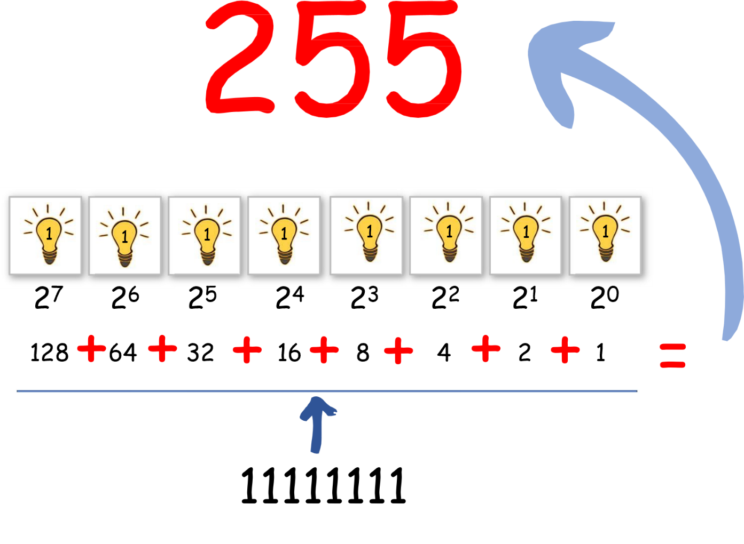
What is the largest number in byte?
1 byte = 8 bits → max number = 255 (11111111).

Slide 30
What if I have larger number such as 257?!!
2 bytes = 16 bits → max number = 65,535 (1111111111111111).

Slide 31
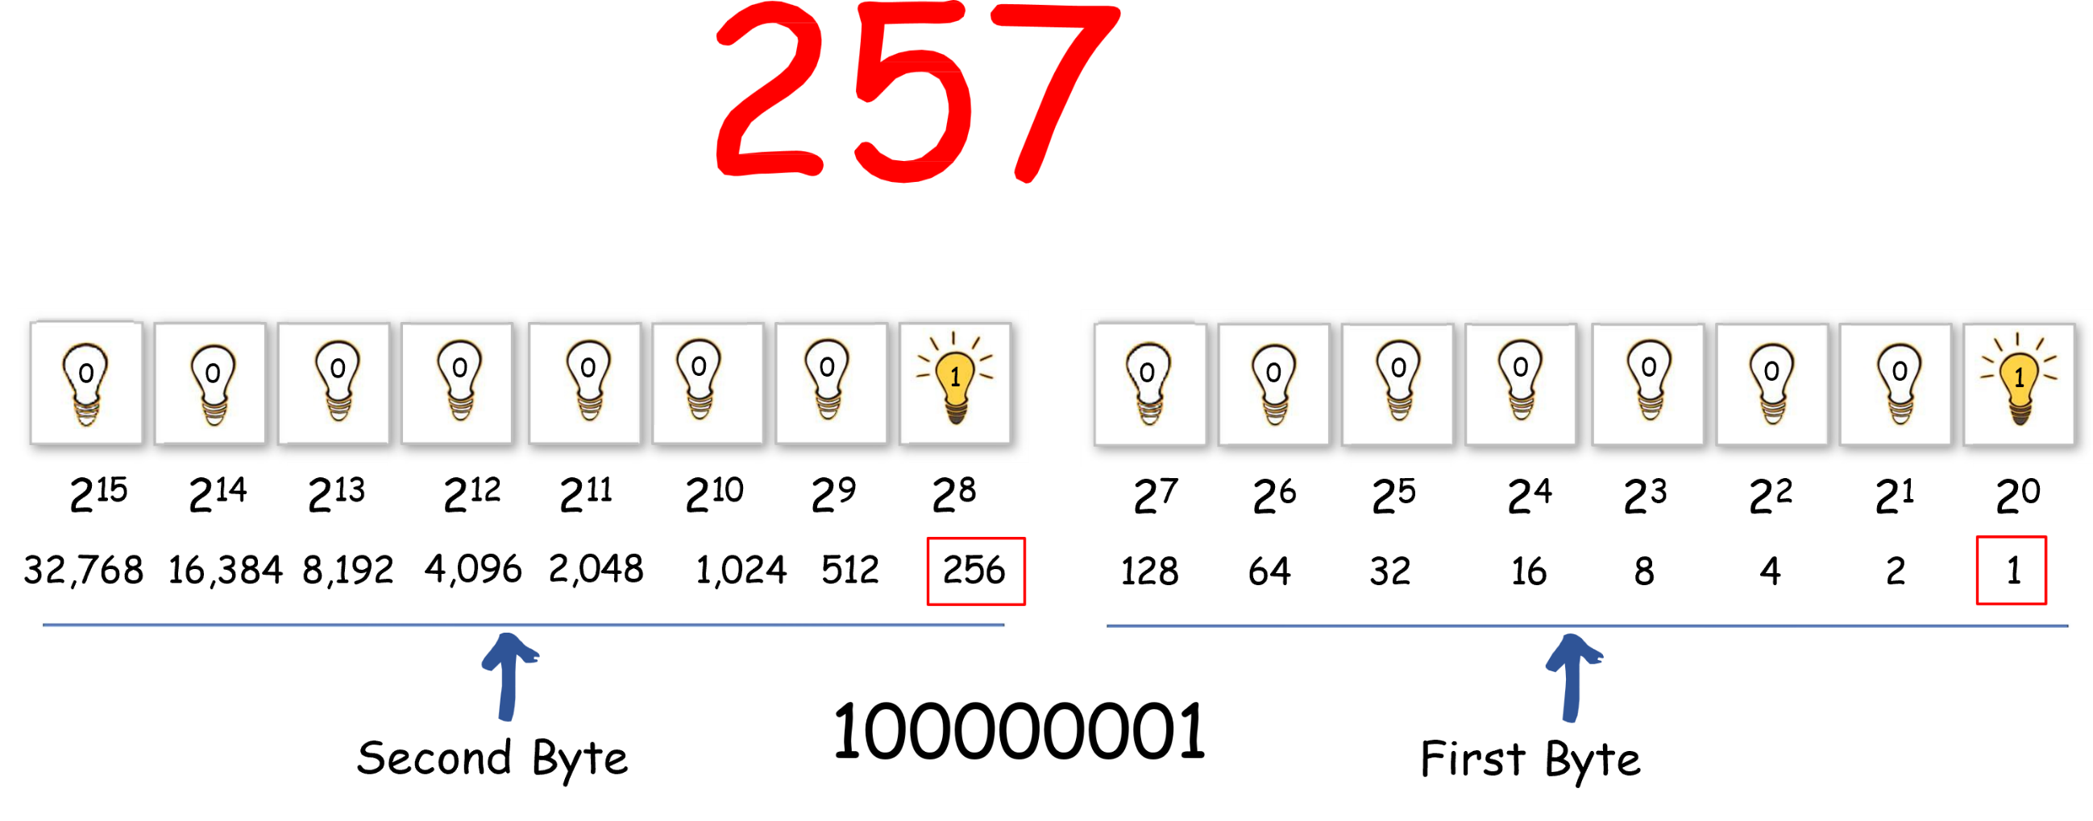
Represent this in binary…

Slide 32
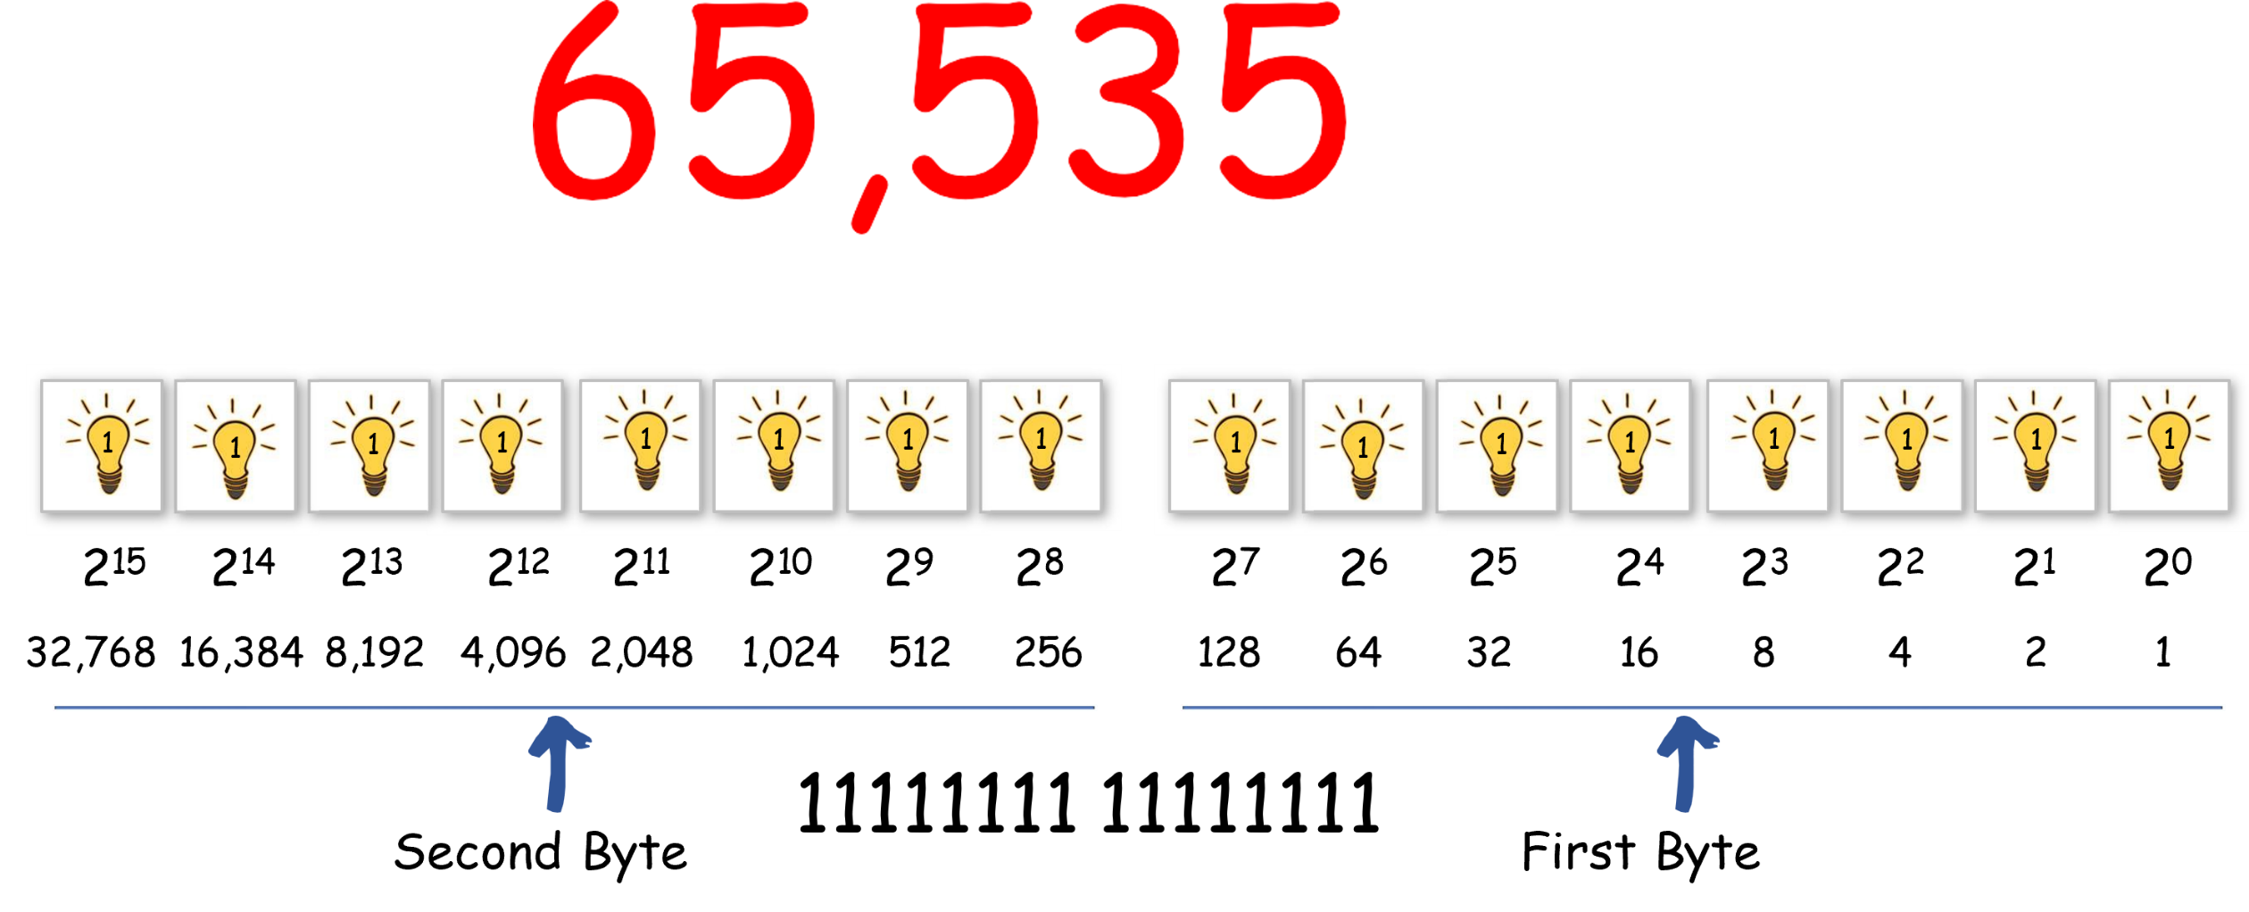
What is the largest number in 2 bytes?

Slide 33
But!
How to represent letters?

Slide 34
Programming Foundations
Level 1
ASCII & Unicode
2

Slide 35
Representing Characters – ASCII
🟨 Computers use codes to represent letters and symbols.
🟨 ASCII (American Standard Code for Information Interchange) assigns a unique binary code to each character.
💡 Example:
  🟩 ‘A’ = 65 = 01000001
  🟩 ‘B’ = 66 = 01000010
  🟩 Space = 32 = 00100000
🟨 Limitation: ASCII supports only English letters and limited symbols (128 or 256 codes).

Slide 36
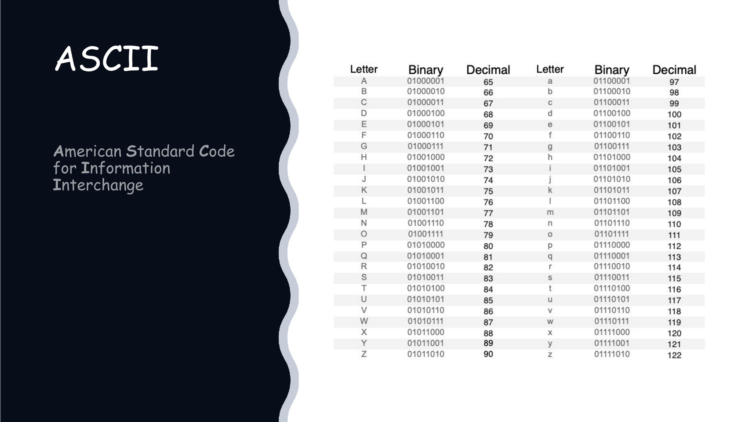

Slide 37
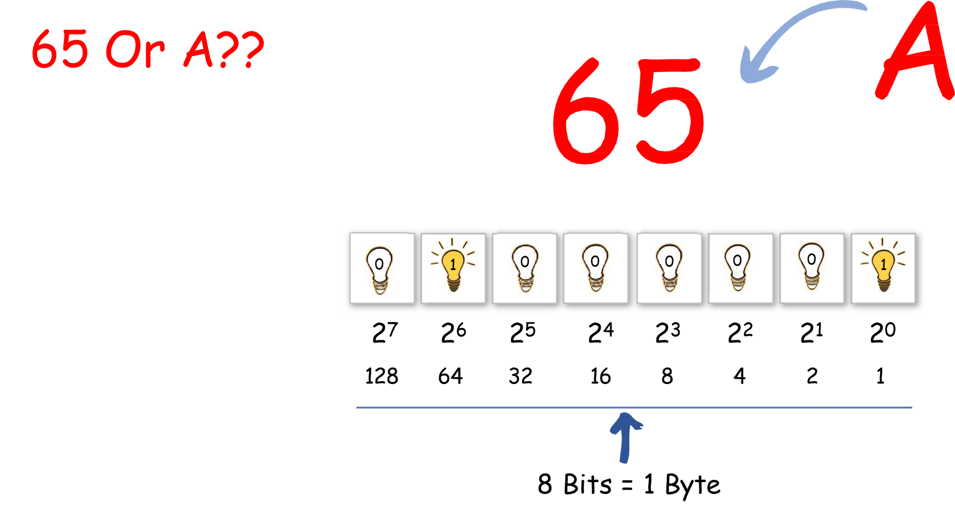
How to represent letters?

Slide 38
This is my name in binary:
Sara Alterkawi
01010011 01100001 01110010 01100001 00100000 01000001 01101100 01110100 01100101 01110010 01101011 01100001 01110111 01101001

Slide 39

What does this mean?
01001001 00100000 01001100 01101111 01110110 01100101 00100000 01011001 01101111 01110101 00100001

Slide 40
But!
How to represent Arabic letters?

Slide 41
Programming Foundations
Level 1
Unicode
2

Slide 42
Representing Characters – ASCII
🟨 To represent all world languages, Unicode was developed.
🟨 Unicode supports:
  🟩 UTF-8 → 256 characters
  🟩 UTF-16 → 65,536 characters
  🟩 UTF-32 → 4,294,967,296 characters
💡 Example:
Arabic letters such as “ساره” require Unicode because ASCII cannot represent them.

Slide 44
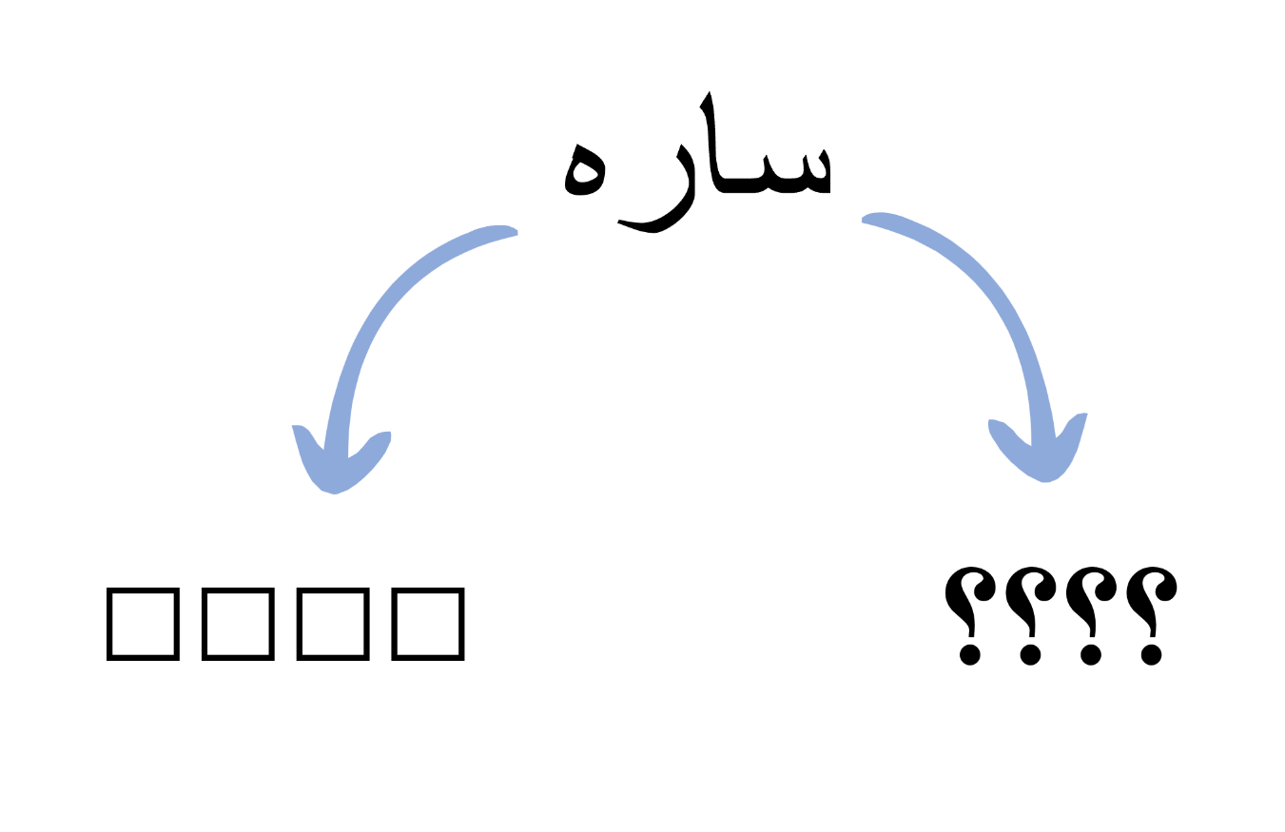
Problem:

Slide 45
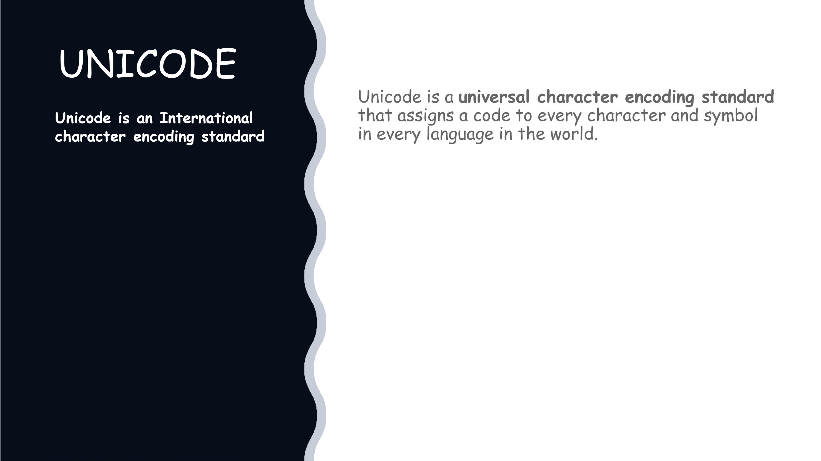

Slide 46




ASCII
UNICODE
VS
American Standard Code for Information Interchange
Universal Coding System
Supports specific characters (less space)
rge number of characters (large space)
Has 2 standards:
bit ASCII – 128 characters
bit ASCII – 256 characters
Diffrences
It has 3 standards:
UTF 8 – 256 characters
UTF 16 – 65,536 characters
UTF 32 – 4,294,967,296 characters
Only one language
Any combination of languages

Slide 47
Programming Foundations
Level 1
Largest number in Binary System
2

Slide 48
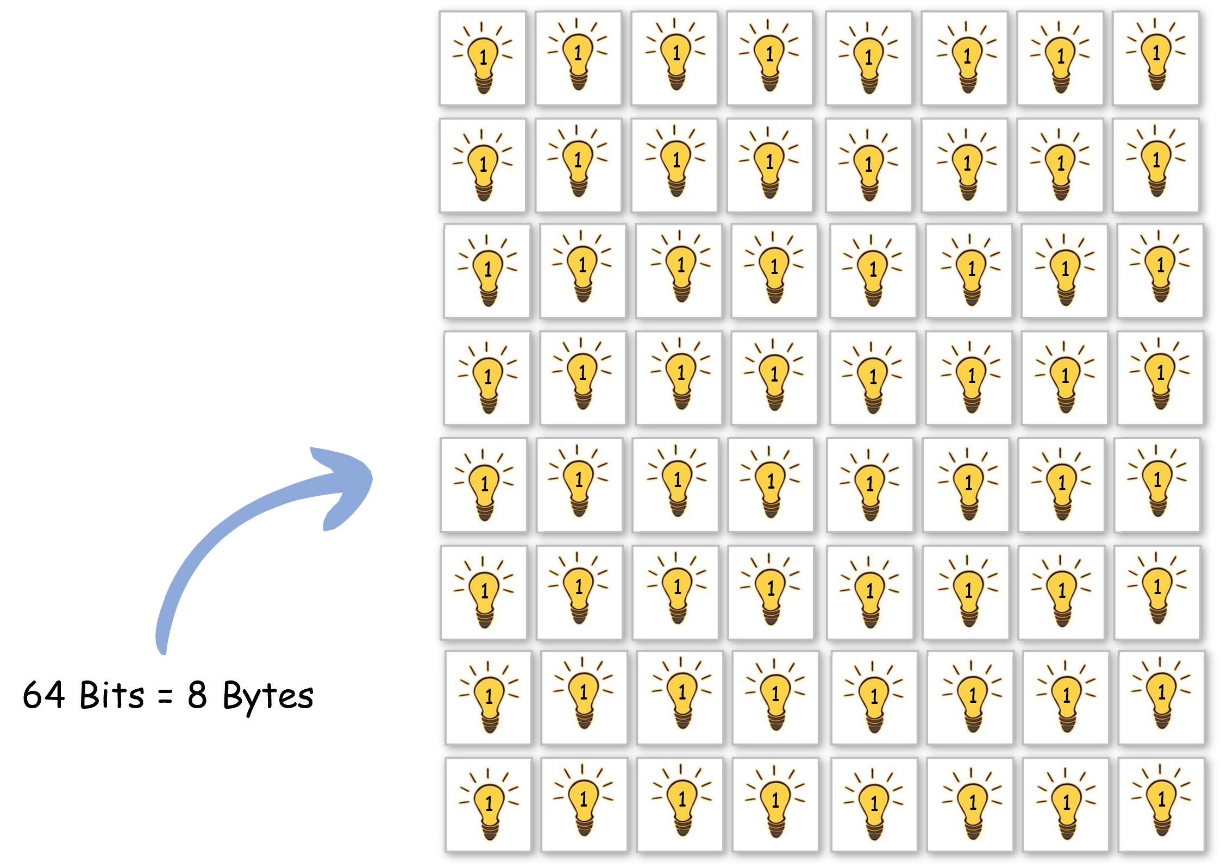

Slide 49
128 | 64 | 32 | 16 | 8 | 4 | 2 | 1
32,768 | 16,384 | 8,192 | 4,096 | 2,048 | 1,024 | 512 | 256
8,388,608 | 4,194,304 | 2,097,152 | 1,048,576 | 524,288 | 262,144 | 131,072 | 65,536
2,147,483,648 | 1,073,741,824 | 536,870,912 | 268,435,456 | 134,217,728 | 67,108,864 | 33,554,432 | 16,777,216
5.49756E+11 | 2.74878E+11 | 1.37439E+11 | 68,719,476,736 | 34,359,738,368 | 17,179,869,184 | 8,589,934,592 | 4,294,967,296
??

Slide 50
8 bytes (64 bits) → Value on 64th square =
9,223,372,036,854,775,808.

Slide 51
128 | 64 | 32 | 16 | 8 | 4 | 2 | 1
32,768 | 16,384 | 8,192 | 4,096 | 2,048 | 1,024 | 512 | 256
8,388,608 | 4,194,304 | 2,097,152 | 1,048,576 | 524,288 | 262,144 | 131,072 | 65,536
2,147,483,648 | 1,073,741,824 | 536,870,912 | 268,435,456 | 134,217,728 | 67,108,864 | 33,554,432 | 16,777,216
5.49756E+11 | 2.74878E+11 | 1.37439E+11 | 68,719,476,736 | 34,359,738,368 | 17,179,869,184 | 8,589,934,592 | 4,294,967,296
??

Slide 52
Total sum (1 to 64) →18,446,744,073,709,600,000

Slide 53
✨ Summary
✅ Binary System → Foundation for all digital data.
✅ Bits & Bytes → Determine data size and capacity.
✅ ASCII → Enables computers to represent text in English.
✅ Unicode → Expands capability to represent global languages.
By understanding how binary underlies all computer data, you gain insight into how programs, storage, and communication truly work! ⚡

Slide 54
🧐 Activity
📋 Instructions:
1️⃣ Convert the following decimal numbers into binary:
44
129
512
717
999
2️⃣ Write your first name in binary using ASCII encoding

Slide 55
🧐 Activity Solution
📋 Solution:
1️⃣ Binary conversions:
🟩 Convert 44 → Binary
Divide 44 by 2:
44 ÷ 2 = 22 remainder 0
22 ÷ 2 = 11 remainder 0
11 ÷ 2 = 5 remainder 1
5 ÷ 2 = 2 remainder 1
2 ÷ 2 = 1 remainder 0
1 ÷ 2 = 0, remainder 1
Now read remainders bottom → top:
1 0 1 1 0 0
➡️ 44 (decimal) = 101100 (binary)

Slide 56
🧐 Activity Solution
📋 Solution:
1️⃣ Binary conversions:
🟩 Convert 129 → Binary
Divide 129 by 2:
129 ÷ 2 = 64 remainder 1
64 ÷ 2 = 32 remainder 0
32 ÷ 2 = 16 remainder 0
16 ÷ 2 = 8 remainder 0
8 ÷ 2 = 4 remainder 0
4 ÷ 2 = 2 remainder 0
2 ÷ 2 = 1 remainder 0
1 ÷ 2 = 0 remainder 1
Now read remainders bottom → top:
1 0 0 0 0 0 0 1
➡️ 129 (decimal) = 10000001 (binary)

Slide 57
🧐 Activity Solution
📋 Solution:
1️⃣ Binary conversions:
🟩 Convert 512 → Binary
Divide 512 by 2:
512 ÷ 2 = 256 remainder 0
256 ÷ 2 = 128 remainder 0
128 ÷ 2 = 64 remainder 0
64 ÷ 2 = 32 remainder 0
32 ÷ 2 = 16 remainder 0
16 ÷ 2 = 8 remainder 0
8 ÷ 2 = 4 remainder 0
4 ÷ 2 = 2 remainder 0
2 ÷ 2 = 1 remainder 0
1 ÷ 2 = 0 remainder 1
Now read remainders bottom → top:
1 0 0 0 0 0 0 0 0 0
➡️ 512 (decimal) = 1000000000 (binary)

Slide 58
🧐 Activity Solution
📋 Solution:
1️⃣ Binary conversions:
🟩 Convert 717 → Binary
Divide 717 by 2:
717 ÷ 2 = 358 remainder 1
358 ÷ 2 = 179 remainder 0
179 ÷ 2 = 44 remainder 1
44 ÷ 2 = 22 remainder 0
22 ÷ 2 = 11 remainder 0
11 ÷ 2 = 5 remainder 1
5 ÷ 2 = 2 remainder 1
2 ÷ 2 = 1 remainder 0
1 ÷ 2 = 0 remainder 1
Now read remainders bottom → top:
1 0 1 0 0 1 1 0 1
➡️ 512 (decimal) = 101001101 (binary)

Slide 59
🧐 Activity Solution
📋 Solution:
1️⃣ Binary conversions:
🟩 Convert 999 → Binary
Divide 999 by 2:
999 ÷ 2 = 499 remainder 1
499 ÷ 2 = 249 remainder 1
249 ÷ 2 = 124 remainder 1
124 ÷ 2 = 62 remainder 0
62 ÷ 2 = 31 remainder 0
31 ÷ 2 = 15 remainder 1
15 ÷ 2 = 7 remainder 1
7 ÷ 2 = 3 remainder 1
3 ÷ 2 = 1 remainder 1
1 ÷ 2 = 0 remainder 1
Now read remainders bottom → top:
1 1 1 1 1 0 0 1 1 1
➡️ 512 (decimal) = 1111100111 (binary)

Slide 60
🧐 Activity Solution
📋 Solution:
2️⃣ Example (Name: “Omar”):
🔤 Step 1 — Get the ASCII Codes
Letter ASCII(Decimal)
O 79
m 109
a 97
r 114

Slide 61
🧐 Activity Solution
📋 Solution:
2️⃣ Example (Name: “Omar”):
🔤 Step 2: Now we convert each decimal value to binary using repeated division:
Convert "O" (79) to Binary
Divide 79 by 2:
79 ÷ 2 = 39 remainder 1
39 ÷ 2 = 19 remainder 1
19 ÷ 2 = 9 remainder 1
9 ÷ 2 = 4 remainder 1
4 ÷ 2 = 2 remainder 0
2 ÷ 2 = 1 remainder 0
1 ÷ 2 = 0 remainder 1
Now read remainders bottom → top:
1 0 0 1 1 1 1
➡️ O = 01001111

Slide 62
🧐 Activity Solution
📋 Solution:
2️⃣ Example (Name: “Omar”):
🔤 Step 2: Now we convert each decimal value to binary using repeated division:
Convert “m" (109) to Binary
Divide 109 by 2:
109 ÷ 2 = 54 remainder 1
54 ÷ 2 = 27 remainder 0
27 ÷ 2 = 13 remainder 1
13 ÷ 2 = 6 remainder 1
6 ÷ 2 = 3 remainder 0
3 ÷ 2 = 1 remainder 1
1 ÷ 2 = 0 remainder 1
Now read remainders bottom → top:
1 1 0 1 1 0 1
➡️ m = 01101101

Slide 63
🧐 Activity Solution
📋 Solution:
2️⃣ Example (Name: “Omar”):
🔤 Step 2: Now we convert each decimal value to binary using repeated division:
Convert “a" (97) to Binary
Divide 97 by 2:
97 ÷ 2 = 48 remainder 1
48 ÷ 2 = 24 remainder 0
24 ÷ 2 = 12 remainder 0
12 ÷ 2 = 6 remainder 0
6 ÷ 2 = 3 remainder 0
3 ÷ 2 = 1 remainder 1
1 ÷ 2 = 0 remainder 1
Now read remainders bottom → top:
1 1 0 0 0 0 1
➡️ a = 01100001

Slide 64
🧐 Activity Solution
📋 Solution:
2️⃣ Example (Name: “Omar”):
🔤 Step 2: Now we convert each decimal value to binary using repeated division:
Convert “r" (114) to Binary
Divide 97 by 2:
114 ÷ 2 = 57 remainder 0
57 ÷ 2 = 28 remainder 1
28 ÷ 2 = 14 remainder 0
14 ÷ 2 = 7 remainder 0
7 ÷ 2 = 3 remainder 1
3 ÷ 2 = 1 remainder 1
1 ÷ 2 = 0 remainder 1
Now read remainders bottom → top:
1 1 1 0 0 1 0
➡️ r = 01110010

Slide 65
🧐 Activity Solution
📋 Solution:
2️⃣ Example (Name: “Omar”):
➡️ “Omar” = 01001111 01101101 01100001 01110010

Slide 66
🏁 Conclusion
✅ Binary is the language of computers. Every piece of data — from text to images is built from bits and bytes represented as 0s and 1s.
✅ Understanding binary helps you grasp how information is stored, processed, and communicated inside a computer.
✅ As a foundation in programming, mastering this concept prepares you for deeper topics like data types, memory, and algorithms. 🚀

Slide 67
Thank you ☺

