Slide 1

Programming Foundations
Level 1

Slide 2

Programming Foundations
Level 1
Computer Speeds and Units
2

Slide 3
Computer Speeds & Units (Bits, Bytes, Hz, and Architectures)
Understanding how we measure data and speed is foundational: from bits & bytes to kilobytes through yottabytes, from CPU cycles (Hz) to how quickly the CPU reaches memory, and why 32-bit vs 64-bit still matters.

Slide 4
Programming Foundations
Level 1
Memory Units
2

Slide 5
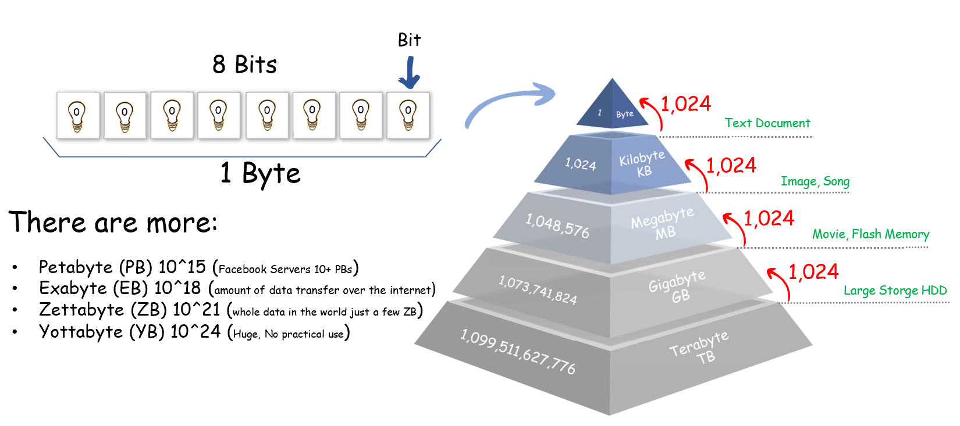
Memory Units…

Slide 6
Memory Units…
🟨 Bit = the smallest unit (0 or 1).
🟨 Byte = 8 bits.
🟨 Binary-scaled units (base 2) commonly taught to beginners:
🟩 1 KB = 1,024 bytes
🟩 1 MB = 1,024 KB
🟩 1 GB = 1,024 MB
🟩 1 TB = 1,024 GB
🟨 Even Larger : PB, EB, ZB, YB with real-world anchors (e.g., Facebook servers in PBs, global internet traffic in EBs, “whole data in the world” a few ZBs).
📌 Note for learners: Operating systems and storage vendors sometimes use decimal ( 10³) labels; this lesson uses the binary (2¹⁰=1,024) view shown in the slides.

Slide 7
Programming Foundations
Level 1
CPU Access to Memory
2

Slide 8
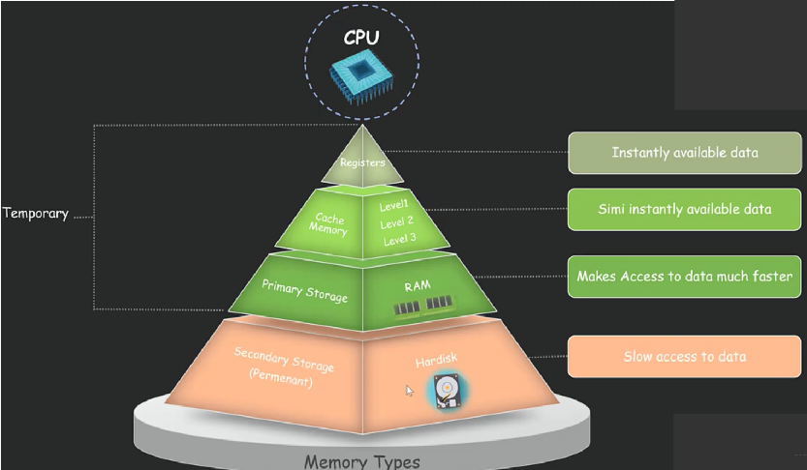

Slide 9
Memory Units…
The closer the storage is to the CPU, the faster the access:
🟨 Registers (inside CPU): instantly available values for current instructions.
🟨 Cache (on-chip): very fast access to recently used data/instructions.
🟨 Main Memory (RAM): fast, but slower than cache.
🟨 Secondary Storage (SSD/HDD): slowest among these tiers, used for long-term storage.
Slides emphasize: “Instantly / semi-instantly available data… makes access to data much faster.”

Slide 10
Programming Foundations
Level 1
CPU Speed
2

Slide 11
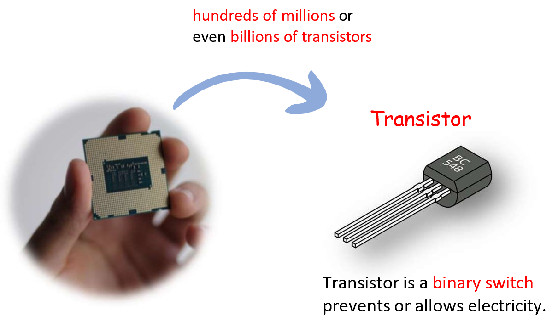
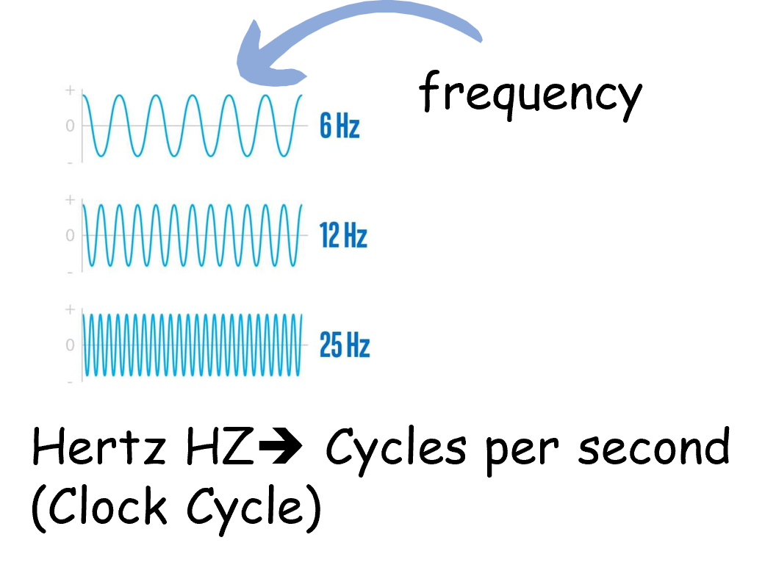
CPU Speed
Higher clock speed means a faster CPU (within the same generation)
Clock speed (also “clock rate” or “frequency”) is one of the most significant.
A CPU with a clock speed of 3.2 GHz executes 3.2 billion cycles per second.
During each cycle, billions of transistors within the processor open and close.

Slide 12
Memory Units…
🟨 Clock speed / frequency measures how many cycles per second the CPU performs, in Hertz (Hz).
🟨 3.2 GHz = 3.2 billion cycles per second.
🟨 On each cycle, billions of transistors open/close (binary switching) to execute instructions.
🟨 Transistor = binary switch that prevents or allows electricity (OFF/ON → 0/1).

Slide 13
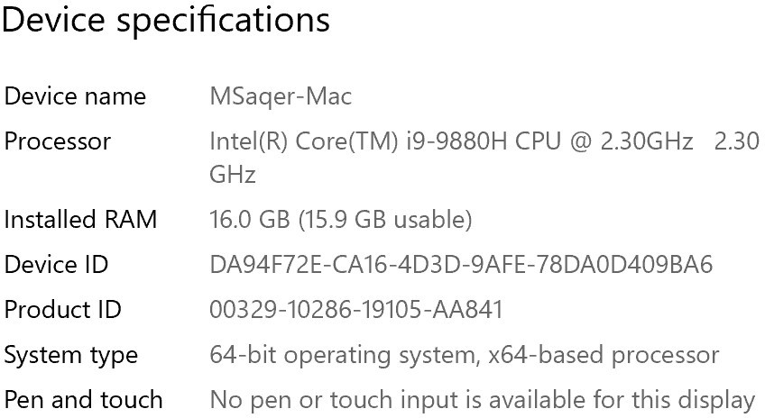

Slide 14
Programming Foundations
Level 1
32-Bit vs 64-Bit
2

Slide 16




32-Bit
64-Bit
VS
Less processing power, older, slower, and less secure
More processing power, newer, faster, and more secure
2^32 (or 4,294,967,296) bytes
2^64 or 18,446,744,073,709,551,616) bytes
Can allocate only 4GB of memory (RAM
Diffrences
Can allocate much more RAM
Referred to as x86 or x86-32
Referred to as x64 or x86-64
Can only run a 32-bit operating system software and 32-bit
Can run both 64-bit and 32-bit operating systems and software
Note: if you have installed 32-bit operating system on a 64-bit computer, then it can run 32-bit software only.

Slide 17
Address space & capacity
🟨 2³² = 4,294,967,296 bytes ≈ 4 GB addressable by a 32-bit system.
🟨 2⁶⁴ = 18,446,744,073,709,551,616 bytes ≈ 16 EB (vastly larger) for 64-bit.
Naming
🟨 32-bit: x86 / x86-32
🟨 64-bit: x64 / x86-64
Performance
🟨 64-bit can handle twice as many bits per cycle (within the same generation), enables larger data types and more RAM.
Compatibility (as shown in slides)
🟨 32-bit CPU → runs 32-bit OS & 32-bit software only.
🟨 64-bit CPU → can run 64-bit & 32-bit OS/software.
🟨 If you install a 32-bit OS on a 64-bit CPU, you can run 32-bit software only (you won’t benefit from 64-bit apps or large RAM).
RAM reality
🟨 32-bit OS: can allocate only about 4 GB.
🟨 64-bit OS: can allocate much more (practically limited by hardware/edition).
If you have ≥ 4 GB RAM, you should use 64-bit CPU + 64-bit OS to utilize it fully.

Slide 18
How to Know Your Device Specifications on Windows
📖 1️⃣ Basic Specifications (Processor, RAM, and System Type)
🧭 Method 1: Using “About This PC”
1️⃣ Press Windows + I → open Settings.
2️⃣ Go to System → About.
3️⃣ Under Device specifications, you’ll see:
💻 Processor: CPU model and speed (e.g., Intel Core i7-10750H @ 2.60 GHz).
🧠 Installed RAM: total physical memory (e.g., 16 GB).
⚙️ System type: whether your Windows and processor are 32- bit or 64-bit.
→ Example: “64-bit operating system, x64-based processor.”

Slide 19
📖 2️⃣ GPU & Graphics Card Details
🧭 Method 2: Using Device Manager
1️⃣ Press Windows + X → select Device Manager.
2️⃣ Expand Display Adapters.
3️⃣ You’ll see one or more GPUs listed:
Integrated GPU (e.g., Intel UHD Graphics).
Dedicated GPU (e.g., NVIDIA GeForce RTX 3060 or AMD Radeon RX 6600).
💡 Alternative (fastest)
Press Windows + R, type dxdiag, press Enter.
Go to the Display tab → see GPU name, driver version, and VRAM (memory).

Slide 20
📖 3️⃣ Storage (SSD / HDD Type & Capacity)
🧭 Method 3: Using File Explorer
1️⃣ Open This PC.
2️⃣ Right-click any drive → Properties.
3️⃣ View:
Used space / Free space / Total capacity.
⚙️ To know the physical drive type
Press Windows + S, type “Defragment and Optimize Drives” → open.
Under Media type, you’ll see:
  “Solid State Drive (SSD)” or
  “Hard Disk Drive (HDD)”.

Slide 21
📖 4️⃣ Advanced Full System Information
🧭 Method 4: Using System Information Tool
1️⃣ Press Windows + R, type msinfo32, press Enter.
2️⃣ This opens the System Information window showing:
OS version
Manufacturer, model
BIOS version
Installed RAM
Processor details
System type (32/64-bit)
Boot mode, etc.
📋 You can also Export this report:
File → Export → choose location.

Slide 22
📖 5️⃣ Using Command Prompt or PowerShell (for advanced users)
💻 Command Prompt:
Press Windows + R, type cmd, press Enter then use the following commands:
CPU info → wmic cpu get name
RAM info → wmic computersystem get totalphysicalmemory
System type → wmic os get osarchitecture
⚡ PowerShell:
Run → Get-ComputerInfo | Select CsName, OsName, OsArchitecture, CsSystemType, CsTotalPhysicalMemory

Slide 23
🧐 Activity
📋 Instructions:
1️⃣ Convert each: 8 KB, 2 MB, 3 GB into bytes (use 1 KB = 1,024 bytes).
2️⃣ Order these by fastest access: RAM, Registers, SSD, L1 Cache. Explain why.
3️⃣ Your laptop has 8 GB RAM and a 64-bit CPU, but a 32-bit OS installed. List two limitations you’ll face.
4️⃣ A CPU runs at 3.6 GHz. How many cycles per second is that? What happens during each cycle (at a high level)?

Slide 24
🧐 Activity Solution
📋 Solution:
1️⃣ Convert each: 8 KB, 2 MB, 3 GB into bytes (use 1 KB = 1,024 bytes).
8 KB = 8 × 1,024 = 8,192 bytes
2 MB = 2 × 1,024 × 1,024 = 2,097,152 bytes
3 GB = 3 × 1,024³ = 3,221,225,472 bytes
2️⃣ Order these by fastest access: RAM, Registers, SSD, L1 Cache. Explain why.
Registers → L1 Cache → RAM → SSD (closest to farthest from CPU → fastest to slowest).
3️⃣ Your laptop has 8 GB RAM and a 64-bit CPU, but a 32-bit OS installed. List two limitations you’ll face.
You can’t fully use > 4 GB RAM; you can run 32-bit apps only (no 64-bit software benefits)
4️⃣ A CPU runs at 3.6 GHz. How many cycles per second is that? What happens during each cycle (at a high level)?
3.6 GHz = 3.6 billion cycles/sec; during each cycle, the CPU’s transistors switch, moving/processing data per the current instruction.

Slide 25
🏁 Conclusion
✅ Bits & Bytes define data size; KB→MB→GB→TB (1,024 steps) scale storage and memory.
✅ CPU↔Memory speed hinges on distance: Registers/Cache (closest, fastest) → RAM → SSD/HDD.
✅ Hz = cycles/sec; more cycles (same gen) → more potential work; transistors toggle every cycle.
✅ 64-bit architectures unlock far larger address space and broader capability than 32-bit—and your OS choice must match your hardware to realize the benefits.

Slide 26
Thank you ☺

