Slide 1

Programming Foundations
Level 1

Slide 2

Programming Foundations
Level 1
Hexadecimal System In Computer
2

Slide 3
Programming Foundations
Level 1
What isHexadecimal System?
2

Slide 4
What Is the Hexadecimal System (Base-16)?
Computers speak binary (base-2), but long strings of 0/1 are hard for humans to read. Hexadecimal (base-16) gives a compact, human-friendly way to view the same bits: every 4 binary bits (a nibble) map to one hex digit. One byte (8 bits) maps neatly to 2 hex digits — perfect for memory dumps, colors, Unicode, and machine code

Slide 5
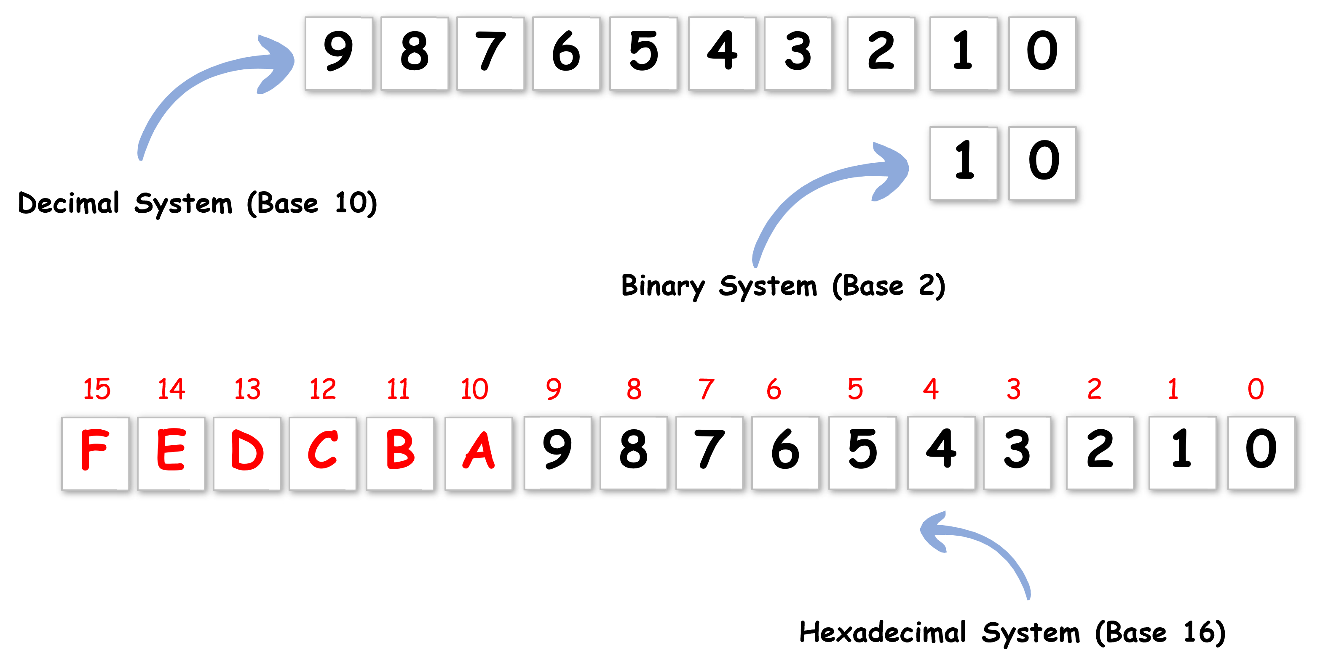
Decimal vs Binary vs Hexadecimal?

Slide 6
What Is the Hexadecimal System (Base-16)?
🟨 Decimal (base-10): digits 0–9
🟨 Binary (base-2): digits 0–1
🟨 Hexadecimal (base-16): digits 0–9 + A, B, C, D, E, F (A=10 … F=15)

Slide 7
Key 4-bit mapping:
Decimal | Binary | Hexadecimal
0 | 0000 | 0
1 | 0001 | 1
2 | 0010 | 2
3 | 0011 | 3
4 | 0100 | 4
5 | 0101 | 5
6 | 0110 | 6
7 | 0111 | 7
8 | 1000 | 8
9 | 1001 | 9
10 | 1010 | A
11 | 1011 | B
12 | 1100 | C
13 | 1101 | D
14 | 1110 | E
15 | 1111 | F

Slide 8

Why Hexadecimal?
It’s hard to human to read binary!
What does this mean ?
01001001 00100000 01001100 01101111 01110110 01100101 00100000 01011001 01101111 01110101 00100001

Slide 9
Hexadecimal System
Provides a human-friendly representation
11010100 ➔D4
Each Byte is represented with 2 letters only.

Slide 10
What Is the Hexadecimal System (Base-16)?
🟨 Humans struggle with long binary strings (e.g., “I Love You!” in ASCII bits).
🟨 Hex compresses binary:
  🟩 11010100 → D4
  🟩 1111 1111 1111 1111 1111 → FFFFFF (grouped by 4 bits)
🟨 Each byte = 2 hex digits → clean, readable dumps and color codes

Slide 11
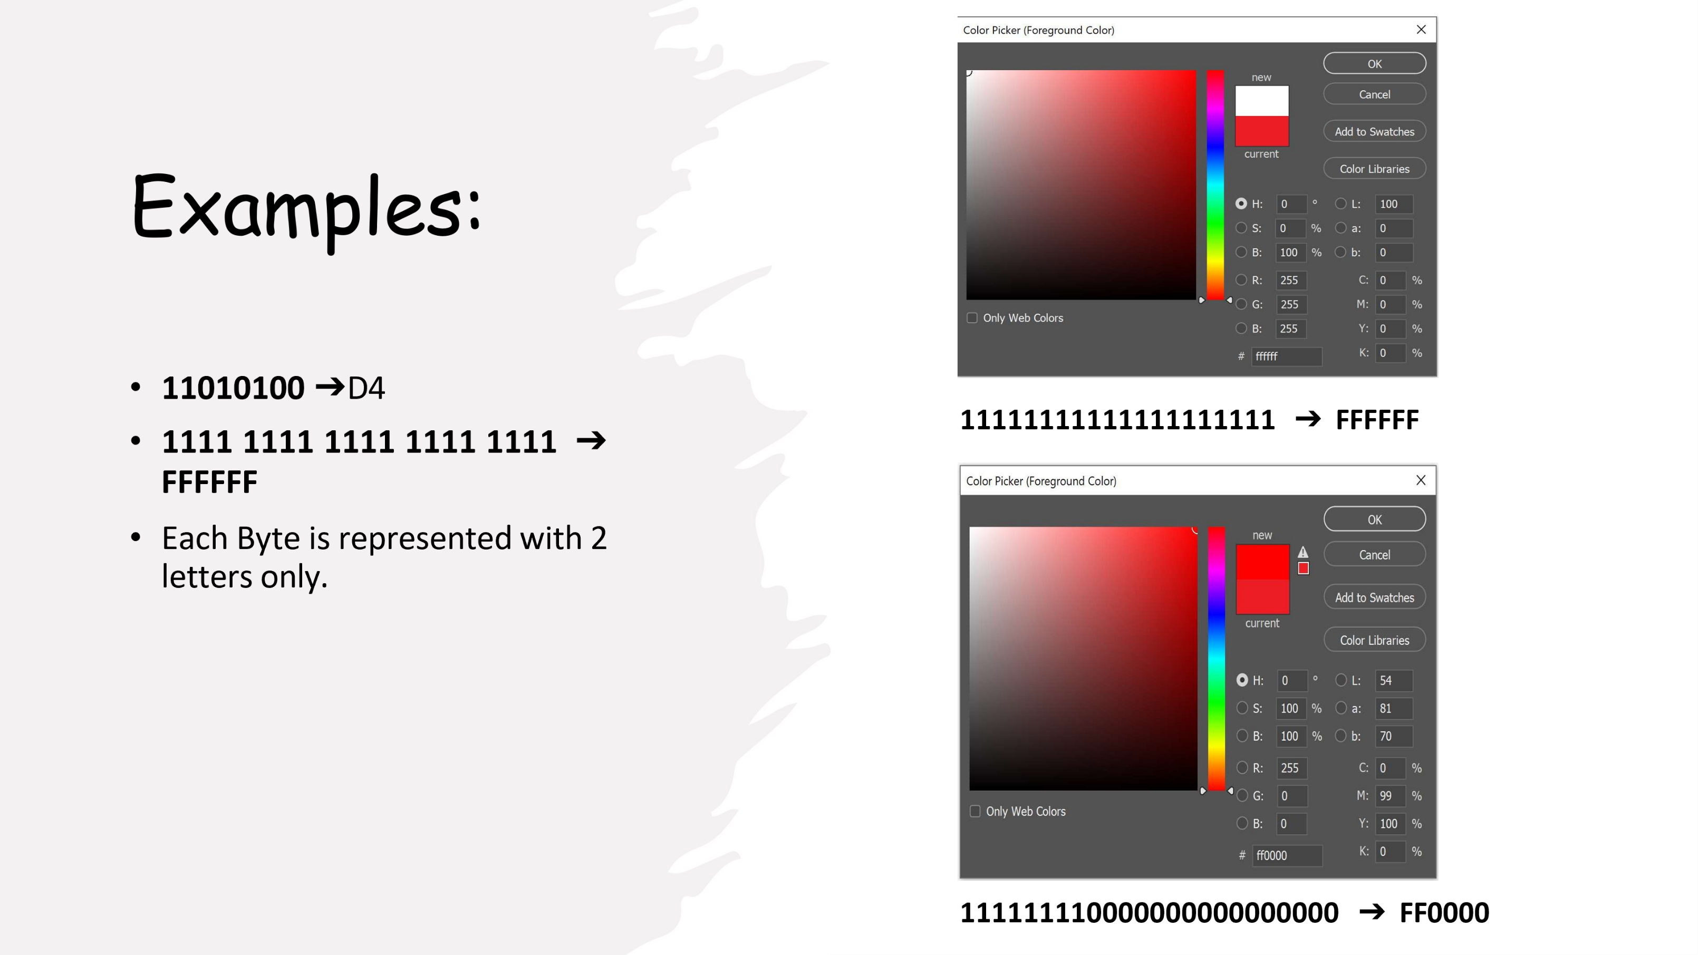
2

Slide 12
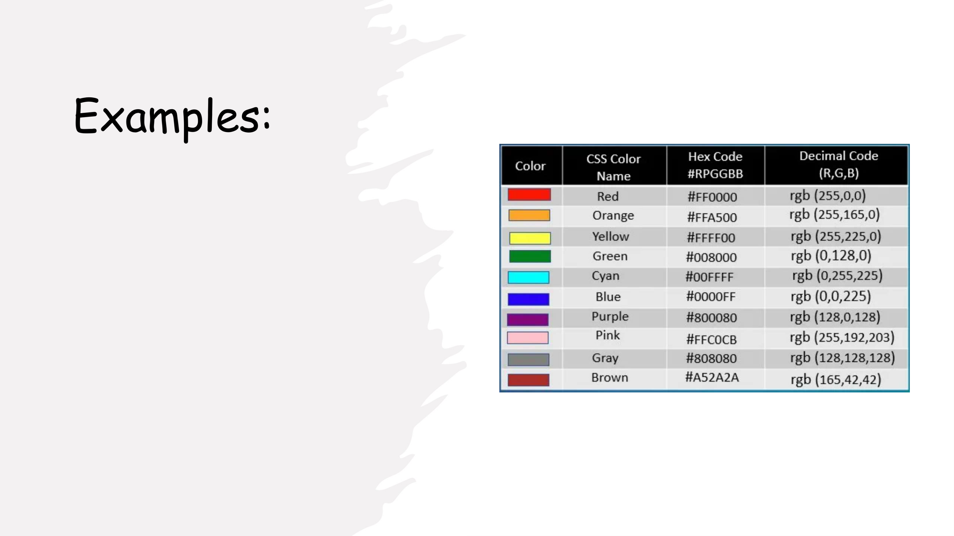
2

Slide 13
Programming Foundations
Level 1
Hexadecimal Prefex
2

Slide 14
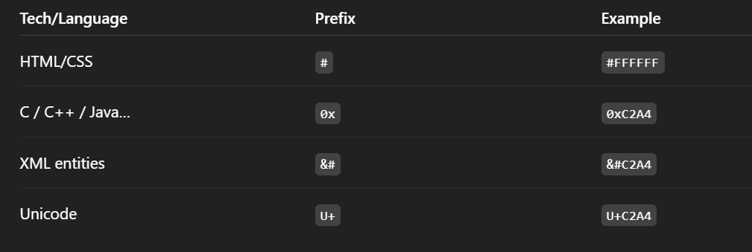
Prefix:
Technology/Language | Prefix | Example
HTML & CSS | #Code | #FFFFFF
C,C++,Java..etc | 0xCode | 0xC2A4
XML | &#Code | &#C2A4
Unicode | U+Code | U+C2A4

Slide 15
Programming Foundations
Level 1
How Hexadecimal works?
2

Slide 16
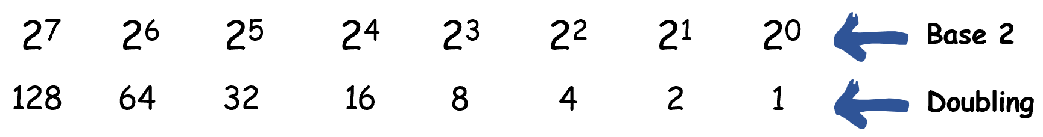
Remember that binary was base 2.

Slide 17
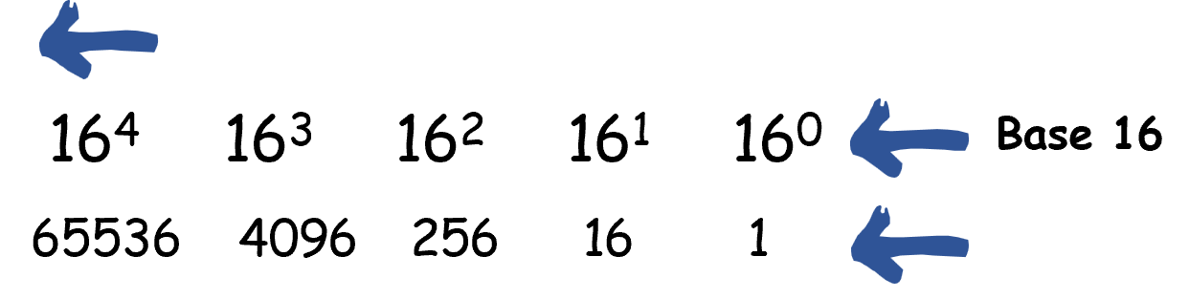
Remember that binary was base 2.

Slide 18
Programming Foundations
Level 1
Convert Decimal to Hex
2

Slide 19
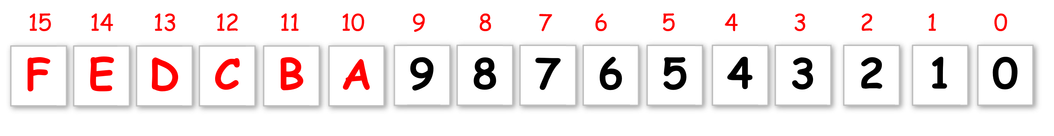
Remember..

Slide 20

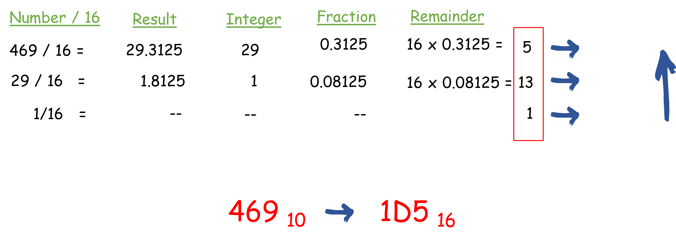
Convert 469 to Hex

Slide 21
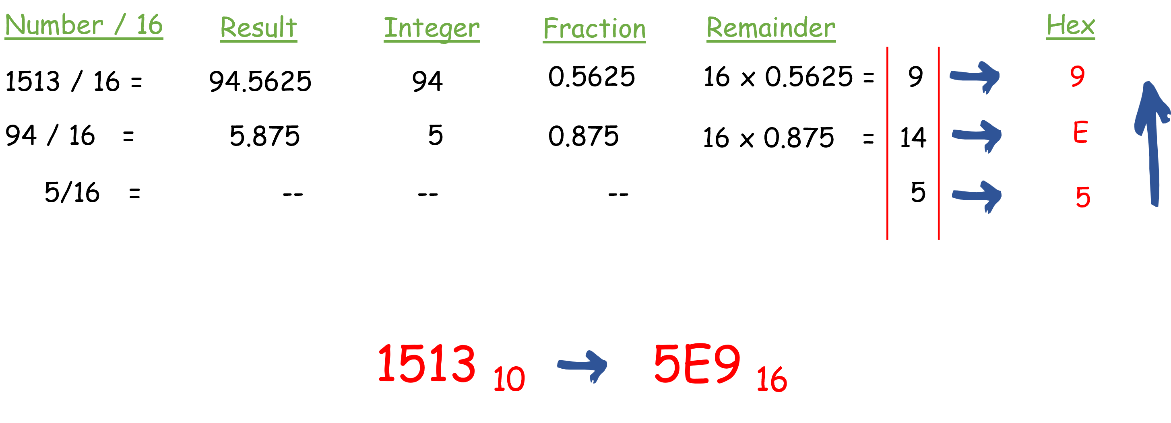
Convert 1513 to Hex

Slide 22
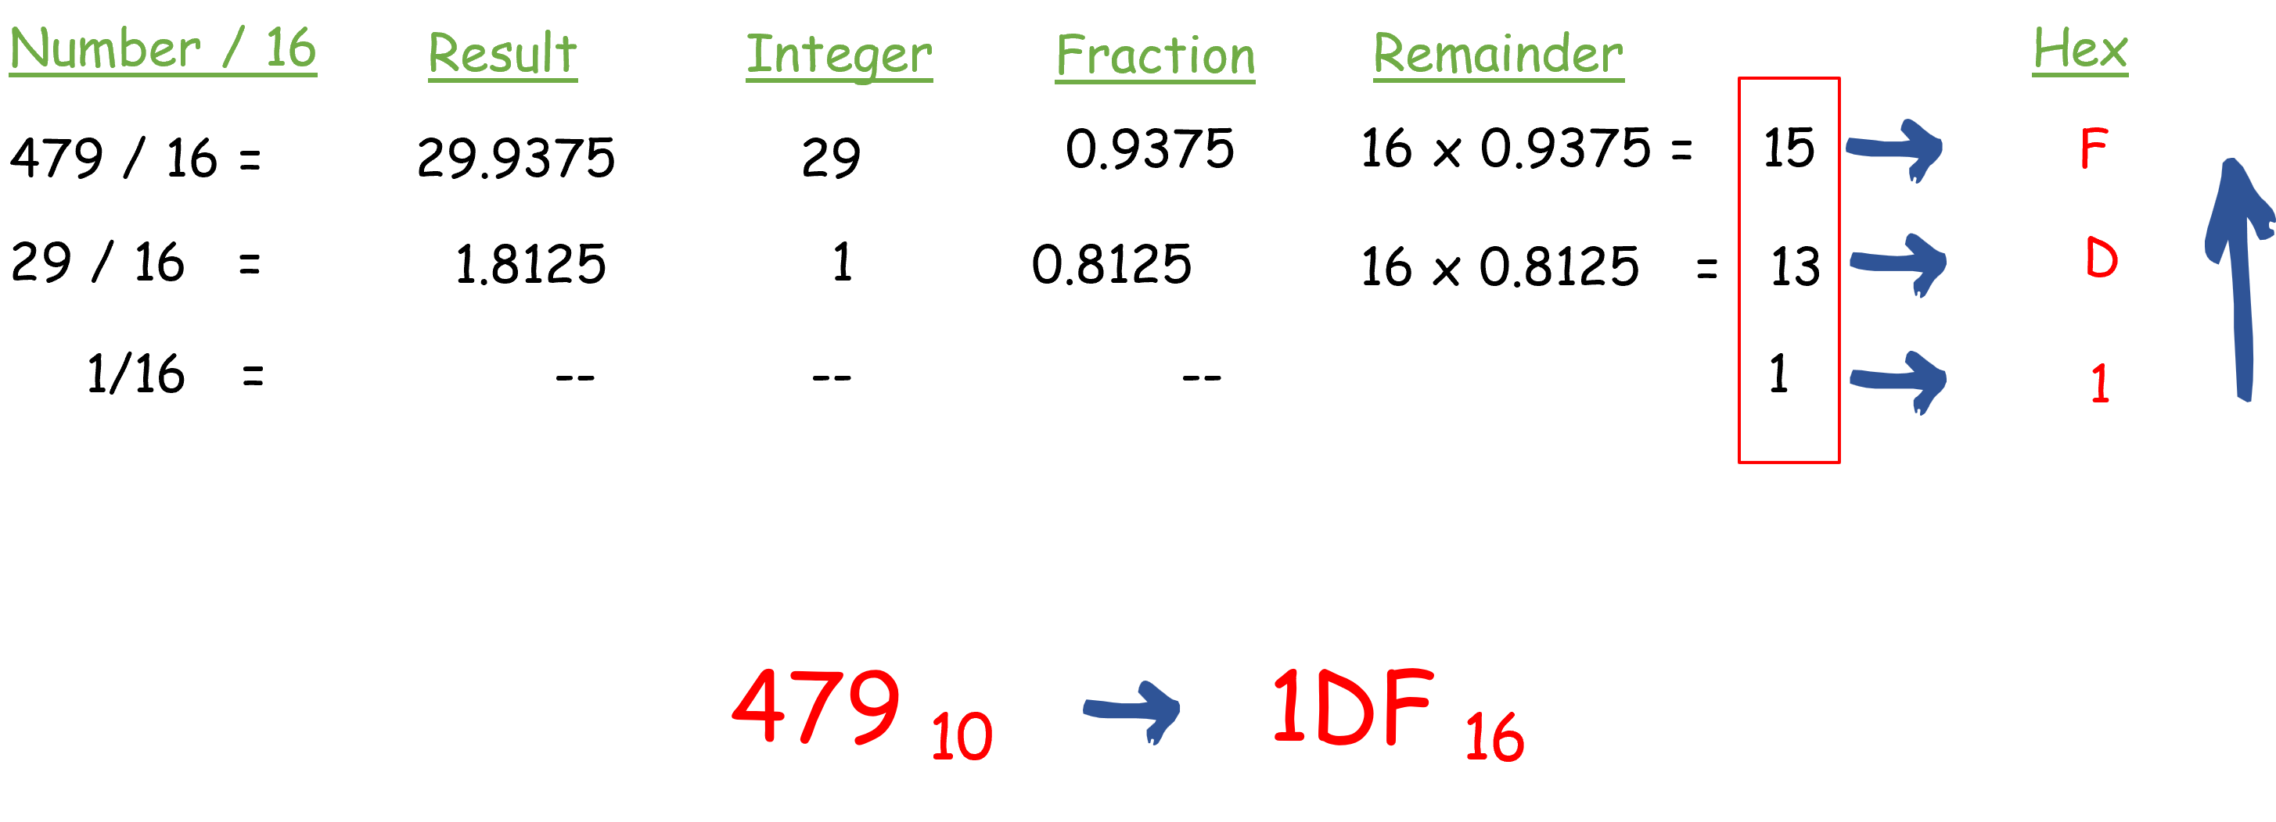
Convert 479 to Hex

Slide 23
Programming Foundations
Level 1
Convert Hex to Decimal
2

Slide 24

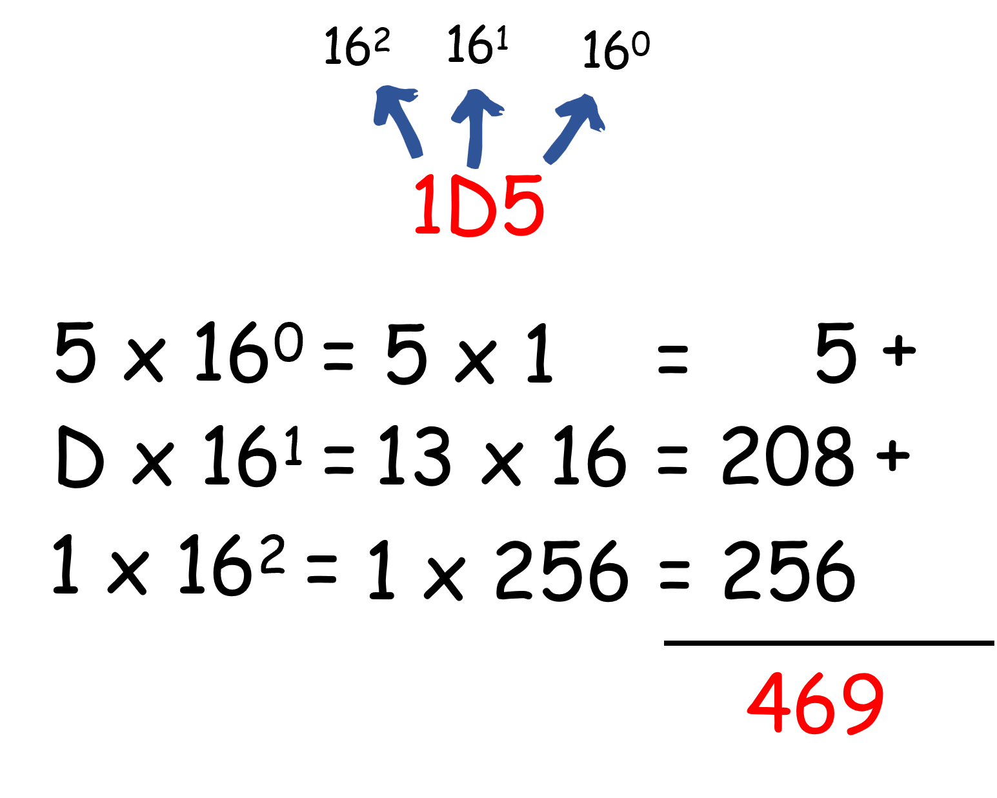
Convert 1D5 to Decimal

Slide 25
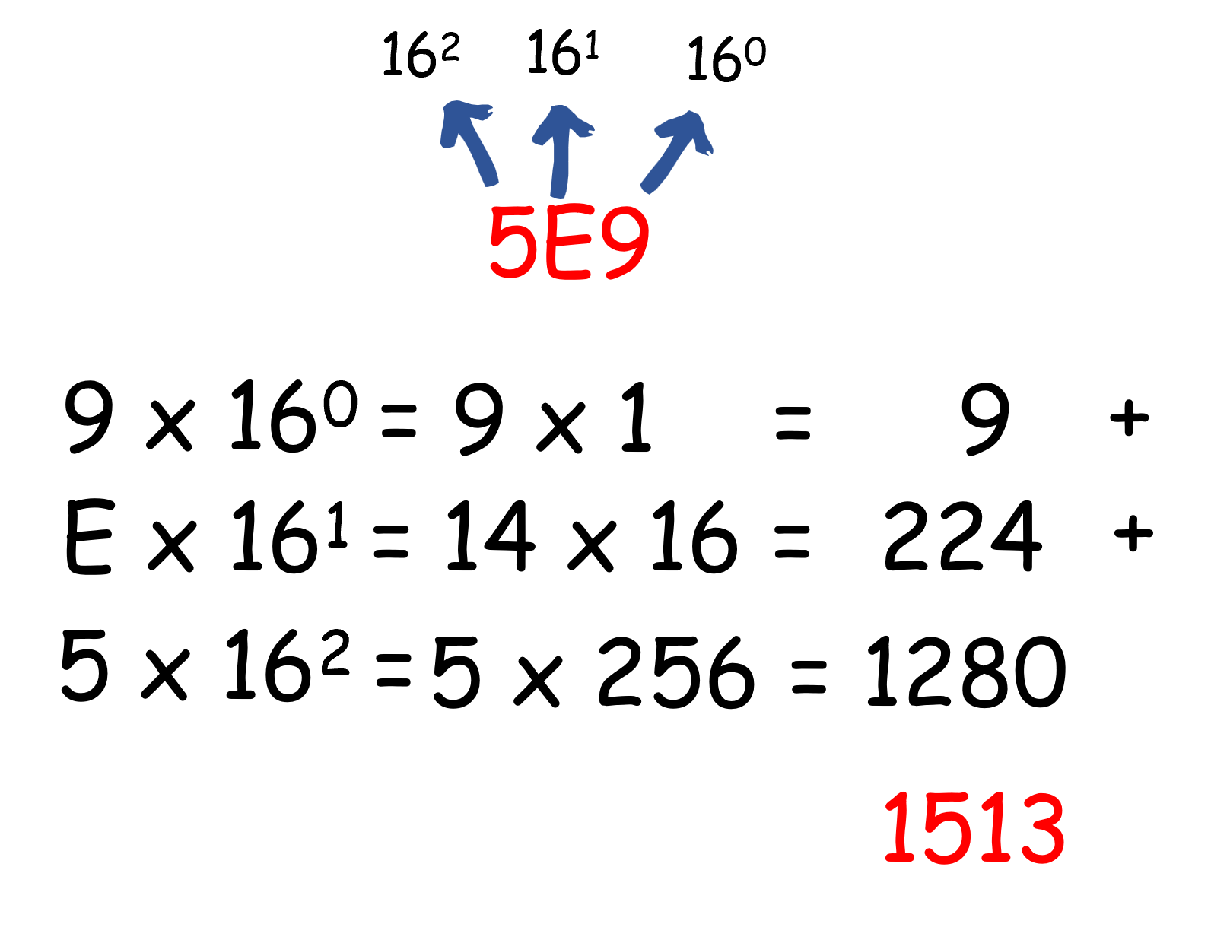
Convert 5E9 to Decimal

Slide 26
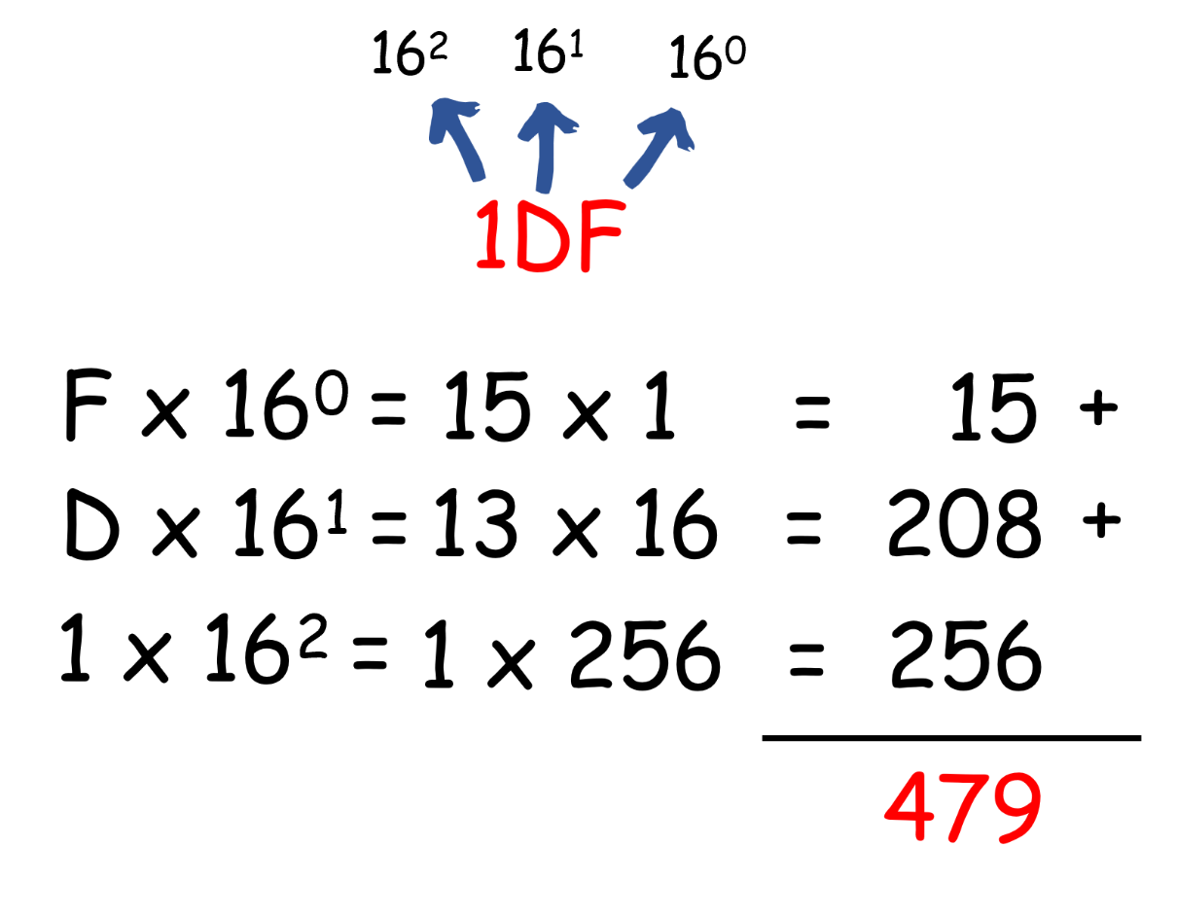
Convert 1DF to Decimal

Slide 27
Programming Foundations
Level 1
Convert Hex to Binary
2

Slide 28
How to Convert Hexa to Binary?
Two steps:
  Convert hexa to decimal.
  Convert decimal to binary.
That’s it.

Slide 29
Convert 1D5 to Binary
Two steps:
  Convert 1D5 to decimal.
  Convert decimal to binary.
That’s it.

Slide 30
Step1:
Convert 1D5 to Decimal
Now convert this to binary

Slide 31
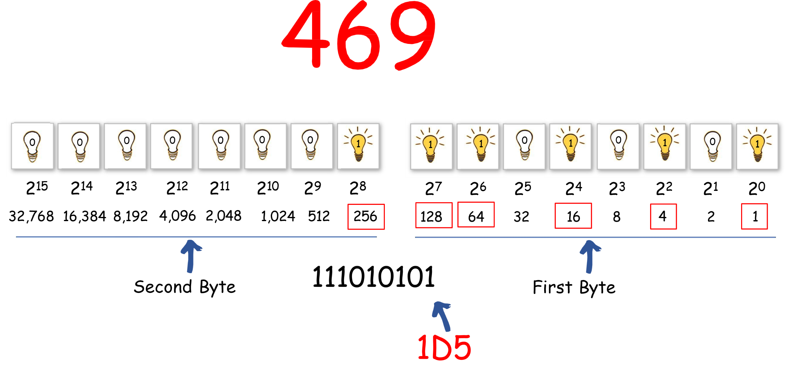
Step2:
Convert 469 to Binary

Slide 32
Programming Foundations
Level 1
Convert Binary to Hexa
2

Slide 33
How to Convert Hexa to Binary?
Two steps:
  Convert binary to decimal.
  Convert decimal to hexa.
That’s it.

Slide 34
🔗 Interconnection:
🔹 4 bits ↔ 1 hex digit → compact human view of binary.
🔹 1 byte ↔ 2 hex digits → easy memory/ASCII/color dumps.
🔹 Powers of 16 (1,16,256,4096…) → drive decimal↔hex math.
🔹 Prefixes (#, 0x, &#, U+) → tell tools to interpret as hex.
By mastering hex, you read/write low-level data confidently — firmware, encodings, colors, addresses — without drowning in 0/1. 🚀

Slide 35
🧐 Activity
📋 Instructions:
1️⃣ Convert 469, 1513, 479 to hex (show steps).
2️⃣ Convert 1D5, 5E9, 1DF to decimal (expand by 16n16^n16n).
3️⃣ Convert 13B4 and A5 to binary using nibble mapping

Slide 36
🧐 Activity Solution
📋 Solution:
1️⃣ Convert 469, 1513, 479 to hex (show steps)
469 → Hex
469 ÷ 16 = 29, remainder 5
29 ÷ 16 = 1, remainder 13 → D
1 ÷ 16 = 0, remainder 1
Read remainders bottom→top → 1 D 5
➡️ 469₁₀ = 1D5₁₆
1513 → Hex
1513 ÷ 16 = 94, remainder 9
94 ÷ 16 = 5, remainder 14 → E
5 ÷ 16 = 0, remainder 5
Read remainders bottom→top → 5 E 9
➡️ 1513₁₀ = 5E9₁₆
479 → Hex
479 ÷ 16 = 29, remainder 15 → F
29 ÷ 16 = 1, remainder 13 → D
1 ÷ 16 = 0, remainder 1
Read remainders bottom→top → 1 D F
➡️ 479₁₀ = 1DF₁₆

Slide 37
2️⃣ Convert 1D5, 5E9, 1DF to decimal (expand by 16n16^n16n).
Convert 1D5₁₆ → Decimal
Hex Decimal Power Calculation
1 1 16 ^2= 256 1x256=256
D 13 16 ^1=16 13x16=208
5 5 16 ^0=1 5x1=5
256+208+1280
➡️ 1D5₁₆ = 1513₁₀
Convert 5E9₁₆ → Decimal
Hex Decimal Power Calculation
5 5 16 ^2= 256 5x256=1280
E 14 16 ^1=16 14x16=224
9 9 16 ^0=1 9x1=9
1280+224+9=1513
➡️ 5E9₁₆ = 1513₁₀
Convert 1DF₁₆ → Decimal
Hex Decimal Power Calculation
1 1 16 ^2= 256 1x256=256
D 13 16 ^1=16 13x16=208
F 15 16 ^0=1 15x1=15
1280+224+9=1513
➡️ 1D5₁₆ = 1513₁₀

Slide 38
3️⃣ Convert 13B4 and A5 to binary
Answers: 13B4 → 0001 0011 1011 0100, A5 → 1010 0101.

Slide 39
🏁 Conclusion
✅ Hex compresses binary while staying bit-accurate: 4 bits ↔ 1 hex digit.
✅ Reading bytes as two hex digits is the de-facto standard in systems work.
✅ With base-16 powers and nibble mapping, you can convert decimal/hex/binary fluently and read real-world artifacts (colors, encodings, addresses) with confidence.

Slide 40
Thank you ☺

