Slide 1

Programming Foundations
Level 1

Slide 2

Programming Foundations
Level 1
Byte Parts and It's Terminology
2

Slide 3
Byte Parts: Bit, Crumb, Nibble, Byte — LSB & MSB
Every piece of digital data—text, images, sound—is built from bits (0 or 1).
Bits group into larger, human-friendly units with specific names: crumbs (2 bits), nibbles (4 bits), and bytes (8 bits).
Understanding these building blocks—and how LSB and MSB work—makes binary, hex, and memory maps much easier.

Slide 4
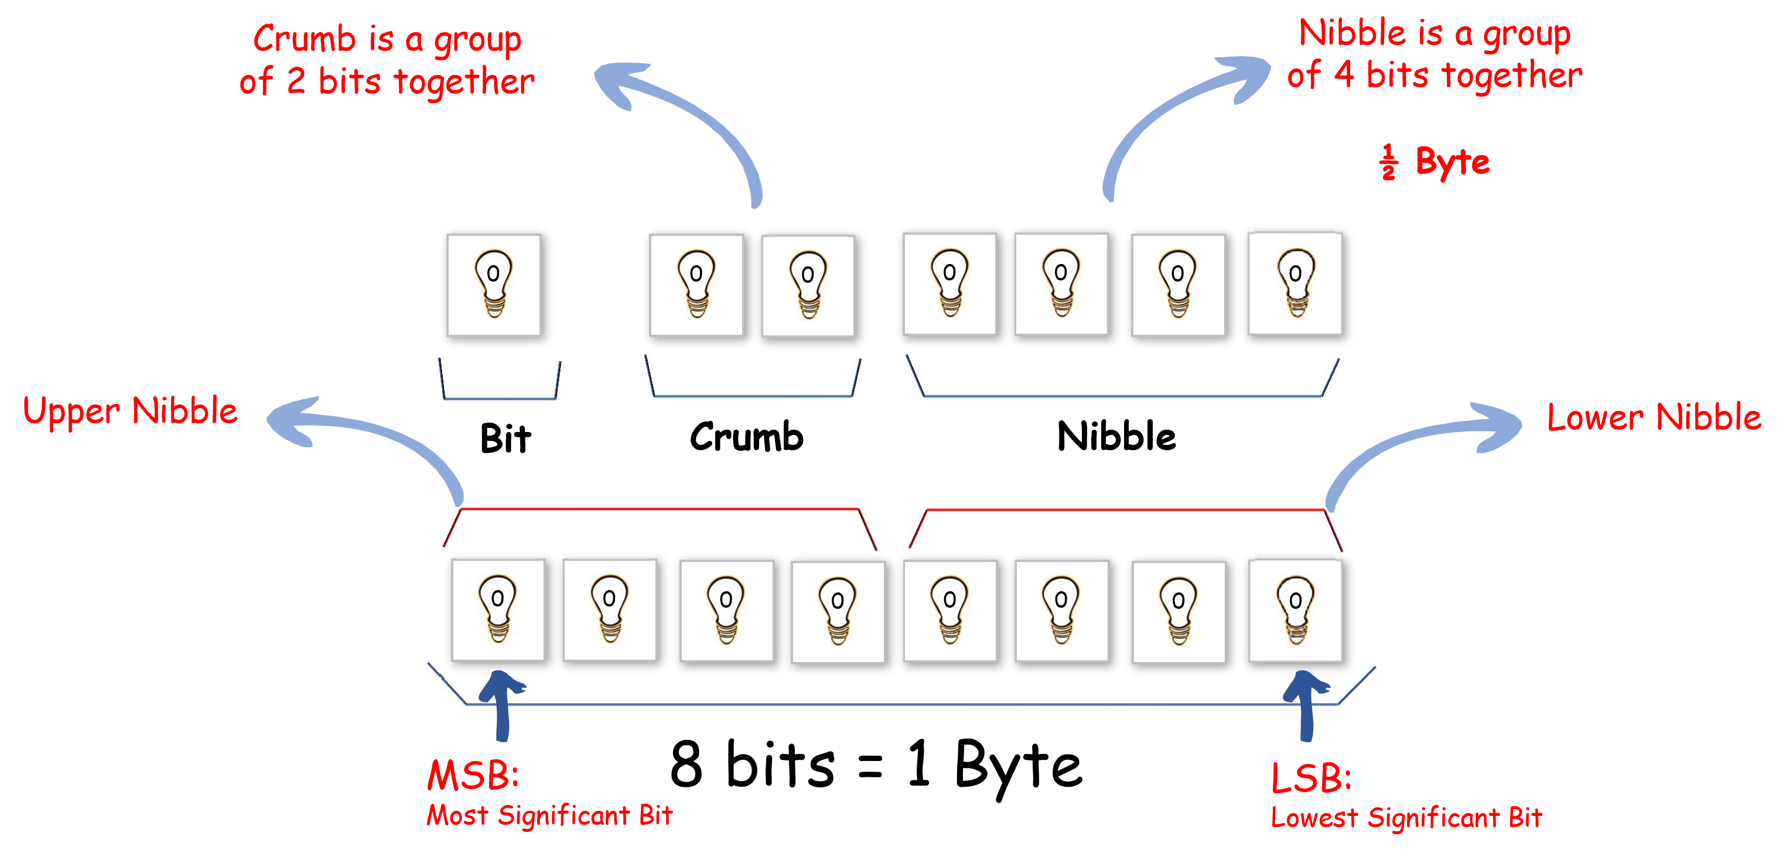
Core Definitions
Byte Parts:

Slide 5
Byte Parts:
🟨 Bit: the smallest unit of information — 0 or 1.
🟨 Crumb: a group of 2 bits. (Yes, “crumb” is the official term used in your slides.)
🟨 Nibble: a group of 4 bits (½ byte).
🟨 Byte: 8 bits. (1 byte = 2 nibbles = 4 crumbs.)

Slide 6
Lower vs Upper Nibble
🟨 Lower Nibble: the rightmost 4 bits of a byte (b3 b2 b1 b0).
🟨 Upper Nibble: the leftmost 4 bits of a byte (b7 b6 b5 b4). These names matter because hex maps perfectly to nibbles: 1 byte ↔ 2 hex digits (upper nibble = first hex digit, lower nibble = second).

Slide 7
LSB & MSB
🟨 LSB (Least Significant Bit): the rightmost bit of the byte (b0). It carries the smallest weight (2⁰).
🟨 MSB (Most Significant Bit): the leftmost bit of the byte (b7). It carries the largest weight (2⁷). We call them “least/most significant” because they contribute the least/most to the numeric value of the binary number.

Slide 8
Quick Examples
🟨 Byte: 0101 1100
  🟩 Upper nibble = 0101 (hex 5)
  🟩 Lower nibble = 1100 (hex C)
  🟩 LSB = 0 (rightmost)
  🟩 MSB = 0 (leftmost)
🟨 Byte: 1010 0111
  🟩 Upper nibble = 1010 (hex A)
  🟩 Lower nibble = 0111 (hex 7)
  🟩 LSB = 1, MSB = 1

Slide 9
🔗 Interconnection
🔹 2 bits = Crumb, 4 bits = Nibble, 8 bits = Byte → hierarchical building blocks.
🔹 Upper nibble (left 4) + Lower nibble (right 4) = 1 byte → aligns perfectly with two hex digits.
🔹 MSB (leftmost) carries the highest weight, LSB (rightmost) the lowest → drives numeric value.
By mastering crumbs, nibbles, bytes, and LSB/MSB, you read binary/hex confidently and avoid off-by-nibble errors in real code! 🚀

Slide 10
🧐 Activity
📋 Instructions:
Answer the following questions based on what you learned about bits, crumbs, nibbles, bytes, and their parts (LSB/MSB):
1️⃣ What is a bit?
2️⃣ What is a crumb?
3️⃣ What is a nibble?
4️⃣ What is a byte?
5️⃣ How many bits are in a byte?
6️⃣ How many crumbs are in a byte?
7️⃣ How many nibbles are in a byte?
8️⃣ How many crumbs are in a nibble?
9️⃣ What is the lower nibble?
🔟 What is the upper nibble?
1️⃣1️⃣ What is LSB, why do we call it LSB, and what is its value?
1️⃣2️⃣ What is MSB, why do we call it MSB, and what is its value?

Slide 11
🧐 Activity Solution
📋 Solution:
1️⃣ What is a bit?
Bit: The smallest unit of information in computing; it can be 0 or 1.
2️⃣ What is a crumb?
Crumb: A small group of 2 bits.
3️⃣ What is a nibble?
Nibble: A group of 4 bits (half of a byte).
4️⃣ What is a byte?
Byte: A collection of 8 bits (2 nibbles or 4 crumbs).
5️⃣ How many bits are in a byte?
Bits in a byte: 8 bits.
6️⃣ How many crumbs are in a byte?
Crumbs in a byte: 4 crumbs (8 bits ÷ 2 bits per crumb).
7️⃣ How many nibbles are in a byte?
Nibbles in a byte: 2 nibbles (8 bits ÷ 4 bits per nibble).
8️⃣ How many crumbs are in a nibble?
Crumbs in a nibble: 2 crumbs (4 bits ÷ 2 bits per crumb).
9️⃣ What is the lower nibble?
Lower nibble: The rightmost 4 bits of a byte (least significant half).
🔟 What is the upper nibble?
Upper nibble: The leftmost 4 bits of a byte (most significant half).

Slide 12
1️⃣1️⃣ What is LSB, why do we call it LSB, and what is its value?
LSB (Least Significant Bit):
  It’s the rightmost bit in a binary number.
  Called “least significant” because it has the smallest weight (2⁰ = 1).
  Its value contributes the least to the overall binary value.
1️⃣2️⃣ What is MSB, why do we call it MSB, and what is its value?
MSB (Most Significant Bit):
  It’s the leftmost bit in a binary number.
  Called “most significant” because it has the highest weight (2⁷ = 128 in an 8-bit byte).
  Its value contributes the most to the binary value, often used to indicate sign or priority.

Slide 13
🏁 Conclusion
✅ Bit → Crumb (2) → Nibble (4) → Byte (8) are the fundamental groupings of binary data.
✅ Upper/Lower nibble make byte parsing and hex representation straightforward.
✅ LSB/MSB determine each bit’s weight and are key in numeric value and flag interpretation.
Mastering these byte parts turns “scary binary” into a clean, predictable structure you can read and write with confidence. 💪

Slide 14
Thank you ☺

