Slide 1

Programming Foundations
Level 1

Slide 2

Programming Foundations
Level 1
Octal System
In
Computer
2

Slide 3
Programming Foundations
Level 1
What is Octal System?
2

Slide 4
Octal Number System (Base-8): Concepts & Conversions
The Octal System (base-8) uses digits 0–7. Like hexadecimal, octal provides a human-friendly view of binary: each octal digit = 3 bits, so long binary strings become shorter and easier to read (e.g., 11010100 → octal 212).
Historically, octal was popular when machines used word sizes in multiples of 3 bits or 6-bit bytes; modern systems use nibbles (4 bits), so hexadecimal is more common today.

Slide 5
Counting Systems (Context)
Decimal (base-10), Binary (base-2), Hexadecimal (base-16), and Octal (base-8) appear together in computing foundations.

Slide 6
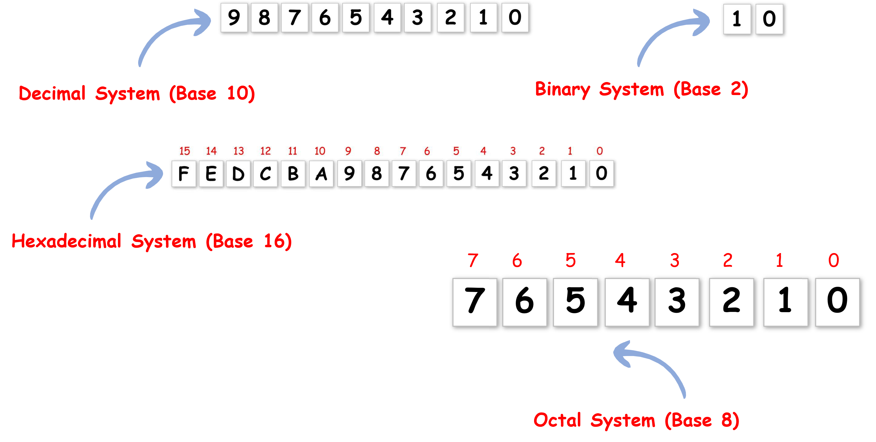
Counting Systems?

Slide 7
What Is Octal?
The Octal Numbering System is very similar in principle to the previous hexadecimal numbering system except that in Octal,
Each octal digit represents 3 bits, so a 6-bit byte is two octal digits
Digits: 0, 1, 2, 3, 4, 5, 6, 7
Place values (powers of 8):
8^0=1, 8^1=8, 8^2=64, 8^3 = 512 ...etc
Binary pairing: 1 octal digit ↔ 3 bits (e.g., 7 ↔ 111).
A 6-bit value is exactly two octal digits.

Slide 8


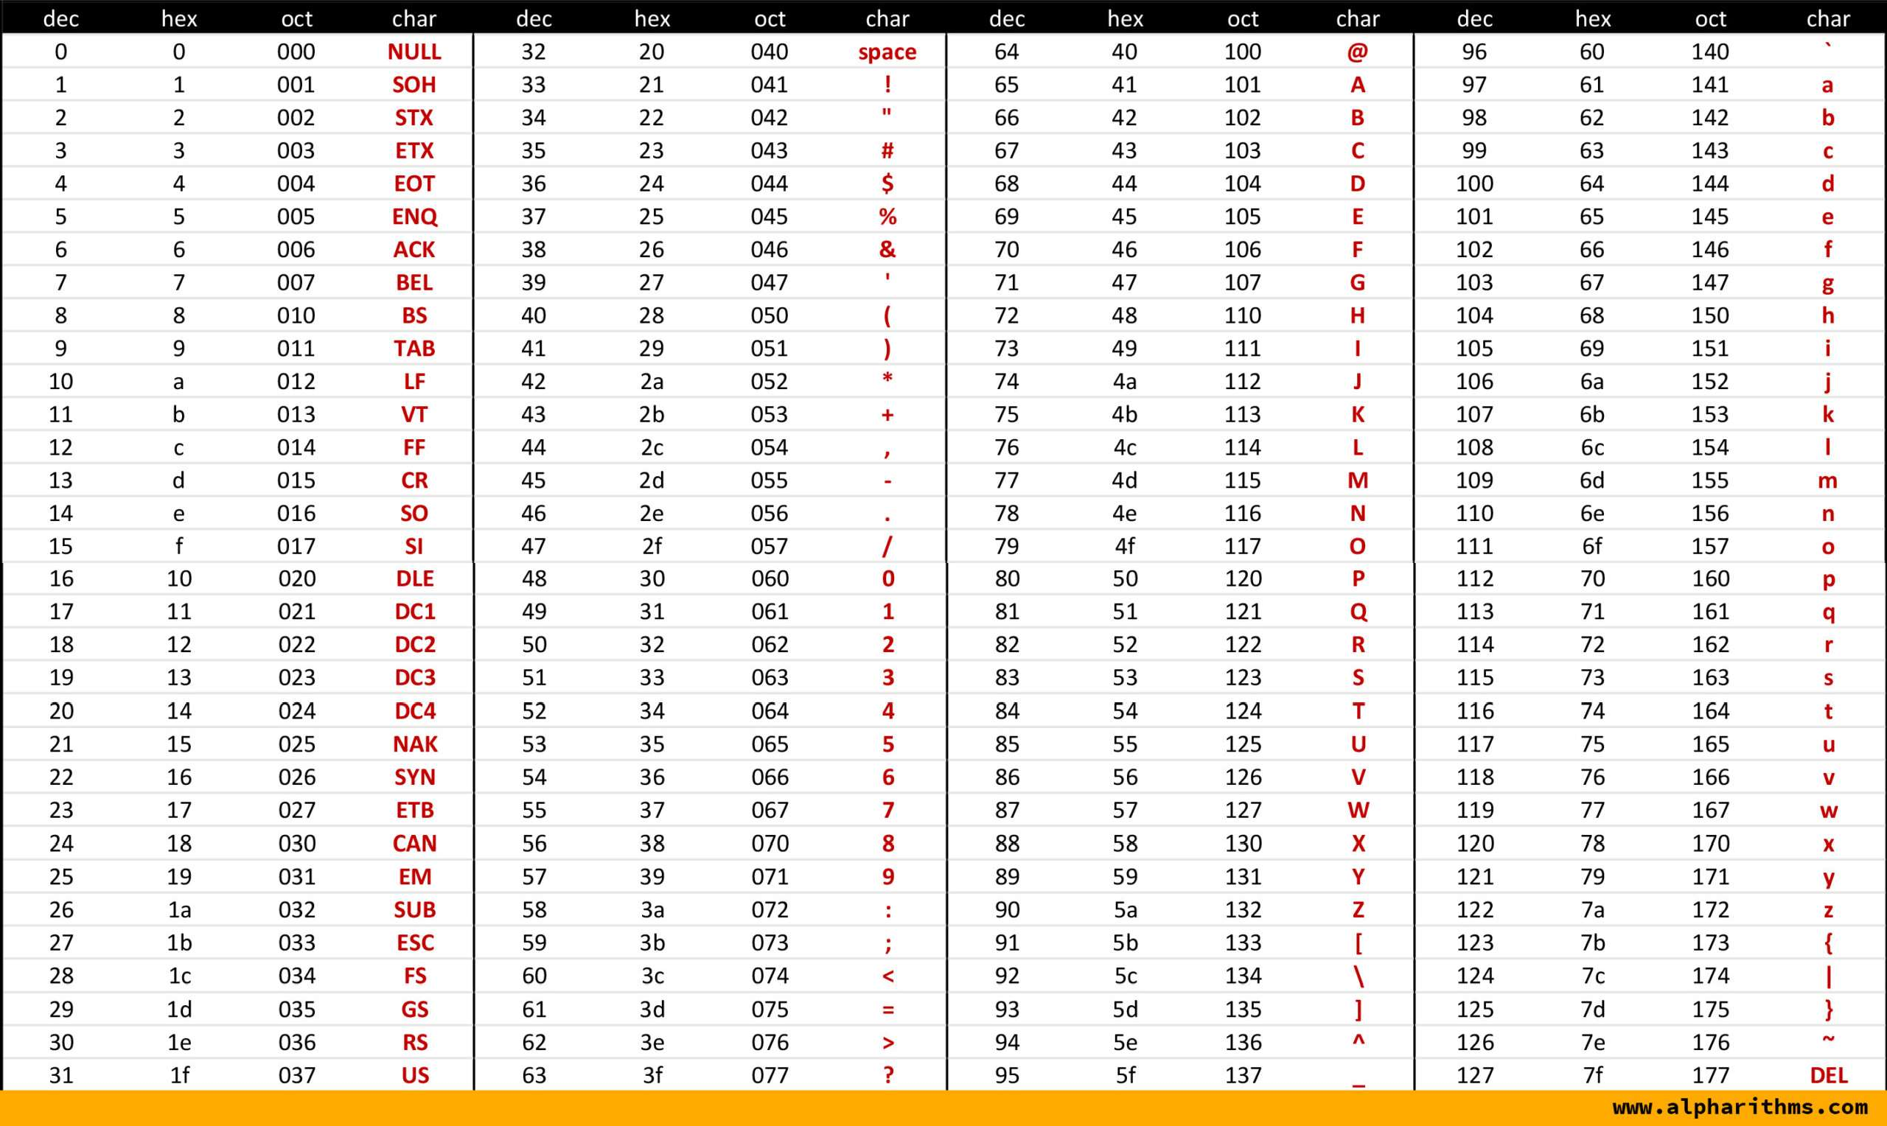


ASCII Table
ProgrammingAdvices.com ^{Mohammed Abu-Hadhoud}
_{Copyright© 2022} MBA, PMOC, PgMP®, PMP®, PMI-RMP®, CM, ITILF, MCPD, MCSD
26+ years of experience

Slide 9
Why Octal (then & now)?
Both Hexadecimal and Octal Systems Provides a human-friendly representation
11010100➔D4 Hexa
11010100➔212 Octal

Slide 10

It’s hard for human to read binary!
What does this mean?
01001001 00100000 01001100 01101111 01110110 01100101
00100000 01011001 01101111 01110101 00100001
I Love You!

Slide 11
Why Octal (then & now)?
🟨 Then: Early computers often used multiples of 3 bits (e.g., 6-bit bytes) → octal fit perfectly.
🟨 Now: Most modern machines use nibbles (4 bits) → hexadecimal aligns better, so octal use has declined. Still, octal remains helpful for compact binary reading.

Slide 12
Programming Foundations
Level 1
Octal Prefix
2

Slide 13
Prefix:
Hexa Prefix:
Octal Prefix:
0oCode ➔ 0o725
🟨 Hex examples (for contrast): #FFFFFF, 0x725, &#C2A4, U+C2A4.
🟨 Octal prefix (programming): 0o (letter o).
  Example: 0o725 is octal 725.
Technology/Language | Prefix | Example
HTML & CSS | #Code | #FFFFFF
C,C++,Java..etc | 0x Code | 0x725
XML | &#Code | &#C2A4
Unicode | U+Code | U+C2A4

Slide 14
Programming Foundations
Level 1
How Octal works?
2

Slide 15
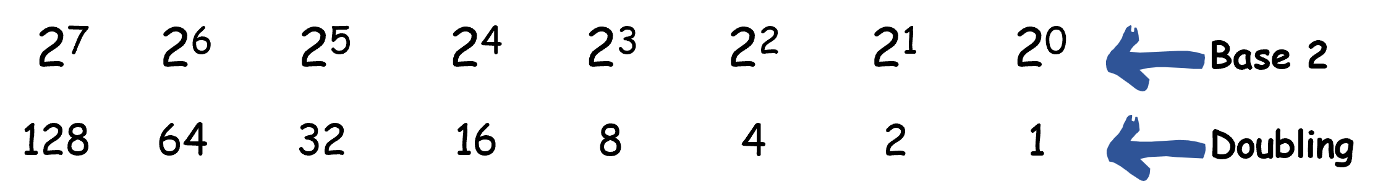
Remember that binary was base 2.

Slide 16
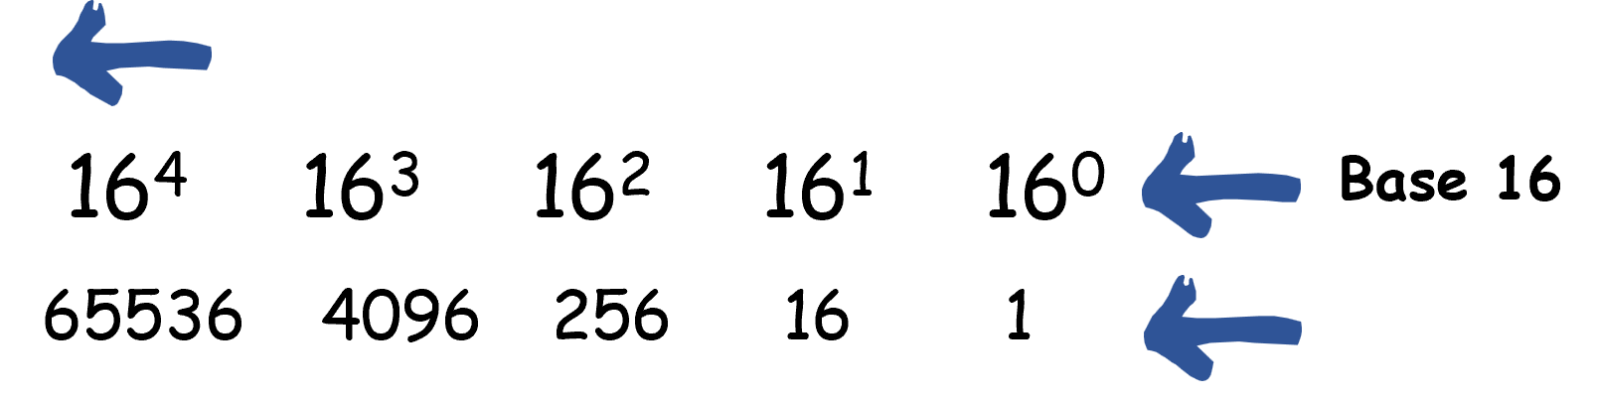
Hexadecimal is base 16.

Slide 17
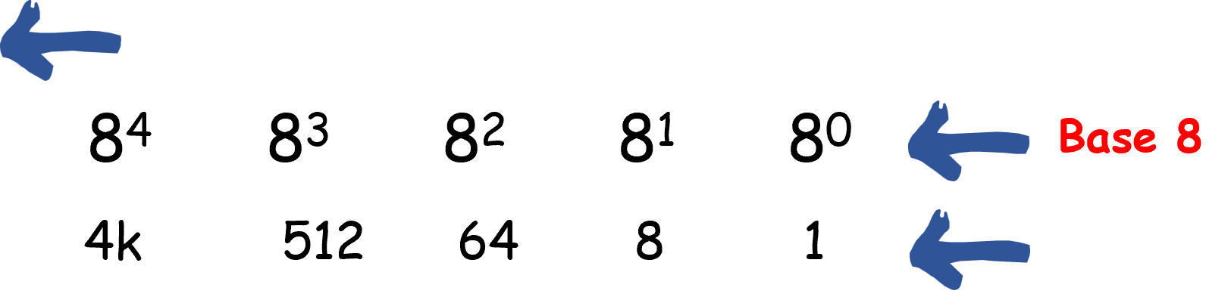
Octal System is base 8

Slide 18
Programming Foundations
Level 1
Convert Decimal to Octal
2

Slide 19
🔢 Conversions
conversion from decimal to octal and binary to octal
Follows the same pattern as we have seen previously for hexadecimal

Slide 20
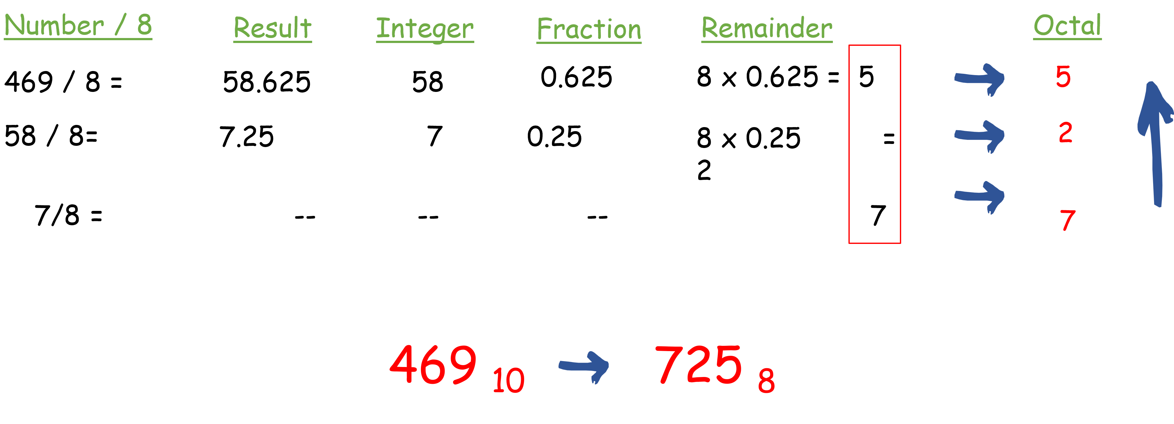
A) Decimal → Octal (long division by 8)
Convert 469 to Octal

Slide 21
Programming Foundations
Level 1
Convert Octal to Decimal
2

Slide 22
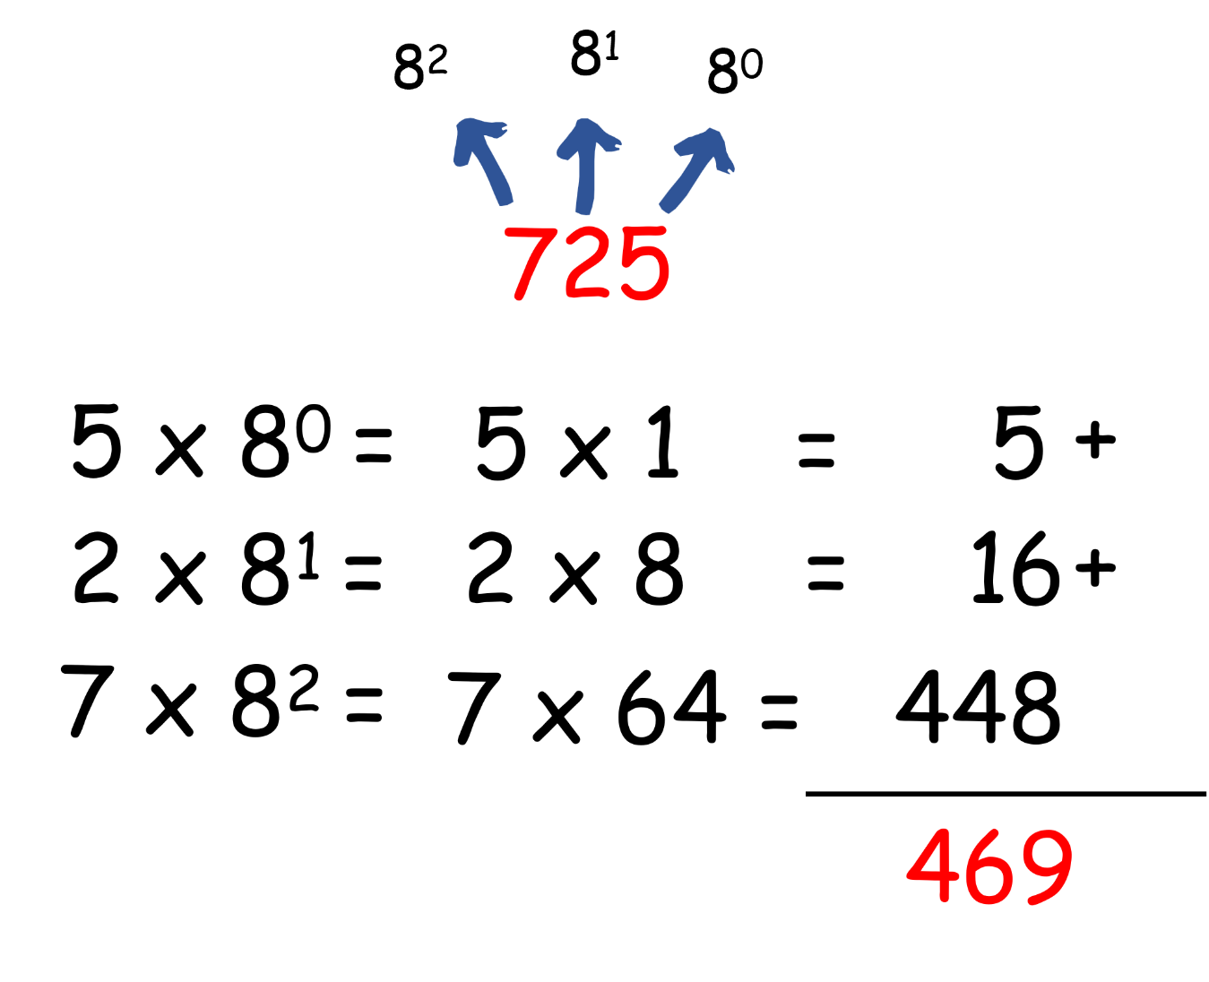
B) Octal → Decimal (expand by power of 8)
Convert Octal 725 to Decimal

Slide 23
Programming Foundations
Level 1
Convert Octal to Binary
2

Slide 24
C) Octal → Binary
How to Convert Octal to Binary?
Way 1:
Two steps:
1. Convert octal to decimal.
2. Convert decimal to binary.
That’s it.

Slide 25
How to Convert Octal to Binary?
Way 2:
Direct Conversion.

Slide 26
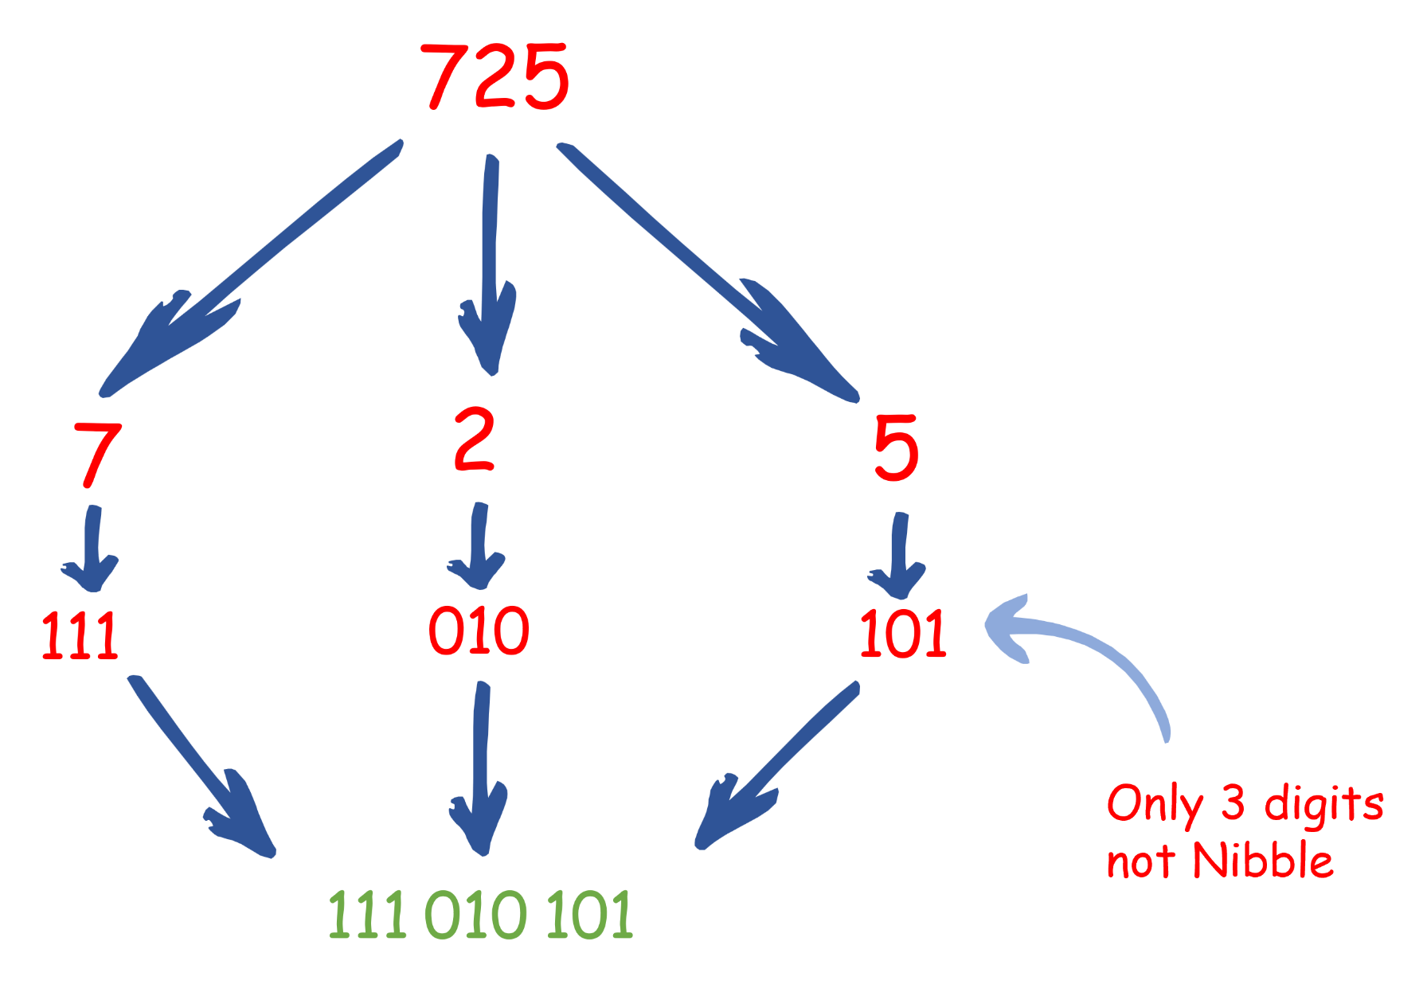
Direct Conversion:
Convert Octal 725 to Binary
7 | 2 | 5 → 111 | 010 | 101 → 111010101 (group as 3-bit blocks).
(You may pad left with zeros for alignment.)

Slide 27
Programming Foundations
Level 1
Convert Binary to Octal
2

Slide 28
How to Convert Binary to Octal?
Way 1:
Two steps:
1. Convert Binary to Decimal.
2.Convert Decimal to Octal.
That’s it.

Slide 29
How to Convert Binary to Octal?
Way 2:
Direct Conversion.

Slide 30
Direct Conversion:
Convert 000111010101 to Octal
Group by 3 from right: 000 | 111 | 010 | 101 → 0 7 2 5 → 725 (drop leading 0).
111
010
101
111
010
101
7
2
5
725

Slide 31
🔗 Interconnection
🟨 Octal digit = 3 bits → compact view for older 3-bit-multiple word sizes.
🟨 Hex digit = 4 bits → better match for modern nibble-based architectures.
🟨 Two conversion ways exist for Octal↔Binary; direct 3-bit grouping is the quickest in practice.
By knowing where octal shines (and where hex does), you can read binary data efficiently in any context. 🚀

Slide 32
🧐 Activity
📋 Instructions:
1️⃣ Octal → Decimal
a) 100₈
b) 512₈
2️⃣ Decimal → Octal
a) 64₁₀
b) 330₁₀
3️⃣ Octal → Binary (direct, 3-bit mapping)
a) 100₈
b) 512₈
4️⃣ Binary → Octal (direct, group by 3 from right)
a) 0100 0000₂
b) 0001 0100 1010₂

Slide 33
🧐 Activity Solution
📋 Solution:
1️⃣ Octal → Decimal
a) 100₈ = 64₁₀
b) 512₈ = 330₁₀
2️⃣ Decimal → Octal
a) 64₁₀ = 100₈
b) 330₁₀ = 512₈
3️⃣ Octal → Binary (direct)
a) 100₈ → 1|0|0 → 001 000 000 → 0100 0000₂ (padded to a full byte)
b) 512₈ → 5|1|2 → 101 001 010 → 0001 0100 1010₂ (padded to 12 bits)
4️⃣ Binary → Octal (direct)
a) 0100 0000₂ → group 010|000|000 → 4 0 0 → 100₈
b) 0001 0100 1010₂ → group 000|101|001|010 → 0 5 1 2 → 512₈ (drop leading 0)

Slide 34
🏁 Conclusion
✅ Octal (base-8) compresses binary using 3-bit groupings per digit.
✅ Use the direct methods for speed: Octal ↔ Binary via 3-bit mapping, Binary ↔ Octal by grouping in 3s from the right.
✅ While hex is more common today, octal remains an important historical and practical lens for reading binary succinctly.

Slide 35
Thank you ☺

