Slide 1

Programming Foundations
Level 1

Slide 2

Programming Foundations
Level 1
Programmers Calculator
2

Slide 3
Using the Programmer’s Calculator to Convert Between Numbering Systems
Computers represent numbers in different bases (Decimal, Binary, Octal, Hexadecimal).
To quickly switch between them, developers and students use a tool built right into Windows — the Programmer’s Calculator.
It allows you to:
🔹 Instantly convert values between Binary (base-2), Octal (base-8), Decimal (base-10), and Hexadecimal (base-16).
🔹 See how the same value looks in each base.
🔹 Avoid manual conversion errors while learning or coding.

Slide 4
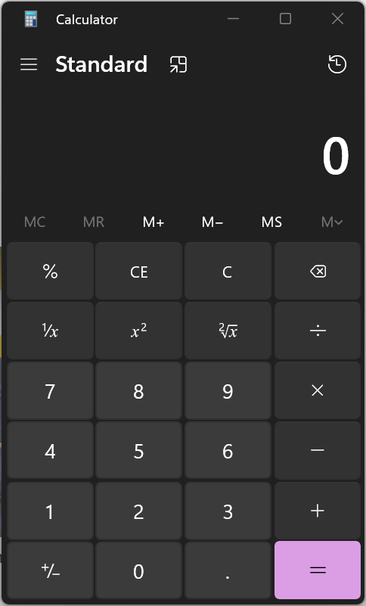
Opening the Programmer’s Calculator
📋 Steps:
1️⃣ Press Windows + R → type calc → press Enter.

Slide 5
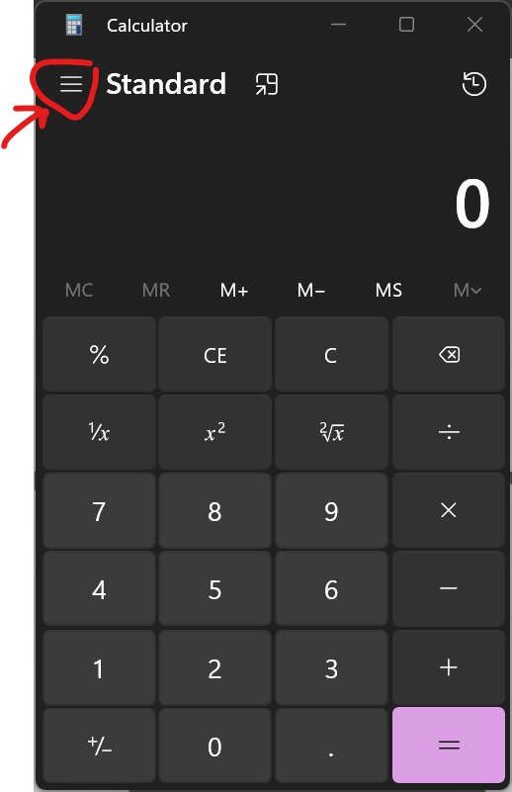
2️⃣ In the Calculator app, open the menu (☰) or click the hamburger icon on the top left.

Slide 6
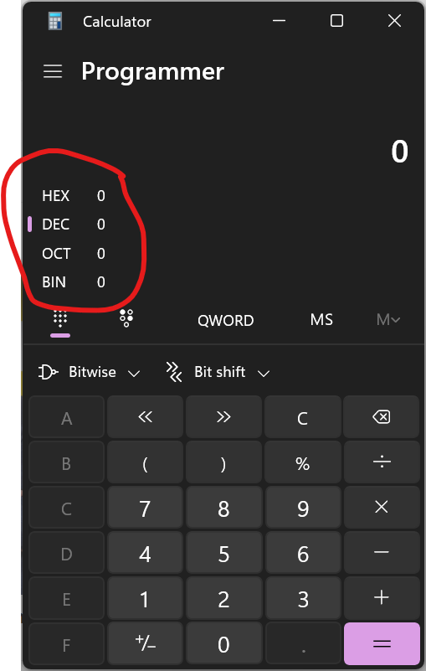
3️⃣ Select Programmer mode (it may appear as “Programmer” or “Programmer’s Calculator”).
💡 Shortcut: Press Alt + 3 (in newer Windows versions)
to open Programmer mode directly.
You’ll now see four numbering systems on the left side of
the window:
HEX → Hexadecimal (base 16)
DEC → Decimal (base 10)
OCT → Octal (base 8)
BIN → Binary (base 2)

Slide 7
🔹 Understanding the Interface
The Programmer’s Calculator shows:
🟨 A numeric keypad (changes depending on the base you choose).
🟨 Four buttons (HEX / DEC / OCT / BIN) to choose the
input base.
🟨 The corresponding values in all systems update
automatically when you enter a number.

Slide 8
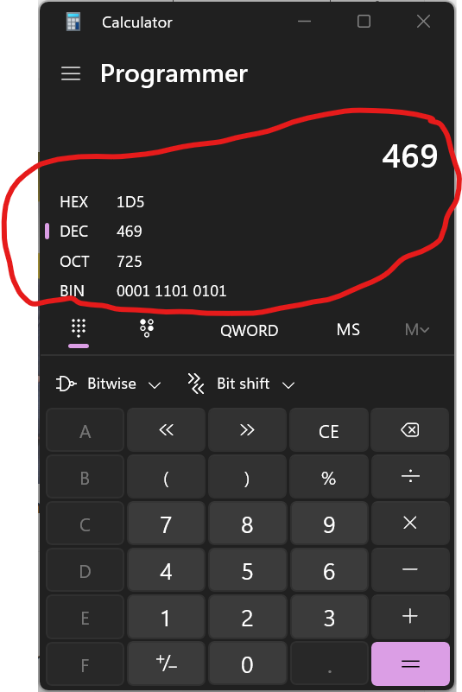
Example:
If you select DEC, type 469, the calculator will automatically show:
🟨 HEX → 1D5
🟨 OCT → 725
🟨 BIN → 111010101
✅ It instantly converts across all four systems!

Slide 9
🔹 Converting Decimal to Other Systems
📋 Example: Convert 469 (decimal)
1️⃣ Select DEC (Decimal).
2️⃣ Type 469.
3️⃣ Observe conversions:
HEX → 1D5
OCT → 725
BIN → 111010101
🧠 Explanation: The calculator automatically interprets your input as Decimal and shows equivalent values in all other bases

Slide 10
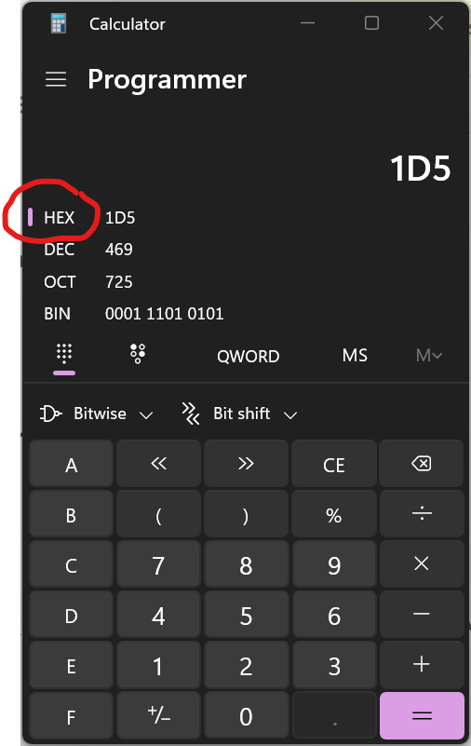
🔹 Converting Hexadecimal to Other Systems
📋 Example: Convert 1D5 (hex)
1️⃣ Select HEX.
2️⃣ Enter 1D5.
If your keyboard doesn’t have letter keys
active, ensure HEX is selected (then A–F
buttons appear)
3️⃣ Observe:
DEC → 469
OCT → 725
BIN → 111010101
✅ The same logic applies — type in any base, and
the others update instantly.

Slide 11
🔹 Converting Binary to Other Systems
📋 Example: Convert 111010101 (binary)
1️⃣ Select BIN.
2️⃣ Type 111010101.
3️⃣ Observe:
OCT → 725
DEC → 469
HEX → 1D5
💡 Tip: The calculator only allows 0 and 1 keys when in binary mode preventing mistakes.

Slide 12
🔹 Converting Octal to Other Systems
📋 Example: Convert 725 (octal)
1️⃣ Select OCT.
2️⃣ Enter 725.
3️⃣ Observe:
BIN → 111010101
DEC → 469
HEX → 1D5
🧩 Notice: every conversion leads back to the same consistent value, regardless of starting base

Slide 13
🔹 Using Word Size (for advanced learners)
In the Programmer’s Calculator, you can change Word size (QWORD, DWORD, WORD, BYTE) to see how numbers behave when truncated (useful for programmers working with 8-bit, 16-bit, 32-bit, or 64-bit systems).
📋 Example:
Change word size → select BYTE → notice that large numbers wrap around if they exceed 255 (since a byte = 8 bits).

Slide 14
🔗 Interconnection
🔹 Binary (base 2) → machine-level representation (0s & 1s).
🔹 Octal (base 8) → legacy system (3-bit groupings).
🔹 Decimal (base 10) → human-readable.
🔹 Hexadecimal (base 16) → compact developer shorthand (4-bit groupings).
By mastering the Programmer’s Calculator, you can see instantly how all four systems interconnect — no manual conversion needed! 🚀

Slide 15
🧐 Activity
📋 Instructions:
Use the Windows Programmer’s Calculator to perform the following conversions.
Write your answers in all four systems (HEX, DEC, OCT, BIN).
1️⃣ Convert 255 (DEC) to HEX, OCT, and BIN.
2️⃣ Convert 0xA3 (HEX) to DEC, OCT, and BIN.
3️⃣ Convert 110101 (BIN) to DEC, OCT, and HEX.
4️⃣ Convert 725 (OCT) to DEC, BIN, and HEX.

Slide 16
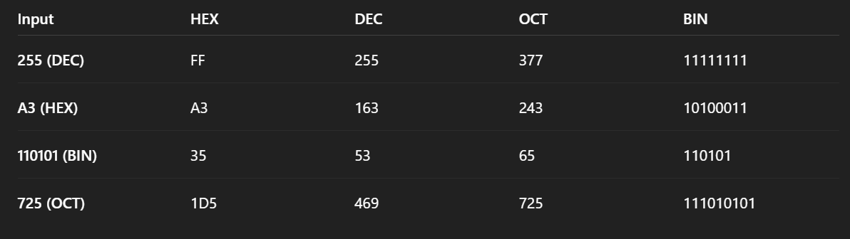
🧐 Activity Solution
📋 Solution:

Slide 17
🏁 Conclusion
✅ The Programmer’s Calculator is an essential tool for anyone learning Binary, Octal, Decimal, and Hexadecimal systems.
✅ It allows instant cross-conversion with zero risk of manual errors.
✅ It helps visualize bit sizes, overflow, and representation — key concepts for programmers.
By practicing with this tool, you’ll quickly become fluent in reading and converting between numbering systems used in computer architecture and coding. 💻⚡

Slide 18
Thank you ☺

