Slide 1

Programming Foundations
Level 1

Slide 2

Programming Foundations
Level 1
Introduction to Computer Networks
Part 1
2

Slide 3
Programming Foundations
Level 1
What is Networks?
2

Slide 4
Networks Part I — Basics, Types, and How Devices Communicate
A network is simply a group of connected computers and devices that can communicate and share resources. From your home Wi-Fi to the global internet, networks enable messaging, streaming, printing, remote control, and more.
In this lesson you’ll learn why we need networks, the difference between LAN and WAN, and how devices communicate via Ethernet, Wireless, Protocols, and Wi-Fi.

Slide 5
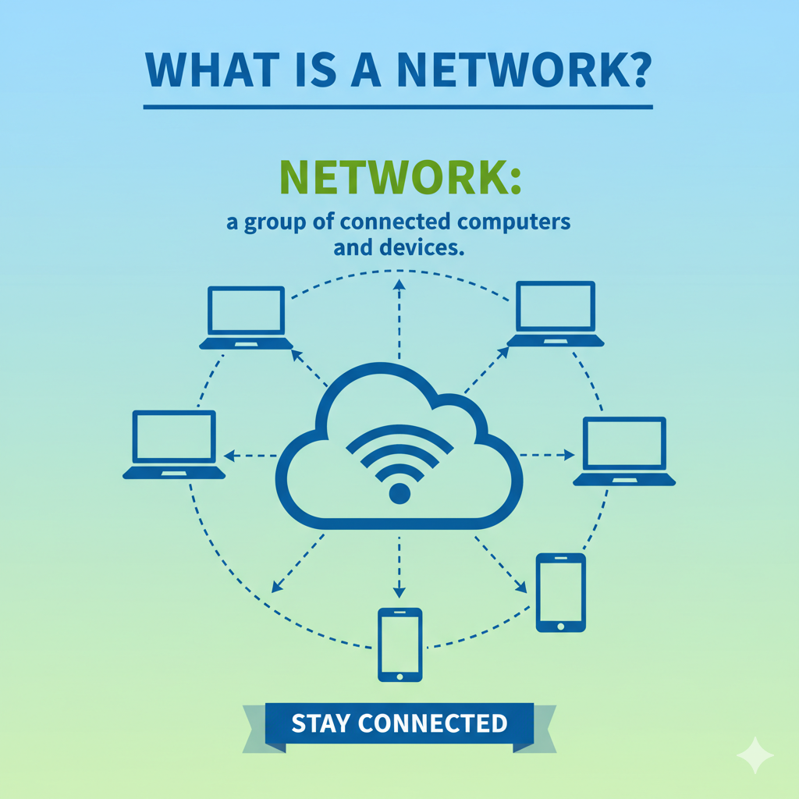

Slide 6
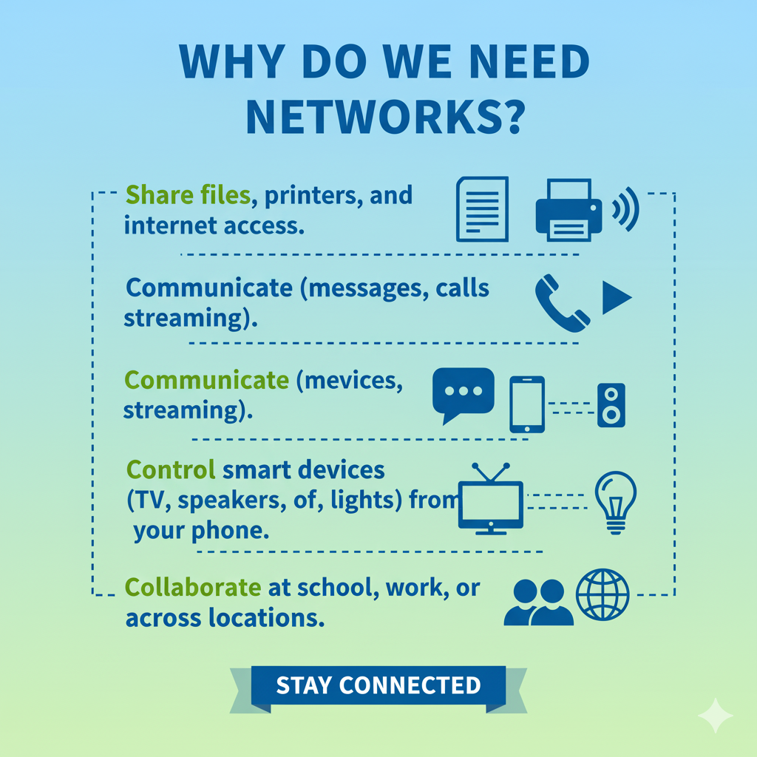

Slide 7
What is Network?
Network: is a group of connected computer and devices.
For example, the computers, phones, and other devices that your family owns are all part of your home computer network.
When you get a new tablet and enter in the Wi-Fi password, you’re joining that tablet to your home computer network.
Why do we need Network?
Devices in the same network can easily communicate and share resources with each other.
For example : you can control your TV with your mobile, or you can stream videos from your mobile to your TV.

Slide 8
Computer Foundations
Level 2
Network Types
2

Slide 9
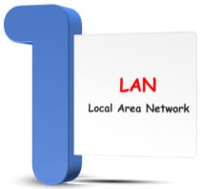

Network Types

Slide 10
Computer Foundations
Level 2
1- LAN
2

Slide 11
What is LAN?
LAN: Local Area Network that has a group of connected devices.
LAN is a type of network made up of nearby computers.
A LAN can have anywhere from a few devices (like a home network) to hundreds of devices (like a school or hospital)
Large organizations like colleges can have multiple LANs - maybe one per building.
A nearby group of connected devices (home, classroom, office, hospital).
Can range from a few devices (home) to hundreds (campus building).
Big organizations can have multiple LANs (e.g., one per building).

Slide 12
Computer Foundations
Level 2
Communicating on LAN
2

Slide 13
🔹 How Do Computers Communicate on a LAN?
Communication happens over wired or wireless connections, following agreed rules called protocols:
🟨 Ethernet (wired): rules for sending data through cables (e.g., via a switch or router).
🟨 Wireless: rules for sending data through radio signals; common form is Wi-Fi.
🟨 Protocol: a standard set of rules defining how devices format, send, and receive data so everything understands each other. the language/rules devices follow to communicate.
🟨 Wi-Fi (Wireless Fidelity): a popular wireless method to connect to a network. radio-based LAN rules.
🟨 Router: connects your LAN to the outside (internet/other networks).
🟨 Switch: interconnects devices inside the LAN.
In practice, a router connects your LAN to other networks (and the internet), while a switch efficiently interconnects devices inside your LAN.

Slide 14
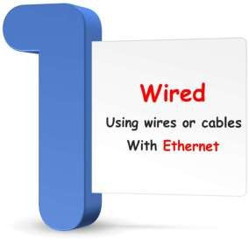

Connection Types

Slide 15
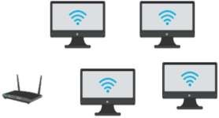
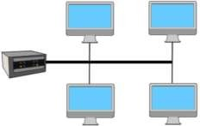
Communication Ways
Switch
Router
Ethernet
that computers follow
Wireless
Rules
that computers follow
Rules
for communicating through a radio signals
for communicating on a wired network
Those Rules are called:
Protocol
Wi-Fi is a popular way to connect wirelessly to a network.
Wi-Fi: Wireless Fidelity
Protocol: is a standard set of rules for how devices communicate through wires or wireless

Slide 16
Computer Foundations
Level 2
2 -WAN
2

Slide 17
What is WAN?
WAN: Wide Area Network.
WAN is made of connected LANs that are far from each other (like in different parts of the country or world).
WANs connect thousands or even millions of devices.
Many LANs connected across cities, countries, or the world.
WANs can connect thousands or millions of devices.
The internet is the biggest WAN.

Slide 18

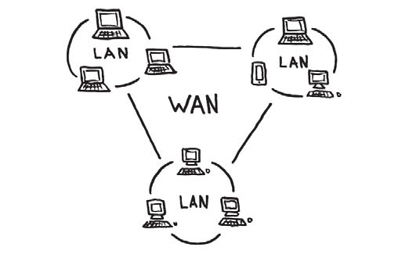

Slide 19
🔗 Interconnection
🔹 Network = connected devices that communicate and share resources.
🔹 LAN (local) vs WAN (wide) → scope & distance differ; WANs interconnect many LANs.
🔹 Ethernet (wired) and Wi-Fi (wireless) use protocols (rules) so devices understand each other.
By understanding these links, learners can map home and school setups to the larger internet and reason about how data flows end-to-end. 🚀

Slide 20
🧐 Activity
📋 Instructions:
1️⃣ What is a Network?
2️⃣ Why do we need a Network?
3️⃣ What is the difference between LAN and WAN?
4️⃣ How do computers communicate together on a network?
5️⃣ What is Ethernet?
6️⃣ What is Wireless?
7️⃣ What is a Protocol?
8️⃣ What is Wi-Fi?
9️⃣ Wi-Fi stands for what?

Slide 21
🧐 Activity Solution
📋 Solution:
1️⃣ Network:
A group of connected computers and devices that can communicate and share resources such as files, printers, or internet access.
2️⃣ Why we need a Network:
To share data, resources, and communicate efficiently between computers, phones, and other devices.
3️⃣ LAN vs WAN:
LAN (Local Area Network): covers a small area (home, office, school).
WAN (Wide Area Network): connects multiple LANs across cities or countries the Internet is the largest WAN.
4️⃣ How computers communicate:
They exchange data through wired (Ethernet) or wireless (Wi-Fi) connections using shared communication protocols.
5️⃣ Ethernet:
A wired networking standard that defines how computers send and receive data using cables.
6️⃣ Wireless:
A network connection without cables, using radio waves to send and receive data.

Slide 22
7️⃣ Protocol:
A set of rules that defines how computers communicate — it ensures all devices understand each other when exchanging data.
8️⃣ Wi-Fi:
A wireless networking technology that allows devices to connect to a network and the internet without cables.
9️⃣ Wi-Fi stands for:
Wireless Fidelity.

Slide 23
🏁 Conclusion
✅ A network connects devices so they can communicate and share resources.
✅ LAN covers local spaces; WAN connects many LANs across long distances.
✅ Devices communicate via Ethernet (wired) or Wireless (Wi-Fi) under agreed protocols.
✅ Knowing these basics lets you understand home setups, campus networks, and the broader internet.

Slide 24
Thank you ☺

