Slide 1

Programming Foundations
Level 1

Slide 2

Programming Foundations
Level 1
Programming Languages
Part 1
2

Slide 3
Programming Foundations
Level 1
Programming Languages and Levels
2

Slide 4
Programming Languages & Levels: From Machine Code to High-Level
A programming language is a tool we use to write instructions (code) so the computer performs a task.
Those instructions can exist at different levels of abstraction — from raw binary (machine language) up to human-readable high-level languages — and we need translator software (compilers/interpreters) to bridge from what we write to what the CPU actually runs.

Slide 5
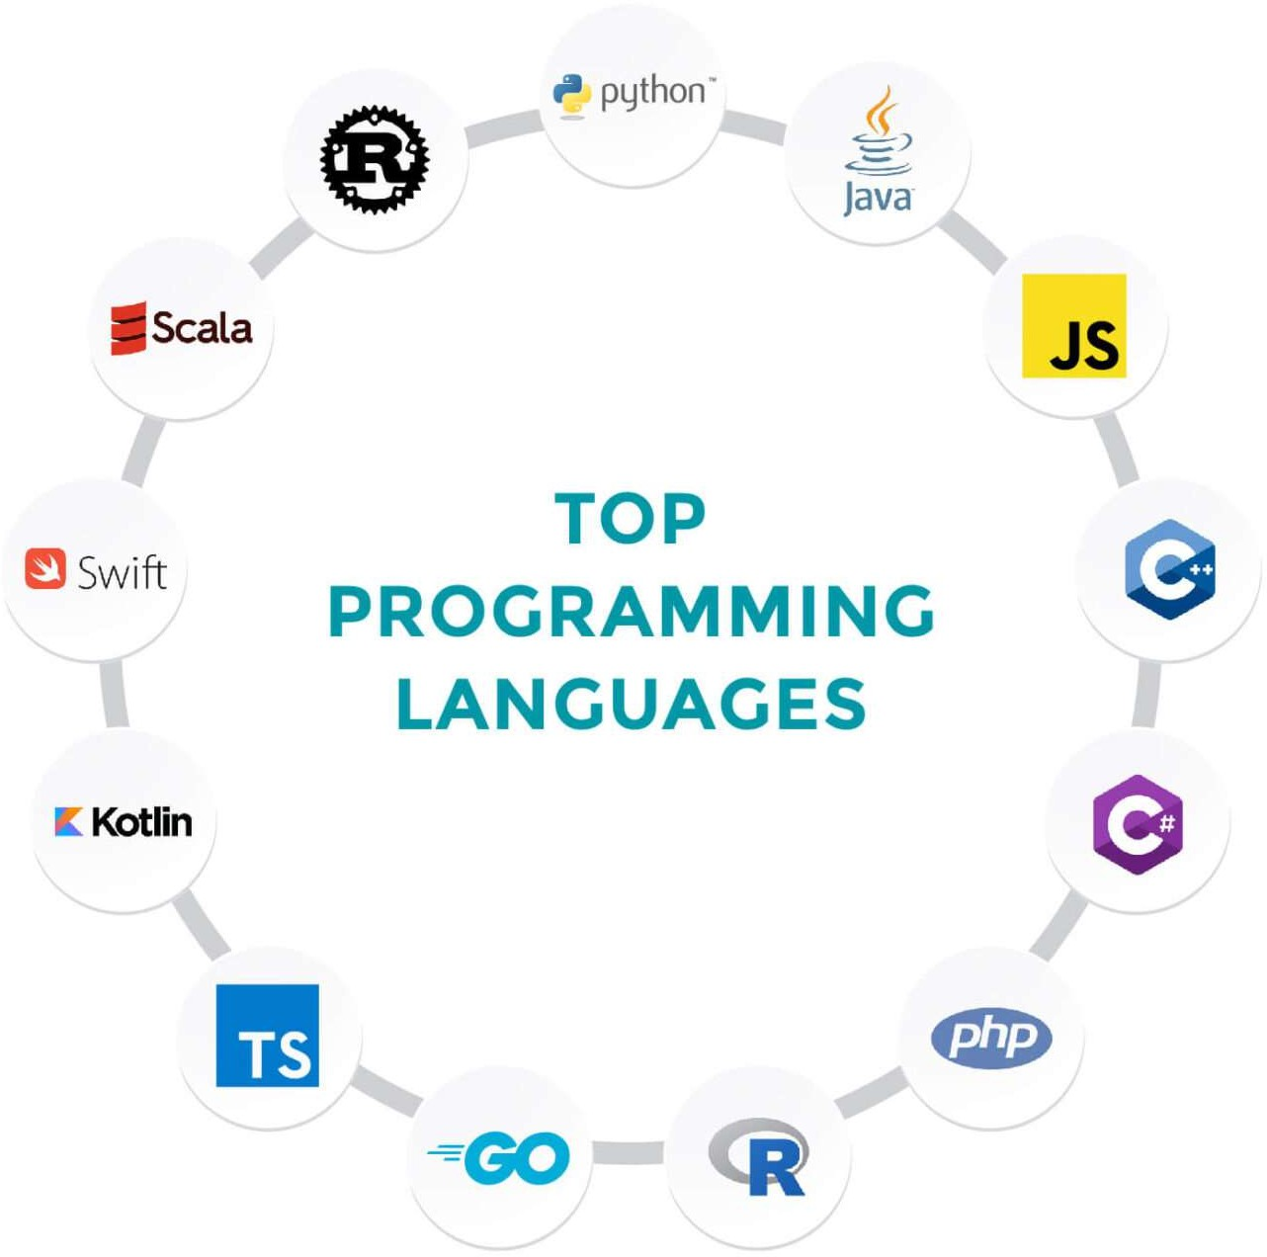
We have hundreds of Programming languages

Slide 6
Programming Foundations
Level 1
What is Programming Language?
2

Slide 7
Programming Language Is only a TOOL to help you write instructions to computer to perform certain operation/Task.
Instructions are called code
A tool to express instructions that a computer will execute.
The instructions we write are called code.

Slide 8

Write a program to print
Machine Language (Binary/Hex): direct CPU instructions, e.g., a stream of 0/1 representing “Hello, World!” — the computer can run this directly, but it’s unreadable for humans.
Hello, World!

Slide 9
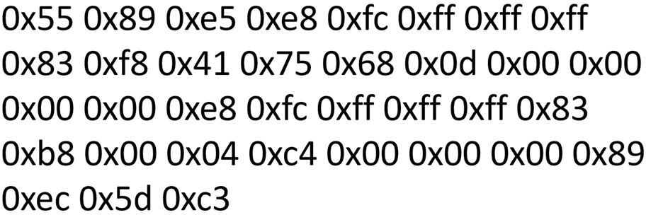
Machine Language:
Computer programming language consisting of binary or hexadecimal instructions which a computer can respond to directly.
Assembly Language: symbolic mnemonics (e.g., MOV, CALL) that map almost 1-to-1 to machine instructions; easier than binary, but still hardware-specific.
Hello, World!
Binary
Machine Language:
01001000 01100101 01101100
01101100 01101111 00101100
00100000 01010111 01101111
01110010 01101100 01100100
00100001

Slide 10
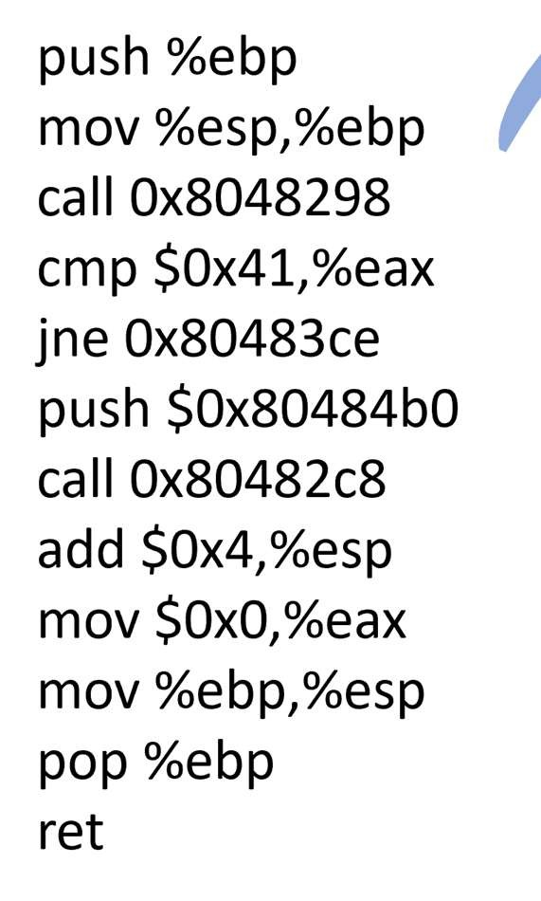
Assembly Language:
Hello, World!

Slide 11
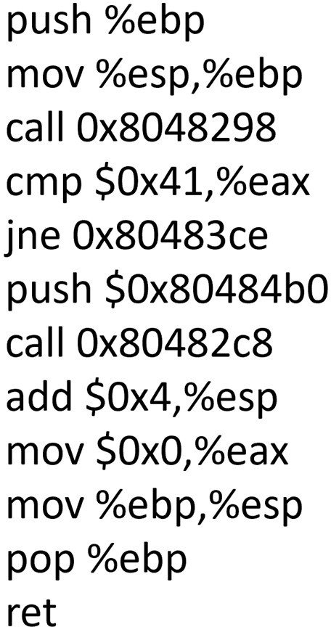

Machine Code vs Assembly Language:
High-Level Languages: human-readable, portable syntax (e.g., PRINT "Hello, World!" in BASIC, or Console.WriteLine("Hello, World!");).
Machine Language
Assembly Language

Slide 12

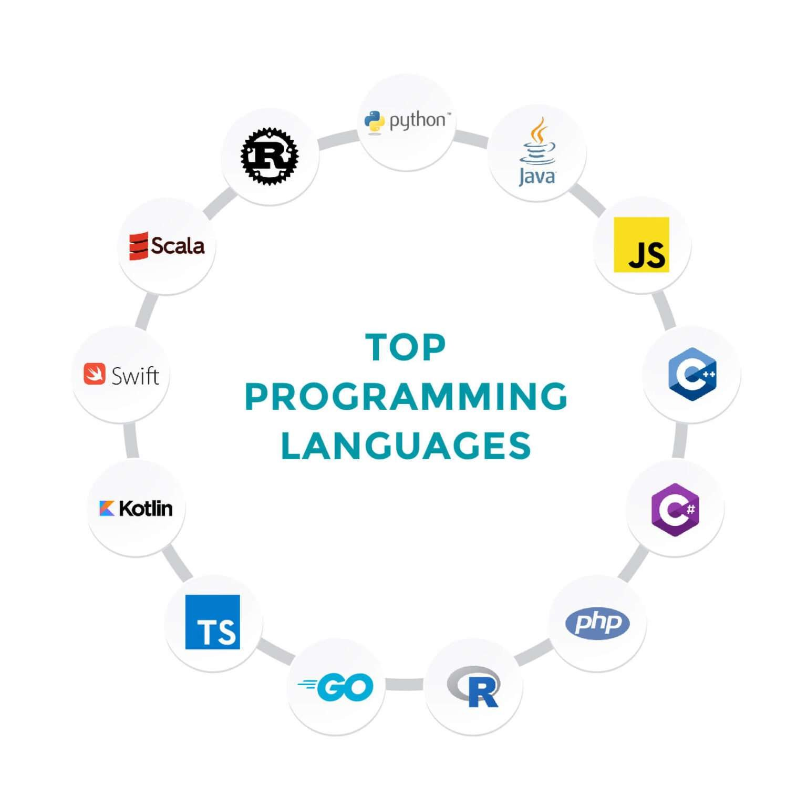
High level Languages
The following contrast all three for “Hello, World!” and show Machine vs Assembly vs High level Languages, highlighting the jump in readability.
Hello, World!
“Basic” Language
PRINT "Hello, World!"

Slide 13
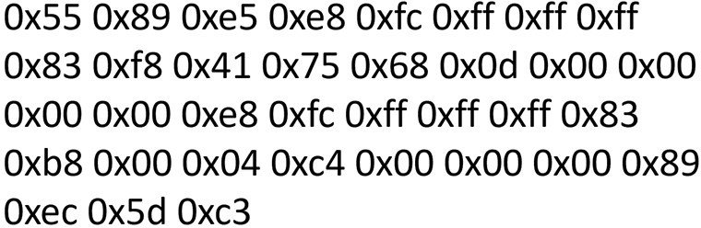
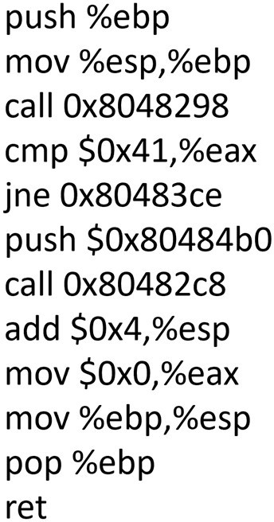
Machine vs Assembly vs Basic:
Low Level Languages
High Level Language
Machine Code
Assembly Language
“Basic” Language
PRINT "Hello, World!"

Slide 14
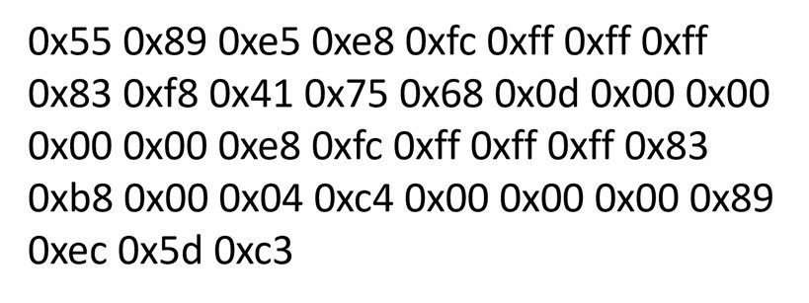
Machine vs Assembly vs Basic:
You need a Translator!
Machine Language
Translator Software
High-level Language
PRINT "Hello, World!"
Interpreter
Code or Source Code
Or
Compiler
Object Code

Slide 15
Machine vs Assembly vs Basic:
Translator Software: either a Compiler or an Interpreter (the slides show both paths).
  Compiler: translates the whole program to object/machine code before execution.
  Interpreter: reads and executes line by line at runtime.
Source Code: what you write in a high-level or assembly language.
Object Code: the translated/compiled low-level form (machine code) that the computer can execute.

Slide 16
Programming Foundations
Level 1
Levels of Programming Languages
2

Slide 17




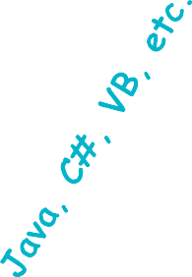

























Machine vs Assembly vs Basic:
Low Level (close to hardware):
  Binary/Assembly → High speed, Low readability.
High Level (farther from hardware):
  BASIC/C/Java/C#… → High readability, Lower raw speed (more abstraction/overhead).
High
High
Low
Hardware
Level
Readability
Speed
Bina
0’s
ry code
and 1’s
Low
Low
High
Hardware

Slide 18
Machine vs Assembly vs Basic:
Key idea: Closer to hardware → faster but harder to read.
Farther → easier to read/write/maintain but potentially slower. Real-world speed also depends on compiler quality, runtime, JIT, optimization flags, and the problem itself.
High
High
Low
Hardware
Level
Readability
Speed
Bina
0’s
ry code
and 1’s
Low
Low
High
Hardware

Slide 19
When is a Language “Fast” or “Slow”?
🔹 Fast (typically):
  Closer to machine code (assembly/C in many cases).
  Compiled ahead-of-time with strong optimizations; minimal runtime overhead.
🔹 Slow (relatively):
  Heavier runtime interpretation/JIT, frequent dynamic checks, or layers of abstraction.
🔹 But: highly optimized compilers/JITs can make some high-level languages very fast for many workloads. Choose based on use case + ecosystem.

Slide 20
🔗 Interconnection
🔹 Machine → Assembly → High-Level forms a spectrum: speed ↑ as we go down to hardware, readability ↑ as we go up.
🔹 Source Code is what we write; Object Code is what runs. A compiler/interpreter connects them.
🔹 “Hello, World!” example across levels shows why translators are essential and how abstraction helps humans.
By understanding these links, learners can pick the right language level and toolchain for performance, portability, and productivity. 🚀

Slide 21
🧐 Activity
📋 Instructions:
Write your answers clearly and concisely in your own words.
1️⃣ What is a Programming Language?
2️⃣ What is Code?
3️⃣ What is Source Code?
4️⃣ What is Object Code?
5️⃣ Why do we need Compilers or Interpreters?
6️⃣ When is a language considered Fast?
7️⃣ When is a language considered Slow?
8️⃣ What is a High-Level Language?
9️⃣ What is a Low-Level Language?
🔟 When do we consider a language human-readable?

Slide 22
🧐 Activity Solution
📋 Solution:
1️⃣ Programming Language:
A tool used by programmers to write instructions that tell a computer what to do.
2️⃣ Code:
The set of written instructions or commands created using a programming language.
3️⃣ Source Code:
The human-readable form of a program that the programmer writes before it’s translated.
4️⃣ Object Code:
The machine-readable form produced after the source code is translated (compiled).
5️⃣ Why Compilers or Interpreters:
Because computers only understand machine code (0s and 1s), we need translators to convert human-readable code into a format the CPU can execute.
6️⃣ When Fast:
A language is considered fast when it runs close to the hardware (low-level) or when its compiler produces highly optimized machine code.

Slide 23
7️⃣ When Slow:
A language is slow when it has more abstraction, is interpreted line by line, or depends on extra runtime layers that add overhead.
8️⃣ High-Level Language:
A programming language that is easy to read and write, close to human language, and hides most hardware details (e.g., Python, C#, Java).
9️⃣ Low-Level Language:
A programming language that is close to machine code, gives full control over hardware, but is harder to read (e.g., Assembly, Machine Language).
🔟 Human-Readable Language:
A language is human-readable when its syntax uses words, symbols, and structure that are easy for people to understand — not binary or numeric codes.

Slide 24
🏁 Conclusion
✅ A programming language is a tool; the instructions we write are code.
✅ Source code must be translated into object/machine code via a compiler or interpreter to run.
✅ There’s a continuum from machine → assembly → high-level where we trade raw speed for human readability and productivity.
✅ Your choice of level depends on performance needs, portability, team skills, and tooling.

Slide 25
Thank you ☺

