Slide 1

Programming Foundations
Level 1

Slide 2

Programming Foundations
Level 1
Compiler vs Interpreter
(and Friends Assembler, Linker, Loader)
2

Slide 3
Programming Foundations
Level 1
Programming Languages and Levels
2

Slide 4
Compiler vs Interpreter (and Friends: Assembler, Linker, Loader)
Computers only execute machine language (binary).
What we write is source code in human-friendly languages.
We therefore need translator software to bridge the gap: compilers (ahead-of-time), interpreters (line-by-line), and assemblers (assembly → machine).
We’ll also see where linkers, libraries, .exe files, and loaders fit in the journey from source to running program.

Slide 5

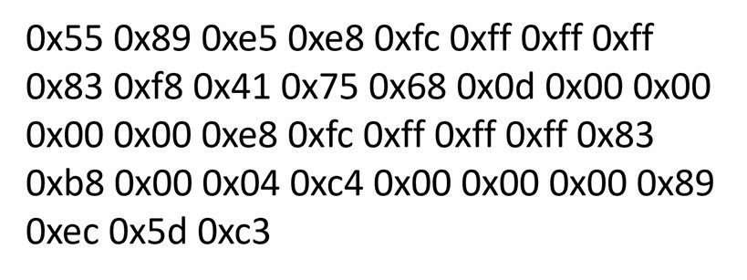
You need a Translator!
We write high-level code (e.g., PRINT "Name : Sara").
CPU runs machine language.
A translator converts source code → object/machine code so the computer can execute it.
Name : Sara
Age : 44
Machine Language
Translator Software
High-level Language
PRINT “Name : Sara
” PRINT “Age : 44”
Interpreter
Code or Source Code
Or
Compiler
Object Code

Slide 6
Programming Foundations
Level 1
Compiler
2

Slide 7



Compiler:
Name : Sara
Age : 44
Linker
Object Code
Build
Libraries
Source Code
Compiler
Object Code
.exe
Input
Output
File
Loader
Saved on HDD
Saved on HDD
PRINT “Name : Mohammed” PRINT “Age : 44”

Slide 8
Compiler:
Input: Source code 👉 Compiler 👉 Object code + Libraries 👉 Linker 👉 .exe file (saved on disk) 👉 Loader loads it into memory 👉 Program runs and prints output (e.g., Name : Mohammed, Age : 44).
Compiler (build time): translates the entire program and reports build errors if found. If errors exist → stop; otherwise produce object code.
Linker: combines object code with libraries to create an executable (.exe), stored on HDD/SSD.
Loader (run time): loads the .exe into memory and starts execution.
machine code is stored on disk, .exe generated, and execution is fast.

Slide 9
Programming Foundations
Level 1
How Compiler Works?
2

Slide 10



Compiler:
Scan entire program.
If build errors? → display error message and stop.
If no errors → continue to produce object code and link.
Object Code
Scan Entire Program
Build
Source Code
Input
Output
Compiler
Errors
?
No
Yes
Display Error Message
Stop
PRINT “Name : Mohammed” PRINT “Age : 44”

Slide 11
Programming Foundations
Level 1
How Interpreter Works?
2

Slide 12
Interpreter:
Reads one instruction at a time, translates it to machine code on the fly, then executes immediately.
If an error occurs → display error message and stop at that line.
No .exe is produced; no machine code is saved on disk.
Execution is generally slower.
Machine Code To Execute
Build Run
Read One Instruction at a time
Source Code
Output
Interpreter
Errors
?
No
Input
Yes
Display Error Message
Stop
PRINT “Name : Mohammed” PRINT “Age : 44”

Slide 13
Programming Foundations
Level 1
Which is Faster?
Compiled or Interpreted Languages?
2

Slide 14
Compiled Languages are much faster than interpreted Languages.

Slide 15
Programming Foundations
Level 1
Compiler
vs
Interpreter
2

Slide 16









Compiled
VS
Interpreted
Reads the Entier Code at once
Reads one instrcution at a time
Execute the process is much faster
Execute the process is much slower
Machine Code is stored in HDD
Generates exe file
Diffrences
Does not store any machine code on HDD
No exe file generated
C, C++
Ruby, Python, Javascript.

Slide 17
Programming Foundations
Level 1
What is Assembler?
2

Slide 18
Assembler is the program that translate the assembly code to Machine code.

Slide 19
🔗 Interconnection
🔹 High-level source needs a translator to become machine code.
🔹 Compiler path: Source → Object → (Linker + Libraries) → .exe → Loader → Run. Fast, reusable binary.
🔹 Interpreter path: Line-by-line translate & run. No .exe, typically slower.
By mastering these flows, learners can choose the right toolchain and predict build/run behavior with confidence. 🚀

Slide 20
🧐 Activity
📋 Instructions:
Answer the following questions based on what you learned about Compilers, Interpreters, and Assemblers.
Write your answers clearly and concisely.
1️⃣ What is a Compiler, and how does it work?
2️⃣ What is an Interpreter, and how does it work?
3️⃣ What is an Assembler?
4️⃣ What is a Linker?
5️⃣ What is an .exe file?
6️⃣ What is a Loader?
7️⃣ Which is faster — Compiled or Interpreted languages?
8️⃣ Does an Interpreter produce an .exe file?
9️⃣ Does an Interpreter save machine code?
🔟 Does a Compiler produce an .exe file?
1️⃣1️⃣ Does a Compiler save machine code?

Slide 21
🧐 Activity Solution
📋 Solution:
1️⃣ Compiler:
A program that translates the entire source code into object code (machine code) before execution.
It checks for errors during the build stage; if none exist, it produces an .exe file through linking.
2️⃣ Interpreter:
A program that reads and executes source code line-by-line.
If it finds an error, it stops immediately and shows an error message.
It does not create or save any .exe file.
3️⃣ Assembler:
A translator that converts assembly language instructions into machine language (binary).
4️⃣ Linker:
A tool that combines object code and required libraries to produce an executable (.exe) file.
5️⃣ .exe file:
A file containing machine code instructions ready to be loaded and executed by the CPU

Slide 22
6️⃣ Loader:
A system program that loads the executable (.exe) into main memory (RAM) so the CPU can run it.
7️⃣ Which is faster:
Compiled languages are faster because their code is translated to machine code in advance, not during execution.
8️⃣ Does Interpreter produce .exe?
❌ No, an interpreter does not generate or store an .exe file.
9️⃣ Does Interpreter save machine code?
❌ No, it executes directly in memory without saving machine code on disk.
🔟 Does Compiler produce .exe?
✅ Yes, after translation and linking, a compiler produces an .exe file stored on disk.
1️⃣1️⃣ Does Compiler save machine code?
✅ Yes, it saves machine code as part of the executable file for later use.

Slide 23
🏁 Conclusion
✅ Compilers translate whole programs, then linkers build executables that load and run natively—fast.
✅ Interpreters translate and run line-by-line—slower, with no .exe saved.
✅ Assemblers handle assembly → machine.
Understanding these roles clarifies build vs run steps and helps you choose the right language/toolchain for performance and productivity.

Slide 24
Thank you ☺

