Slide 1

Programming Foundations
Level 1

Slide 2

Programming Foundations
Level 1
Which programming
language is better?
2

Slide 3
Programming Foundations
Level 1
Why do we have many programming languages?
2

Slide 4
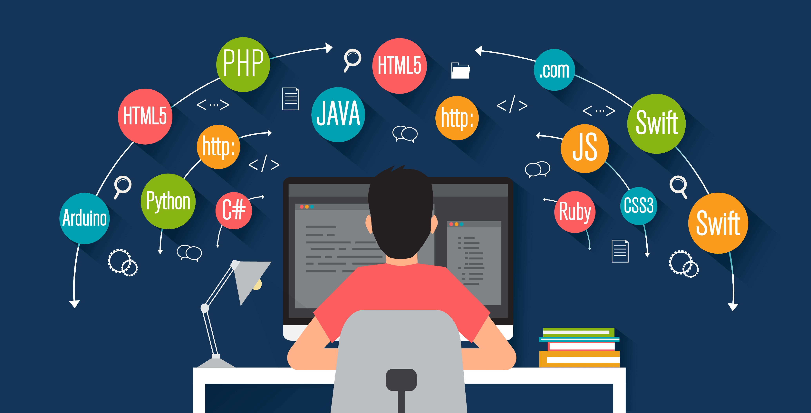

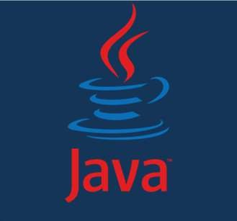
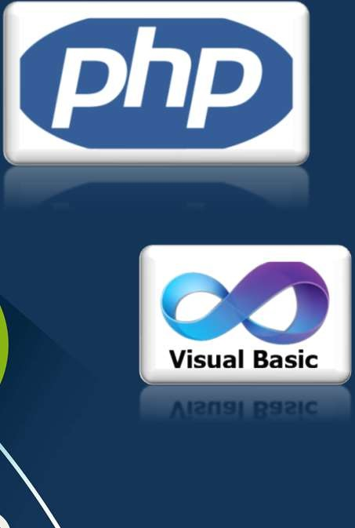
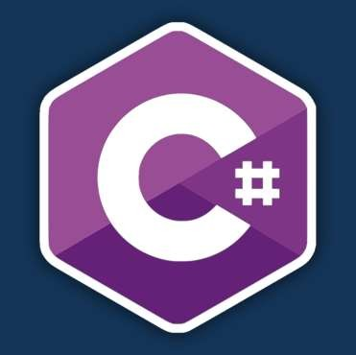
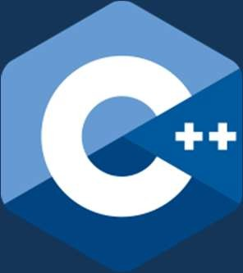


Slide 5
Programming Foundations
Level 1
Which Language is Better?
2

Slide 6



Which Programming Language Is Better? (The Right Question to Ask)
What is your best color?
This is incomplete question!!
Cars
Lights
Shirts

Slide 7
Which Programming Language Is Better? (The Right Question to Ask)
Asking “Which programming language is better?” is like asking “What’s the best color?” — it’s an incomplete question.
For example, I like black cars but dislike white ones, yet when it comes to clothing, I prefer white shirts and dislike black ones. So, can I really say that I hate the color white in general? Of course not!
The truth is, color alone means nothing without context — it depends on where and how it’s used. The same applies to programming languages: there’s no universally “best” language, only the best one for a specific purpose.

Slide 8



Driving Is Important
not the car itself!
Programming Is
Important
not the Language!

Slide 9
If you ask, “Which is the best car?”, that’s actually an incomplete question — best for what?
The answer will always depend on the purpose.
For example:
If you want the best car for fuel efficiency, I’ll say small compact cars.
If you ask for the best car for off-road driving, I’ll say 4x4 vehicles.
If you want to carry heavy loads, I’ll recommend a truck.
If your goal is speed, then it’s a Lamborghini.
You see? There’s no single best car — each one excels in a different context. You can’t simply claim that a 4x4 is the best overall, because while it’s great off-road, it’s poor in fuel consumption.

Slide 10
Which Language is Better?
This is incomplete question!!
It Depends on your need
You can use many programming languages at the same time.

Slide 11
The right answer is always “It depends on your needs.”
You should focus on mastering programming skills first, because the language is only a vehicle — not the destination.
A programming language is simply a tool, and the best tool depends on the job.
Sometimes Visual Basic is a far better choice than C++ for certain tasks, while in other situations C++ clearly outperforms Visual Basic.
“Best for what?” Web backend? Mobile app? Embedded device? Data science? Without context, “Which is better?” has no useful answer.
It’s not about which language is superior — it’s about choosing the right one for the right situation.
You can even use multiple languages on the same project.
Choose by domain & constraints (performance, team skills, libraries, hosting).
Many systems combine languages (e.g., C++ core + Python glue + JS/TS frontend).

Slide 12
Programming Foundations
Level 1
No Racism In Programming Languages
2

Slide 13
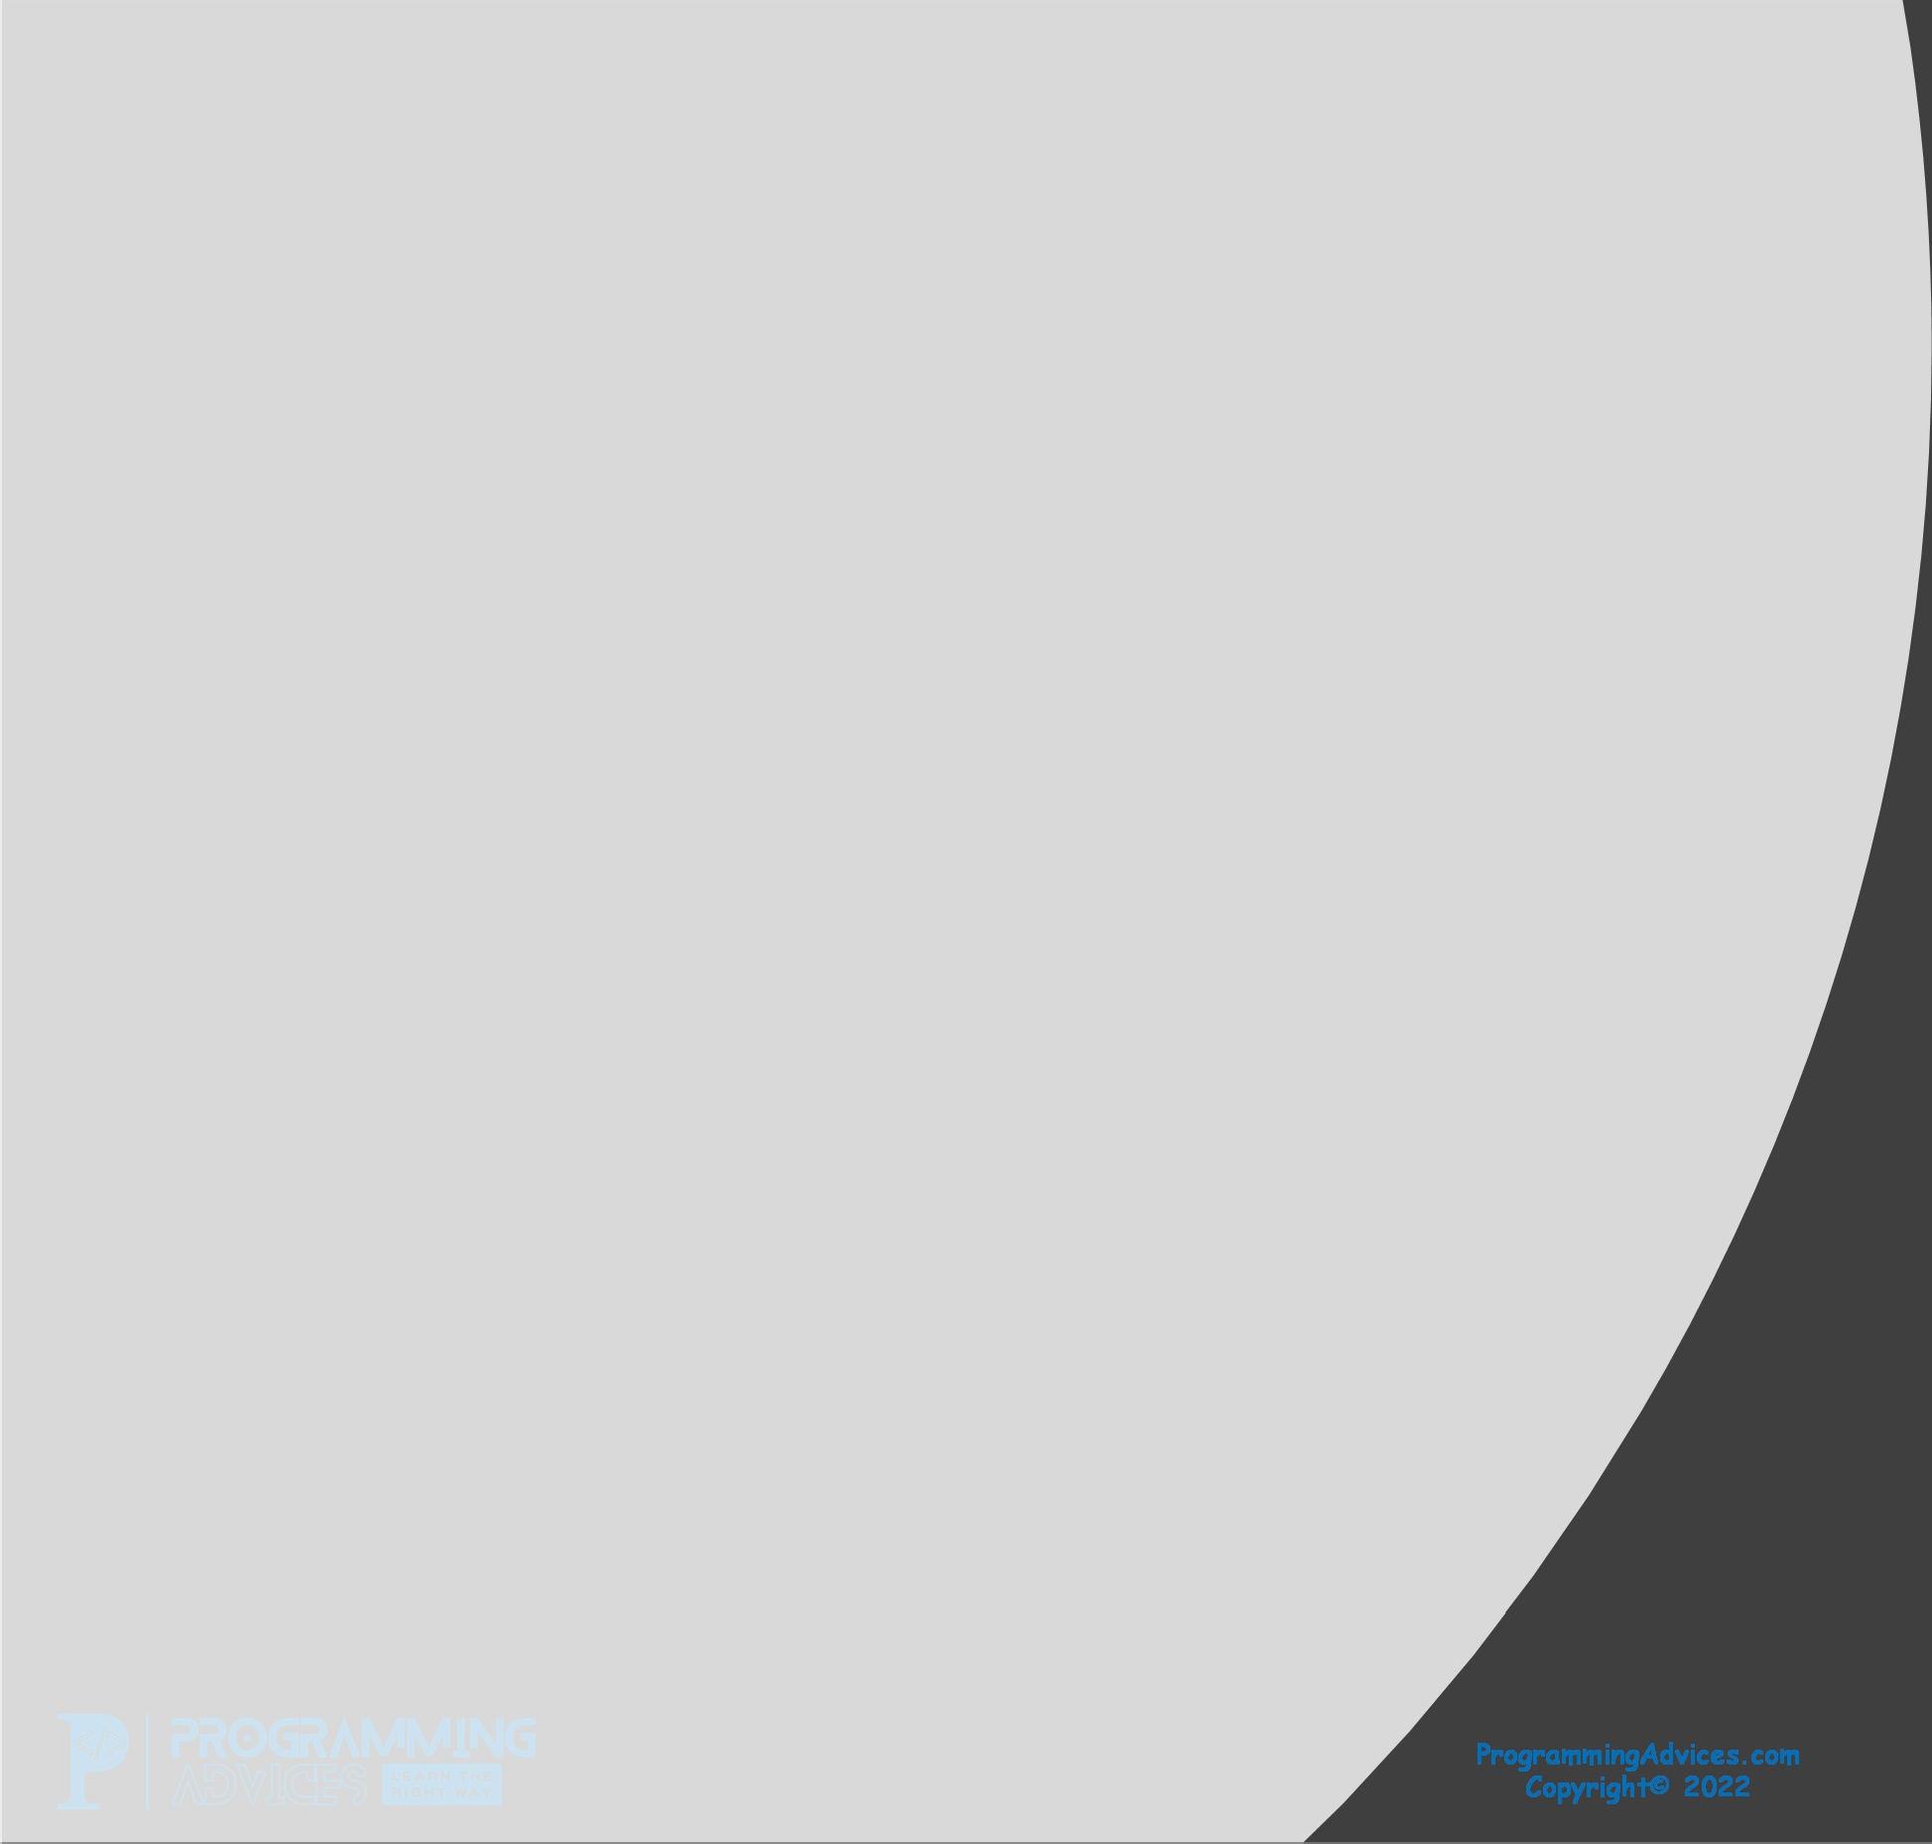


Slide 14
All programming languages are great — each one is simply a tool in your hands to help you achieve your goal.
Disliking or being biased against a language doesn’t make you a stronger developer; it shows limited understanding. A truly skilled programmer appreciates the value of every language and chooses the right one for the task.
So, instead of being “language-racist,” it’s time to grow as a professional — focus on solving problems, not defending preferences.
Avoid fanboy wars. Languages are tools, not identities. Be pragmatic and respectful; use what solves the problem well.

Slide 15
Programming Foundations
Level 1
Why Many Languages Exist?
2

Slide 16
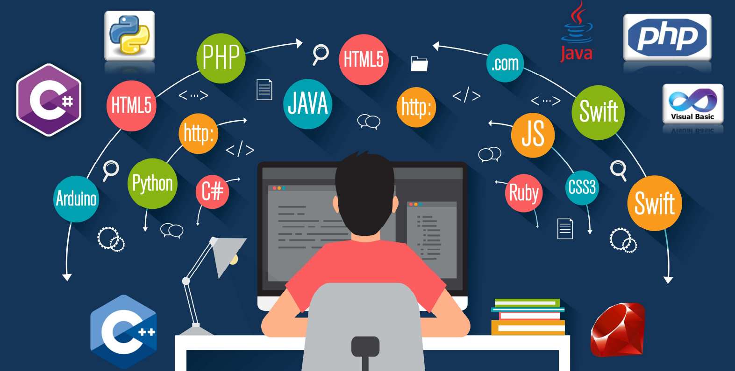
Different problems require different trade-offs — such as speed, safety, ecosystem, tooling, or domain suitability. There’s no universal language that fits every situation. Just as a craftsman uses the right tool for each task, a good programmer chooses the right language for the job.

Slide 17
Programming Foundations
Level 1
How long it takes to learn a
programming language?
2

Slide 18
Less than a month’s time
Learning a Programming Language Is 5% of Learn Programming
Syntax is the easy part you can learn it i a very short time. The 95% includes: Design, problem-solving, data structures, algorithms, architecture, testing, tooling, debugging, deployment, collaboration.

Slide 19
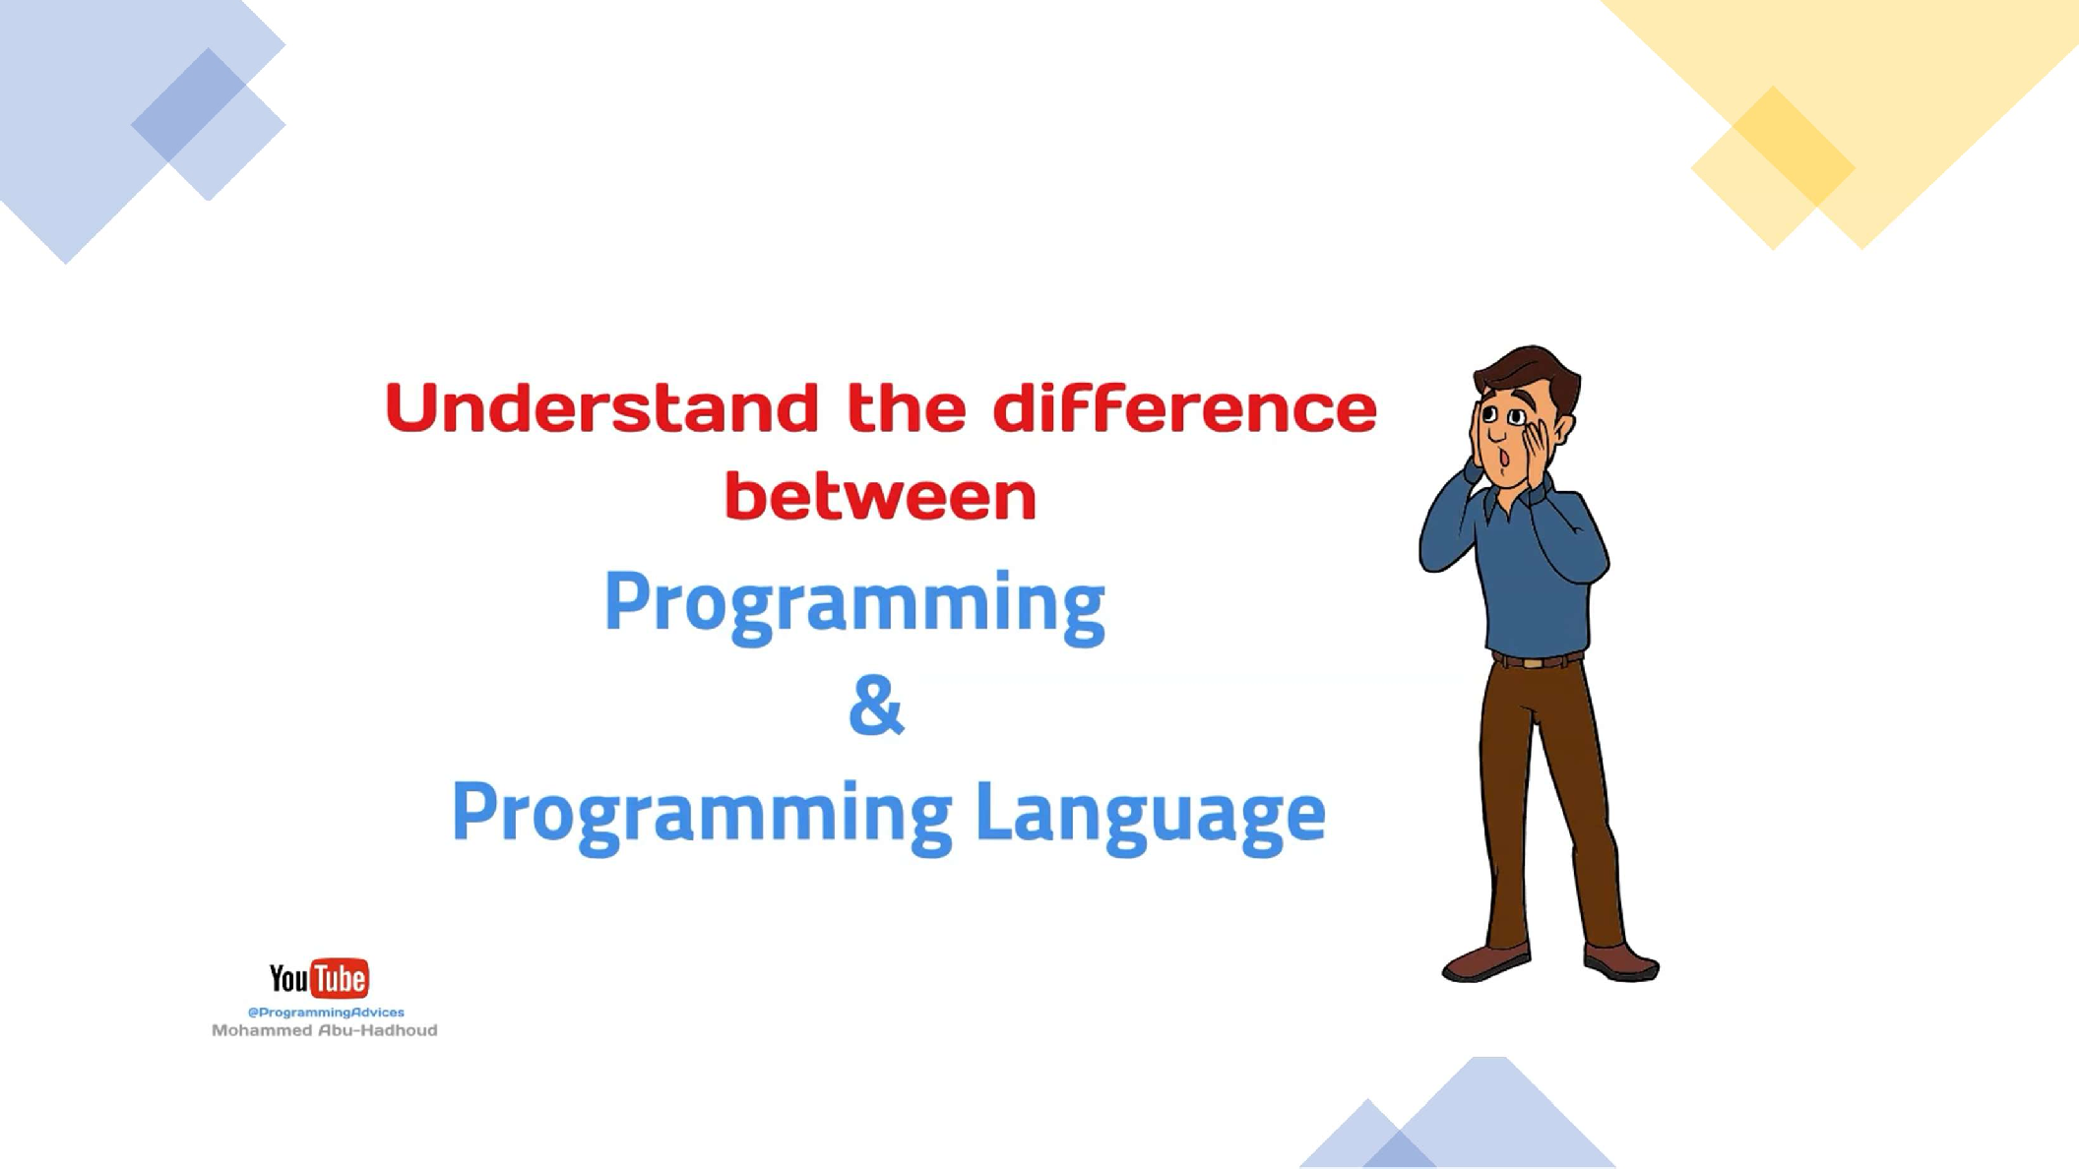

Slide 20
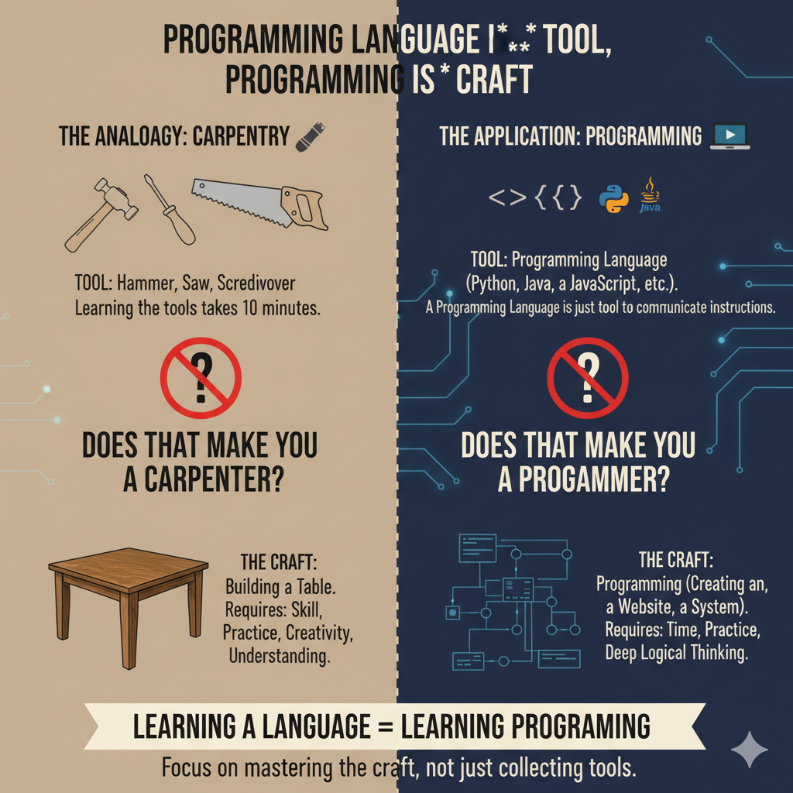
Learning programming is not the same as learning a programming language — there’s a big difference.

Slide 21
Imagine you want to become a carpenter.
You must learn how to use carpentry tools, but more importantly, you need to master the craft of carpentry itself.
Tools like the hammer, saw, and screwdriver can be learned in just ten minutes — but does that make you a carpenter?
Of course not, because tools alone don’t build a table.
Building a table requires skill, practice, creativity, and understanding — that’s the craft.
Similarly, in programming:
A programming language is just a tool, while programming itself is the craft. And mastering that craft takes time, practice, and deep logical thinking.
A programming language is just a tool — programming is the craft.
Knowing the tools doesn’t make you a carpenter; mastering the craft does.
You use tools to build, but you use skill to create.
Programming is not about writing code; it’s about shaping logic.

Slide 22
🔹 What Is Programming?
Programming is the art of designing logical solutions and expressing them precisely so that computers can execute them.
It’s not just about writing code — it’s about thinking clearly about requirements, logic, and trade-offs.
It’s your ability to break down large problems into smaller, manageable parts, solve each one efficiently, and then assemble them into a complete, working program that achieves the intended goal.
🔹 What Is a Programming Language?
A programming language is simply a tool — a way to communicate instructions to a computer.
It provides the syntax and structure that programmers use to express their ideas and solutions.
Just like a hammer or saw helps a carpenter build furniture, a programming language helps a programmer build software.
The true power lies not in the tool itself, but in how skillfully you use it.
Driving is important, not the car itself. Likewise, Programming is important, not the language. Strong fundamentals transfer across languages.

Slide 23
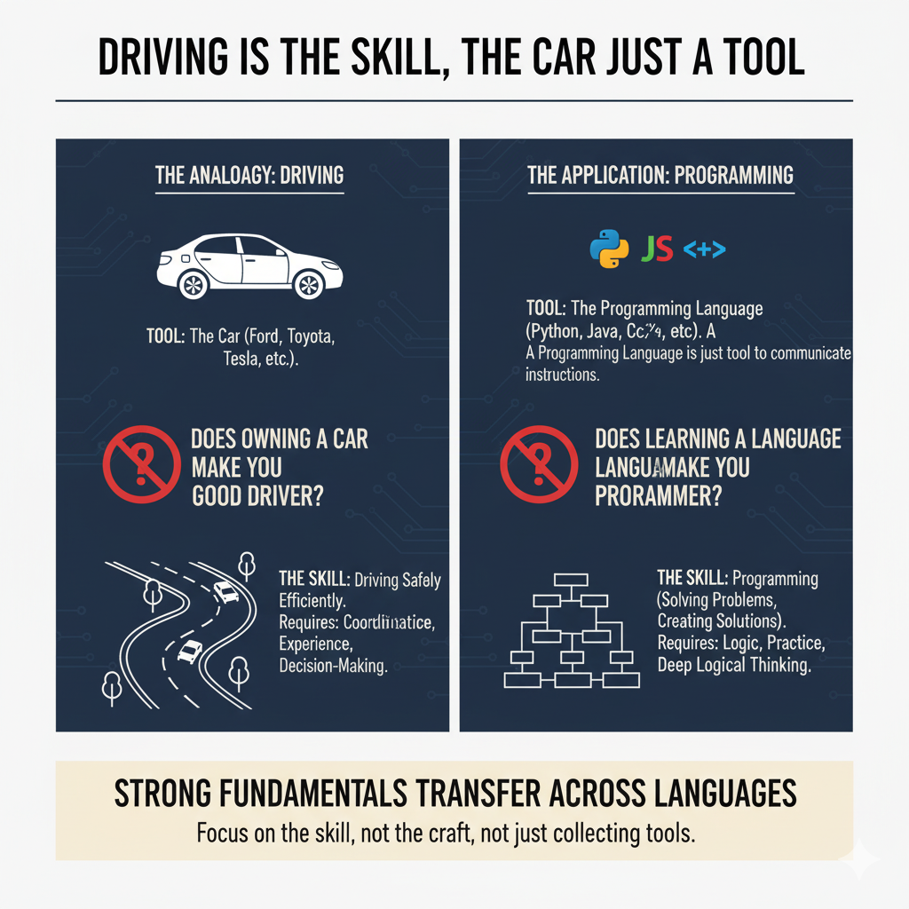

Slide 24
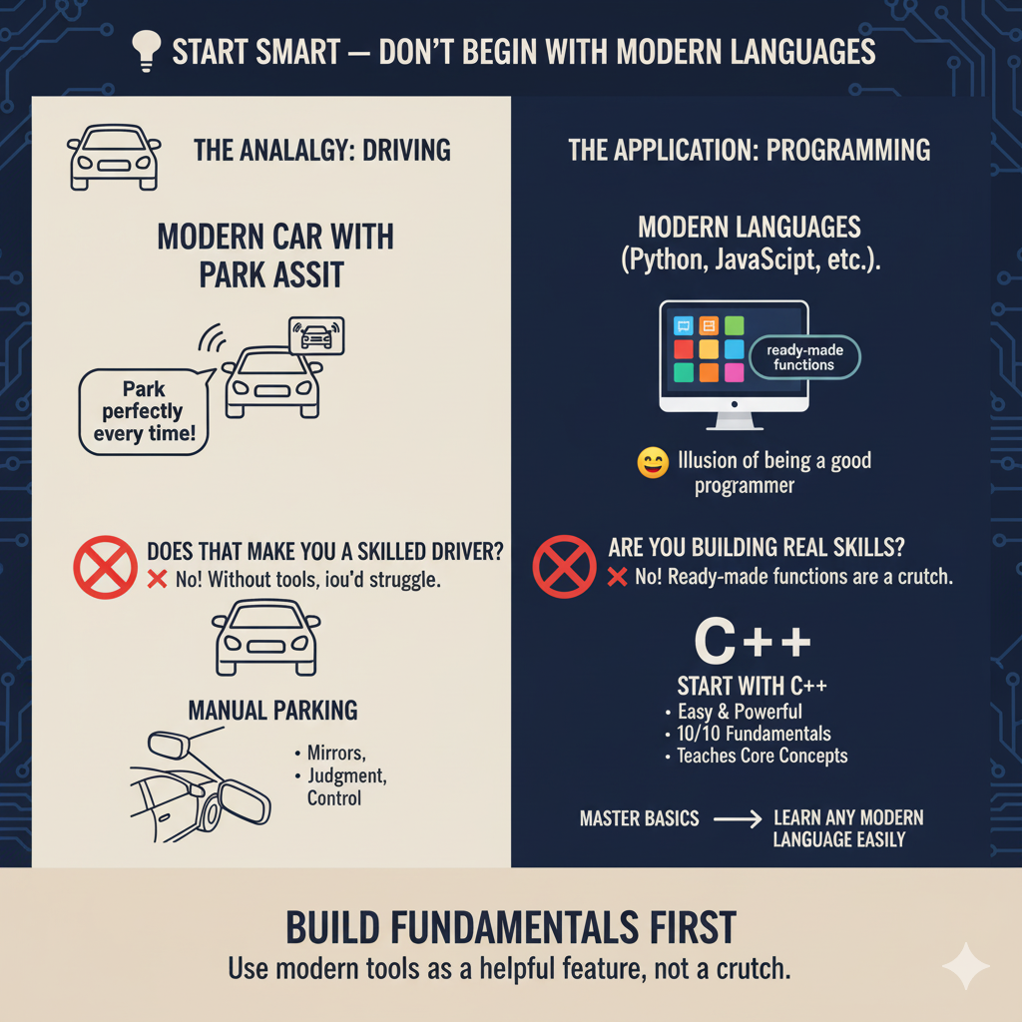

Slide 25
Never start learning with modern programming languages, because they are full of ready-made functions and tools that can give you the illusion that you’re a good programmer — when you’re actually not building the real skills yet.
Think of it like learning to drive:
The hardest part for beginners is reversing.
Now imagine I teach you using a modern car with park assist, cameras, and sensors. You’ll park perfectly every time — but does that make you a skilled driver?
❌ No! Because without those tools, you’d struggle.
To become a real driver, you must first learn manual parking — using mirrors, judgment, and control. Once you master that, you can use parking assistants as a helpful feature, not a crutch.
The same applies to programming.
Start with C++ — it’s actually an easy and powerful language that teaches you all the core programming concepts (10/10 fundamentals).
Once you master those basics, you can learn any modern language easily at any time. and this is not wasting your time because learning any other languages will not take time at all.

Slide 26
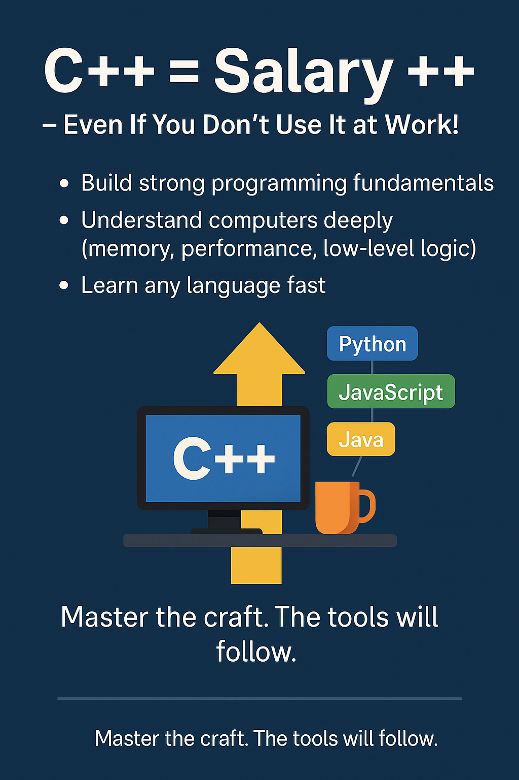

Slide 27
Learning C++ is one of the smartest investments you can make as a programmer.
Even if you don’t use it in your daily job, it will:
Build strong programming fundamentals.
Teach you how computers truly work — memory, logic, performance.
Give you the key to learn any other programming language quickly and easily.
Easy to learn by the way!.
C++ trains your mind to think like a real programmer, not just a code user — and that mindset will make you valuable in any programming field.

Slide 28
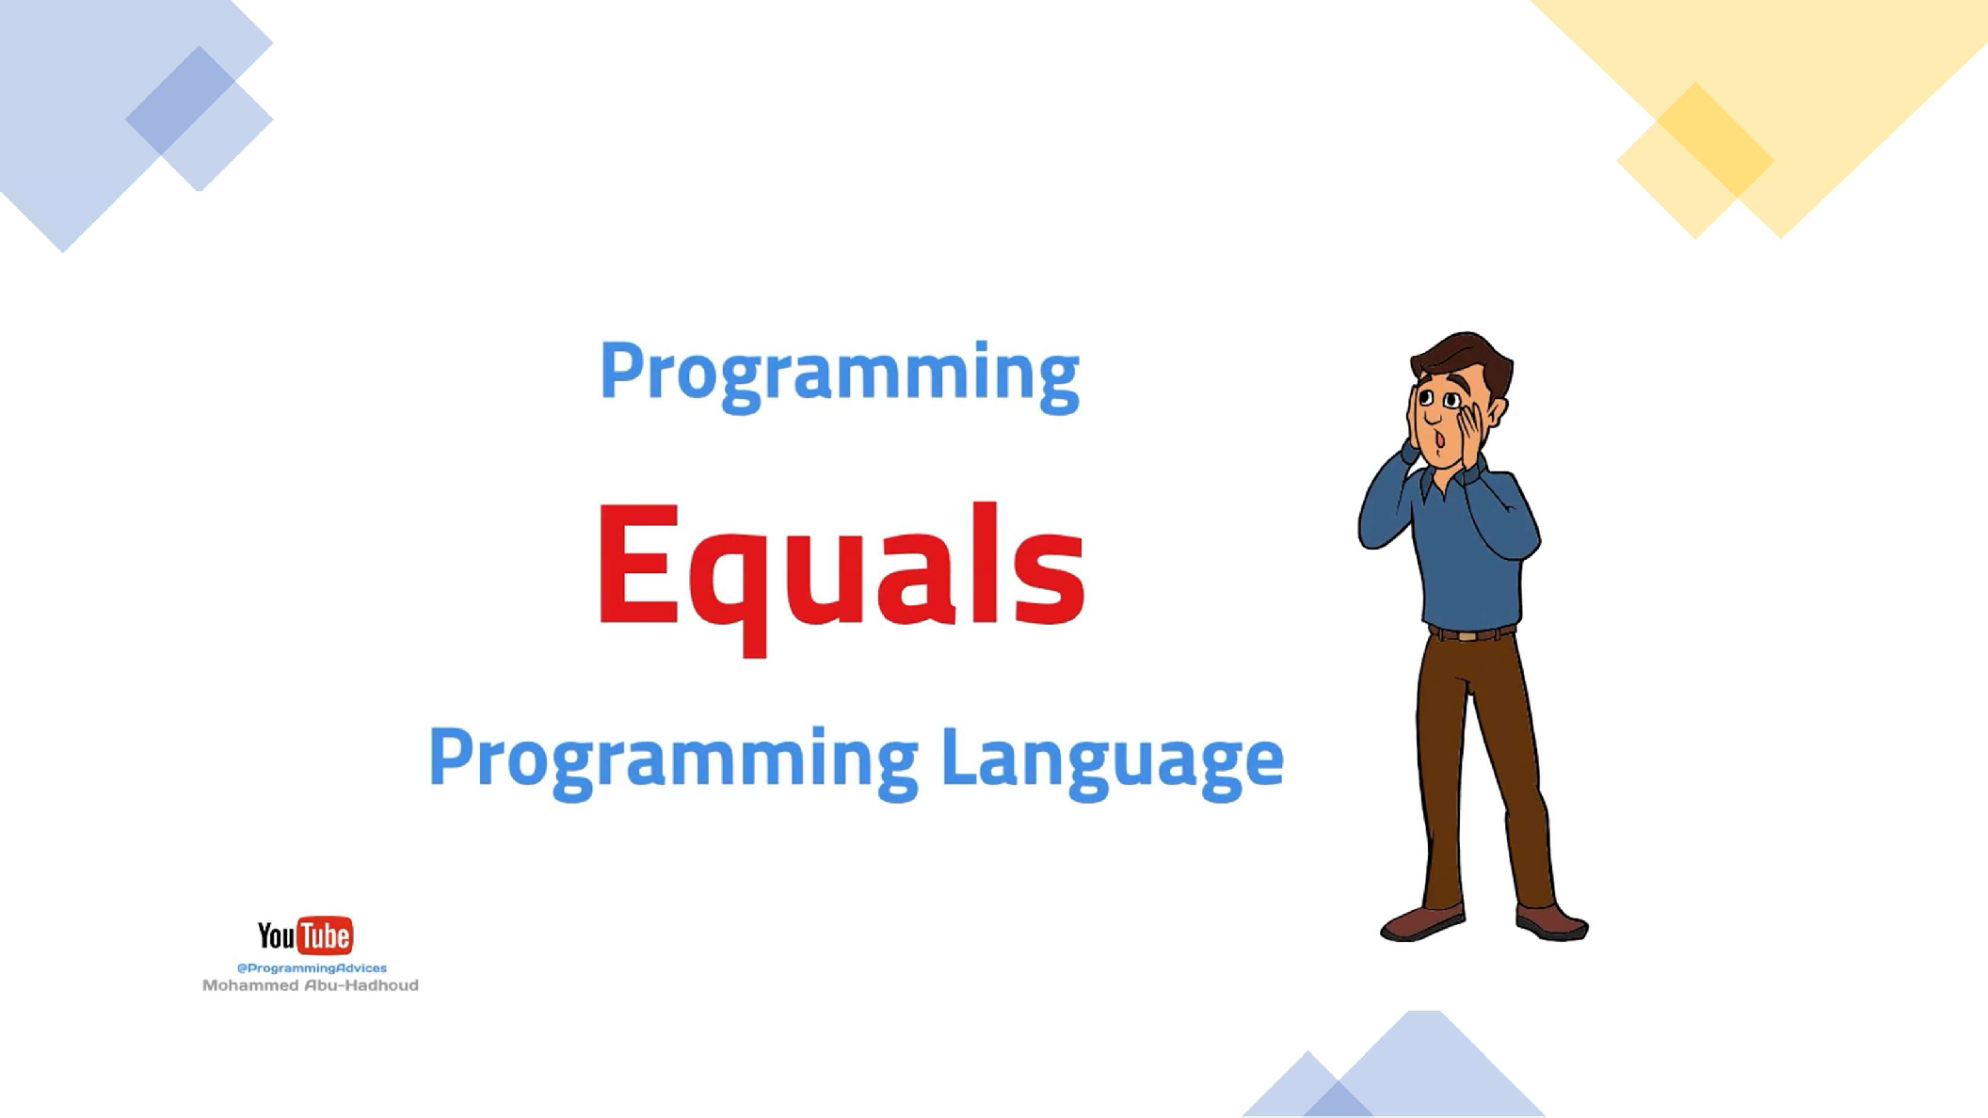

Slide 29
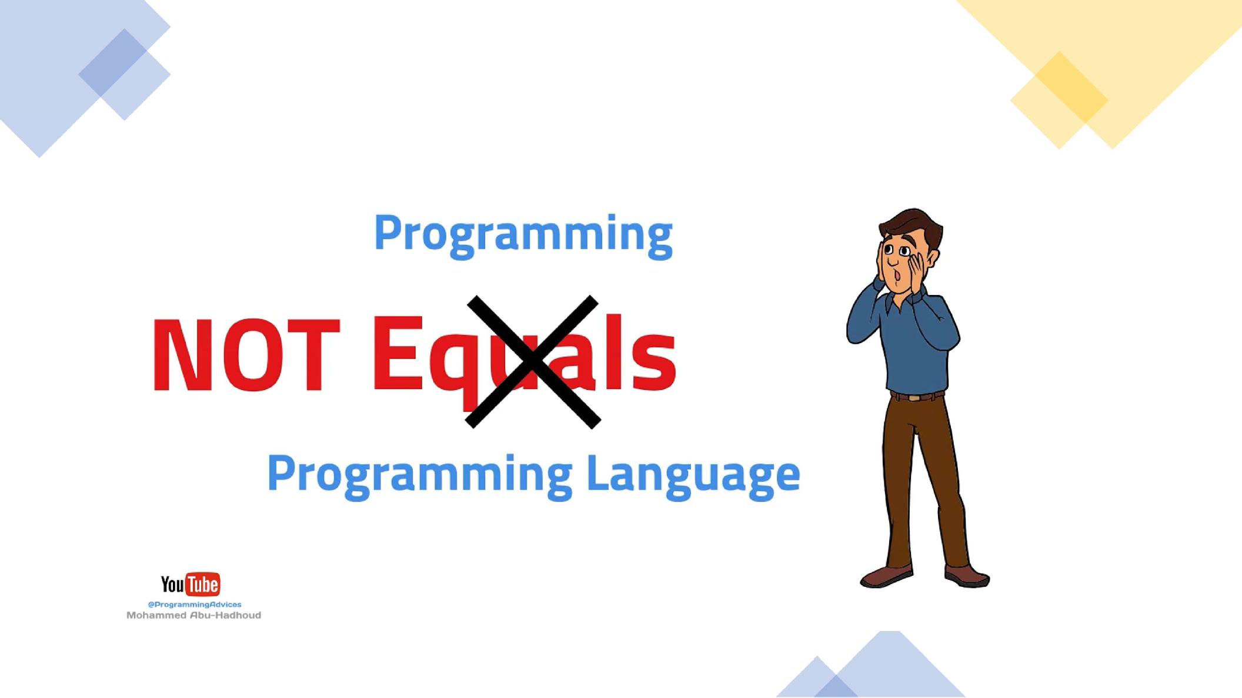

Slide 30


Driving

Slide 31
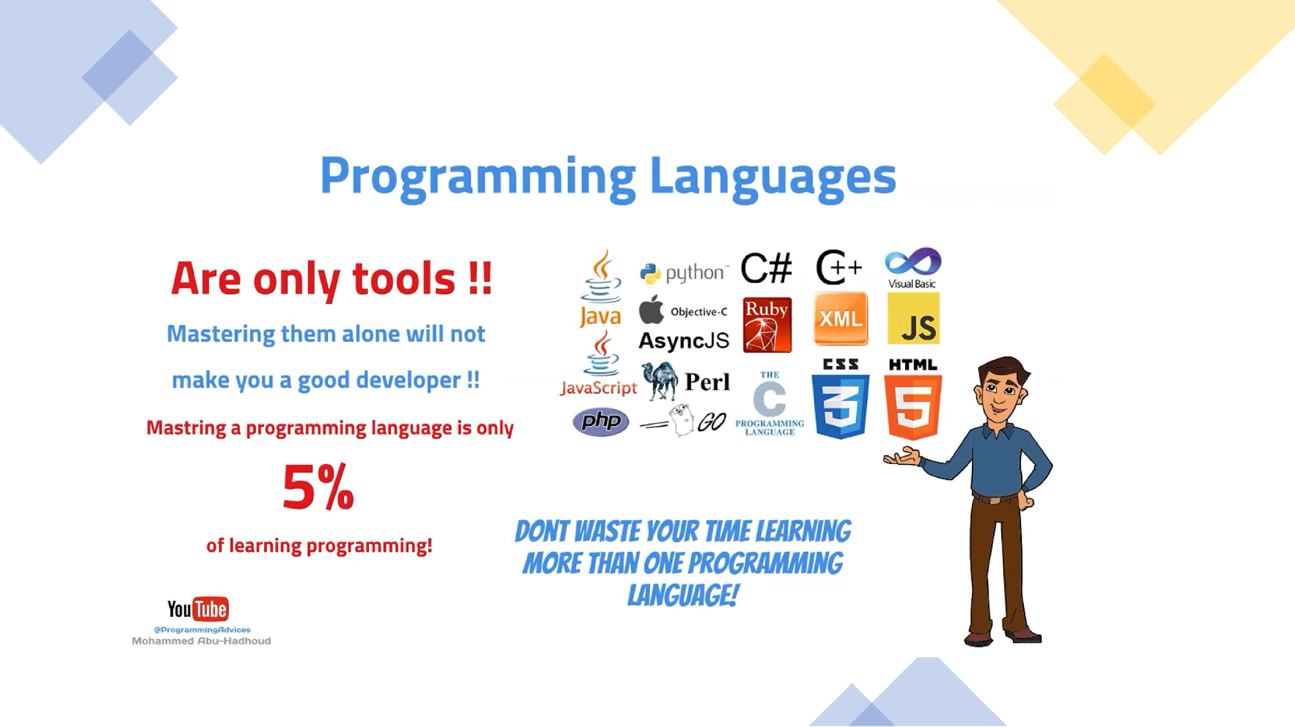

Slide 32
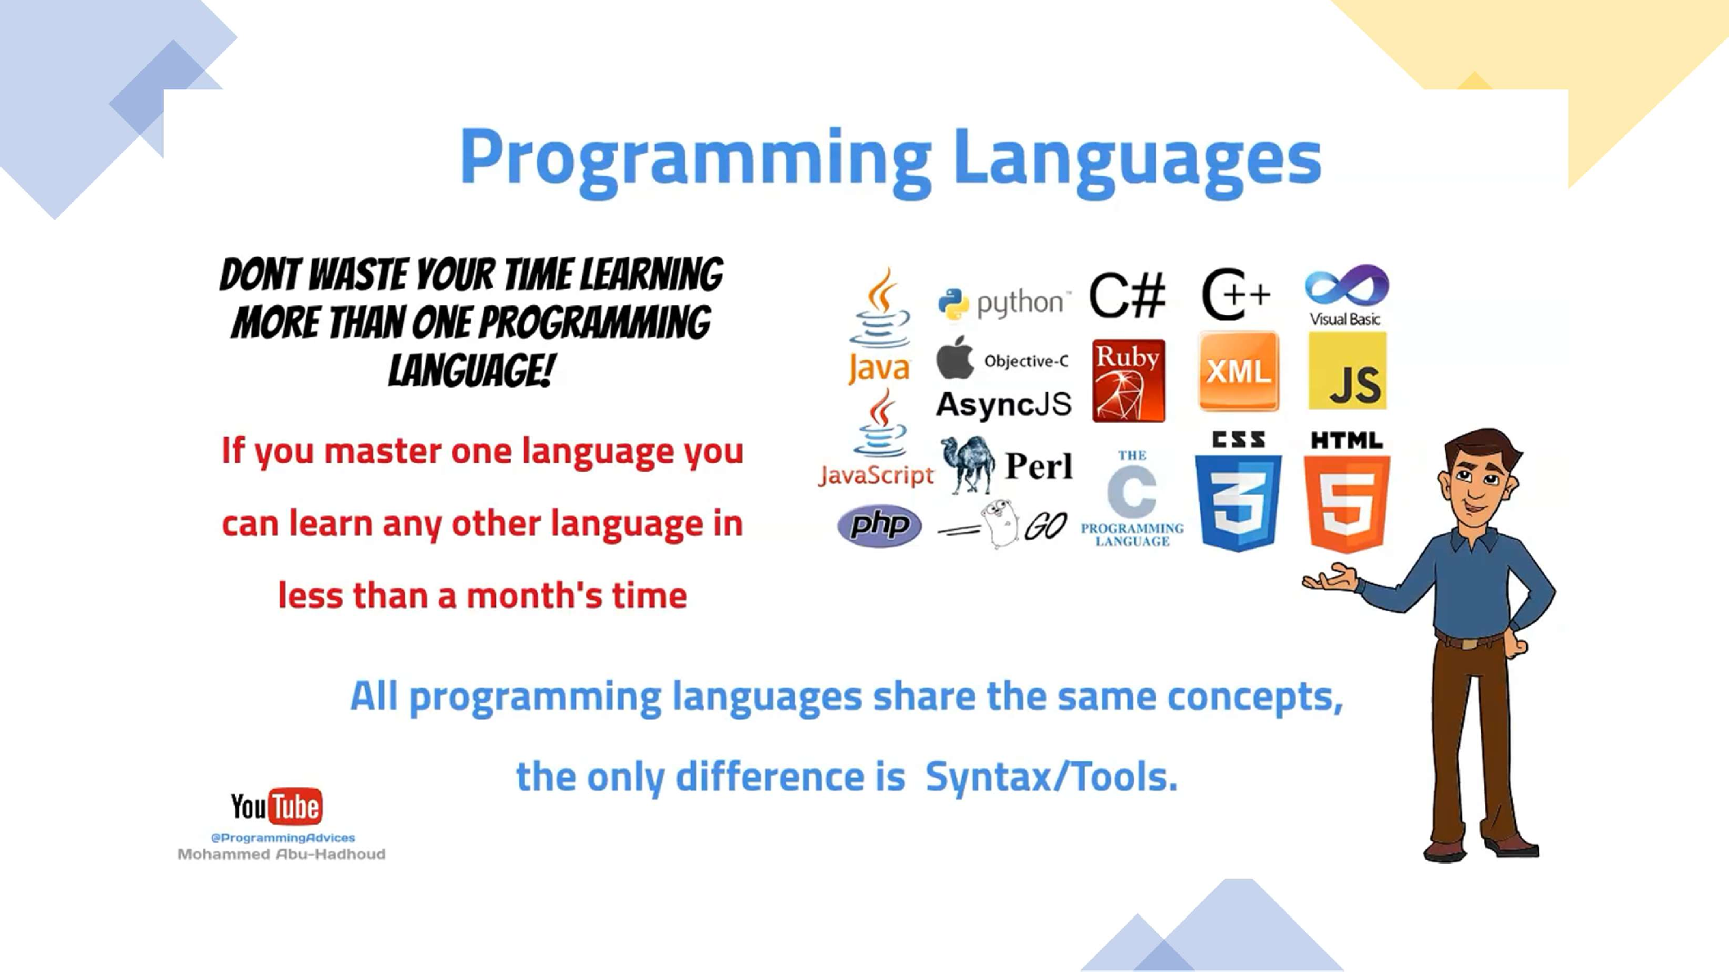

Slide 33
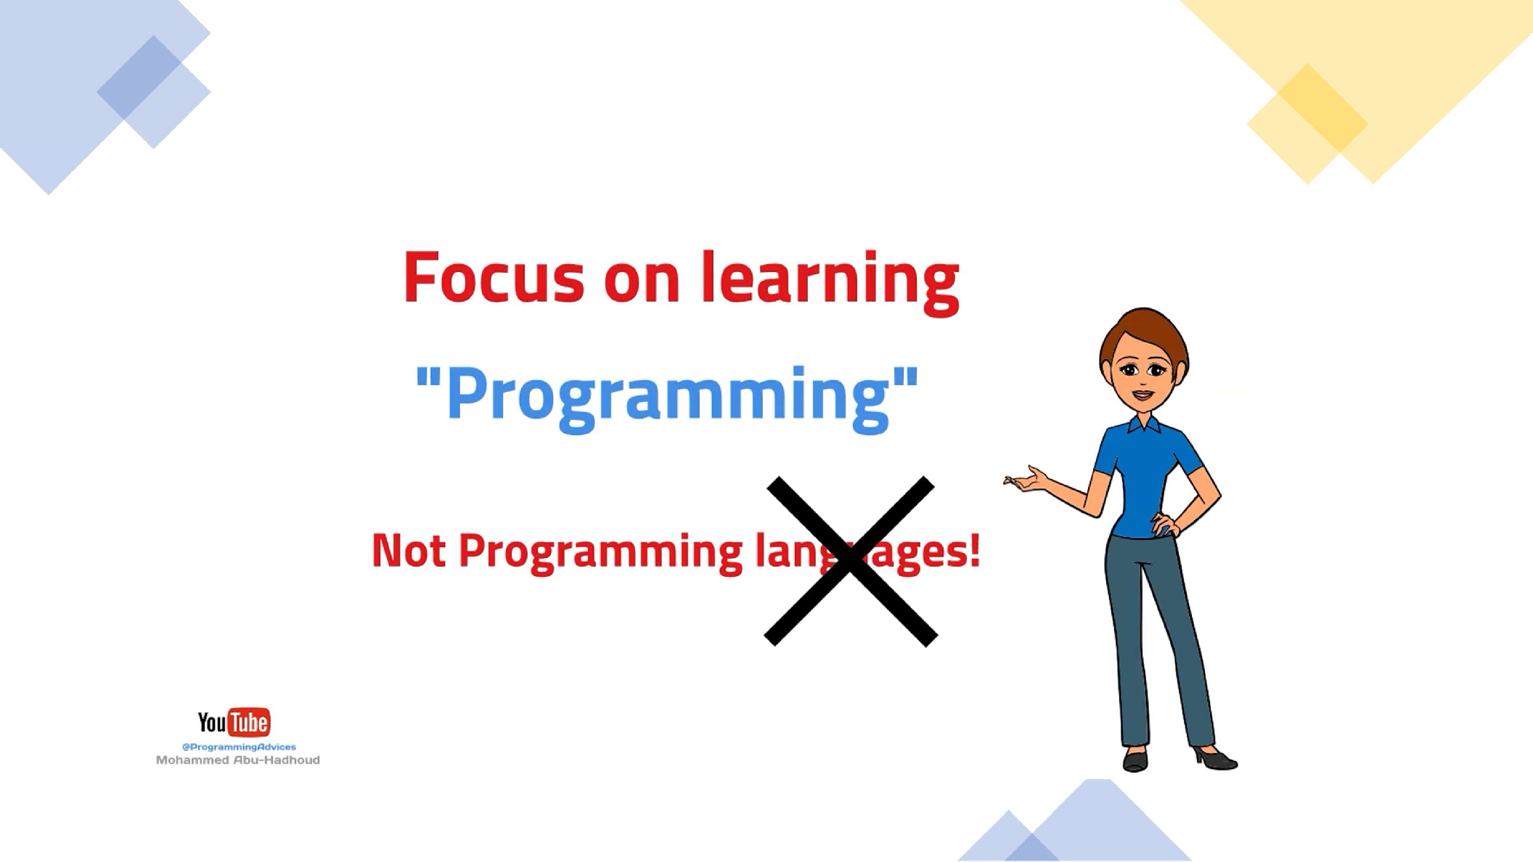

Slide 34
Programming Foundations
Level 1
What is Programming?
2

Slide 35
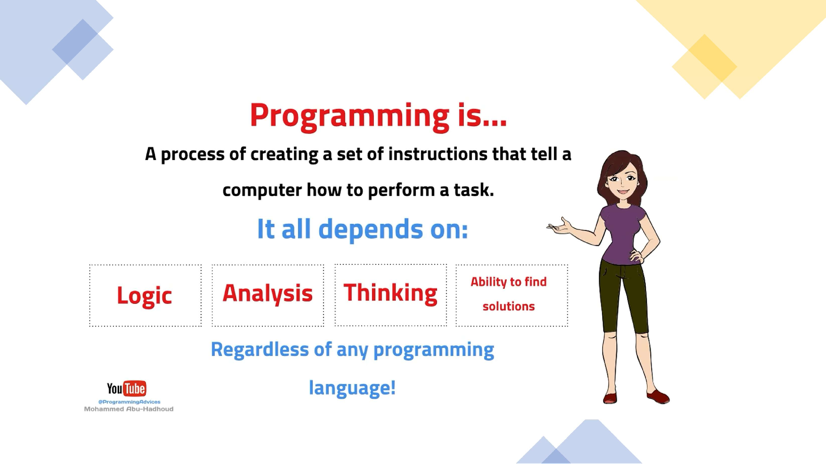

Slide 36
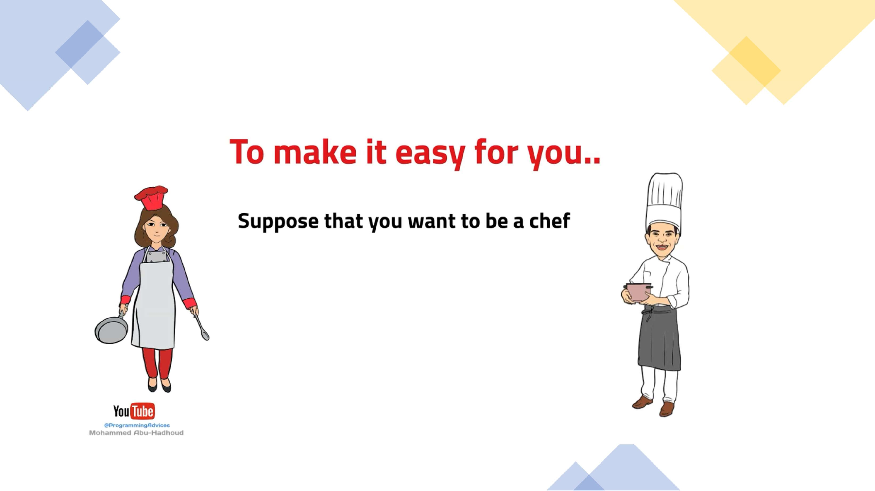

Slide 37


Slide 38
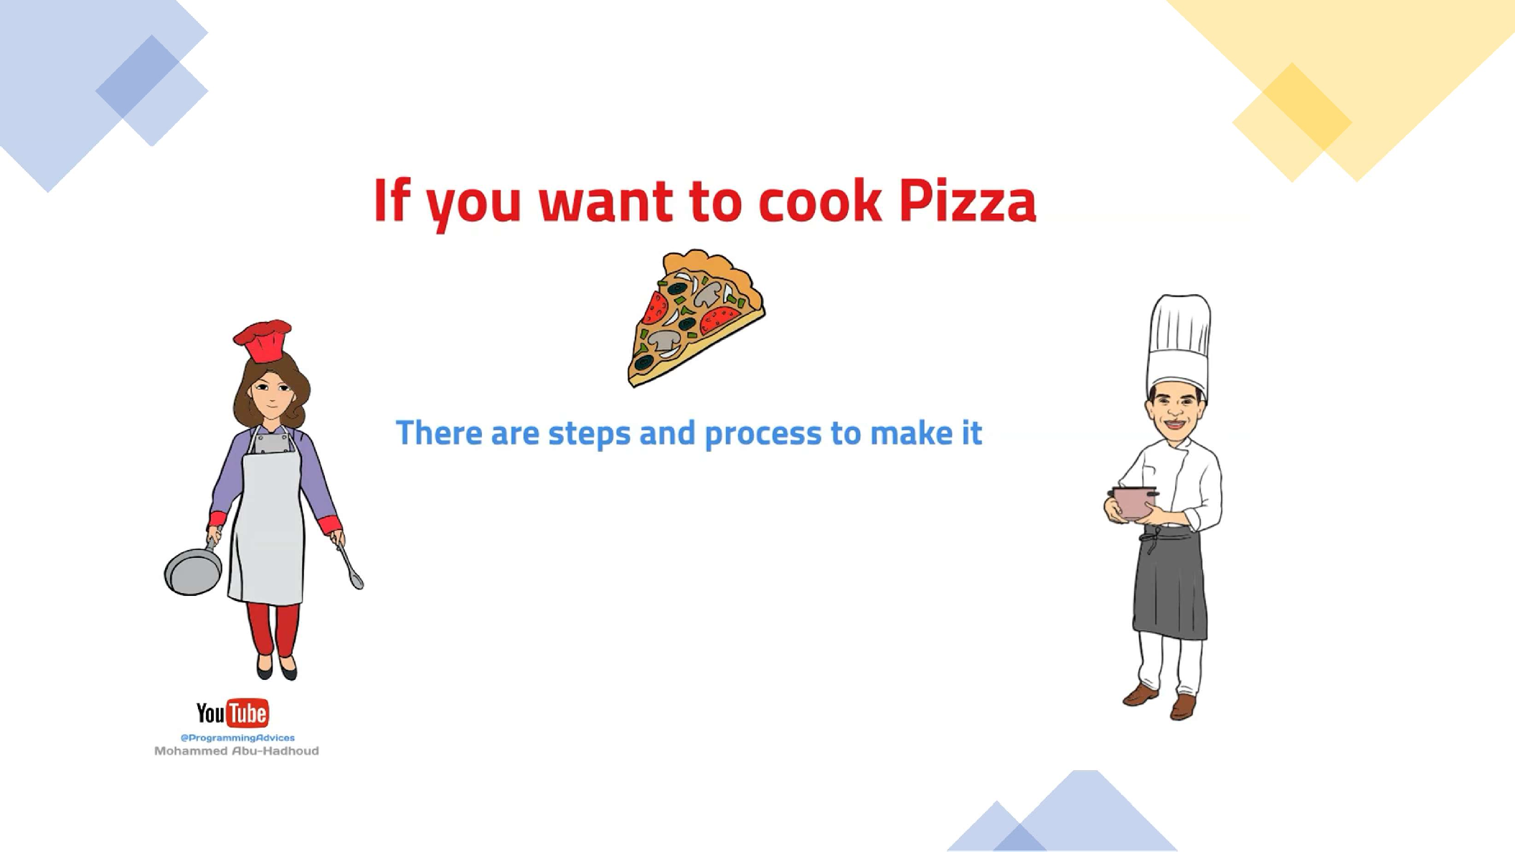

Slide 39
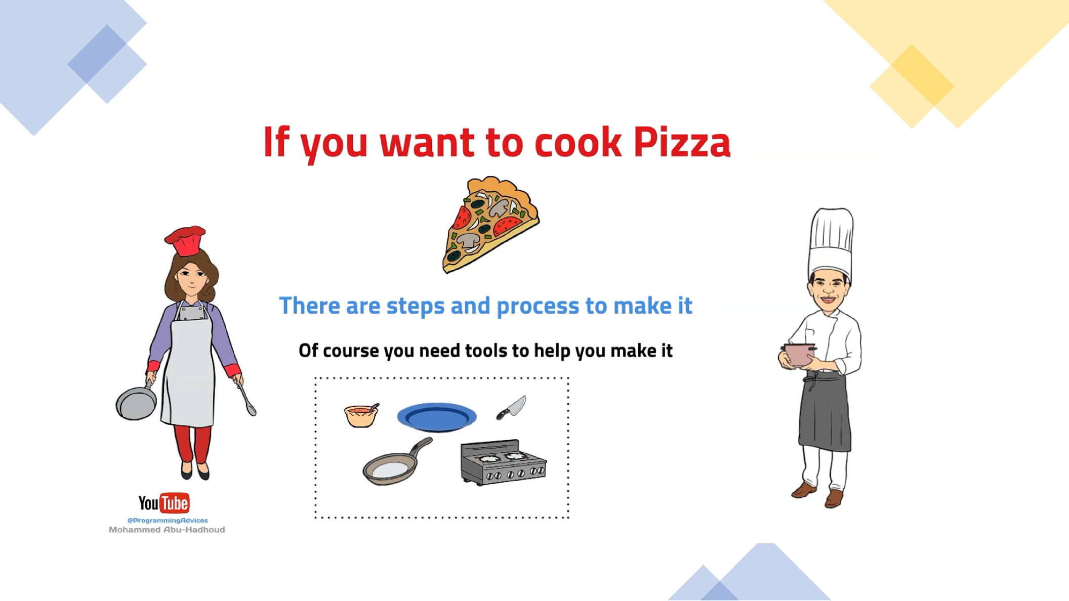

Slide 40
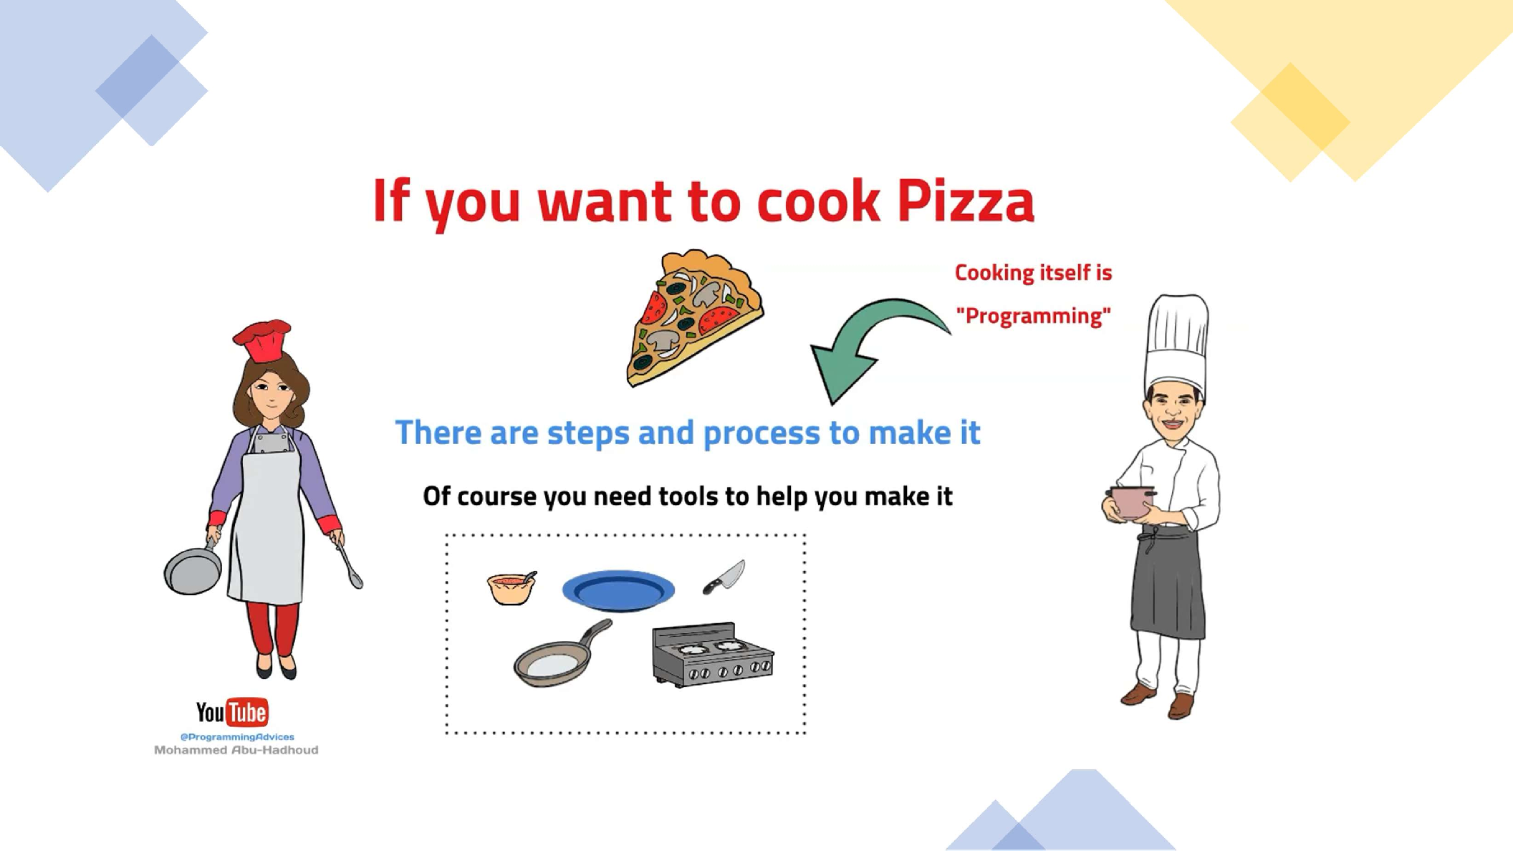

Slide 41
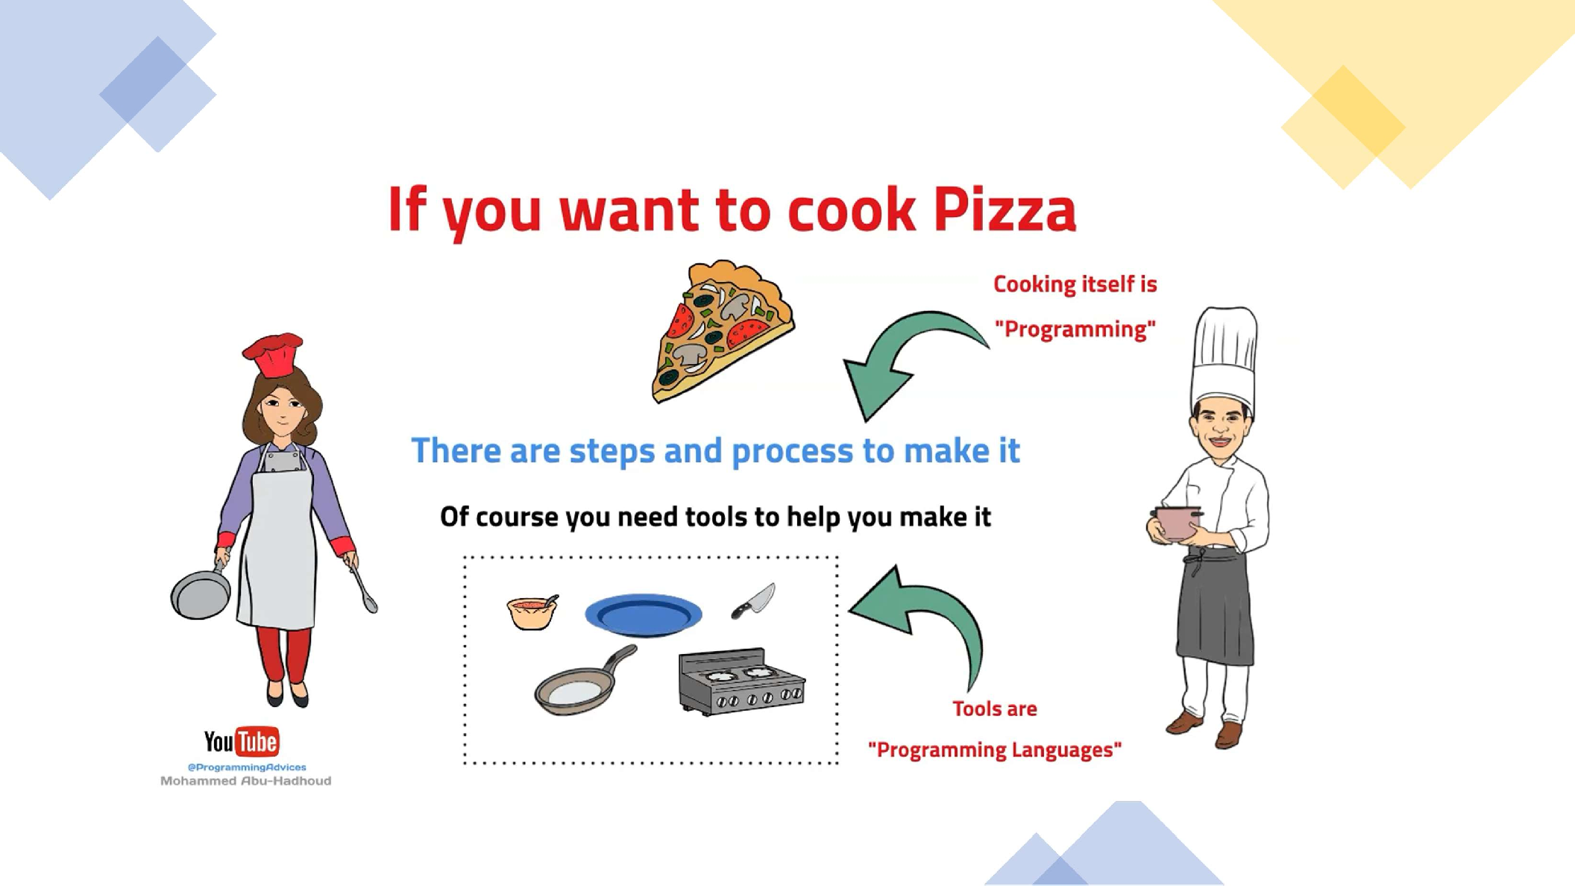

Slide 42
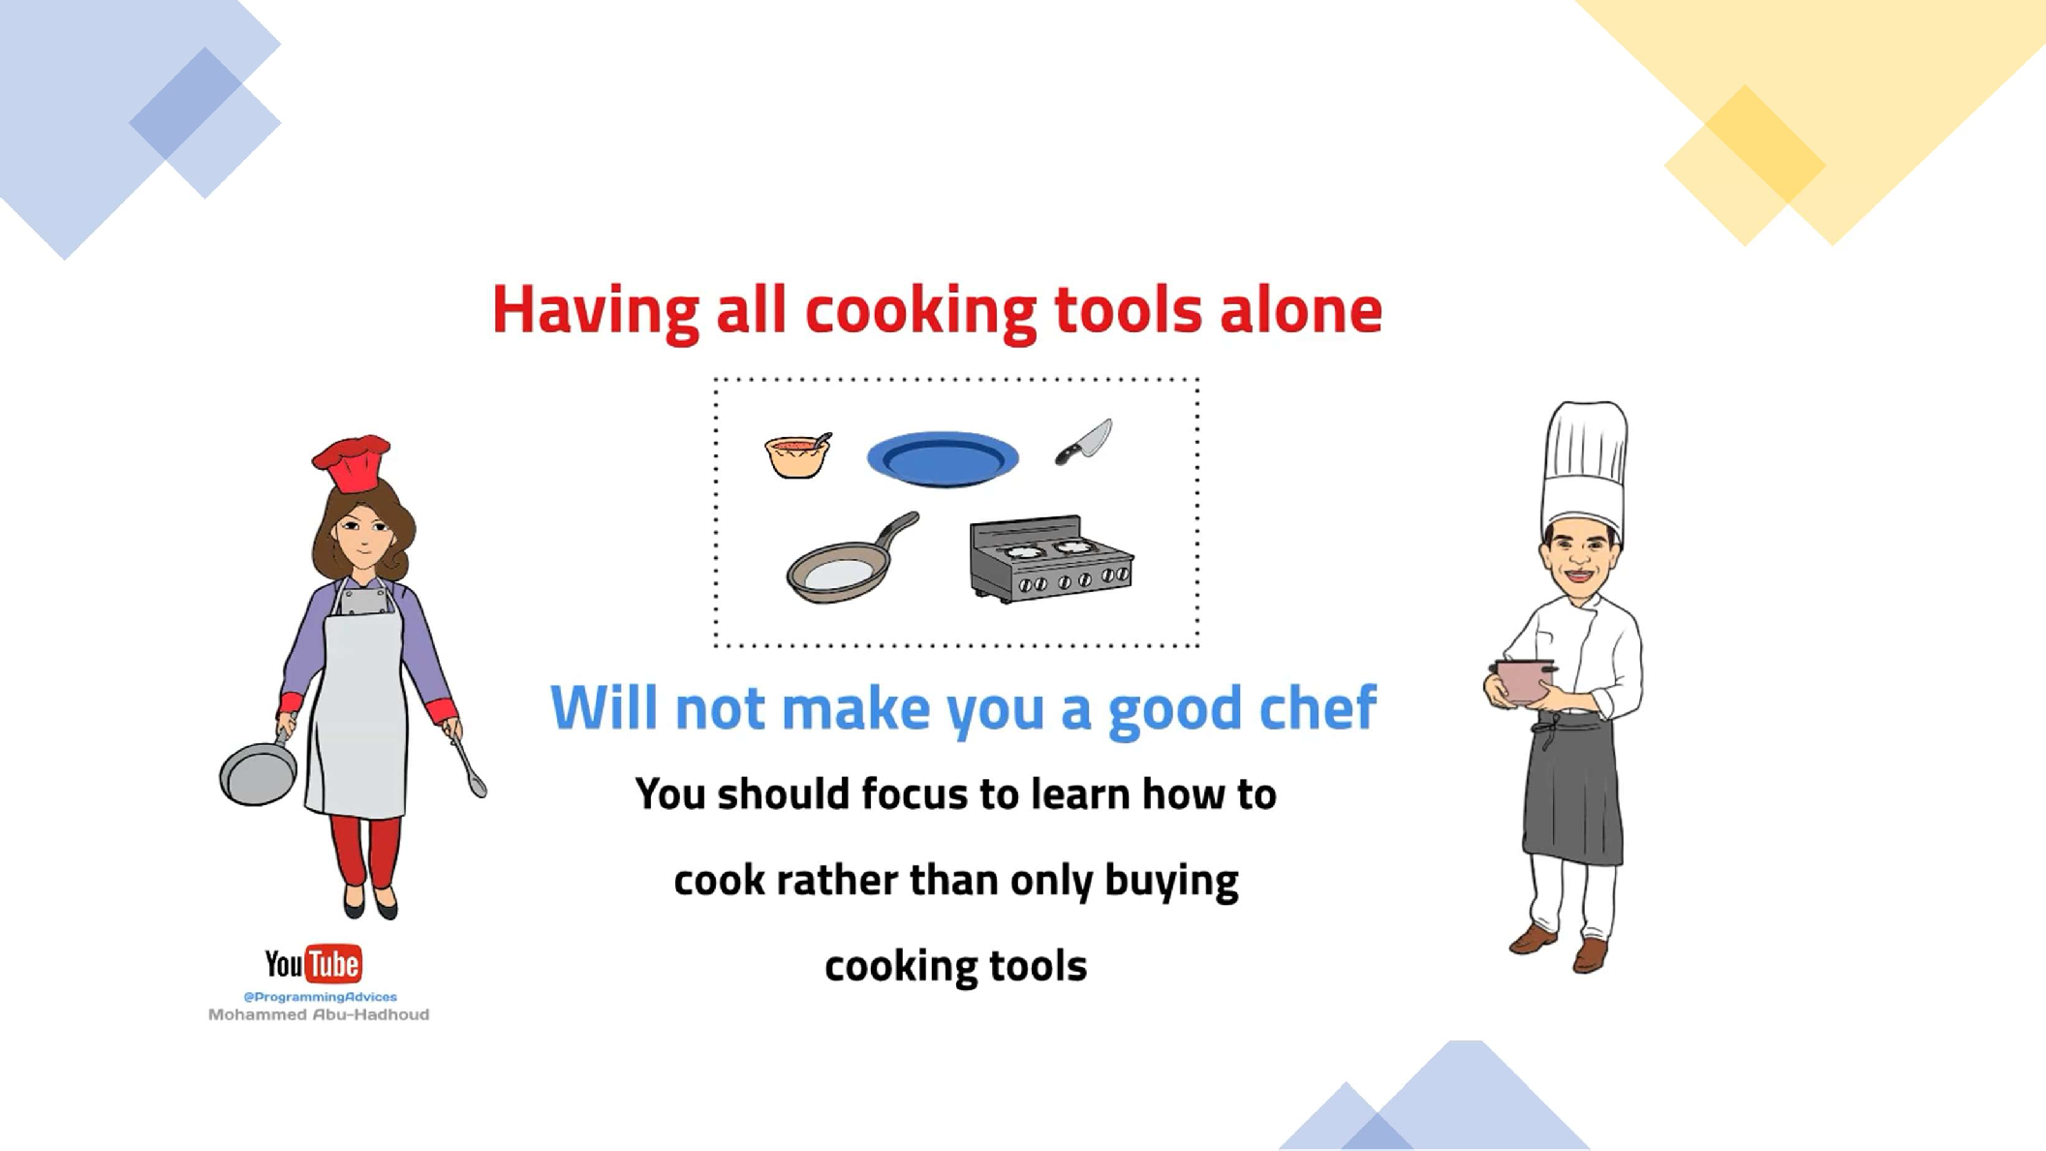

Slide 43
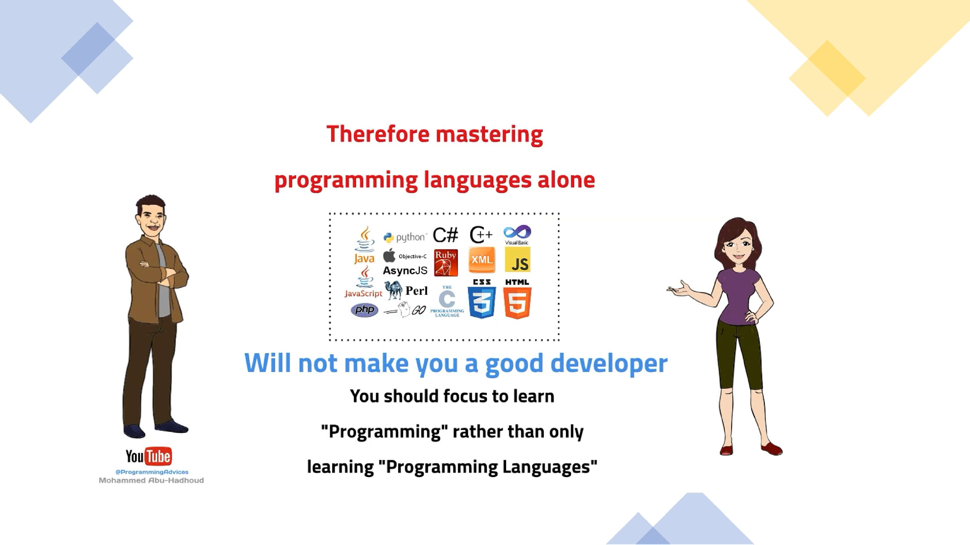

Slide 44
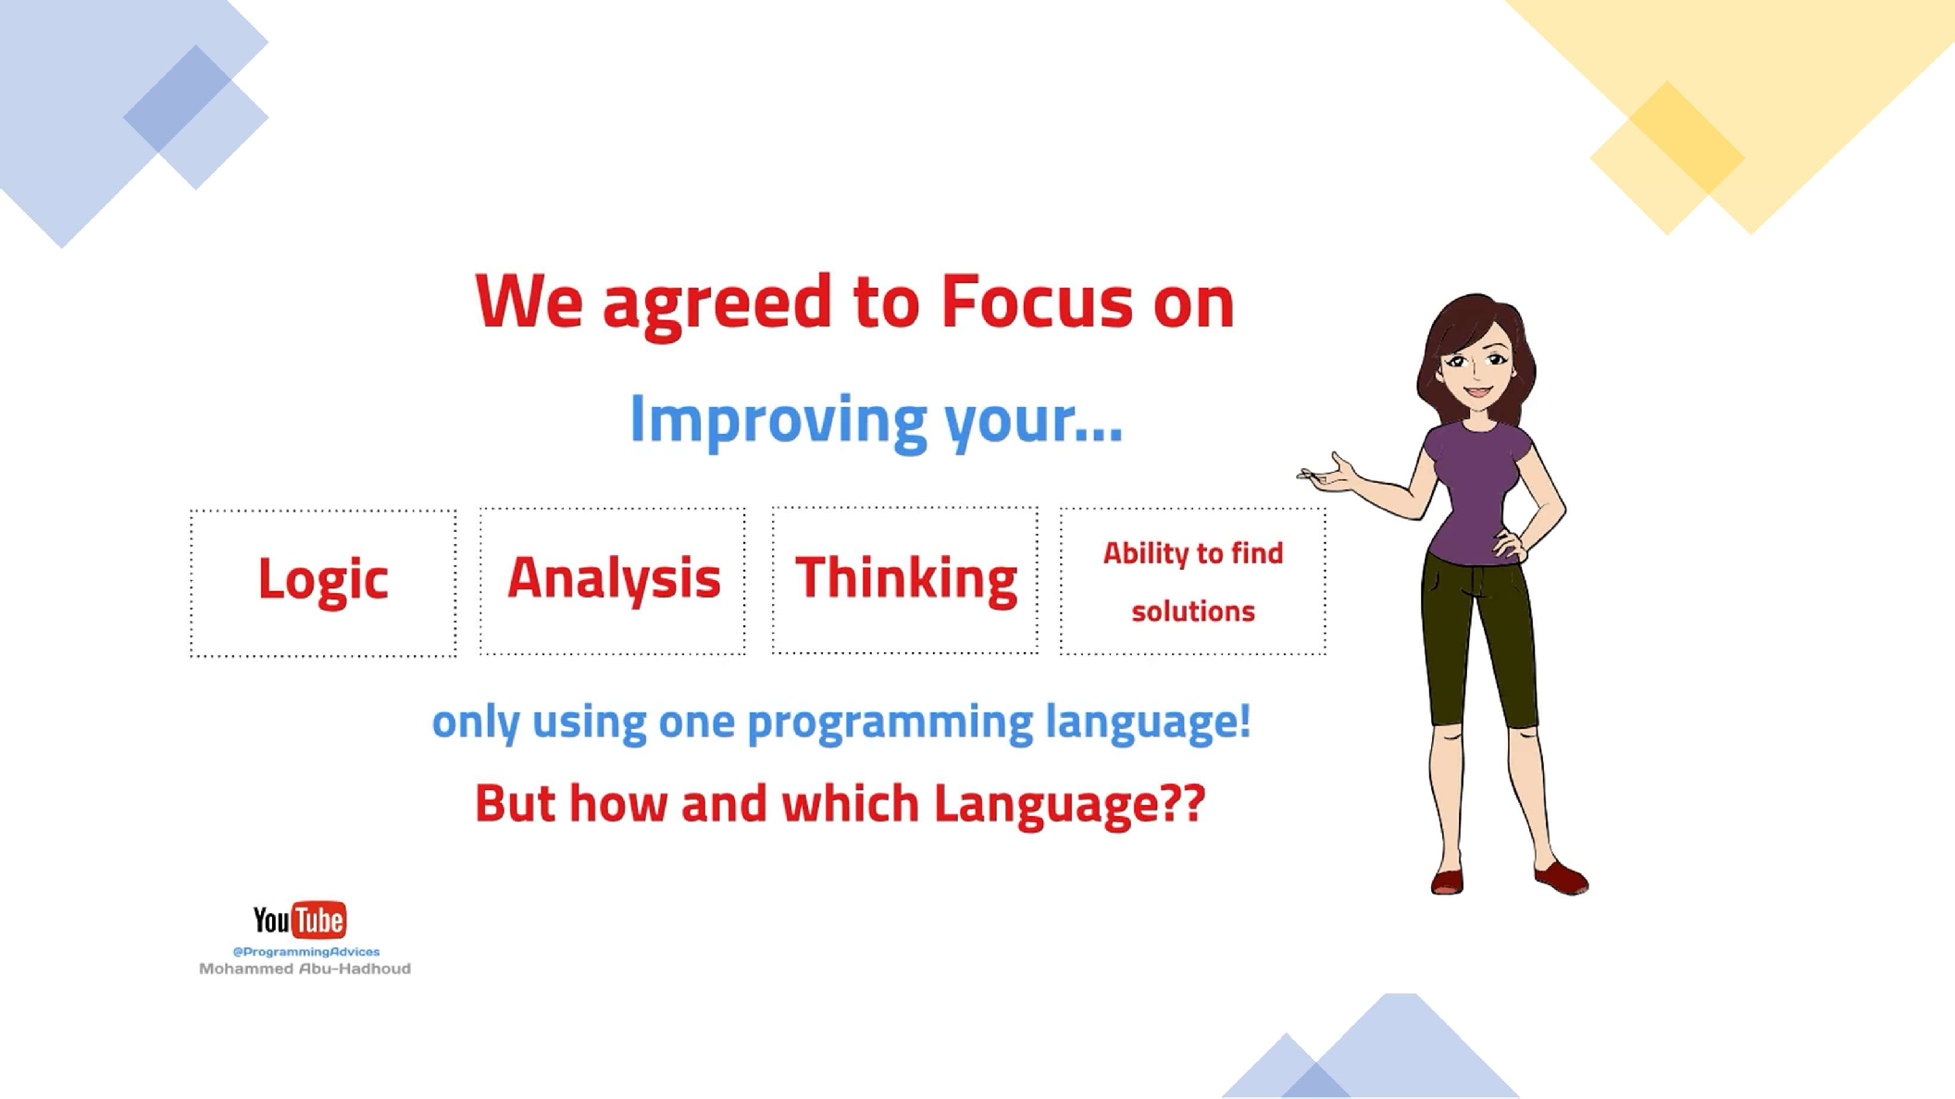

Slide 45
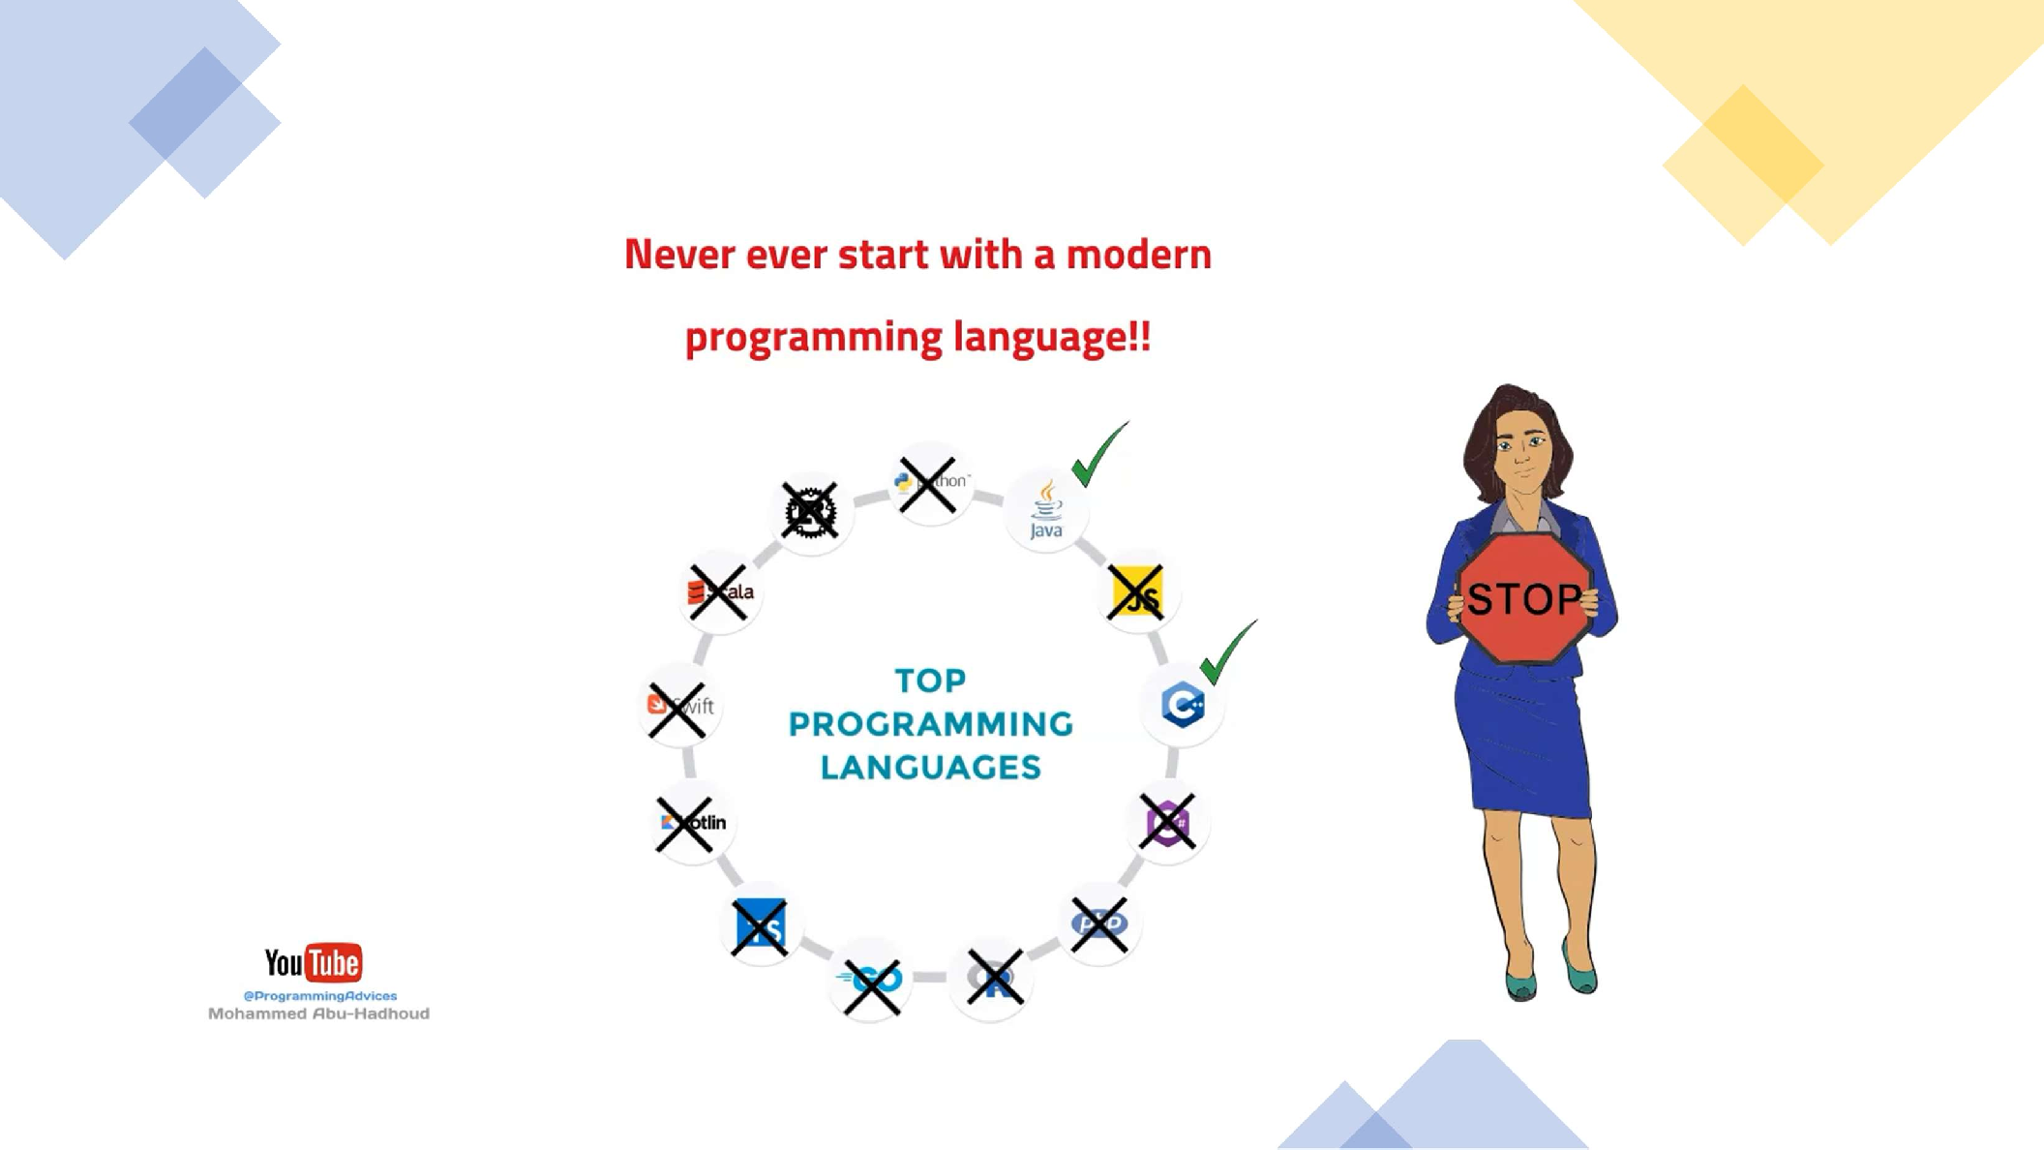

Slide 46
🔗 Interconnection
🔹 “Which is better?” → “Better for what?” Context first.
🔹 Programming fundamentals outlast language trends; language choice is 5% of the journey.
🔹 Mixing languages is normal; pick by domain, ecosystem, and constraints.
C++ is the key for all programming languages and it is easy.
By focusing on principles, you’ll switch cars (languages) easily and drive anywhere

Slide 47
🧐 Activity
📋 Instructions:
1️⃣ Why is asking “Which programming language is better?” an incomplete question?
Explain using the color or car analogy.
2️⃣ What is the correct answer to “Which language is better?”
What does the phrase “It depends on your needs” really mean in programming?
3️⃣ Why do many programming languages exist?
List at least three factors that make different languages suitable for different situations (hint: speed, safety, ecosystem...).
4️⃣ What’s the difference between programming and a programming language?
Explain it using the carpentry analogy (tools vs craft).
5️⃣ Why should you focus on learning programming fundamentals before languages?
What part of programming is the “craft,” and what part is just “tools”?
6️⃣ Why is it not a good idea to start with modern languages?
Use the driving analogy (manual parking vs park assist) to explain.
7️⃣ Why is C++ recommended as the first language to learn?
List three reasons based on the lesson (hint: fundamentals, concepts, mindset).
8️⃣ What does “C++ = Salary ++” mean?
Explain why learning C++ adds long-term value — even if you don’t use it in daily work.
9️⃣ What makes a good programmer?
Is it the language they use, or something deeper?

Slide 48
🧐 Activity Solution
📋 Solution:
1️⃣ Why is asking “Which programming language is better?” an incomplete question?
Explain using the color or car analogy.
Because “better” depends on context and purpose.
It’s like asking “What’s the best color?” or “What’s the best car?” — it makes no sense without specifying what it’s used for.
Example: a 4x4 is great off-road but bad for fuel efficiency, just like some languages are fast but not easy to use.
2️⃣ What is the correct answer to “Which language is better?”
What does the phrase “It depends on your needs” really mean in programming?
The correct answer is “It depends on your needs.”
Each language is designed to solve certain problems efficiently.
There is no single “best” language — only the right language for a specific purpose.

Slide 49
3️⃣ Why do many programming languages exist?
List at least three factors that make different languages suitable for different situations (hint: speed, safety, ecosystem...).
Because different problems require different trade-offs, such as:
Speed & performance (C++, Rust)
Safety & reliability (Java, Ada)
Ecosystem & libraries (Python, JavaScript)
Tooling or platform compatibility (C#, Swift)
Domain fit (SQL for databases, HTML for web pages)
Just like tools in a toolbox — each one is specialized for a certain job.
4️⃣ What’s the difference between programming and a programming language?
Explain it using the carpentry analogy (tools vs craft).
A programming language is just a tool to express instructions, while programming is the craft of problem-solving.
Learning syntax is easy — like learning to use a hammer or saw.
Becoming a programmer means mastering how to design, plan, and combine those tools to build complete solutions — like crafting a perfect piece of furniture.

Slide 50
5️⃣ Why should you focus on learning programming fundamentals before languages?
What part of programming is the “craft,” and what part is just “tools”?
Because the fundamentals — logic, algorithms, data structures, and problem-solving — are what make you a real programmer.
Once you understand those concepts, you can switch between any language easily.
Languages change, but the thinking skills never go out of date.
6️⃣ Why is it not a good idea to start with modern languages?
Use the driving analogy (manual parking vs park assist) to explain.
Modern languages have many built-in functions and helpers that hide complexity.
They make you feel skilled, but you’re relying on the tools — not your understanding.
It’s like learning to drive using automatic parking sensors — you’ll park perfectly, but without them, you’ll struggle.
Start with C++, which forces you to think logically and learn the true mechanics of programming.

Slide 51
7️⃣ Why is C++ recommended as the first language to learn?
List three reasons based on the lesson (hint: fundamentals, concepts, mindset).
Because C++ teaches you all the fundamentals (10/10 concepts).
It’s:
Powerful yet easy to learn once guided correctly.
Helps you understand how computers truly work (memory, logic, speed).
Gives you the foundation to learn any modern language quickly.
Once you master C++, every other language feels simple.
8️⃣ What does “C++ = Salary ++” mean?
Explain why learning C++ adds long-term value — even if you don’t use it in daily work.
It means learning C++ increases your value and career potential.
Even if you don’t use it daily, it builds strong fundamentals that make you adaptable and capable in any programming field.
C++ teaches discipline, structure, and performance thinking — qualities that employers reward highly.

Slide 52
9️⃣ What makes a good programmer?
Is it the language they use, or something deeper?
A good programmer is defined by how they think, analyze, and solve problems, not by which language they use.
Programming is about logic, design, and creativity — the language is just the medium used to express those ideas.
✅ Final Summary:
There’s no “best language” — only the best for the task.
Focus on programming concepts, not syntax.
C++ builds fundamentals that unlock every other language.
Languages are tools — programmers are the craftsmen who use them to build solutions.

Slide 53
🏁 Conclusion
✅ “Which language is better?” → Clarify the goal first.
✅ Prioritize programming fundamentals; languages are interchangeable tools.
✅ Choose per domain fit, ecosystem, performance, team, and market — and don’t be afraid to mix languages.
This mindset keeps you flexible, effective, and employable across fast-changing tech stacks.

Slide 54
Thank you ☺

