Slide 1

Programming Foundations
Level 1

Slide 2

Programming Foundations
Level 1
Why You Should Start with C++?
2

Slide 3
Programming Foundations
Level 1
What is C++?
2

Slide 4

What/Why C++?
C++ is a cross-platform/Portable language that can be used to create high- performance applications that can be adapted to multiple platforms
C++ is fun and easy to learn!
C++ is the mother of all languages.
It Supports Procedural & OOP programming.
It will force you learn basic programming concepts.
If you learn it very well, you can learn any other programming language in less than a month’s time.

Slide 5
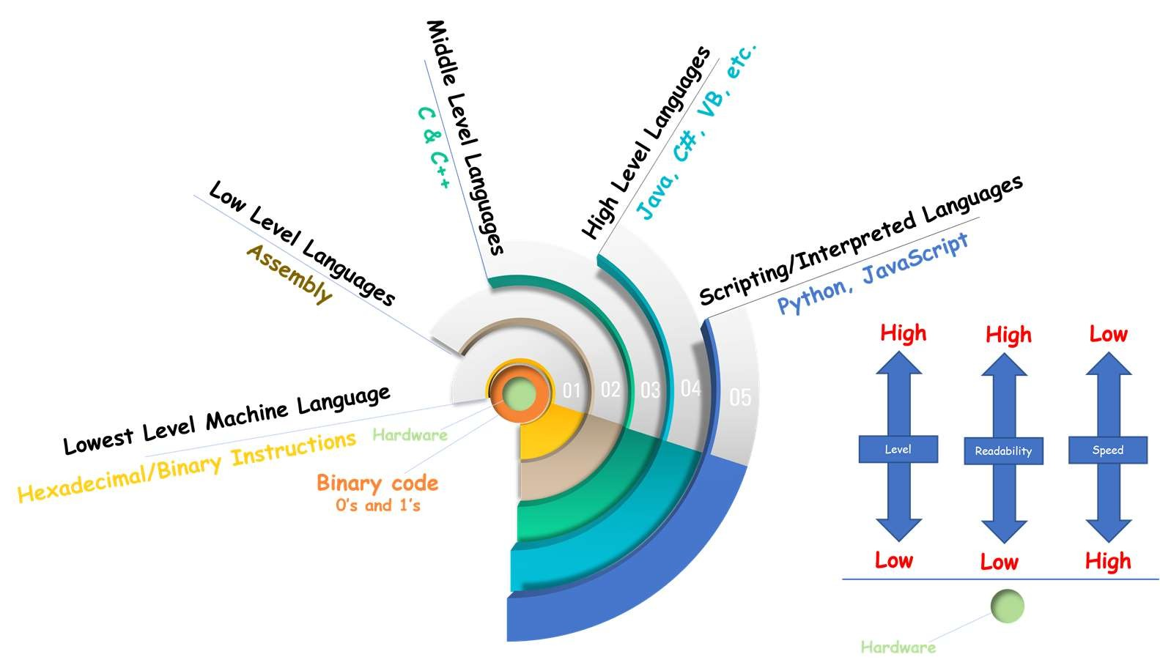
What/Why C++?
Both C and C++ are considered Mid-level languages that are close to hardware and are able to program and manipulate the underlying hardware resources.
C and C++ have full control on computer resources such as memory, no automatic memory management.
Cross-platform/portable and used to build high-performance apps.
Fun and easy to learn; known as the “mother of all languages.”
Supports procedural & OOP paradigms → you learn both styles.
Forces core concepts; learn it well → learn any other language in < 1 month.
Closer to hardware:
C and C++ are mid-level: close to hardware, able to manipulate resources.
Full control of memory (no automatic memory management).

Slide 6
Programming Foundations
Level 1
What can you do with C++?
2

Slide 7
Operating systems, enterprise software, embedded systems, medical & engineering apps, databases, IDEs, compute platforms, web browsers, compilers, game engines, and desktop apps.
Real products built :
OS: Parts of Apple OS X; many Microsoft Windows versions built with C++ (Visual C++).
Apps: Adobe Illustrator/Photoshop core functions; Microsoft Word/Excel/PowerPoint; Amazon processing core.
Browsers / Databases / IDEs / Game Engines: highlighted as major C++ domains.
Enterprise & Embedded: flight sims, radar, cars/flights/medical machines.
Libraries: chosen for high-level math & performance; multithreading & concurrency support.
Banking: concurrency & performance (e.g., Finacle backend).
Advanced Computation & Graphics: e.g., Maya 3D (animation, VR, 3D).
Cloud/Distributed: close to hardware + threading → great fit; Bloomberg stack note (C for DB engine; C++ for dev environment/libraries).
When you talk about… performance, speed, cross-platform adaptability, heavy math, multithreading/concurrency → it’s C++.

Slide 8
To Design OS
Desktop Applications
Design Database
Design Compilers/Programming Languages
Engg. Applications
Medical Applications
Game Development
Design Web Browsers
Embedded Systems
Computation Platforms
Built Enterprise Software
IDEs

Slide 9
Programming Foundations
Level 1
Real Things done using C++
2

Slide 10

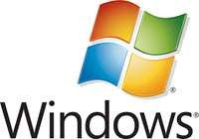
Operating Systems:
Most of the software from Microsoft is developed using C++ (flavors of Visual C++).
Applications like Windows 95, ME, 98; XP, etc. are written in C++.
Apple OS X has some of its parts written in C++. Similarly, some parts of the iPod are also written in C++.

Slide 11




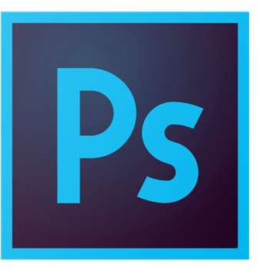
Applications:
Core Functions are written in C++
Amazon was primarily written in C++. Now C++ is mainly responsible for processing requests.
Most of the applications of the adobe systems including Illustrator, Photoshop, etc.
Microsoft products like Word, Excel, PowerPoint…etc

Slide 12




Browsers:

Slide 13


Database:

Slide 14


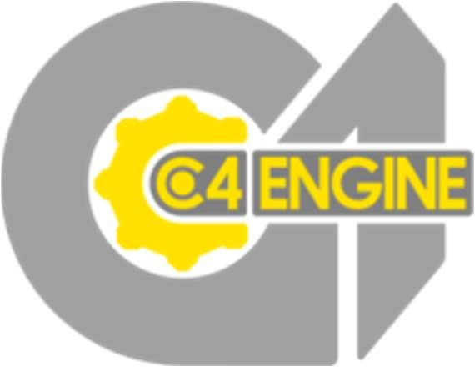

Gaming Engines:
A game engine is a dedicated software or an architecture, or program that developers use for creating games

Slide 15

IDEs:

Slide 16



Enterprise Software
C++ is used in developing many enterprise software as well as advanced applications like flight simulation and radar processing.

Slide 17
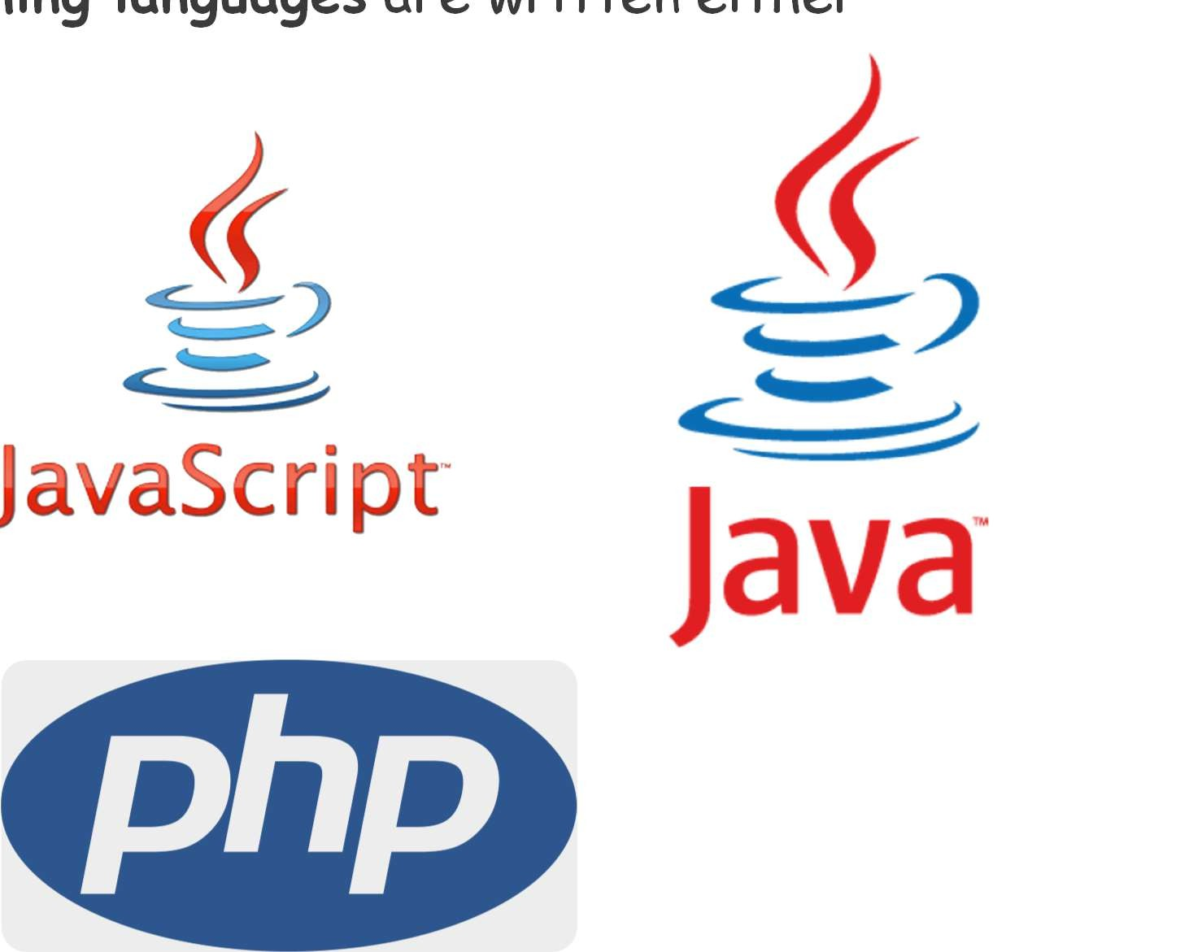
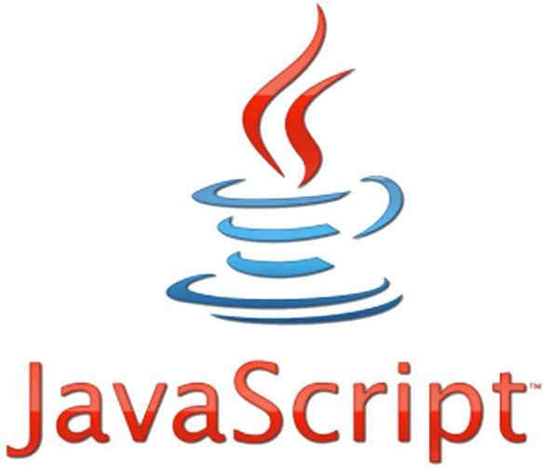
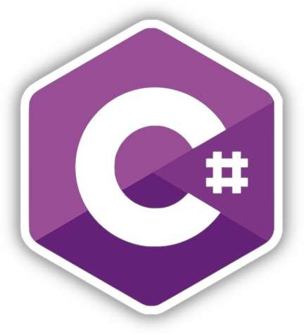

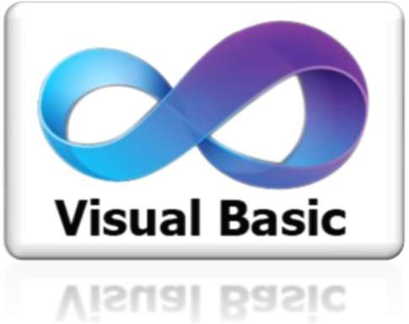

Compilers and Programming Languages
Compilers of various high-level programming languages are written either in C or C++.

Slide 18
Embedded Systems
CARs, Flights, Medical Machines, and others

Slide 19
Libraries
When we require very high-level mathematical computations, performance and speed become important. Hence most of the libraries use C++ as their core programming language. Most high-level machine language libraries use C++ as backend
C++ is faster than most of the other programming languages and also supports multithreading with concurrency.

Slide 20

Banking Applications
As C++ aids in concurrency, it becomes the default choice for banking applications that require multi-threading, concurrency, and high performance.
Infosys Finacle – is a popular core banking application that uses C++ as backend programming languages.

Slide 21

Advanced Computation And Graphics
C++ is useful in developing an application that requires high-performance image processing, real- time physical simulations, and mobile sensor applications that need high performance and speed.
Maya 3D software from Alias system is developed in C++ and is used for animation, virtual reality, 3D graphics, and environments.

Slide 22

Cloud/Distributed Systems
Cloud storage systems that are extensively used nowadays work close to the hardware. C++ becomes a default choice for implementing such systems as it is close to the hardware. C++ also provides multithreading support that can build concurrent applications and load tolerance.
Bloomberg is a distributed RDBMS application that is used for accurately providing real-time financial information and news to investors.
While Bloomberg’s RDBMS is written in C, its development environment and set of libraries are written in C++.

Slide 23
Therefore, when you talk about…
Performance
Speed
Cross Platform/Adaptable
High-level mathematical computations
Multithreading with concurrency
IT’s…

Slide 24
Programming Foundations
Level 1
Why C++ not C?
2

Slide 25
C vs C++
Similarities
Both the languages have a similar Syntax/Grammar/Code Structure.
The compilation of both the languages is similar.
Both are Mid-level languages that are close to hardware and are able to program and manipulate the underlying hardware resources.
Differences..
C C++
C was developed by Dennis Ritchie C++ was developed by Bjarne
between the year 1969 and 1973 at Stroustrup in 1979.
AT&T Bell Labs. C++ Superset of C.
C is a subset of C++. Supports both Procedural and OOP.
Procedural Language.
That’s why you should learn C++ not C, it will take the same efforts
Similarities: syntax/grammar/compilation; both mid-level and close to hardware.
Differences: C is procedural, C++ is a superset that supports both procedural + OOP.
Conclusion : Learn C++ (not C) — same effort, broader power.

Slide 26
Programming Foundations
Level 1
Why to start with C++ not JAVA?
2

Slide 27
C++ vs Java
Similarities
Both the great languages.
However, its recommended to start with C++ because:
C++ Java
Supports both Procedural and OOP. Supports Only OOP.
That’s why you should start with C++, you will learn all types of programming.
C++ supports procedural + OOP, while Java is OOP-only.
Both are great; slides recommend starting with C++ so you learn all types of programming.

Slide 28
Will I work in C++?
Yes and No.

Slide 29


Is it outdated and not used
No, it still widely used for high performance systems.

Slide 30
And remember !!!!!
IF you learn C++, you can learn any other programming language easily in almost not time.

Slide 31


C++ Developer learning Python
Python Developer Learning C++

Slide 32
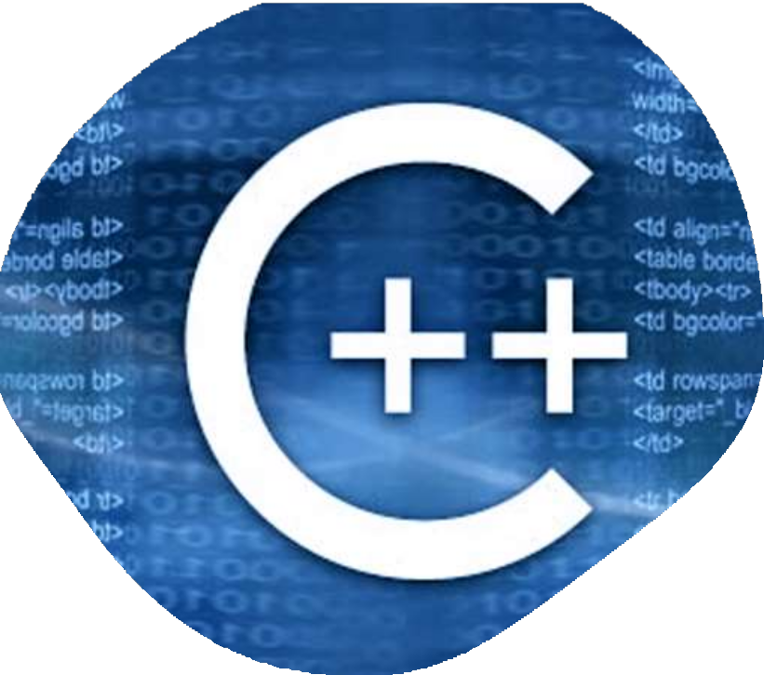

“Yes and No” (depends on role).
Not outdated — widely used in high-performance systems.
Even if you don't work using C++ , it will give you the keys to all programming languages and programming foundations.
C++ = Salary ++ even if you don't work using it!

Slide 33
🔗 Interconnection
🔹 C++ = mid-level control → performance, memory control, concurrency
🔹 Paradigm coverage (procedural + OOP) → broader mental model than single- paradigm starts.
🔹 Industry uses (OS, browsers, engines, finance, graphics, cloud) → long-term relevance.
By starting with C++, you build transferable fundamentals that make every other language easier. 🚀

Slide 34
🧐 Activity
📋 Instructions:
1️⃣ Give three reasons to start with C++.
2️⃣ Name five domains where C++ is used .
3️⃣ What paradigms does C++ support, and why does that matter when compared to Java?
4️⃣ Why do the slides say “Learn C++ not C” for beginners?
5️⃣ Explain two performance reasons C++ is chosen for infrastructure (libraries / cloud / banking).
6️⃣ True or False: “C++ is outdated.”
Explain your answer.

Slide 35
🧐 Activity Solution
📋 Solution:
1️⃣ Give three reasons to start with C++.
Cross-platform and high-performance.
Teaches both procedural + OOP programming styles.
Builds core fundamentals, making other languages easy to learn.
2️⃣ Name five domains where C++ is used .
Operating systems
Web browsers
Game engines
Enterprise / banking systems
Embedded & medical systems
Databases, IDEs, graphics tools (e.g., Maya), and cloud computing.
3️⃣ What paradigms does C++ support, and why does that matter when compared to Java?
C++ supports Procedural + Object-Oriented Programming (OOP).
Java is OOP-only, so C++ provides a broader foundation for beginners.
4️⃣ Why “Learn C++ not C” for beginners?
Same learning effort, but C++ is a superset of C.
Covers more paradigms and teaches stronger concepts.

Slide 36
5️⃣ Explain two performance reasons C++ is chosen for infrastructure (libraries / cloud / banking).
Closer to hardware for faster execution and better memory control.
Supports multithreading and concurrency for scalable, high-performance systems.
6️⃣ True or False: “C++ is outdated.”
Explain your answer.
❌ False.
C++ is still widely used in performance-critical systems (OS, finance, cloud, graphics, and gaming).

Slide 37
🏁 Conclusion
✅ Start with C++ to gain deep, transferable fundamentals.
✅ C++ powers OS, browsers, engines, finance, embedded, graphics, cloud — proving long-term value.
✅ With C++ as your base, other languages come quickly, and you can choose the best tool for each job.

Slide 38
Thank you ☺

