Slide 1

Programming Foundations
Level 1

Slide 2

Programming Foundations
Level 1
Operator
2

Slide 3
Operators in Computers: Math, Relational, and Logic
Operators are the symbols that tell the computer what action to perform on data.
In this lesson you’ll learn the three core families you’ll use everywhere:
🟨 Mathematical operators (e.g., +, -, *, /, Mod, ^)
🟨 Relational operators (e.g., =, <, >, <=, >=, <>)
🟨 Logical operators (e.g., AND, OR, NOT)
You’ll also see truth tables, how computers view True = 1 and False = 0, and realistic decision examples.

Slide 4
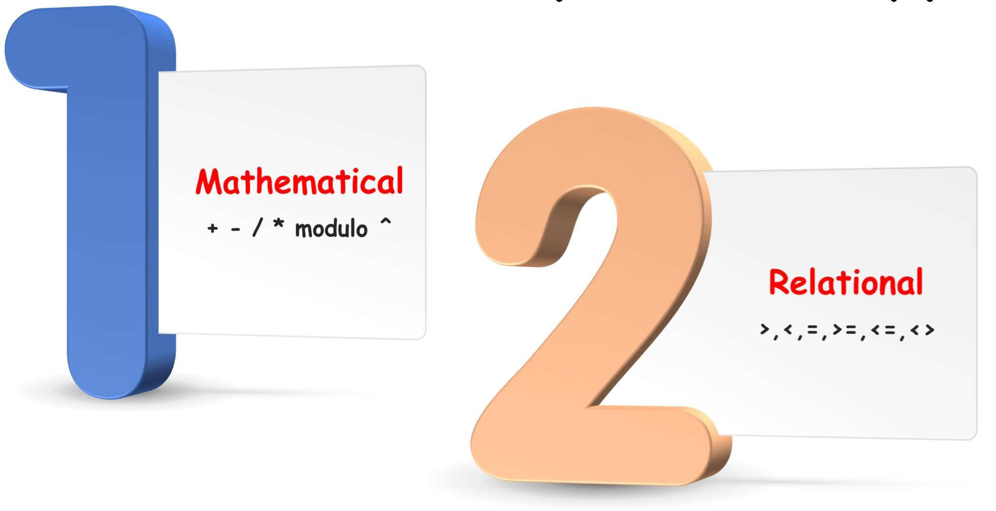
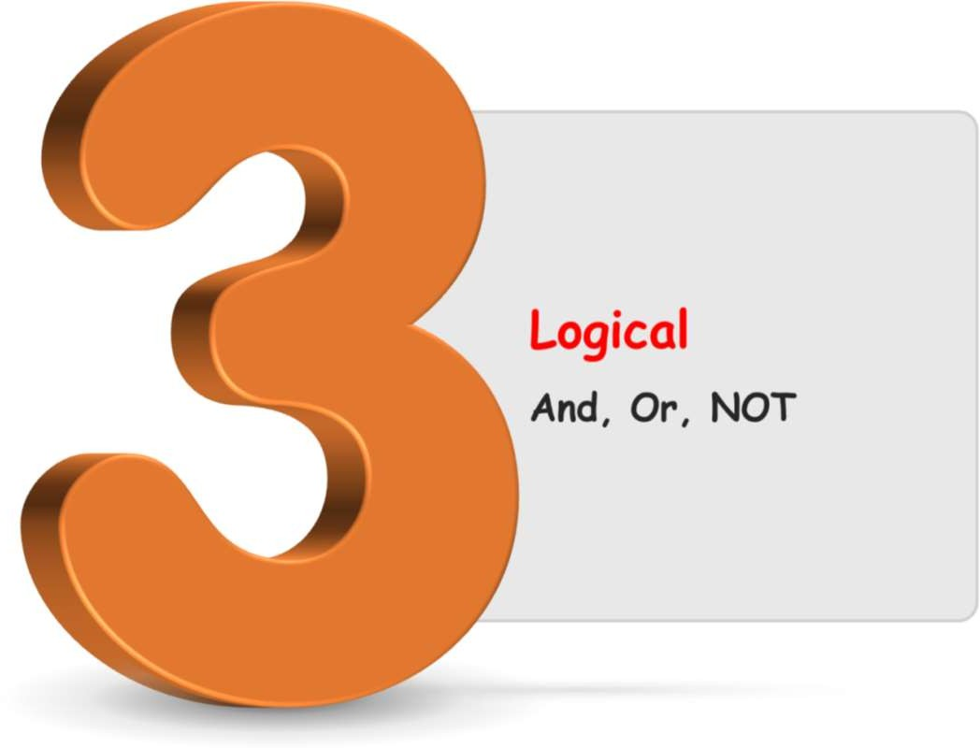
Operator Types
🟨 Mathematical: arithmetic on numbers
🟨 Relational: compare two values → returns True/False
🟨 Logical: combine/negate conditions (True/False)

Slide 5
Programming Foundations
Level 1
Mathematical Operators
2

Slide 6
Mathematical Operators
Operator | Computer Symbol | Example
 |  | Operation | Results
Addition | + 3.0 + 4.2 |  | 7.2
Subtraction | - 8.5 – 4.0 |  | 4.5
Multiplication | * 5 * 5 |  | 25
Integer Division | / 10 / 5 |  | 2
Modulo Division | Mod 9 Mod 4 |  | 1
Power | ^ 3^2 |  | 9

Slide 7
Programming Foundations
Level 1
Relational Operators
2

Slide 8
Relational Operators
Operator | Computer Symbol | Example
 |  | Operation | Results
Equal to | = | 5 = 7 | False
Less than | < | 5 < 7 | True
Grater than | > | 5 > 7 | False
Less than or equal to | <= | 5 <= 7 | True
Grater than or equal to | >= | 5 >= 7 | False
Not equal to | <> | 5 <> 7 | True

Slide 9
Programming Foundations
Level 1
Logical Operators
2

Slide 10
Programming Foundations
Level 1
Logic in Marriage
2

Slide 11


Logic in Marriage Life
Your wife is always right no matter what, and you are always wrong :-)
Husband | Wife | Result
True | False | True
True | True | True
False | True | True
False | False | True

Slide 12
Programming Foundations
Level 1
Logic in Computer
2

Slide 13
Programming Foundations
Level 1
Logic Operators
2

Slide 14
Programming Foundations
Level 1
“AND” Operators
2

Slide 15
Relational Operators
Operator | Computer Symbol | Example
 |  | Operation | Results
And | AND | True AND True | True
Or | OR | True OR False | True
Not | NOT | NOT True | False

Slide 16

Logical Operators
True ➔ 1 False ➔0
(5 > 3) ➔ True
1
(5 > 7) ➔ False
(5 > 3) AND (5>7) ➔ False
True
False
0

Slide 17
Logical Operators
The slides illustrate logic with everyday statements (“logic in marriage/life”) and then map that to computer-style logic with AND / OR / NOT. This helps you see how conditions become code decisions.
Practical AND example (hiring rule):
“You must meet both conditions to be hired:
🟨 Age ≥ 21 AND Has a driver license.
Computer form: (Age >= 21) AND (HasDriverLicense = True)
A single False in AND → result False (not hired).
Practical OR example (hiring rule):
“You must meet at least one:
🟨 Age ≥ 21 OR Has a driver license.”
Computer form: (Age >= 21) OR (HasDriverLicense = True)
Any True in OR → result True (hired).

Slide 18
Logical “AND” Operator:
Condition A | Condition B | A AND B
Age | Has Driver License
25 >= 21 ➔ True | Yes ➔ True | True
25 >= 21 ➔ True | No ➔ False | False
19 >= 21 ➔ False | Yes ➔ True | False
19 >= 21 ➔ False | No➔ False | False

Slide 19
AND Any “False” in AND
the result is False
A | B | A AND B
1 | 1 | 1
1 | 0 | 0
0 | 1 | 0
0 | 0 | 0
A | B | A AND B
True | True | True
True | False | False
False | True | False
False | False | False

Slide 20
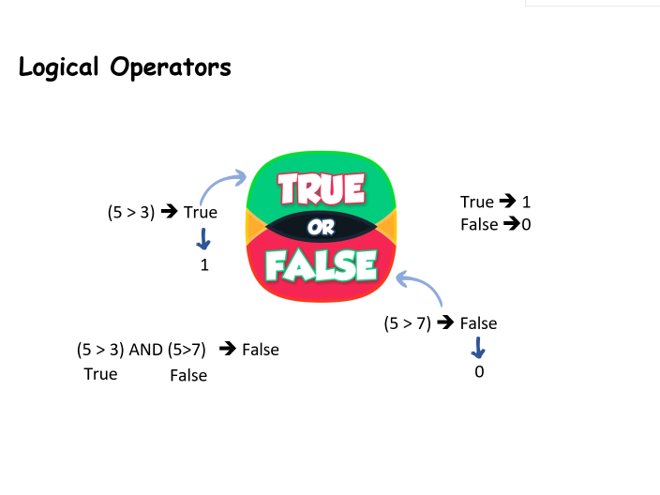

Logical Operators
True ➔ 1 False ➔0
(5 > 3) ➔ True
1
(5 > 7) ➔ False
(5 > 3) AND (5>7) ➔ False
True
False
0

Slide 21
Practical Example to learn “AND” operator:
IF you wan to get hired you have to have all the following conditions:
Your Age must be >= 21 years
You should have a driver license.
This in computer means:
(Age>=21 AND HasDriverLicesne=True) Then will be hired

Slide 22
Programming Foundations
Level 1
“OR” Operators
2

Slide 23
Logical “OR” Operator:
Condition A | Condition B | A OR B
Age | Has Driver License
25 >= 21 ➔ True | Yes ➔ True | True
25 >= 21 ➔ True | No ➔ False | True
19 >= 21 ➔ False | Yes ➔ True | True
19 >= 21 ➔ False | No➔ False | False

Slide 24
OR Any “True” in OR
the result is True
A | B | A OR B
1 | 1 | 1
1 | 0 | 1
0 | 1 | 1
0 | 0 | 0
A | B | A OR B
True | True | True
True | False | True
False | True | True
False | False | False

Slide 25
Logical Operators
True ➔ 1 False ➔0
(5 > 3) ➔ True
1
(5 > 7) ➔ False
(5 > 3) AND (5>7) ➔ False
True
False
0

Slide 26
Practical Example to learn “OR” operator:
IF you wan to get hired you have to have at least One the following conditions:
Your Age must be >= 21 years
You should have a driver license.
This in computer means:
(Age>=21 OR HasDriverLicesne=True) Then will be hired

Slide 27
Programming Foundations
Level 1
“NOT” Operators
2

Slide 28
Logical “NOT” Operator:
Condition A | NOT A
True False
False True

Slide 29
Logical Operators
True ➔ 1 False ➔0
(5 > 3) ➔ False
0
NOT (5 > 7) ➔ True
1

Slide 30
Practical Example to learn “NOT” operator:
I want to hire only Males , so you can say in computer:
If Male then hire
or you can use Not: If not (Female) then hire. because not female means male

Slide 31
🔗 Interconnection
🔹 Math operators compute values; Relational compare values; Logical combine decisions.
🔹 Computers evaluate conditions as True/False (i.e., 1/0) and use AND/OR/NOT to decide flow.
🔹 Real policies (like hiring rules) translate directly into logical expressions you can code.
By mastering these, you’ll express real-world rules precisely and build reliable decisions in programs. 🚀

Slide 32
🧐 Activity
📋 Instructions:
Decide True/False or compute the result.
1️⃣ 12 >= 12
2️⃣ 12 > 7
3️⃣ 8 < 6
4️⃣ 8 = 8
5️⃣ 12 <= 12
6️⃣ 7 = 5
7️⃣ (7 = 7) AND (7 > 5)
8️⃣ (7 = 7) AND (7 < 5)
9️⃣ (7 = 7) OR (7 < 5)
🔟 (7 < 7) OR (7 > 5)
1️⃣1️⃣ NOT (7 = 7) AND (7 > 5)
1️⃣2️⃣ (7 = 7) AND NOT (7 < 5)
1️⃣3️⃣ NOT (12 >= 12)
1️⃣4️⃣ NOT (12 < 7)
1️⃣5️⃣ NOT (8 < 6)
1️⃣6️⃣ NOT (8 = 8)
1️⃣7️⃣ NOT (12 <= 12)
1️⃣8️⃣ NOT (7 = 5)

Slide 33
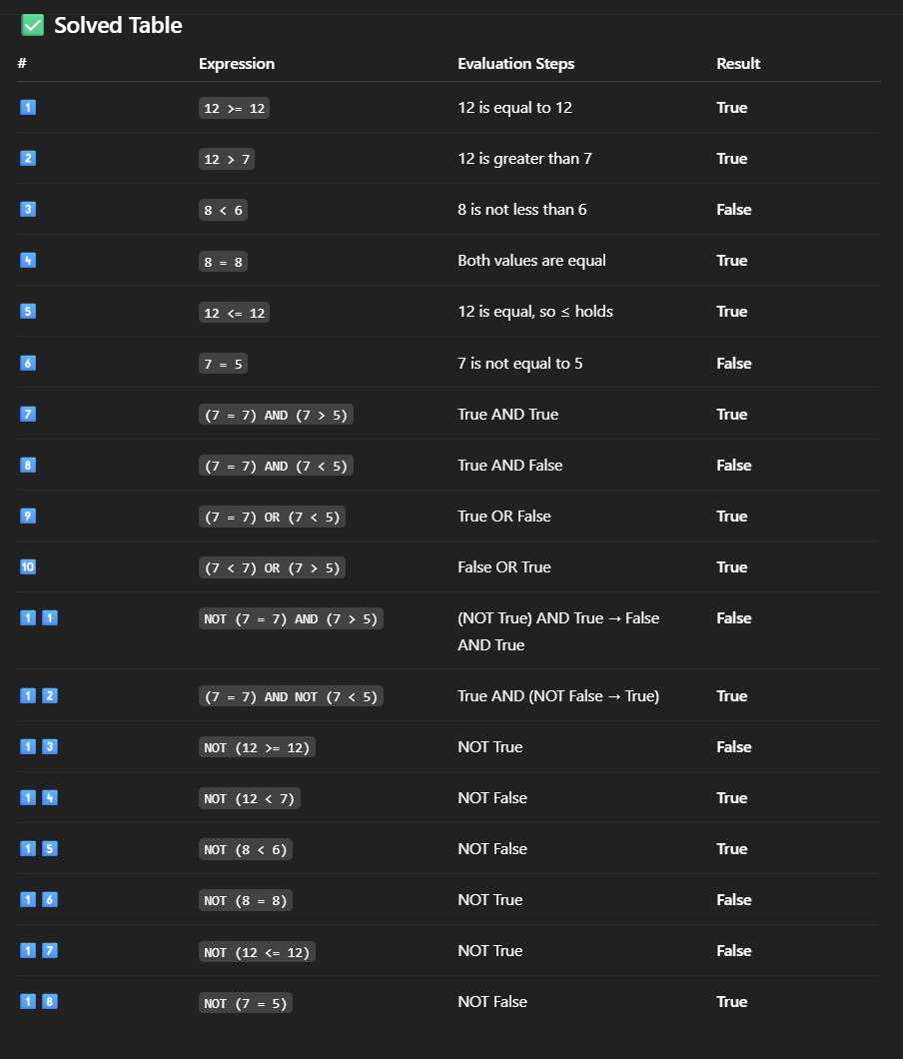
🧐 Activity Solution
📋 Solution:

Slide 34
🏁 Conclusion
✅ Math operators compute values; relational compare; logical combine decisions.
✅ Computers reduce conditions to True/False (1/0) and use AND/OR/NOT to decide program flow.
✅ Real policies map cleanly to logical expressions — a foundation you’ll reuse in every programming language.

Slide 35
Thank you ☺

