Slide 1

Programming Foundations
Level 1

Slide 2

Programming Foundations
Level 1
Calculation Priorities
2

Slide 3
Calculation Priorities (Math & Logic) — Do It In the Right Order
A huge part of programming (and math!) is doing operations in the correct order.
This lesson shows how to evaluate expressions correctly using operation priorities (parentheses, powers, multiply/divide, add/subtract) and logic priorities (NOT, AND, OR) — with step-by-step examples from the slides.

Slide 4
73% of people fail to solve this!
4 x 4 + 4 x 4 + 4 – 4 x 4
Stop the video now, try to solve it and come back
Why?!
The answer is
20
— yet the correct answer is 20 when you respect the rules. (not 36, 52, etc.).
Reason: priority for × and ÷ before + and −, and for the same rank, go left to right.

Slide 5
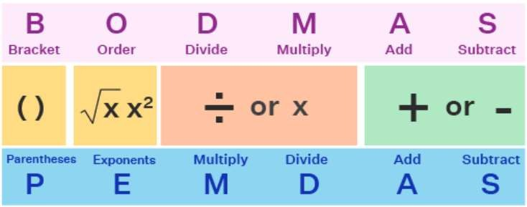
Order of Operations
1️⃣ Parentheses/Brackets first
2️⃣ Exponents/Orders (e.g., 2²)
3️⃣ M/D Multiply & Divide (left→right)
4️⃣ A/S Add & Subtract (left→right)
Keep in mind parentheses first and left-to-right for same-priority ops.
From Left to Right

Slide 6
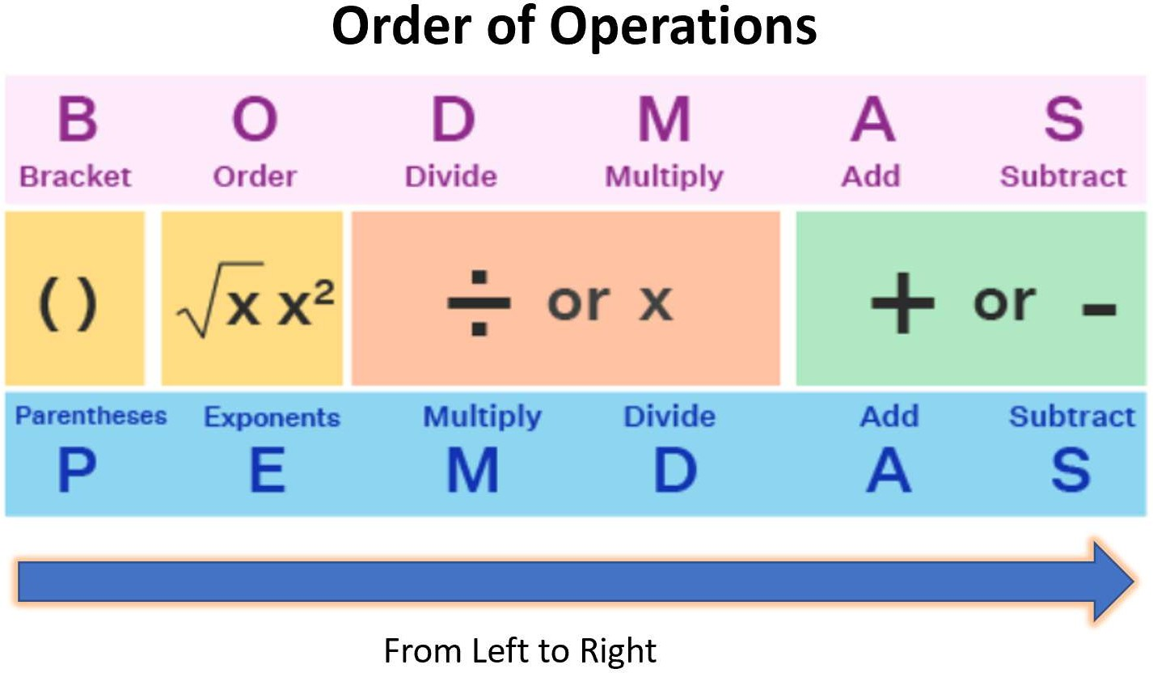
4 x 4 + 4 x 4 + 4 – 4 x 4
Example 1:
Solve this:
1
=16
2
=16
3
=16
4
=32
5 =36
6
=20

Slide 7
18 ÷ (9 - 2 × 3)
Example 2:
Solve this:
Inside parentheses + precedence:
18 ÷ (9 − 2 × 3)
Compute inside: 2 × 3 = 6 → (9 − 6) = 3
Then: 18 ÷ 3 = 6 ✅ (answer = 6).
1
=6
2
=3
3
=6

Slide 8
10 - [72 ÷ (4 + 5)]
Example 3:
Solve this:
Brackets within brackets:
10 − [72 ÷ (4 + 5)]
(4+5)=9, so 72 ÷ 9 = 8, then 10 − 8 = 2 ✅ (answer = 2).
1
=9
2
=8
3
=2

Slide 9
(6 × 2 - 6 - 1)×2²
Example 4:
Solve this:
Powers & grouping:
(6 × 2 − 6 − 1) × 2²
Inside: 6×2=12, 12−6=6, 6−1=5 → so (…) = 5
Power: 2² = 4 → 5 × 4 = 20 ✅ (answer = 20).
1
=12
4 =4
2 =6
3
=5
5
=20

Slide 10
4 x ( 2 + ( 7 x (5 - 3)))
Example 5:
Solve this:
Nested parentheses:
4 × ( 2 + ( 7 × ( 5 − 3 ) ) )
Innermost: 5−3=2 → 7×2=14 → 2+14=16 → 4×16=64 ✅ (answer = 64).
1
=2
2
=14
3
=16
4
=64

Slide 11
(1 + 20 − 9 ÷ 3²) ÷ (( 3 + 1)² + 8 ÷ 2 )
Example 6:
Solve this:
3 =21
1
=9
5
=4
7
=4
=16
2
=1
6
4
=20
8 =20
9
=1

Slide 12
Programming Foundations
Level 1
Logic Priorities
2

Slide 13
True AND ((9 > 2) OR (4 +2 = 5))
Solve this:
True AND ((9 > 2) OR (4 + 2 = 5))
(9>2) is True; (4+2=5) is False → (True OR False) = True
True AND True = True ✅ (result = True).
1 =True
2 =6
3
=False
4
= True
5
=True

Slide 14
🧐 Activity
📋 Instructions:
1️⃣ Parentheses → 2️⃣ Powers → 3️⃣ Multiply/Divide (left to right) → 4️⃣ Add/Subtract (left to right)
💡 Hint:
👉 Always start with what’s inside parentheses first.
👉 Simplify exponents before multiplication/division.
👉 Finally, perform addition and subtraction in order from left to right.
🔹 Set A
1️⃣ 6 ÷ 3 + 4 × 2
2️⃣ 6 × 4 − 12 ÷ 3 − 8
3️⃣ 4 × 4 − 3 × 3 − 16 ÷ 4
4️⃣ 20 − (3 × 23 − 5)
5️⃣ (5 + 2)² − 9 × 3 + 2³
6️⃣ (7 − √9) × (42 − 3 + 1)
🔹 Set B
1️⃣ 5 × (2² + 3) + (2³)²
2️⃣ 6 × 2 + 5 × 1 + 4 ÷ 2 − 1
3️⃣ 1 + (2 × (4 − 3 + 1) + 7) − 2
4️⃣ 10 + 6 × (3 − 2) × 8 ÷ 24 − 1
5️⃣ (20 − 18)³ ÷ 8 × 3 − 1
6️⃣ (2 + 1 − 3 + 1 + 4)² − 2 × 4

Slide 15
🧐 Activity Solution
📋 Solution:
🔹 Set A :
1️⃣ 6 ÷ 3 + 4 × 2
6 ÷ 3 = 2 → 4 × 2 = 8 → 2 + 8 = 10
2️⃣ 6 × 4 − 12 ÷ 3 − 8
6 × 4 = 24 → 12 ÷ 3 = 4 → 24 − 4 − 8 = 12
3️⃣ 4 × 4 − 3 × 3 − 16 ÷ 4
4 × 4 = 16 → 3 × 3 = 9 → 16 − 9 = 7 → 16 ÷ 4 = 4 → 7 − 4 = 3
4️⃣ 20 − (3 × 23 − 5)
3 × 23 = 69 → (69 − 5) = 64 → 20 − 64 = −44
5️⃣ (5 + 2)² − 9 × 3 + 2³
(5 + 2)² = 7² = 49 → 9 × 3 = 27 → 2³ = 8 → 49 − 27 + 8 = 30
6️⃣ (7 − √9) × (42 − 3 + 1)
√9 = 3 → (7 − 3) = 4 → (42 − 3 + 1) = 40 → 4 × 40 = 160

Slide 16
🔹 Set B :
1️⃣ 5 × (2² + 3) + (2³)²
2² = 4 → (4 + 3) = 7 → 5 × 7 = 35 → 2³ = 8 → 8² = 64 → 35 + 64 = 99
2️⃣ 6 × 2 + 5 × 1 + 4 ÷ 2 − 1
6 × 2 = 12 → 5 × 1 = 5 → 4 ÷ 2 = 2 → 12 + 5 + 2 − 1 = 18
3️⃣ 1 + (2 × (4 − 3 + 1) + 7) − 2
(4 − 3 + 1) = 2 → 2 × 2 = 4 → 4 + 7 = 11 → 1 + 11 − 2 = 10
4️⃣ 10 + 6 × (3 − 2) × 8 ÷ 24 − 1
(3 − 2) = 1 → 6 × 1 × 8 ÷ 24 = 48 ÷ 24 = 2 → 10 + 2 − 1 = 11
5️⃣ (20 − 18)³ ÷ 8 × 3 − 1
(20 − 18) = 2 → 2³ = 8 → 8 ÷ 8 = 1 → 1 × 3 = 3 → 3 − 1 = 2
6️⃣ (2 + 1 − 3 + 1 + 4)² − 2 × 4
(2 + 1 − 3 + 1 + 4) = 5 → 5² = 25 → 2 × 4 = 8 → 25 − 8 = 17

Slide 17
🏁 Conclusion
✅ Math priorities: () → powers → ×/÷ → +/− with left→right for ties.
✅ Logic priorities: Parentheses → NOT → AND → OR.
✅ Respecting priorities eliminates “trick” errors and aligns your math with how compilers/interpreters evaluate expressions.

Slide 18
Thank you ☺

