Slide 1

Programming Foundations
Level 1

Slide 2

Programming Foundations
Level 1
Variables & Constants:
How Programs Store Data
2

Slide 3
Programming Foundations
Level 1
What is a Variable?
2

Slide 4
Variables & Constants: How Programs Store Data
Programs need a place to store information while they run.
That place is a variable—a named container in memory that holds a value you can read and change. Sometimes you also need a constant—a container you cannot change after setting it.
In this lesson you’ll see how data lives in memory cells, what a memory address is, what an identifier means, and how to choose the right type without wasting memory.

Slide 5

A variable is a container for storing data values you’ll reuse during program execution.

Slide 6
What are Variables?
Variables are containers for storing data values
VARIABLES are used to store data.
Storing information is useful when you want to reuse that information many times or use it at different times while running a program.
🔹 Think “kitchen containers”: you pick the right size and label it for what it holds.

Slide 7


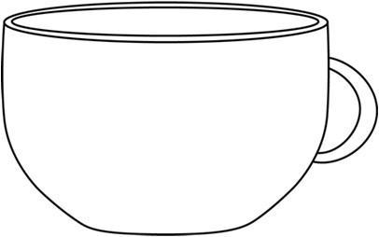
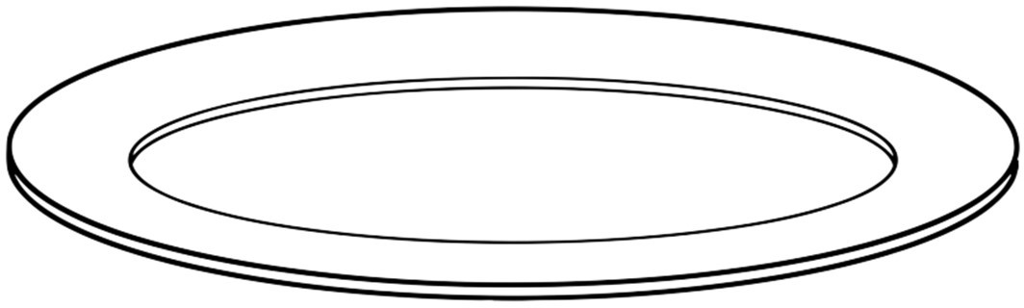
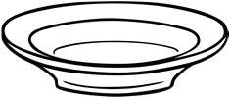


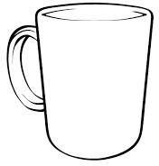
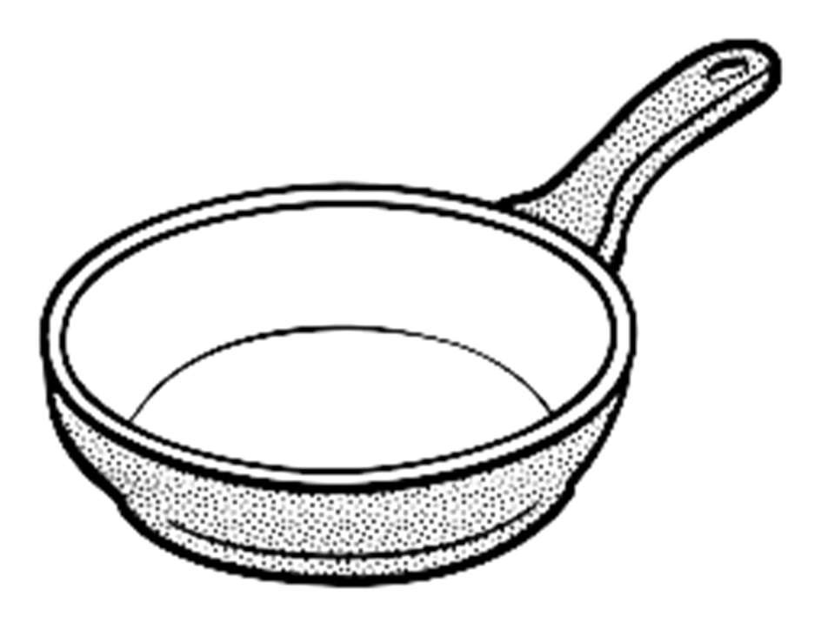
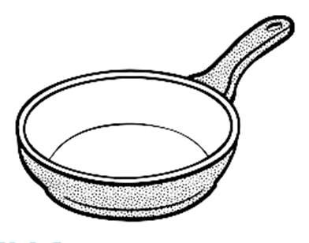
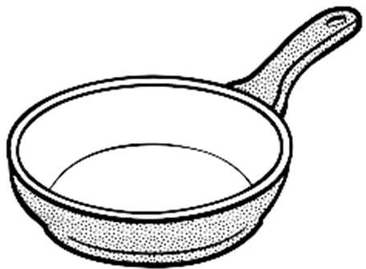
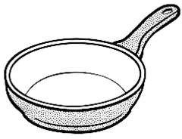
In the kitchen
Containers
Can you use this for one Egg?

Slide 8
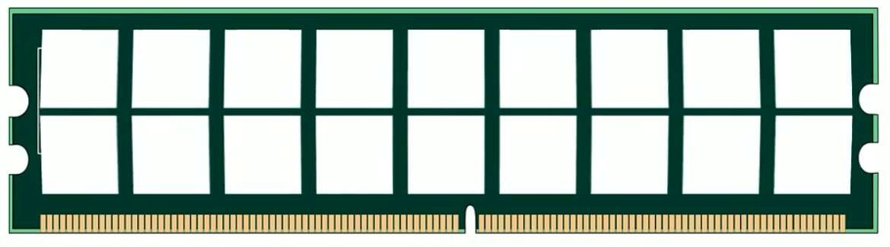
Anatomy of a Variable (RAM view)
RAM
Type
Memory Location
Memory Cell
45
Name: Age Value: 45
Address: 0x7fff5694dc58
Int Age = 45
Identifier
Value

Slide 9
For a single variable you always have:
🟨 Address (e.g., 0x7fff...) → Location in memory (hexadecimal)
🟨 Type (e.g., Int, Float, String, Boolean)
🟨 Identifier (Name) (e.g., Age)
🟨 Value (e.g., 45)
🟨 Memory Cell (the physical slot that holds the bits)

Slide 10
Anatomy of a Variable (RAM view)
RAM
Memory Cell
Memory Cell
Name: Age
Address: 0x7fff5694dc58
X
Int Age = 45 Age = Age + 2 Age = 45 + 2
Age = 47
45
47

Slide 11
Example :
🟨 Type: Int
🟨 Identifier (Name): Age
🟨 Value: 45
🟨 Memory cell: a slot in RAM that actually stores the bits
🟨 Memory address: where this cell lives (shown in hex, e.g., 0x7fff5694dc58)
Updating a variable:
Age = Age + 2 → from 45 to 47. The same cell gets a new value.

Slide 12
Programming Foundations
Level 1
Variable Types
2

Slide 13
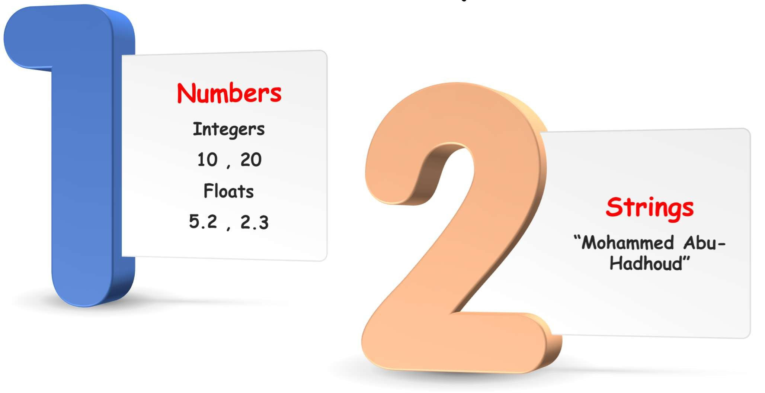
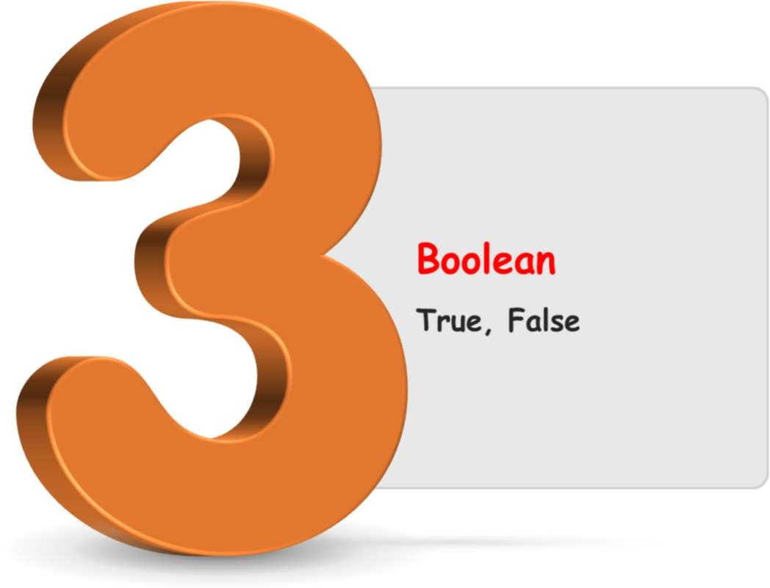
Primary Variable Types
🟨 Integer (Int): whole numbers (e.g., 0, 45, −3)
🟨 Float/Double: numbers with fractions (e.g., 3.14)
🟨 String: text (e.g., “Sara")
🟨 Boolean: True/False (1/0)

Slide 14
Programming Foundations
Level 1
Constants
2

Slide 15
What are Constants?
Constants are containers for storing data values, but they are read only.

Slide 16

Type
Memory Location
Memory Cell
Name: PI Value: 3.14
Address: 0x7ffd5794dc58
Const Float PI = 3.14
3.14
Identifier
Value

Slide 17

Memory Cell
Name: PI Value: 3.14
Address: 0x7ffd5794dc58
Const Float PI = 3.14
3.14
PI = PI + 2
Error
🔹 A constant is also a container for storing data, but read-only after initialization.
🔹 If you try to assign a new value → Error.
Example: Const Float PI = 3.14 → PI = PI + 2 ❌ (not allowed).

Slide 18
Programming Foundations
Level 1
Performance Tips
2

Slide 19

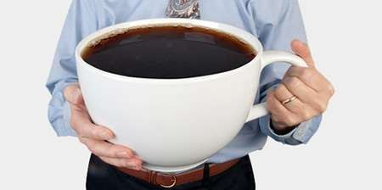
If you want to drink coffee, then..
It is ok to Drink Coffee like this. It is not ok to drink it like this.

Slide 20
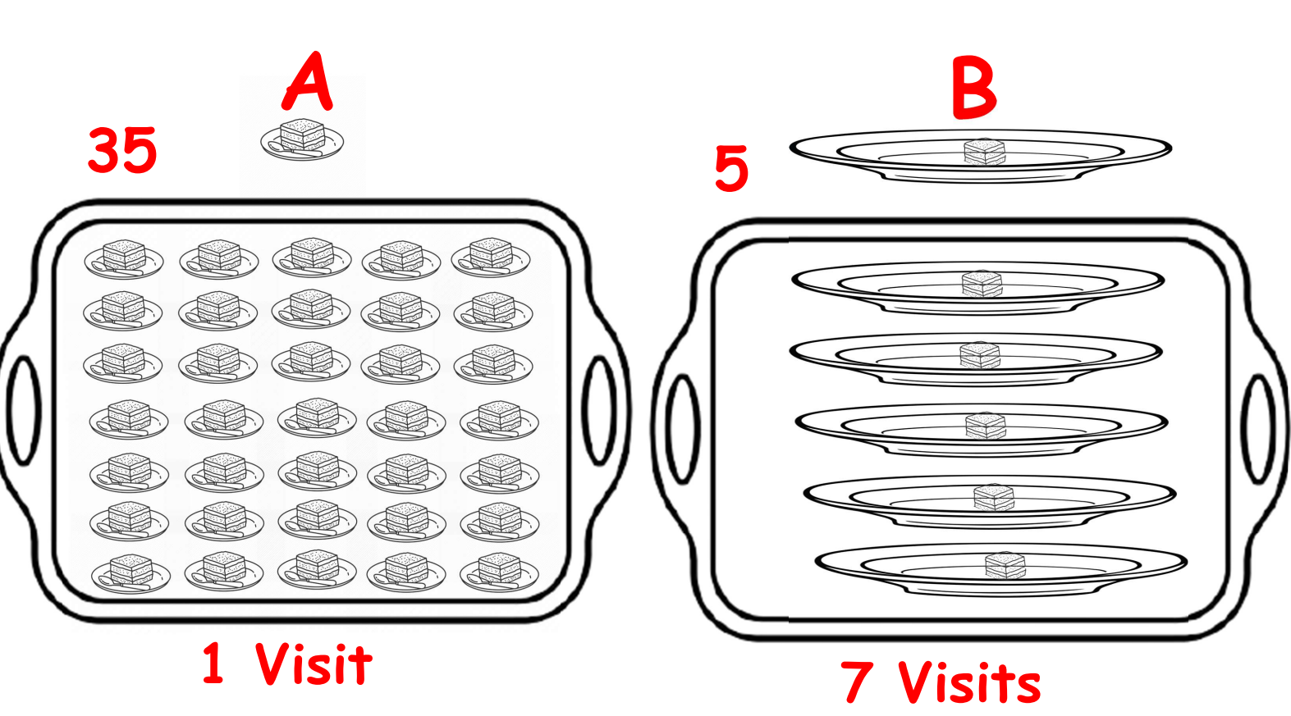

Slide 21
Don’t waste memory !!!!!
Age
Human lives 100-150 years Maximum number you need is 150
4,294,967,295
🟨 Choose the smallest sensible type for the real-world range.
🟨 Example : human Age will never be 4,294,967,295; typical max ~150 → don’t reserve a huge type unnecessarily.
🟨 Fewer/lighter variables → fewer memory space → better performance.

Slide 22
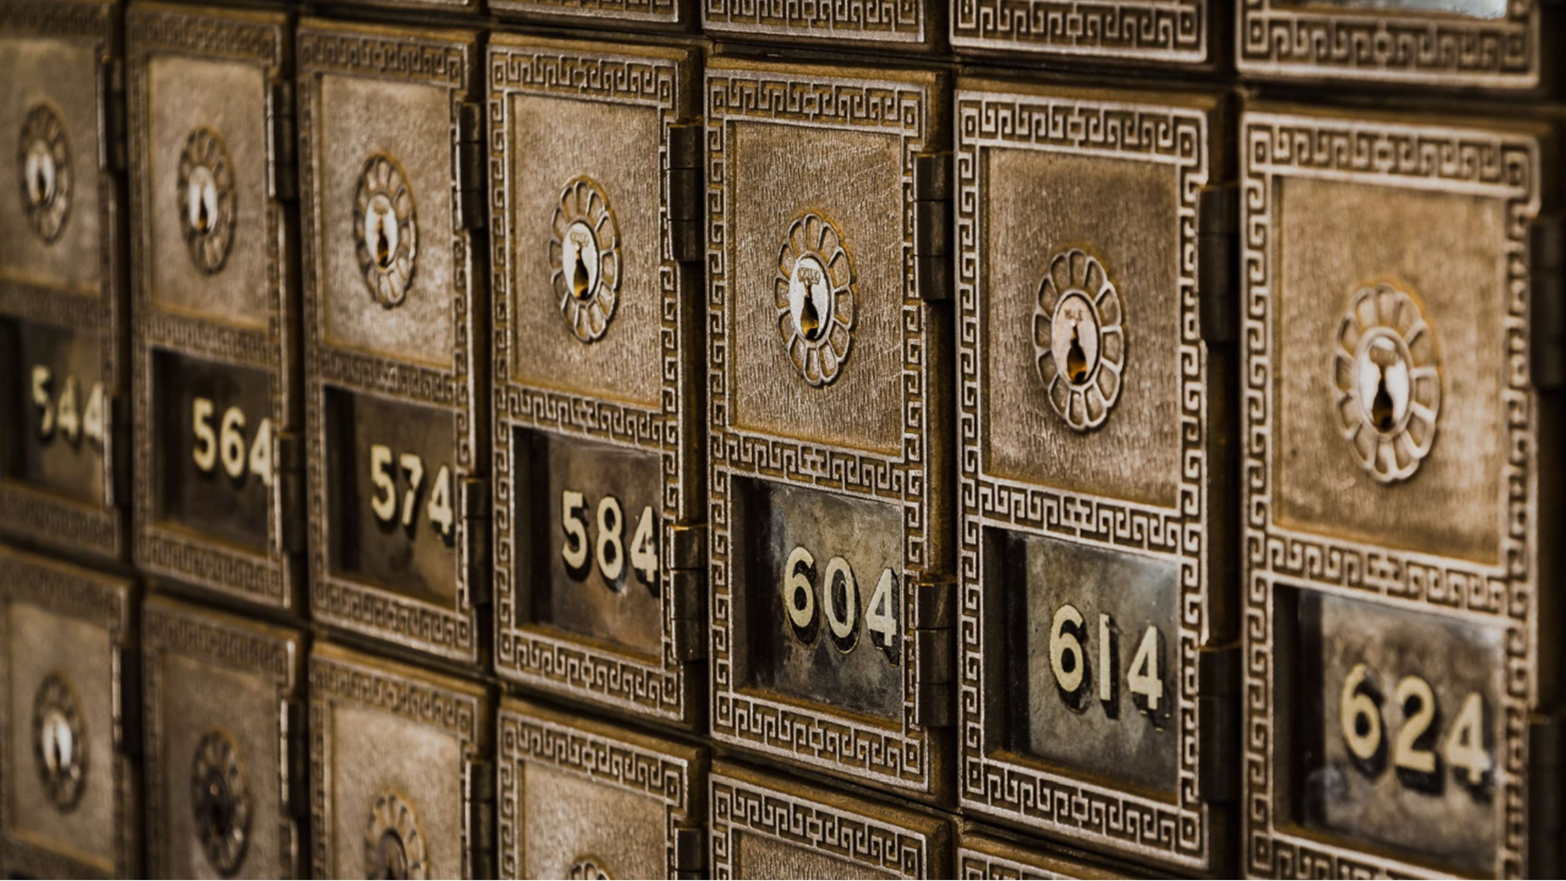

Slide 23
🧬 Characteristics
1️⃣ Variable → mutable (can be changed) value in a memory cell.
2️⃣ Constant → immutable (cannot be changed) value; compile/runtime prevents changes.
3️⃣ Identifier → human-friendly name bound to a memory location.
4️⃣ Address → precise location in RAM (shown in hexadecimal).
5️⃣ Type → defines what kind of data and how much memory to use.

Slide 24
🧬 Characteristics
🔹 Type decides size/format → impacts performance and limits.
🔹Identifier ↔ Address: name you use vs where it lives in RAM.
🔹Variable vs Constant: mutable vs read-only; both are containers but with different rules.
By carefully choosing names, types, and mutability, you write code that’s clear, safe, and fast. 🚀

Slide 25
🧐 Activity
📋 Instructions:
Write your answers clearly and concisely.
1️⃣ What is a Variable, and why do we need it?
2️⃣ What is a Constant, and why do we need it?
3️⃣ What is a Memory Cell?
4️⃣ What is an Identifier?
5️⃣ What is a Memory Address, and what is its relation to location in memory?
6️⃣ Which numbering system is used to represent memory addresses?
7️⃣ Mention the primary types of variables.
8️⃣ What are the number types, and give examples for each.
9️⃣ What is a String, and give an example of it.
🔟 What is a Boolean, and give an example of it.

Slide 26
🧐 Activity Solution
📋 Solution:
1️⃣ What is a Variable, and why do we need it?
A variable is a container in memory that stores data temporarily while the program runs.
We need it to hold, update, and reuse information such as names, numbers, or results.
2️⃣ What is a Constant, and why do we need it?
A constant is a read-only container whose value cannot change once assigned.
We need it to protect fixed values (like π = 3.14) from being modified accidentally.
3️⃣ What is a Memory Cell?
A memory cell is a small storage unit in RAM that holds the binary bits of a variable’s value.
4️⃣ What is an Identifier?
An identifier is the name given to a variable or constant so the programmer can refer to it easily (e.g., Age, PI).
5️⃣ What is a Memory Address, and what is its relation to location in memory?
A memory address is the exact location of a memory cell inside the computer’s RAM.
Each variable is stored at a unique address — just like houses have unique addresses.

Slide 27
6️⃣ Which numbering system is used to represent memory addresses?
Memory addresses are represented in hexadecimal (base 16) form, e.g., 0x7FFF89A2.
7️⃣ Mention the primary types of variables.
Integer (Int) → whole numbers (e.g., 25)
Float/Double → decimal numbers (e.g., 3.14)
String → text (e.g., "Omar")
Boolean → True/False (e.g., True)
8️⃣ What are the number types, and give examples for each.
Integer (Int): Whole numbers (e.g., −10, 0, 150)
Float (Decimal): Numbers with fractions (e.g., 3.5, 7.25)
9️⃣ What is a String, and give an example of it.
A String stores text or characters, written between quotation marks.
Example: "Hello World" or "Mohammed".
🔟 What is a Boolean, and give an example of it.
A Boolean represents True or False values used in decisions.
Example: IsStudent = True or HasLicense = False.

Slide 28
🏁 Conclusion
✅ A variable is a named memory cell at an address that holds a typed value you can change.
✅ A constant is the same concept but immutable—great for safety.
✅ Always pick the right type and avoid wasting memory; it keeps programs efficient and reliable.

Slide 29
Thank you ☺

