Slide 1

Computer Foundations
Level 2

Slide 2

Computer Foundations
Level 2
What is
Networks?
2

Slide 3
What is Network?
Network: is a group of connected computer and devices.
For example, the computers, phones, and other devices that your family owns are all part of your home computer network.
When you get a new tablet and enter in the Wi-Fi password, you’re joining that tablet to your home computer network.
Why do we need Network?
Devices in the same network can easily communicate and share resources with each other.
For example : you can control your TV with your mobile, or you can stream videos from your mobile to your TV.

Slide 4
Computer Foundations
Level 2
Network Types
2

Slide 5
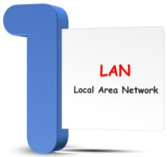

Network Types

Slide 6
Computer Foundations
Level 2
1- LAN
2

Slide 7
What is LAN?
LAN: Local Area Network that has a group of connected devices.
LAN is a type of network made up of nearby computers.
A LAN can have anywhere from a few devices (like a home network) to hundreds of devices (like a school or hospital)
Large organizations like colleges can have multiple LANs - maybe one per building.

Slide 8
Computer Foundations
Level 2
Communicating on LAN
2

Slide 9
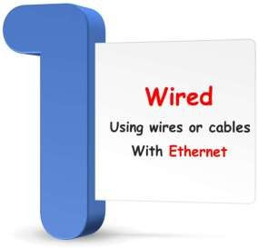
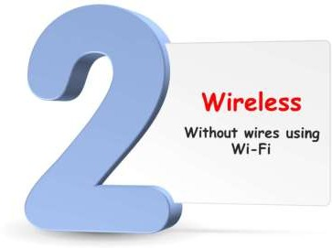
Connection Types

Slide 10
Computer Foundations
Level 2
2- WAN
2

Slide 11
What is WAN?
WAN: Wide Area Network.
WAN is made of connected LANs that are far from each other (like in different parts of the country or world).
WANs connect thousands or even millions of devices.

Slide 12

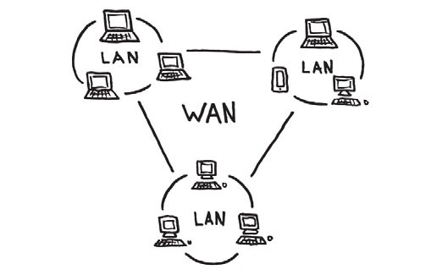

Slide 13
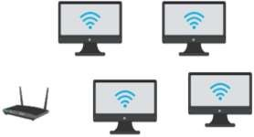
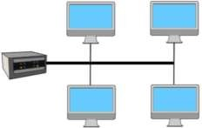
Communication Ways
Switch
Router
Ethernet
that computers follow
Wireless
Rules
that computers follow
Rules
for communicating through a radio signals
for communicating on a wired network
Those Rules are called:
Protocol
Wi-Fi is a popular way to connect wirelessly to a network.
Wi-Fi: Wireless Fidelity
Protocol: is a standard set of rules for how devices communicate through wires or wireless

Slide 14


Slide 15
Answer the following questions:
What is network?
Why do we need network?
What is LAN vs WAN?
How computers communicate together?
What is Ethernet?
What is Wireless?
What is Protocol?
What is Wi-Fi?
Wi-Fi stands for what?

Slide 16
Thank you ☺

