Slide 1

Computer Foundations
Level 2

Slide 2

Computer Foundations
Level 2
MAN
Metropolitan Area Network
2

Slide 3
Computer Foundations
Level 2
What is
Networks?
2

Slide 4
What is Network?
Network: is a group of connected computer and devices.
For example, the computers, phones, and other devices that your family owns are all part of your home computer network.
When you get a new tablet and enter in the Wi-Fi password, you’re joining that tablet to your home computer network.
Why do we need Network?
Devices in the same network can easily communicate and share resources with each other.
For example : you can control your TV with your mobile, or you can stream videos from your mobile to your TV.

Slide 5
Computer Foundations
Level 2
Network Types
2

Slide 6
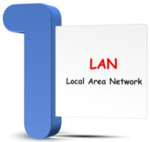

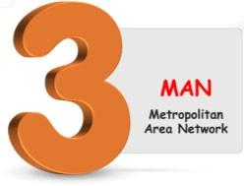
Network Types

Slide 7
Computer Foundations
Level 2
1- LAN
2

Slide 8
What is LAN?
LAN: Local Area Network that has a group of connected devices.
LAN is a type of network made up of nearby computers.
A LAN can have anywhere from a few devices (like a home network) to hundreds of devices (like a school or hospital)
Large organizations like colleges can have multiple LANs - maybe one per building.

Slide 9
Computer Foundations
Level 2
2- WAN
2

Slide 10
What is WAN?
WAN: Wide Area Network.
WAN is made of connected LANs that are far from each other (like in different parts of the country or world).
WANs connect thousands or even millions of devices.

Slide 11

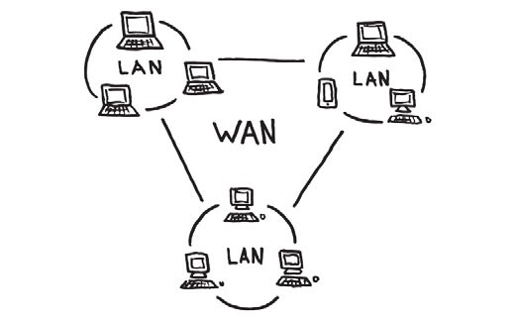

Slide 12
Computer Foundations
Level 2
3- MAN
2

Slide 13
What is MAN?
MAN: Metropolitan Area Network.
It is a medium-sized network Larger than LAN and Smaller than WAN.
MAN can cover a broad area such as cities and towns.

Slide 14
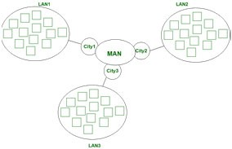
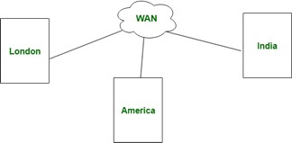

Slide 15




MAN
WAN
VS
MAN stands for Metropolitan Area Network
WAN stands for Wide area network.
Faster Transmission Speed, less latency
Slower Transmission Speed, high letancy
Less noise and error
Diffrences
More noise and error
MAN has moderate congestion.
WAN has high congestion
Low cost of installation & design
High cost of installation and design

Slide 16
Thank you ☺

