Slide 1

Computer Foundations
Level 2

Slide 2

Computer Foundations
Level 2
What is Server?
2

Slide 3
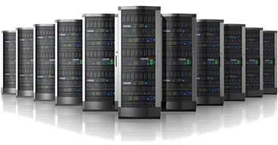
What is Server?
Server:
is a type of computer that shares information with other computers.
The ultimate function of a server is to receive, store, process, and share data.
It provides services to others.

Slide 4
Server can be a software

Slide 5
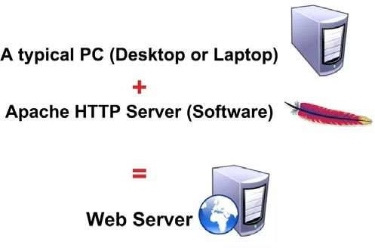
Your laptop can be a server ☺

Slide 6
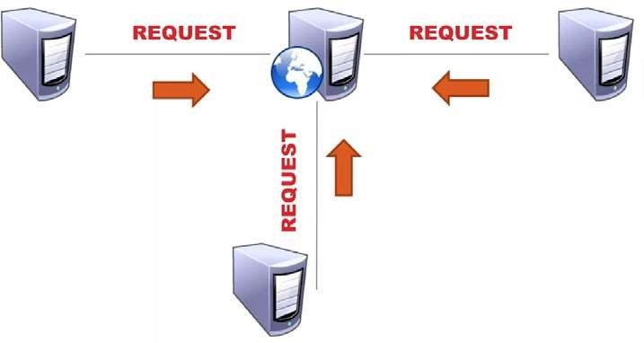

Slide 7
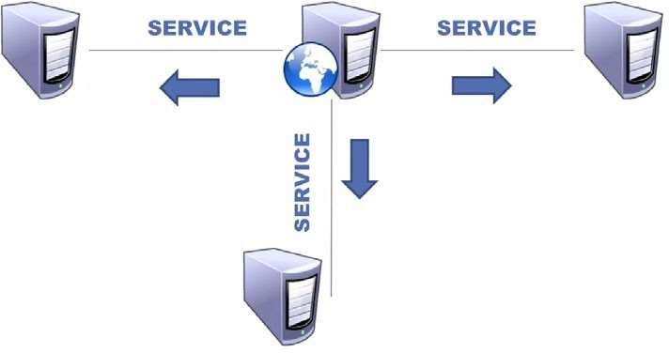

Slide 8
Computer Foundations
Level 2
Server vs PC
2

Slide 9
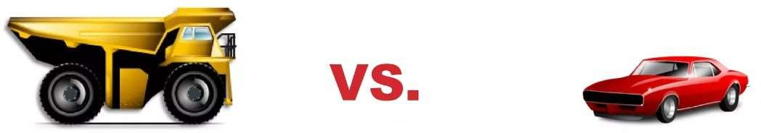
Server vs PC

Slide 10




Server
PC
VS
High relaiability & Dependability
Less Relaiability & Dependability
High performance
Less performance
Can run for years without shudown
Diffrences
Cannot run for years without shutdown
Less mainance cost
High maintenance cost
High Price
Less Price

Slide 11
Computer Foundations
Level 2
Types of Server
2

Slide 12










Some Types of Servers
Web Server
Application Server
File Server
VoIP Server
Printing/Fax Server
Mail Server
Database Server
Image Server
Game Server
Many Other Servers

Slide 13
Computer Foundations
Level 2
Forms of Server
2

Slide 14


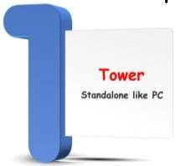
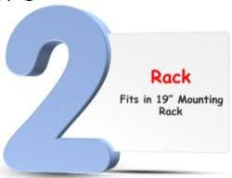

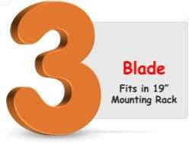

Forms of Servers

Slide 15
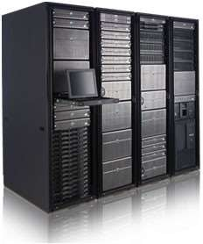
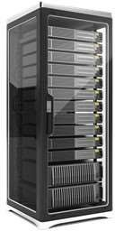
Racks

Slide 16
Thank you ☺

