Slide 1

Computer Foundations
Level 2

Slide 2

Computer Foundations
Level 2
MAN
How Data is
Transferred?
2

Slide 3

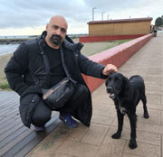


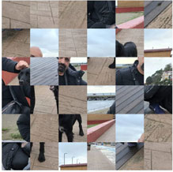



Slide 5
BUT!!!
Who is Responsible for this?

Slide 6


Who is responsible for this?
Packet2 Packet1

Slide 7
Will answer you in
the coming lessons ☺

Slide 8
Thank you ☺

