Slide 1
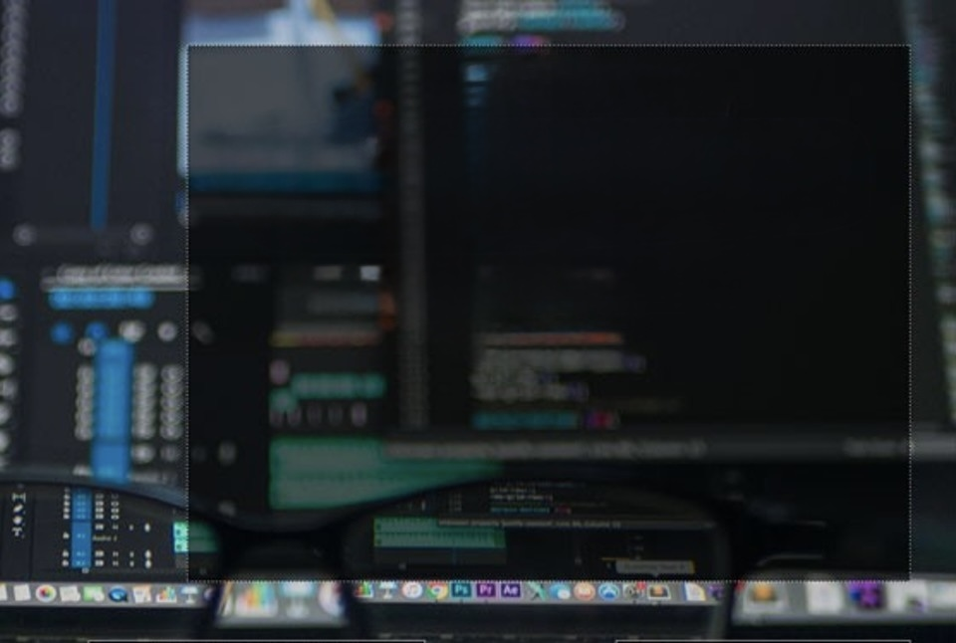
Computer Foundations
Level 2

Slide 2

Computer Foundations
Level 2
Transsion Control
Protocol (TCP)
2

Slide 3

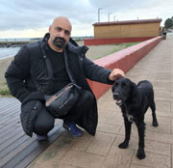



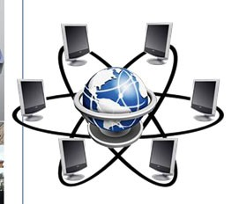
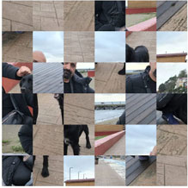


Who is responsible for this?
Packet2 Packet1

Slide 4
TCP Transmission Control Protocol
Packet2 Packet1

Slide 5
TCP: Transmission Control Protocol Responsible for:
TCP defines how applications can create channels of communication across a network.
It also manages how a message is assembled into smaller packets before they are then transmitted over the internet. and reassembled in the right order at the destination address.

Slide 6
BUT!!!
Something is missing!!

Slide 7
How Computers Know the address of each others?
Packet2 Packet1

Slide 8
Will answer you in
the coming lessons ☺

Slide 9
Thank you ☺

