Slide 1

Computer Foundations
Level 2

Slide 2

Computer Foundations
Level 2
IP Part 1 (IPV4)
2

Slide 3
Computer Foundations
Level 2
Communicating on LAN
2

Slide 4
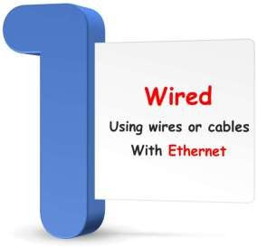
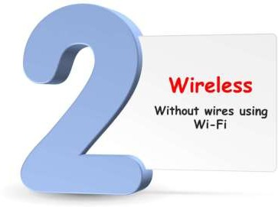
Connection Types

Slide 5
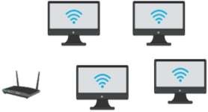
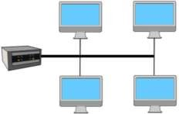
Communication Ways
Switch
Router
Ethernet
that computers follow
Wireless
Rules
that computers follow
Rules
for communicating through a radio signals
for communicating on a wired network
Those Rules are called:
Protocol
Wi-Fi is a popular way to connect wirelessly to a network.
Wi-Fi: Wireless Fidelity
Protocol: is a standard set of rules for how devices communicate through wires or wireless

Slide 6
Computer Foundations
Level 2
How Network Reaches
Computeror Devices?
2

Slide 7





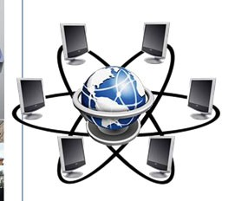



How Computers Know the address of each others?
Packet2 Packet1

Slide 8


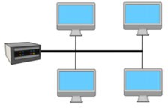
How to locate certain device?
Switch

Slide 9
What is IP Address?
Every computer on an Ethernet network is given an IP address.
An IP address, like your home's street address, identifies network machines.
Because each computer has its own IP address, it aids traffic flow between them.
(IP address) is a numerical identifier that is connected with a certain computer or computer network.
When computers are connected to the internet or Network, the IP address allows them to send and receive data.

Slide 10

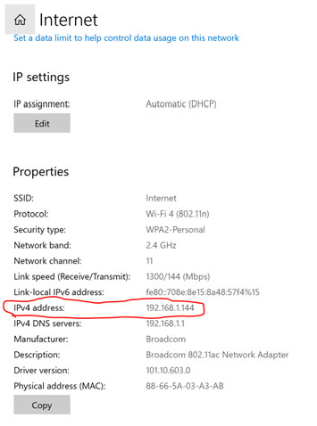



Slide 11
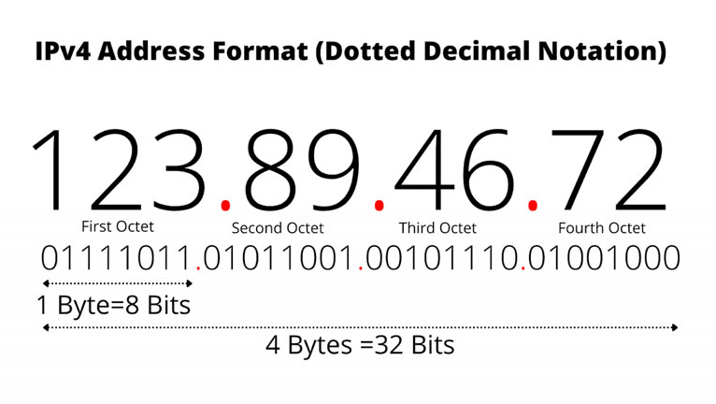

Slide 12
What is IP Stands for?
IP: is Internet Protocol.
The acronym IP stands for "Internet Protocol," which is a collection of rules that regulate the format of data transferred over the internet or a local network.

Slide 13
Thank you ☺

