Slide 1

Computer Foundations
Level 2

Slide 2

Computer Foundations
Level 2
IP Part 2 (IPV6)
2

Slide 3


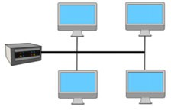
How to locate certain device?
Switch

Slide 4


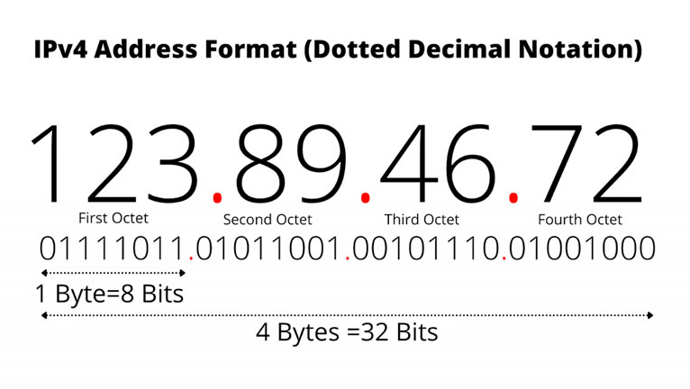

provides 232 (4,294,967,296) addresses

Slide 5
Computer Foundations
Level 2
(4,294,967,296)
addresses
Is That Enough?
2

Slide 6
Computer Foundations
Level 2
(4,294,967,296)
addresses
It Was Enough, now
NO NO NO
2

Slide 7
Computer Foundations
Level 2
What is the solution?!
2

Slide 8
Computer Foundations
Level 2
Simply IPv6 ☺
2

Slide 9
provides 232 (4,294,967,296) addresses

Slide 10
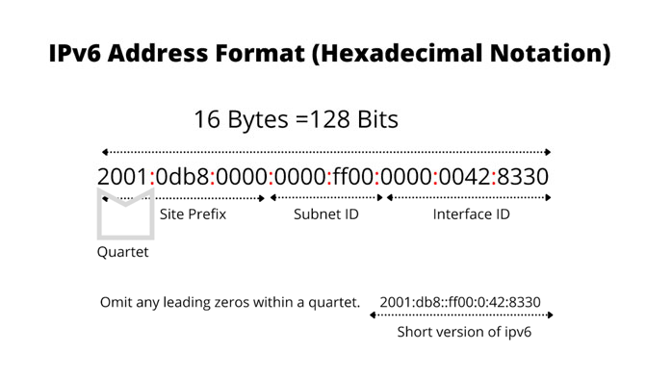
provides 232 (4,294,967,296) addresses

Slide 11
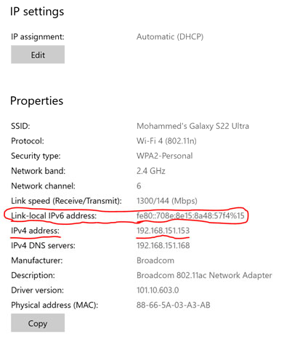

Slide 12

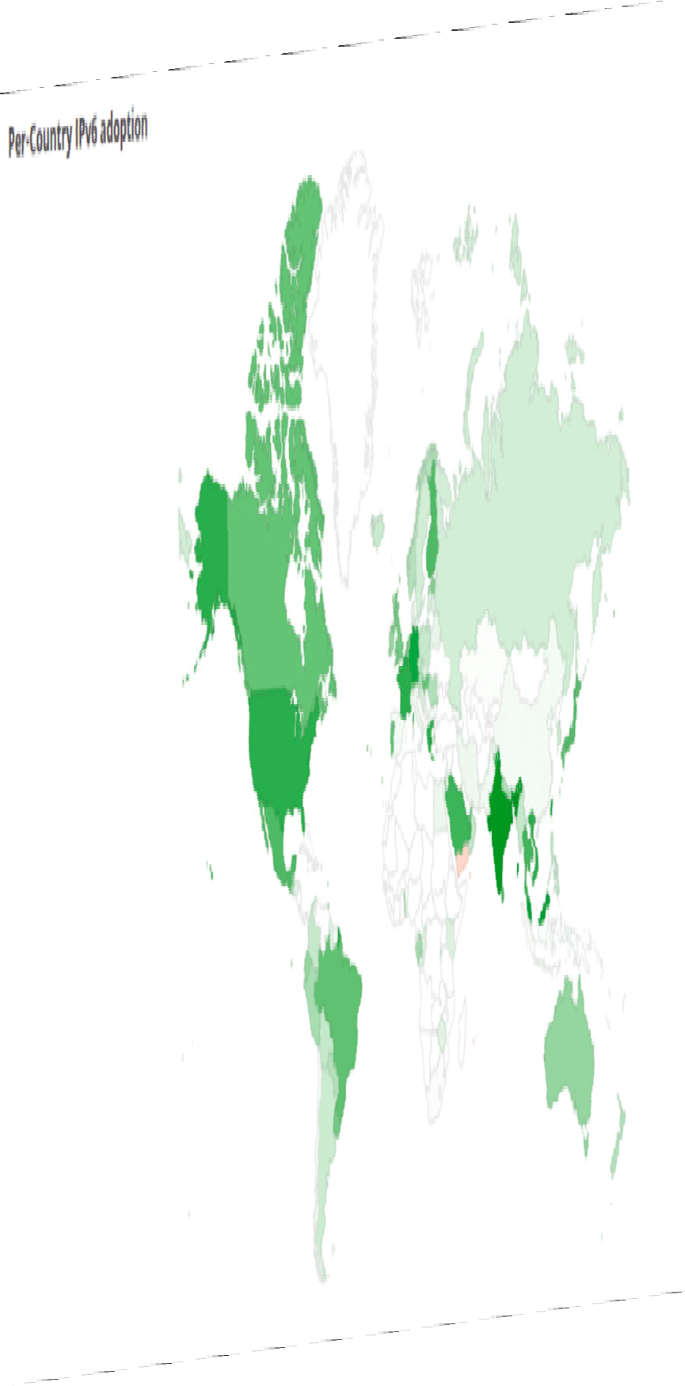

Slide 13
Thank you ☺

