Slide 1

Computer Foundations
Level 2

Slide 2

Computer Foundations
Level 2
Modem vs Router vs
Gateway
2

Slide 3
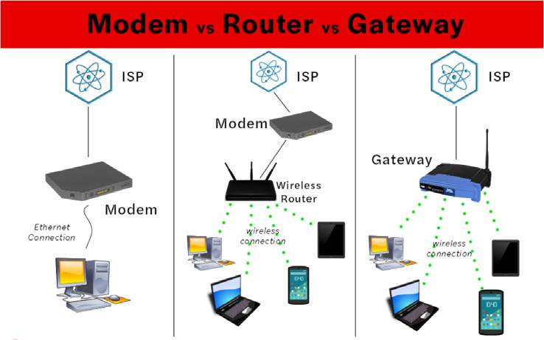
DSL or Cable or Fiber
2.4 GHz
Or
5 GHz

Slide 4
Computer Foundations
Level 2
What is Gateway?
2

Slide 5
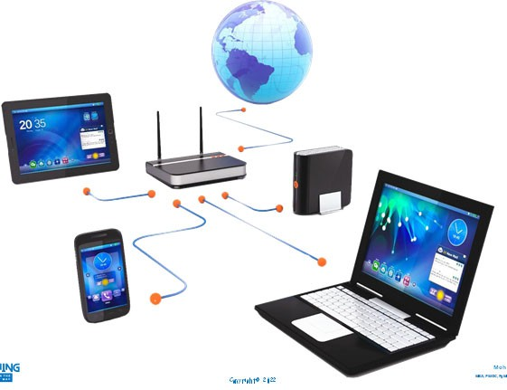

Slide 6

What is Gateway?
Gateway is:
A computer that sits between different networks or applications.
The gateway converts information, data or other communications from one protocol or format to another.
A router may perform some of the functions of a gateway.
An Internet gateway can transfer communications between an enterprise network and the Internet.

Slide 7
Computer Foundations
Level 2
Is gateway same as
router?
2

Slide 8
Is gateway same as router?
A router is a device that is capable of sending and receiving data packets between computer networks.
A Gateway, on the other hand, joins dissimilar systems.
Gateway it is defined as a network entity that allows a network to interface with another network with different protocols.

Slide 9
Computer Foundations
Level 2
Is gateway better
than router?
2

Slide 10
Is gateway better than router?
It Depends:
If your devices are on the same network, then routers and gateways can be peer to peer.
But if you want to connect two different networks with different protocols, the gateway can suit your demands.

Slide 11
Computer Foundations
Level 2
What is Mesh
Network?
2

Slide 12
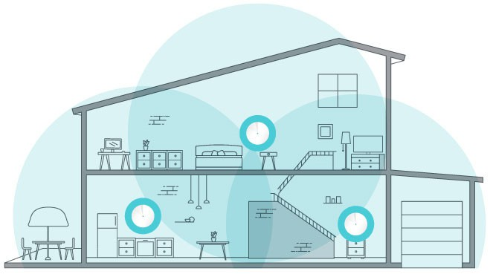
Mesh Network

Slide 13
What is Mesh Network?
Mesh networks still have a router that connects to a modem, but it includes mini WiFi devices that are set up around your home.
These mini WiFi devices, or nodes, communicate with each other and repeat the signal from your router from one node to another, which can extend the range of your wireless network.
This means that your Wi-Fi connection will be strong in every corner of your house, even in areas where you may have previously had a hard time connecting.

Slide 14
Thank you ☺

