Slide 1

Computer Foundations
Level 2

Slide 2

Computer Foundations
Level 2
IP Part 4(DHCP)
2

Slide 3
Computer Foundations
Level 2
What is DHCP?
2

Slide 4
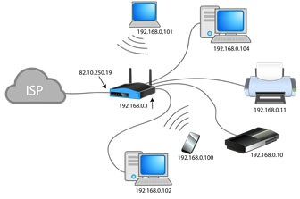
What is DHCP?
DHCP: Dynamic Host Configuration Protocol
DHCP is a client/server protocol that automatically provides an Internet Protocol (IP) host with its IP address and other related configuration information.

Slide 5
Thank you ☺

