Slide 1

Computer Foundations
Level 2

Slide 2

Computer Foundations
Level 2
IP Part 5
(NAT and Mapping)
2

Slide 3
Computer Foundations
Level 2
What is NAT & IP
Mapping?
2

Slide 4

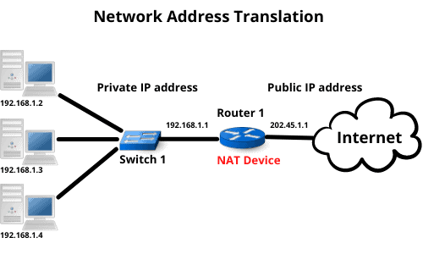

Slide 5
What is NAT and IP Mapping?
NAT: Network Address Translation
It is a technique implemented in network gateways (typically a router); it maps the private IP addresses of the locally connected devices to its own public IP address.
Which means all the locally connected devices can access the Internet using a similar public IP address of the gateway.
The router keeps track of the addresses and data routing in a NAT table, which the router maintains in its working memory to distinguish communication data of different devices. The following paragraph explains the concept of NAT and IP mapping.

Slide 6
Big Question????
How Does the router distinguish that the data received by public IP should go to which program in that device?

Slide 7
The answer is:
In the next lesson ☺

Slide 8
Thank you ☺

