Slide 1

Computer Foundations
Level 2

Slide 2

Computer Foundations
Level 2
ISP
2

Slide 3
Computer Foundations
Level 2
What is ISP?
2

Slide 4
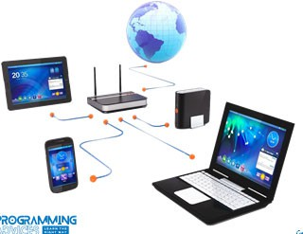


What is ISP?
ISP: Internet Service Provider
ISP is a company that provides Internet connections and services to individuals and organizations.

Slide 5
Thank you ☺

