Slide 1

Computer Foundations
Level 2

Slide 2

Computer Foundations
Level 2
Port/Socket
2

Slide 3
Computer Foundations
Level 2
What is Port?
2

Slide 4
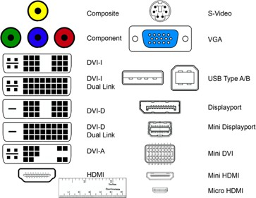
Hardware Port:

Slide 5




A Server can have many Services on it
Web and Email Server 192.168.1.2
Web Server
Mail Server

Slide 6
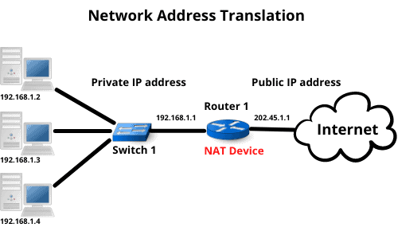
A Server can have many Services on it
Web and Email Server 192.168.1.2

Slide 7
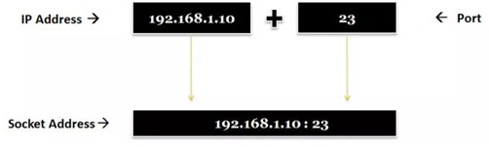
Software Port:
In networking, a socket is used to allow many processes within a single or different host to use TCP communication simultaneously.
a port is a number assigned to uniquely identify a connection endpoint and to direct data to a specific service.

Slide 8
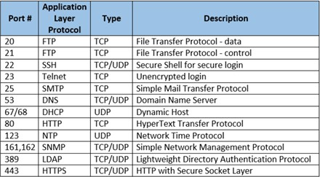
Software Port:

Slide 9
Thank you ☺

