Slide 1

Computer Foundations
Level 2

Slide 2

Computer Foundations
Level 2
Subnet
2

Slide 3
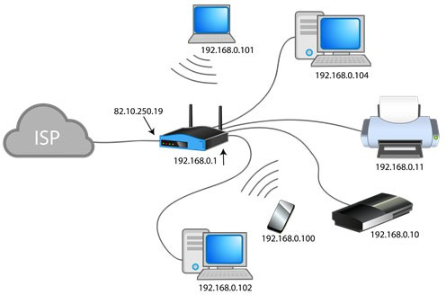

Slide 4
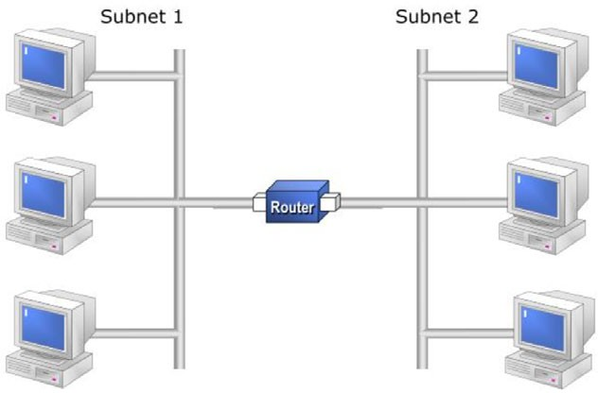

Slide 5
Computer Foundations
Level 2
What is Subnetting?
2

Slide 6
What is Subnetting?
Subnetting is the practice of dividing a network into two or more smaller networks. It increases routing efficiency, enhances the security of the network.

Slide 7
203.177.100.2
Network ID
IP
Host (Device) ID
Network Identifier: The first part of the IP address is the network identifier that identifies the network segment in which the computer is located. The same network identifier is required for all computers in the same segment, just as all houses in a particular county must have the same postal code.
Host identifier: The second part of the IP address is the host identifier, which identifies a computer, router, or other device within a segment. The host identifier must be unique within the network segment, just as the street name for a house within the postcode area must be unique.

Slide 8
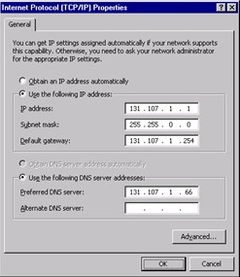
Subnet Mask

Slide 9
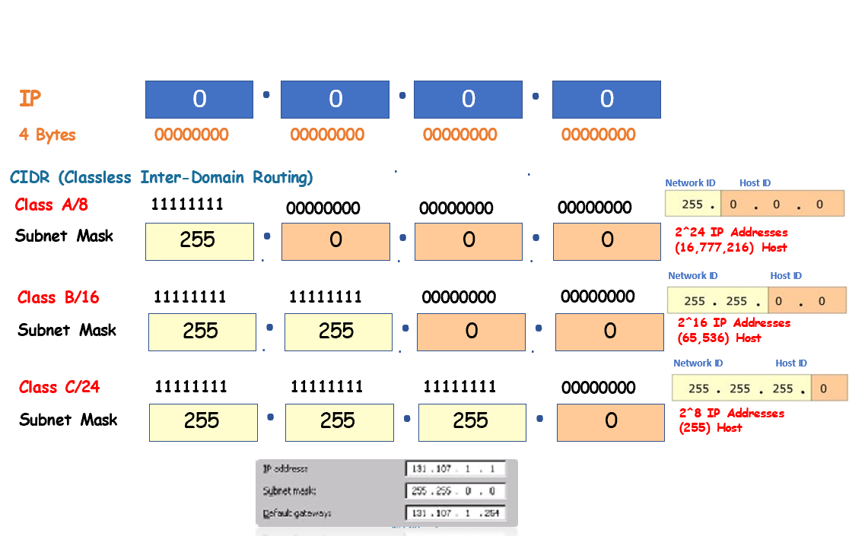

Slide 10
Subnet Mask

Slide 11
Thank you ☺

