Slide 1

Computer Foundations
Level 2

Slide 2

Computer Foundations
Level 2
Mac Address
2

Slide 3
Computer Foundations
Level 2
What is Mac Address?
2

Slide 4
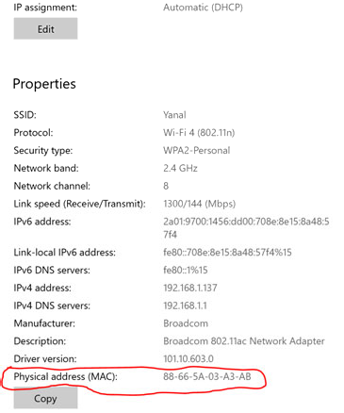
What is Mac Address?

Slide 5
What is Mac Address?
MAC : Media Access Control address: is a hardware identifier that uniquely identifies each device on a network. Primarily, the manufacturer assigns it.
MAC address is a unique number which is used to track a device in a network.
MAC address provides a secure way to find senders or receivers in the network.
It helps prevent unwanted network access.
Mac address is also used in Wi-Fi networks at the airport for a specific device in order to identify it.

Slide 6
Thank you ☺

