Slide 1

Computer Foundations
Level 2

Slide 2

Computer Foundations
Level 2
What IP Address
Reveals about us?
2

Slide 3
Computer Foundations
Level 2
Where our IP Address
Is shared?
2

Slide 4
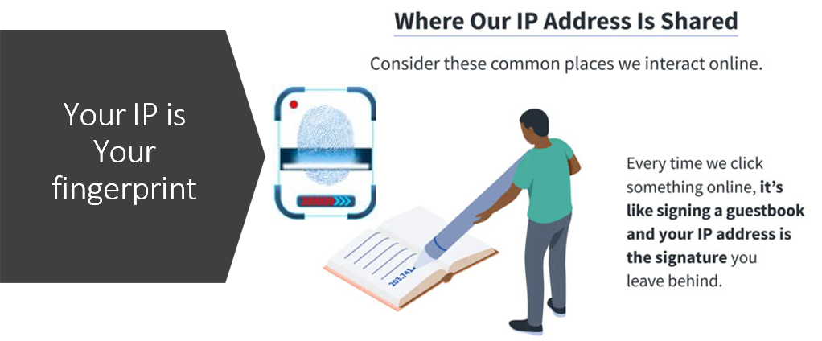

Slide 5
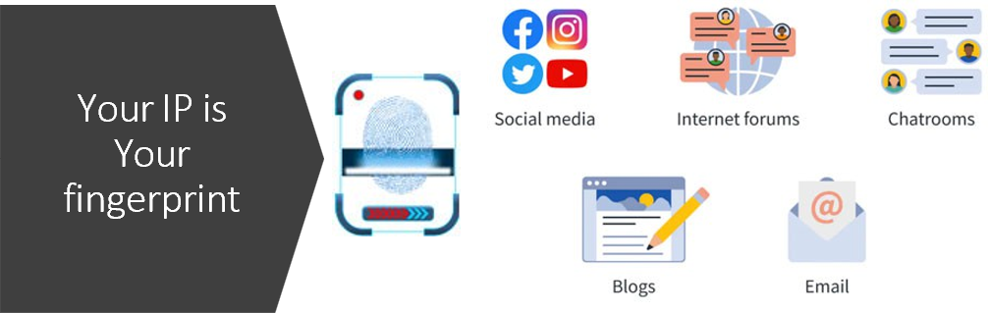

Slide 6
Computer Foundations
Level 2
Who wants your IP
Address?
2

Slide 7
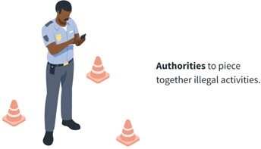
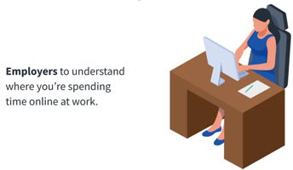

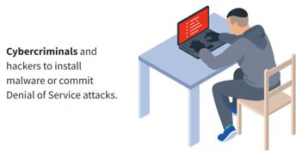
Who wants your IP Address?

Slide 8
Computer Foundations
Level 2
How to protect your IP
Address?
2

Slide 9
How to protect your IP Address?
In the next lessons ☺

Slide 10
Thank you ☺

