Slide 1
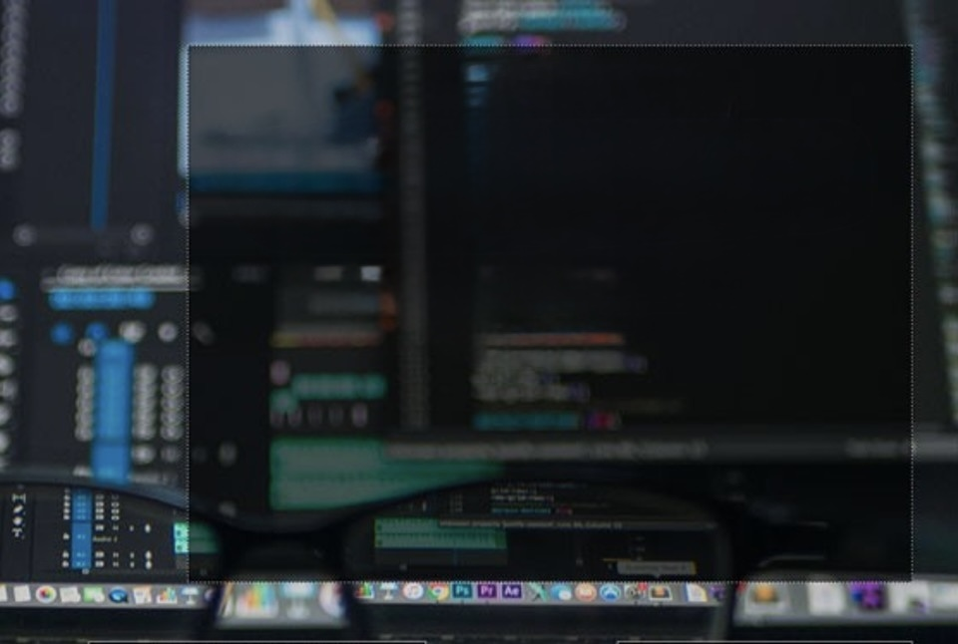
Computer Foundations
Level 2

Slide 2

Computer Foundations
Level 2
What is VPN?
2

Slide 3
Computer Foundations
Level 2
Who wants your IP
Address?
2

Slide 4
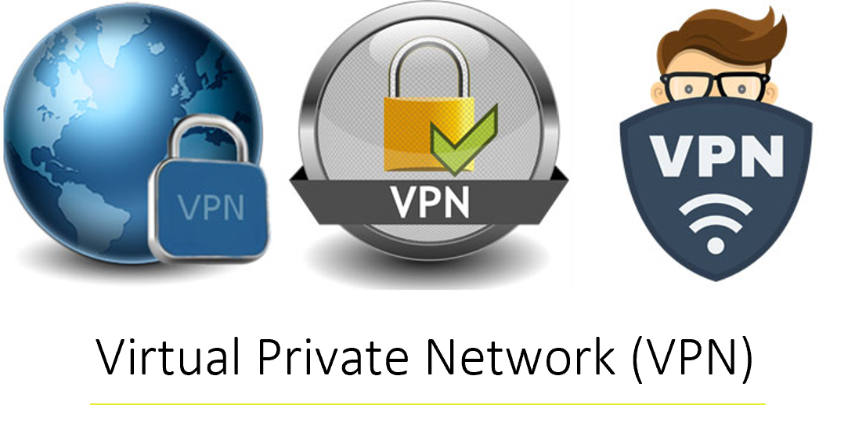

Slide 5
Computer Foundations
Level 2
How to protect your IP
Address?
2

Slide 6
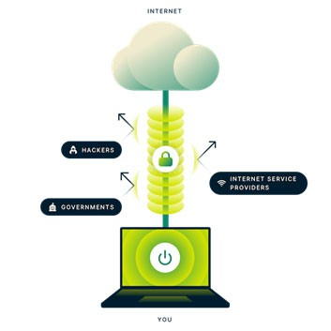
What is VPN?
A VPN (virtual private network) is the easiest and most effective way for people to protect their internet traffic and keep their identities private online.
As you connect to a secure VPN server, your internet traffic goes through an encrypted tunnel that nobody can see into, including hackers, governments, and your internet service provider.
It also changes your IP address completely.
Placing your geolocation hundreds or maybe thousands of miles from where you are accessing the internet.

Slide 7
Thank you ☺

