Slide 1
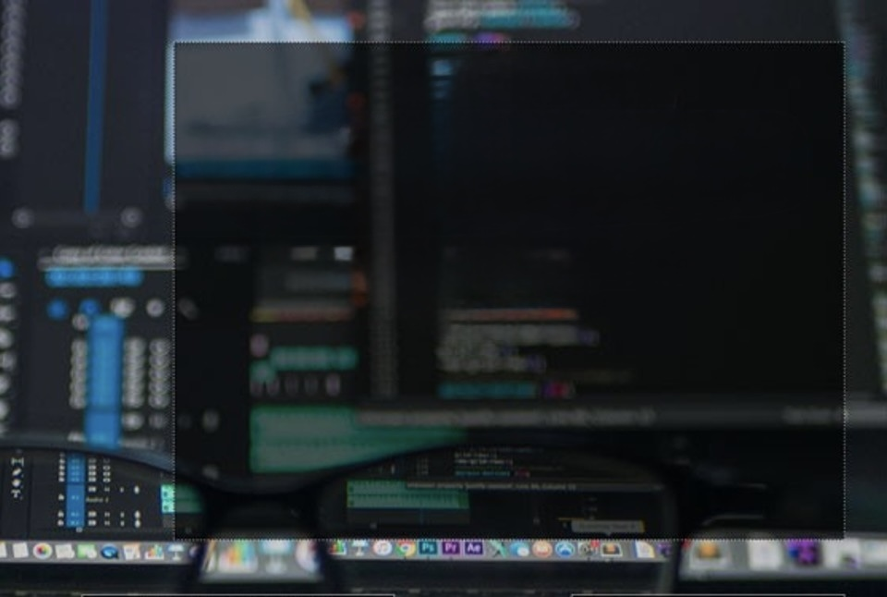
Computer Foundations
Level 2

Slide 2

Computer Foundations
Level 2
Internet VS WWW
2

Slide 3
Computer Foundations
Level 2
How to protect your IP
Address?
2

Slide 4
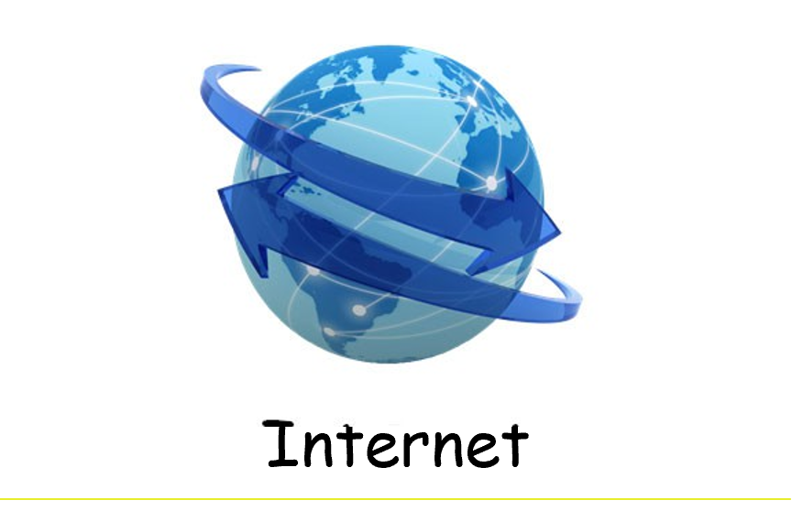

Slide 5
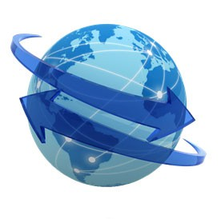
What is Internet?
The Internet or Net (Network of Networks) is the largest computer network in the world that connects billions of computer users.
Internet is a giant network of smaller network.
Word internet came from Interconnection + Network.
No one owns the internet.

Slide 6
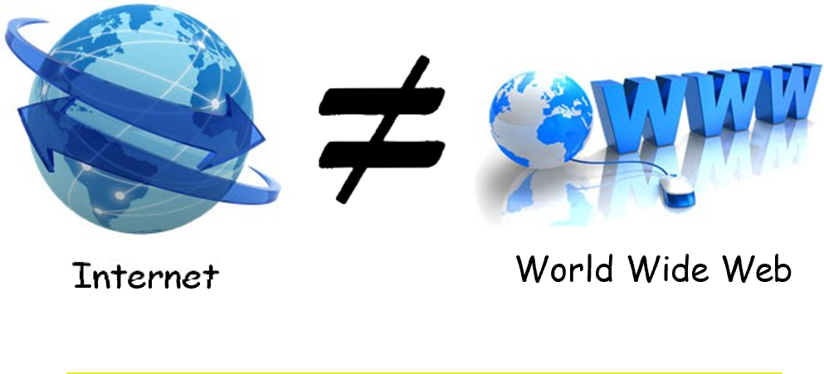

Slide 7


Slide 8
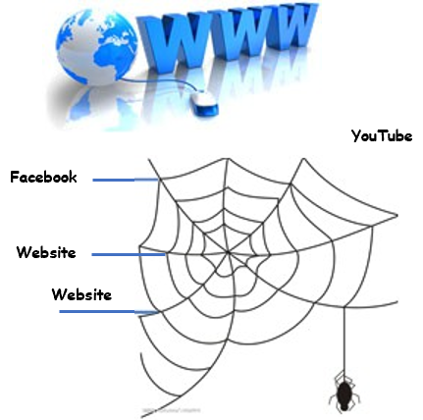
What is WWW?
WORLD WIDE WEB, or web, is a collection of websites that are linked together through the internet.
The web is the content you can view, read, listen to, stream, and download.
Most websites have links that connect them to other websites.
If you were to draw an image of all these links, it would look like a spiderweb made of websites around the globe. That ’s why it ’s called the World Wide Web.

Slide 9
Thank you ☺

