Slide 1

Computer Foundations
Level 2

Slide 2

Computer Foundations
Level 2
Surfing Internet
2

Slide 3


Slide 4
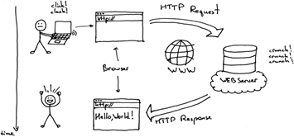
What is Browser?
Borwser is a software application that lets people access the World Wide Web.
It is used to locate, fetch and display content on the internet, including web pages, images, videos, documents, and other files.
In other words browser is the program that request a webpage and download it, interpret it and show it on the screen in the right format

Slide 5
Thank you ☺

