Slide 1

Computer Foundations
Level 2

Slide 2

Computer Foundations
Level 2
http/Https
Protocol
2

Slide 3


Slide 4
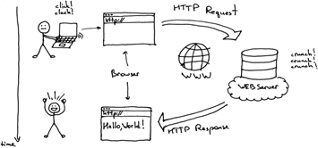
What is Http?
Hypertext Transfer Protocol (HTTP) is an application-layer protocol for transmitting hypermedia documents, such as HTML.
It is a protocol used to access the data on the World Wide Web (www).
The HTTP protocol can be used to transfer the data in the form of plain text, hypertext, audio, video, and so on.

Slide 5
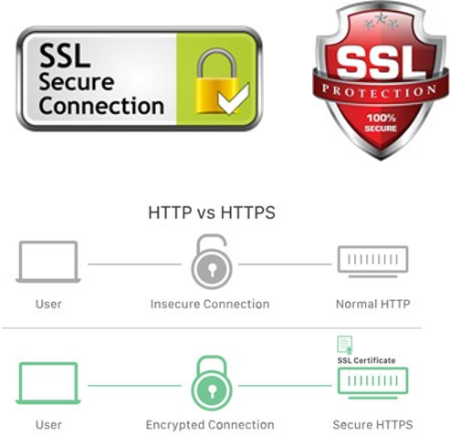
What is Https?
HTTPS is HTTP with encryption and verification.
The only difference between the two protocols is that HTTPS uses TLS (Transport Layer Security) or SSL (Secured Socket Layer) to encrypt normal HTTP requests and responses, and to digitally sign those requests and responses. As a result, HTTPS is far more secure than HTTP.
TLS is higher security than SSL and more reliable and faster.

Slide 6

How to reach a website on the internet?
First you need a domain name

Slide 7
What is a domain name?
Will discuss it in the next lesson ☺

Slide 8
Thank you ☺

