Slide 1

Computer Foundations
Level 2

Slide 2

Computer Foundations
Level 2
Domain Name
2

Slide 3
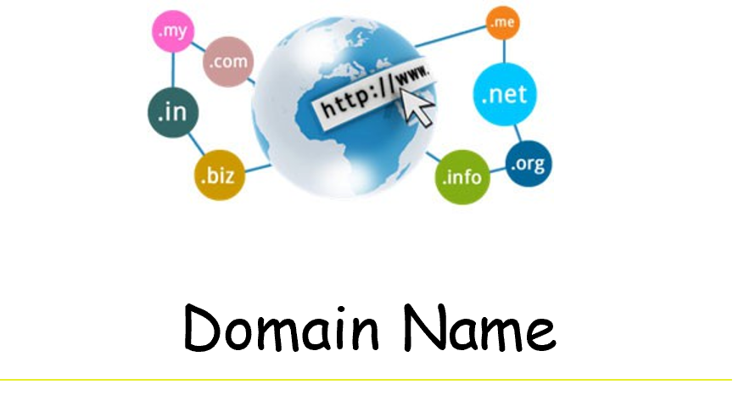

Slide 4
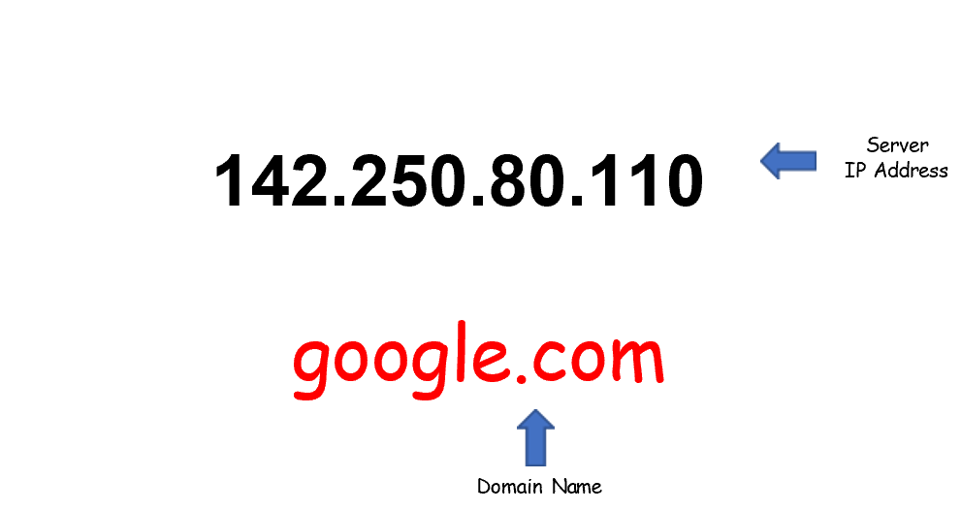
What does this mean?

Slide 5
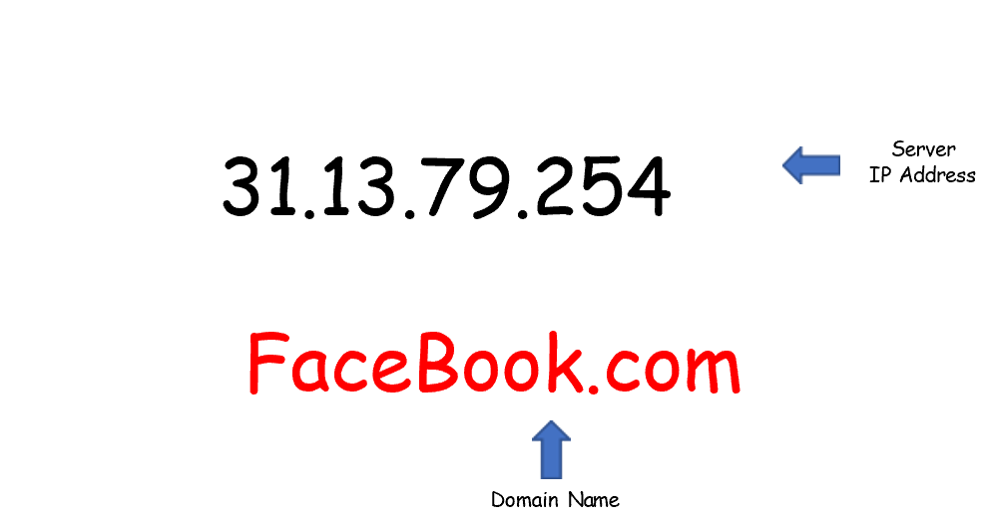
What does this mean?

Slide 6

What is Domain?
A domain name (often simply called a domain) is an easy-to-remember name that’s associated with a physical IP address on the Internet.
It’s the unique name that appears after the @ sign in email addresses, and after www. in web addresses.

Slide 7


Slide 8
Thank you ☺

