Slide 1

Computer Foundations
Level 2

Slide 2

Computer Foundations
Level 2
DNS
Domain Name Server
2

Slide 3
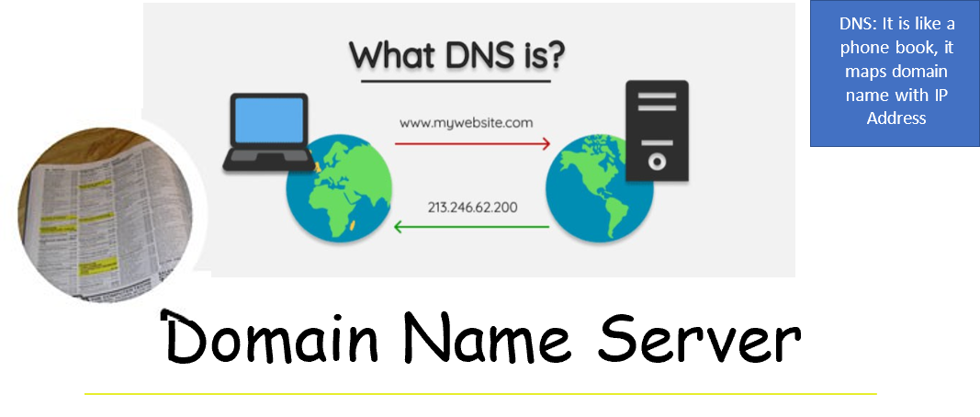

Slide 4
Thank you ☺

