Slide 1

Computer Foundations
Level 2

Slide 2

Computer Foundations
Level 2
URL Uniform
Resource Locator
2

Slide 3
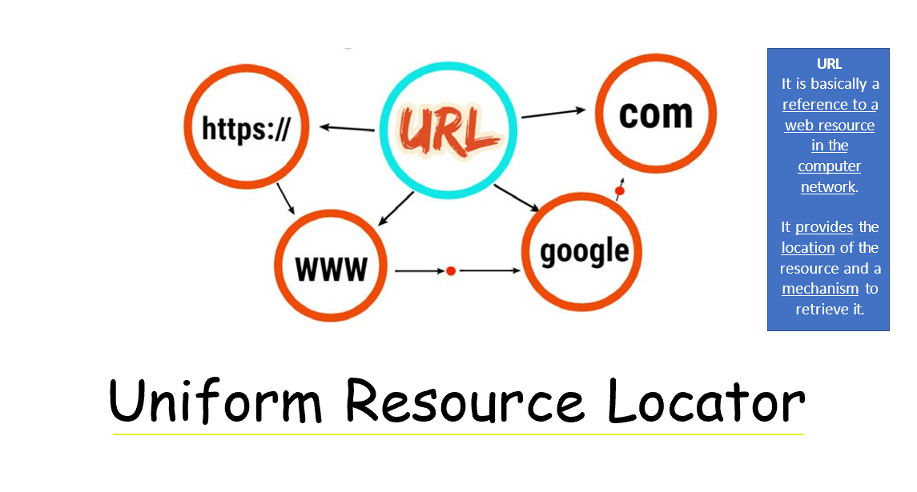

Slide 4
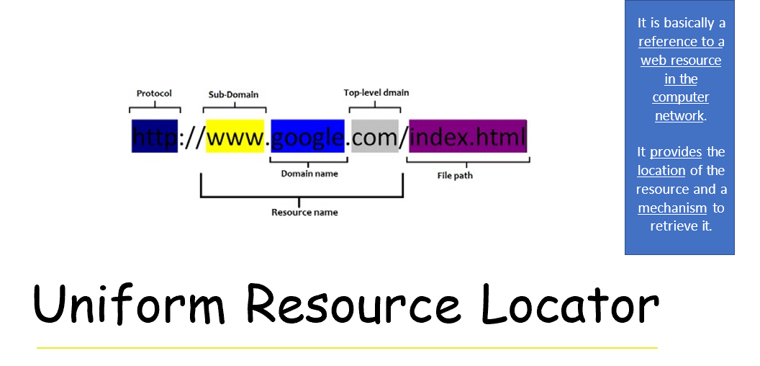

Slide 5
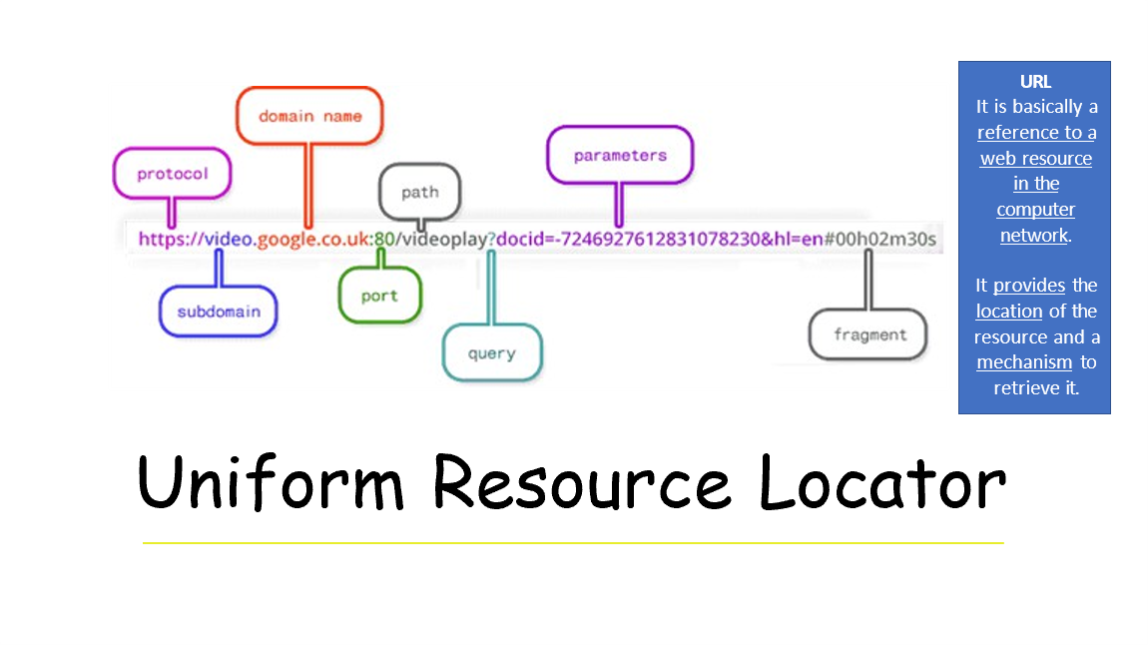

Slide 6
Thank you ☺

