Slide 1

Computer Foundations
Level 2

Slide 2

Computer Foundations
Level 2
FTP
File Transfer Protocol
2

Slide 3
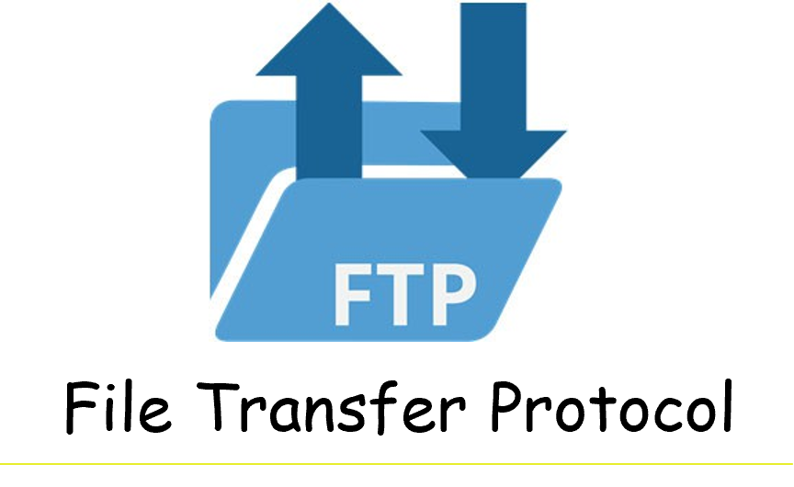

Slide 4
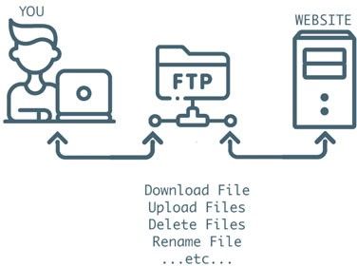
What is FTP?
File Transfer Protocol (FTP) is a way to download, on the Internet and between computer systems.
What are the advantages of FTP?
Allows the transfer of multiple files and directories.
Ability to resume a transfer if the connection is lost.
Ability put items into a queue to be uploaded or downloaded.
Allows you to schedule transfers.
No size limitation on single transfers (browsers only allow up to 2 GB)

Slide 5
Thank you ☺

