Slide 1

Computer Foundations
Level 2

Slide 2

Computer Foundations
Level 2
API
Application Programming Interface
2

Slide 3
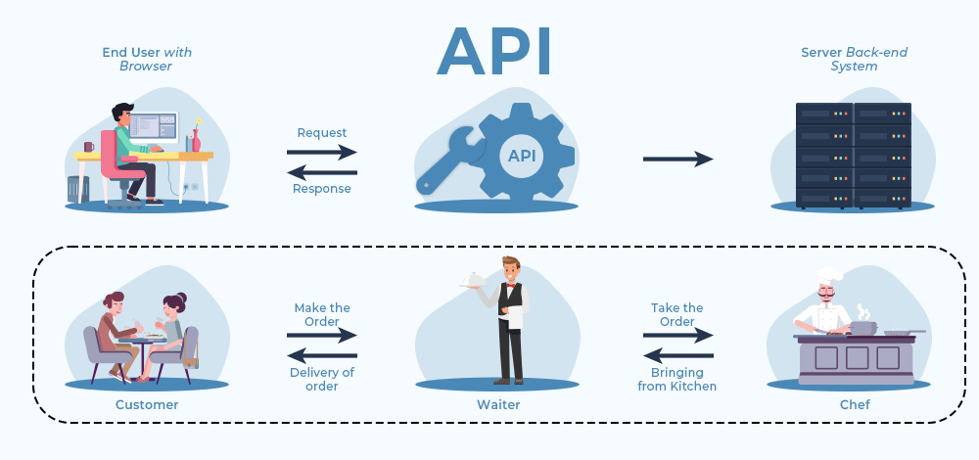

Slide 4
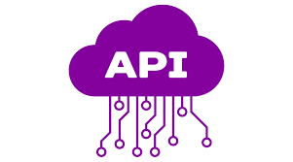
What is API?
Application Programming Interface (API) is a set of rules and protocols that allows different software applications to communicate and exchange data.
It works as a middle layer that handles requests and responses between applications.
It allows developers to reuse existing services (maps, payments, login, etc.).
It powers common features in apps and websites.
Its goal is to simplify integration and speed up development.

Slide 5
Thank you ☺

