Slide 1

Computer Foundations
Level 2

Slide 2

Computer Foundations
Level 2
XML
EXtensible Markup
Language
2

Slide 3
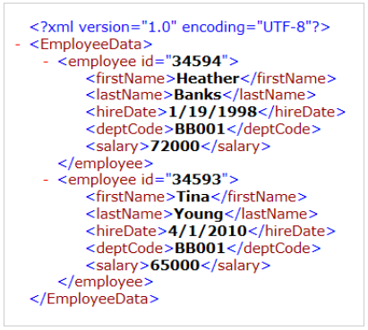

Slide 4
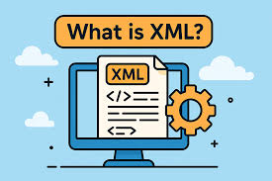
What is XML?
EXtensible Markup Language (XML) is a markup language that is designed to store and transport data in a format that is both human-readable and machine-readable.
XML stands for eXtensible Markup Language.
XML is a markup language much like HTML.
XML was designed to store and transport data.
ML was designed to be self-descriptive.
ML is widely used for data storage, exchange, and configuration purposes.
It provides a platform-independent and standardized way to represent structured data, making it easier for different systems to exchange and interpret information.

Slide 5
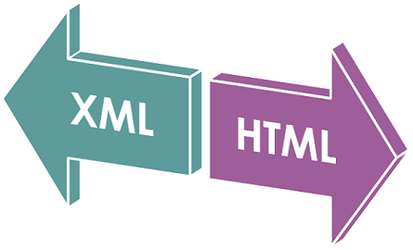
HTML VS XML
Main difference between HTML and XML:
HTML: shows how data looks (presentation).
XML: shows what data means (structure + content).
In XML, you can create your own tags, while HTML uses predefined ones.

Slide 6
XML SimpLifies Things:
XML simplifies data sharing.
XML simplifies data transport.
XML simplifies platform changes.
XML simplifies data availability.
XML + XSLT → New Format (html, PDF,.. etc).

Slide 7
Thank you ☺

