Slide 1

Computer Foundations
Level 2

Slide 2

Computer Foundations
Level 2
JSON
JavaScript Object
Notation
2

Slide 3
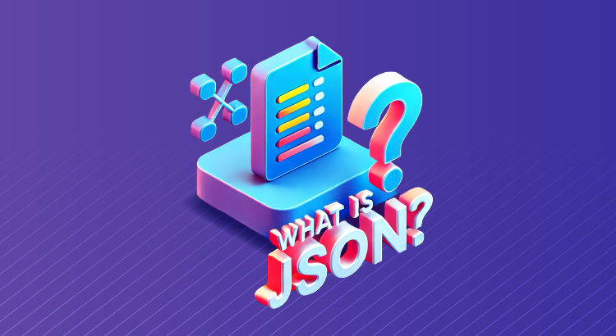
What is JSON?
JavaS cript Object Notation (JSON) is a lightweight data-interchange format. It is easy for humans to read and write. It is easy for machines to parse and generate.
JSON is a lightweight data-interchange format.
JSON is used to send data between computers.
JSON is a text format.
JSON for storing and transporting data.
JSON is "self-describing" and easy to understand.
JSON is language independent.

Slide 4
JSON SimpLifies Things:
JSON simplifies data sharing.
JSON simplifies data transport.
JSON simplifies platform changes.
JSON simplifies data availability.
JSON stores data in plain text format. This provides a software- and hardware-independent wayrof storing, transporting, and sharing data.

Slide 5
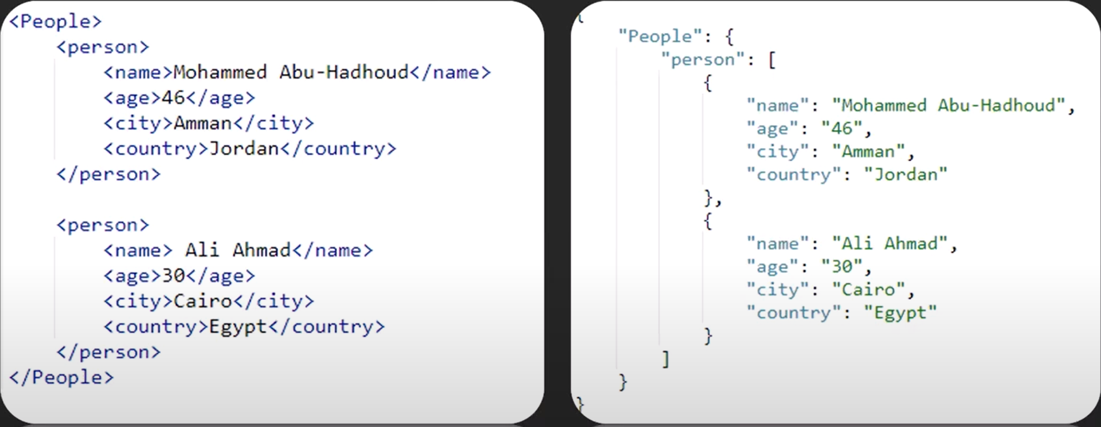
XML VS JSON

Slide 6
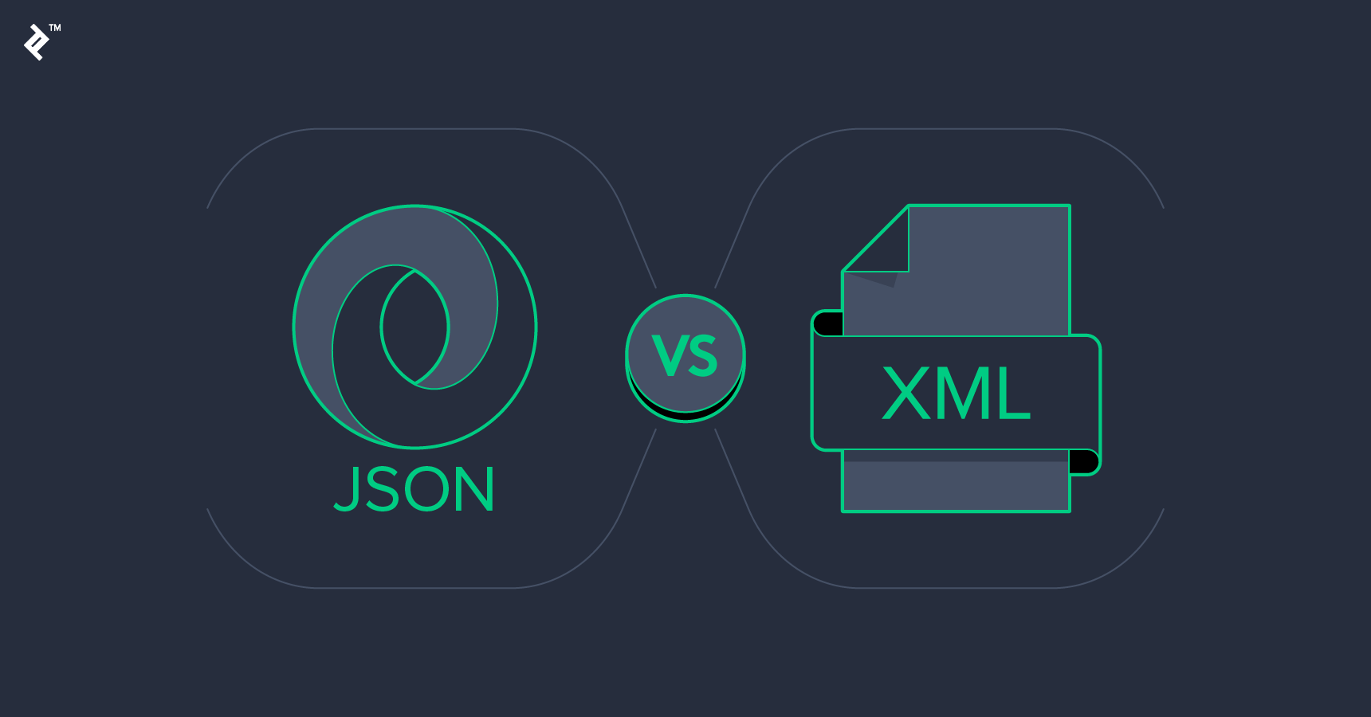
JSON VS XML
Main difference between JSON and XML:
JSON supports numbers, strings, objects, Booleans, and arrays.
XML supports all JSON types plus extra ones (Boolean variations, dates, images, namespaces).
JSON is smaller in size and faster to transmit.
XML uses more complex tags, making files larger and harder to read.

Slide 7
Thank you ☺

