Slide 1

Computer Foundations
Level 2

Slide 2

Computer Foundations
Level 2
What is 3-Tier
Architecture?
2

Slide 3
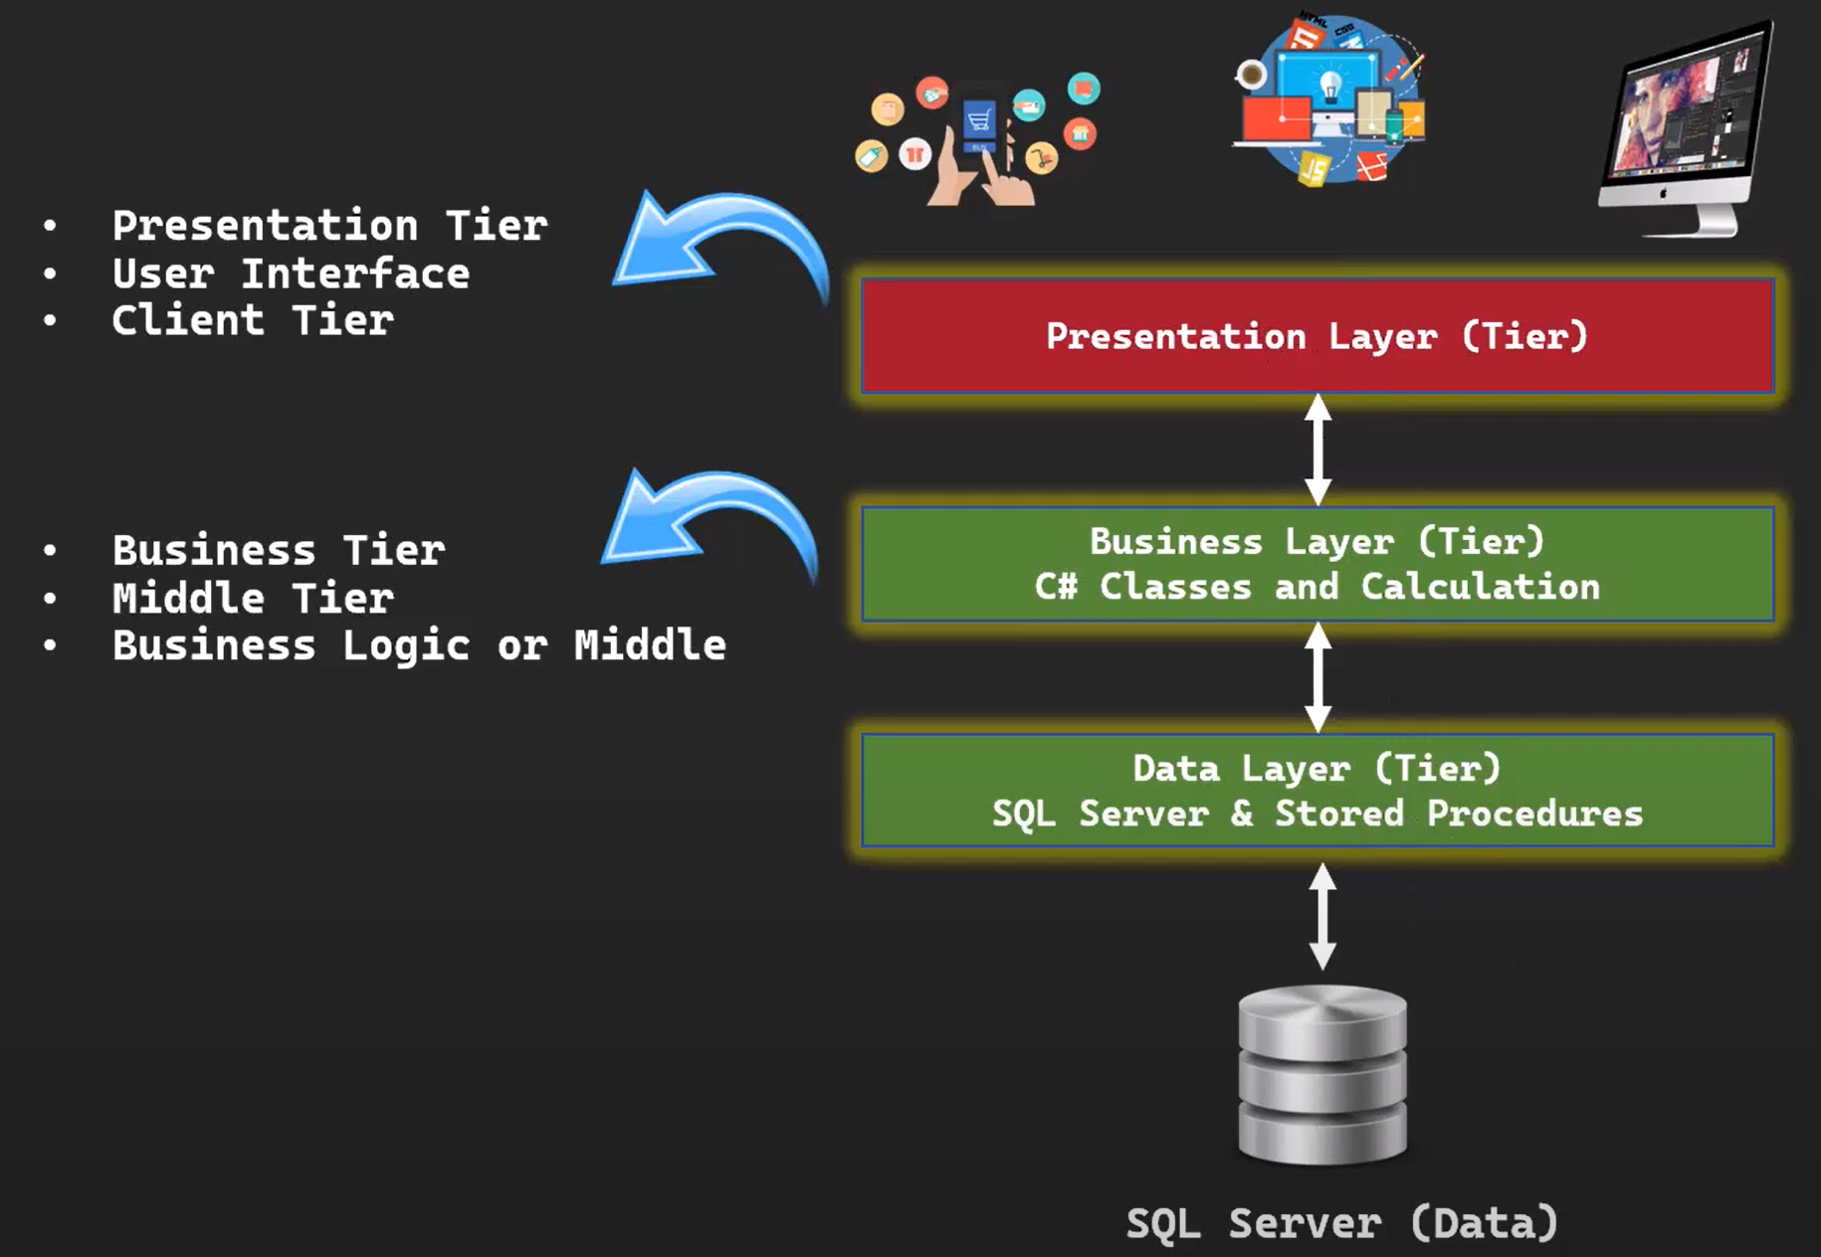
What is 3-Tier Architecture?

Slide 4
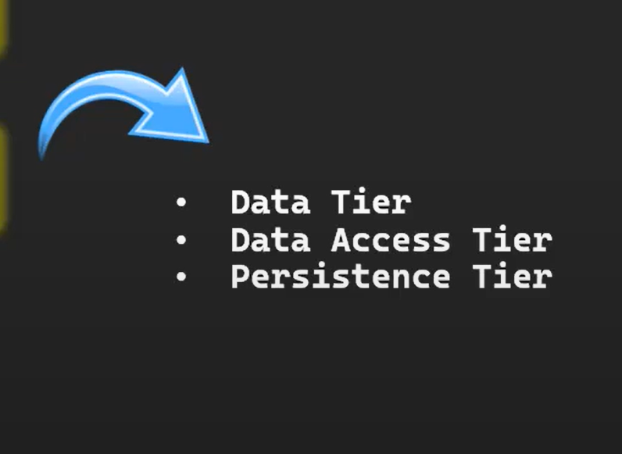
What is 3-Tier Architecture?

Slide 5
Thank you ☺

