Slide 1

Computer Foundations
Level 2

Slide 2

Computer Foundations
Level 2
What is Business
Intelligence?
and what is Cube?
2

Slide 3
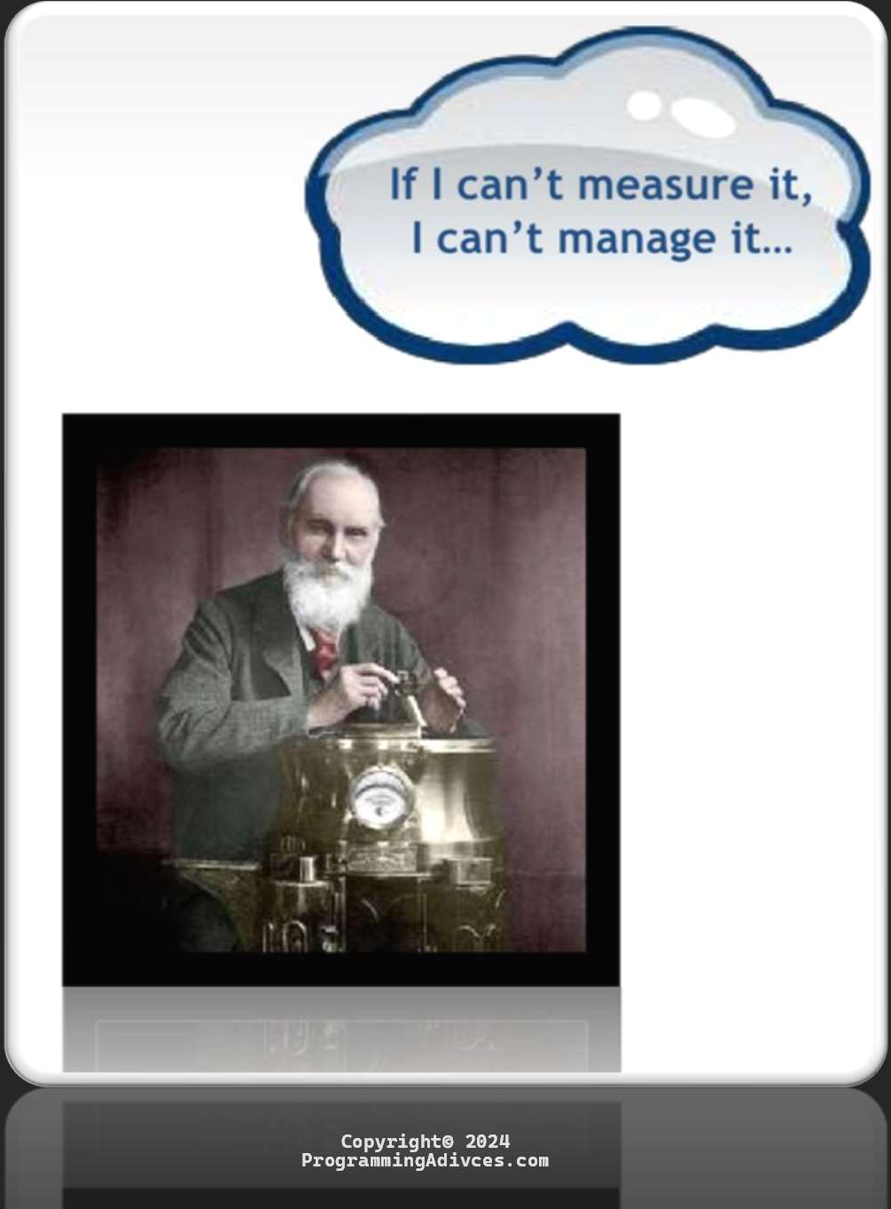

Slide 4

Business Intelligence (BI)

Slide 5

Common Pain..
Business data is distributed across the enterprise.
Data everywhere, information nowhere.
Takes too long – wasted resources/efforts.
So many excuses - Why I just can’t get it to you when you want it.
Different users have different needs:
    Excel versus PDF
    Pull versus push
    On demand – on schedule
    Your format - My format

Slide 6
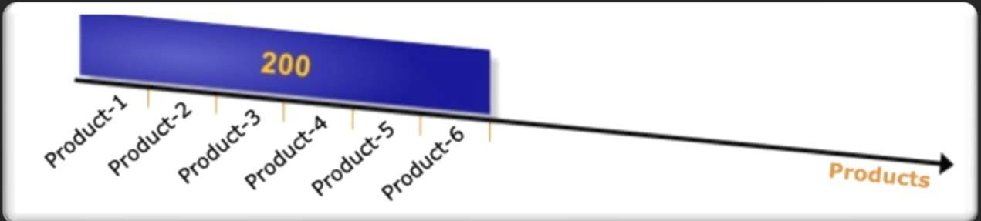
Example:
You can see the total number of products sold ever.

Slide 7
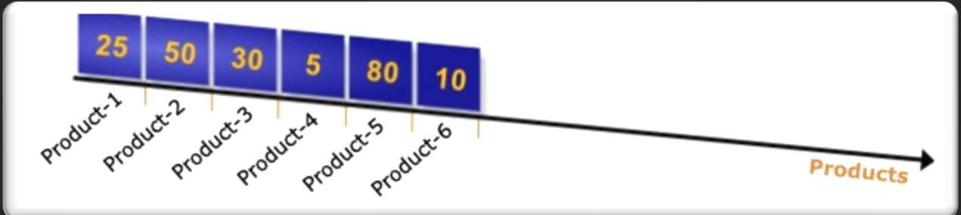
Example:
You can see the total number of products sold ever.
The total number (200) is divided among the individual products.

Slide 8
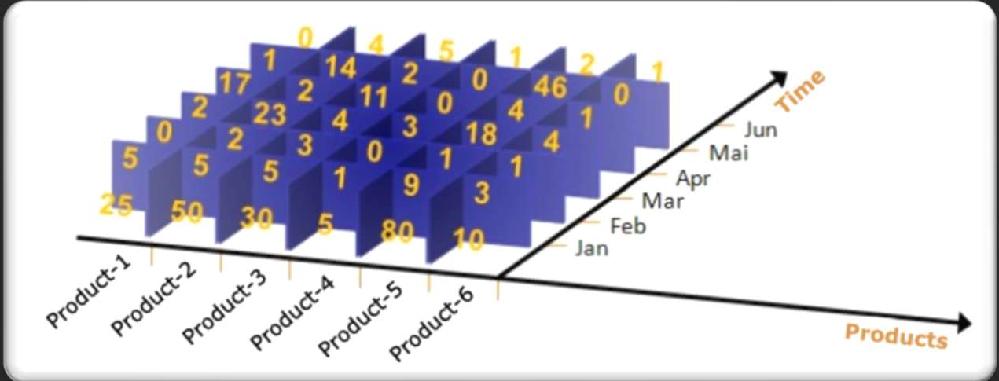
Example:
Adding the “Time” dimension to it.

Slide 9
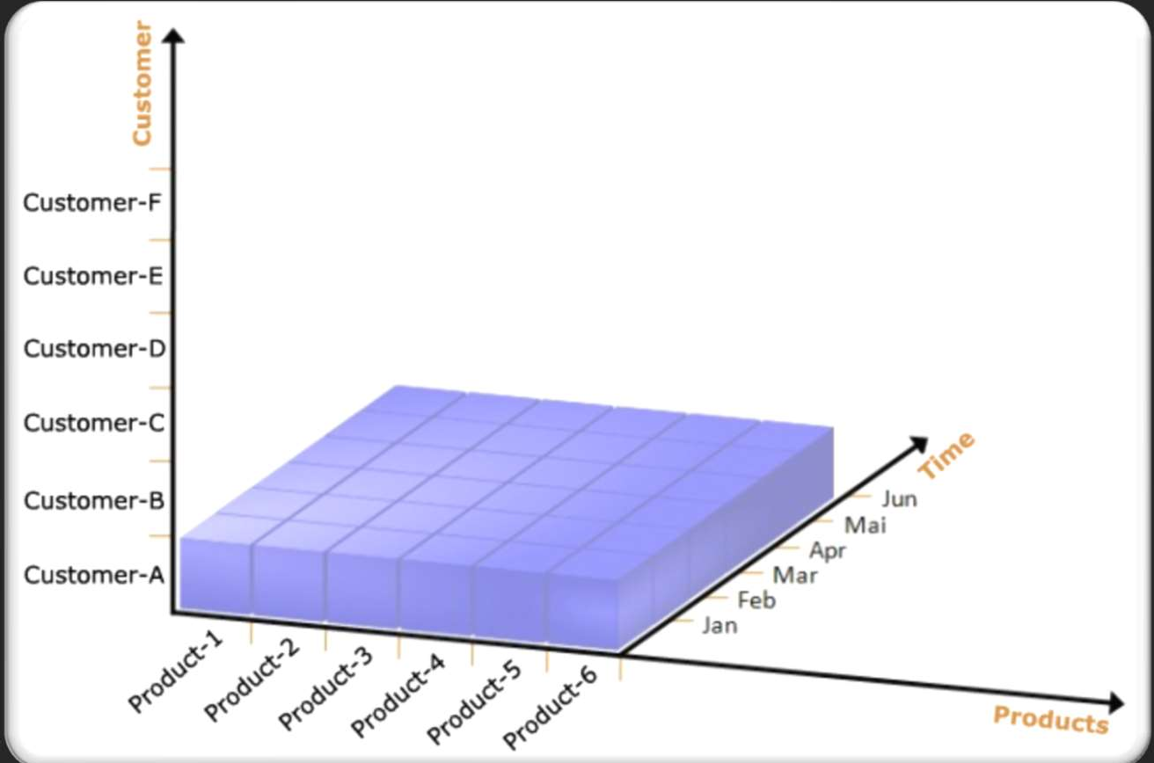
Example:
Adding the “Customer” dimension.

Slide 10
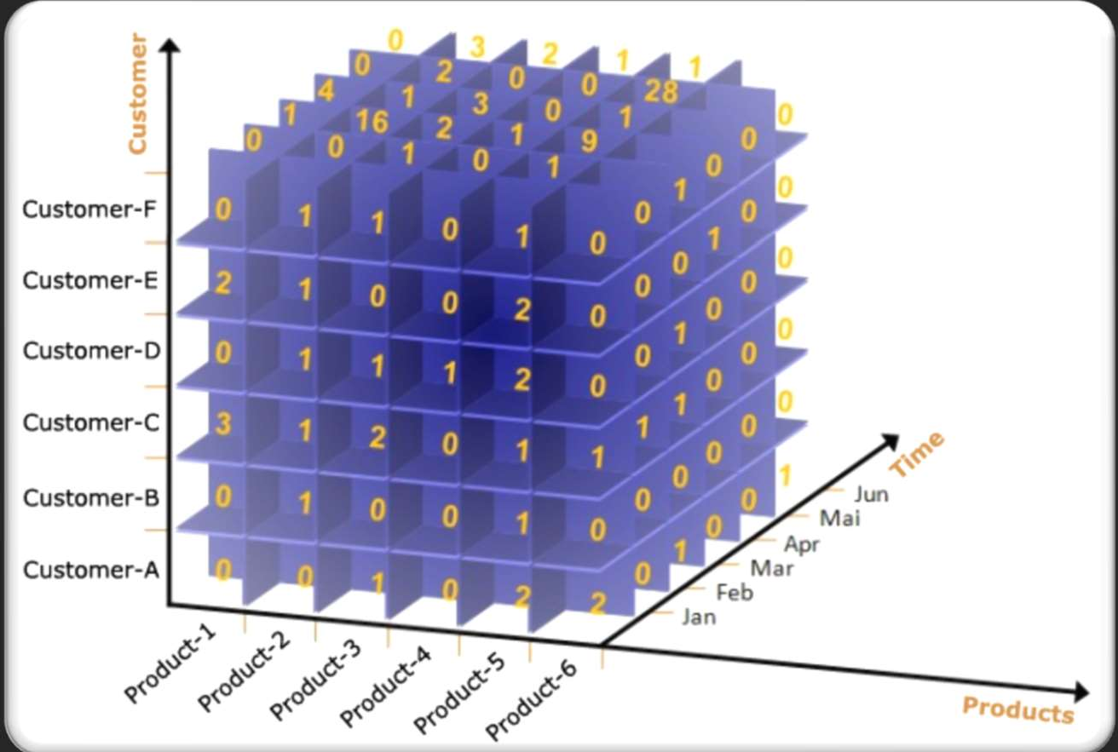
1st scenario:
The following cube will be used to Answer the following example scenarios

Slide 11
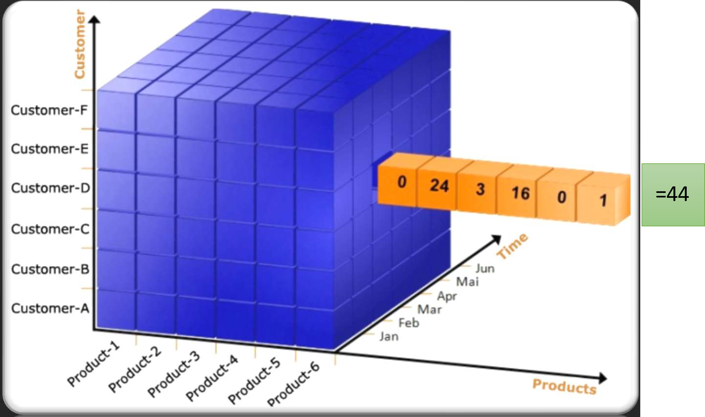
1st scenario:
How many products purchased by customer-D in March?

Slide 12
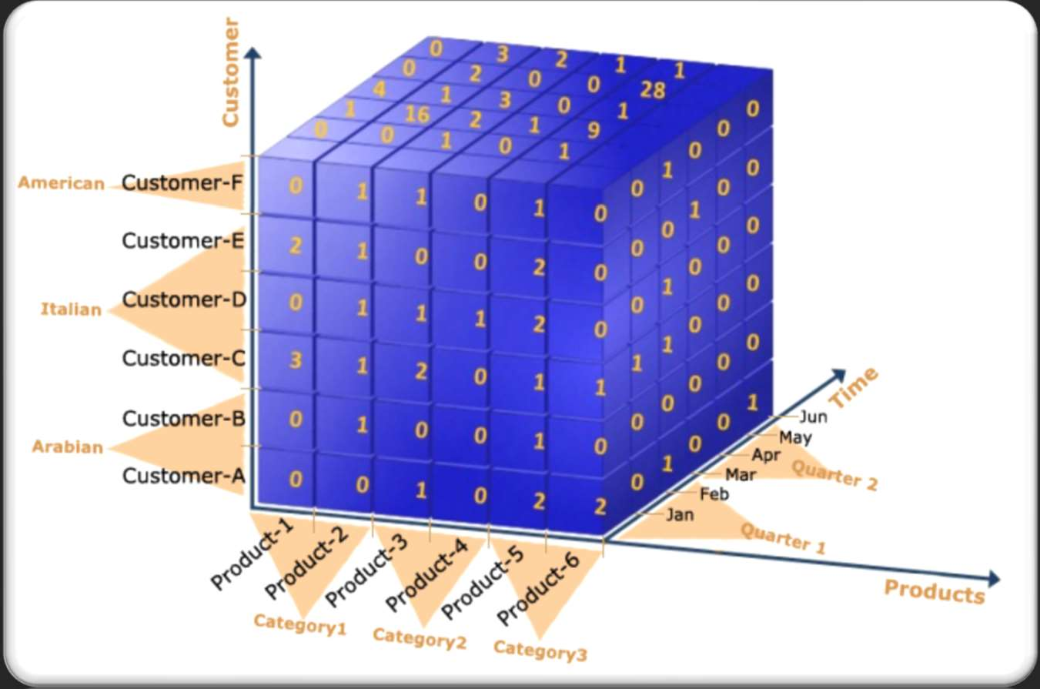
1st scenario:
Grouping Dimensions.

Slide 13
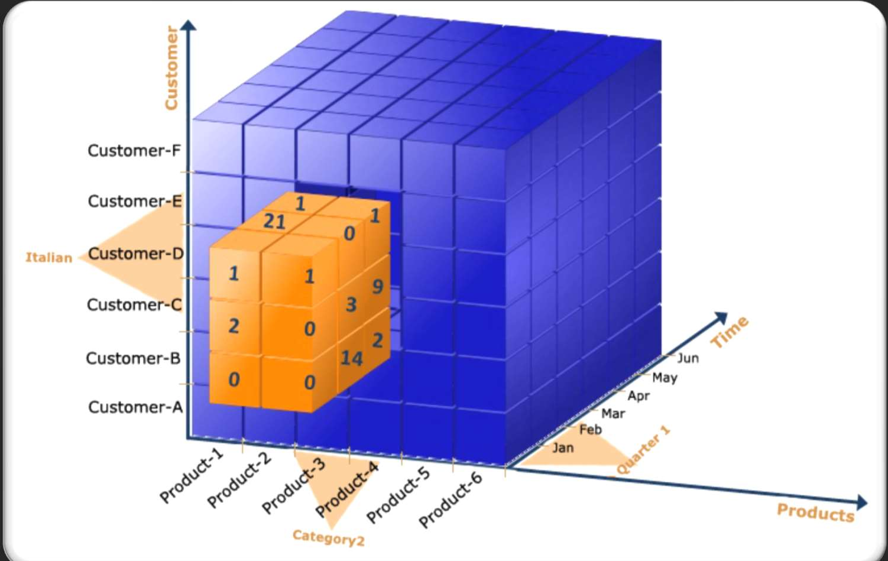

2nd scenario:
How many “Category2” products in Italy 1 Quarter sold?

Slide 14
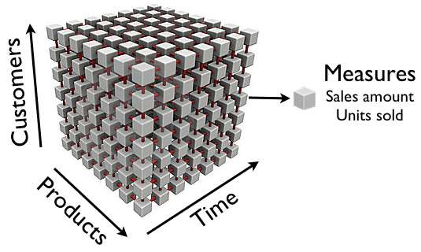
So the Cube is:

Slide 15
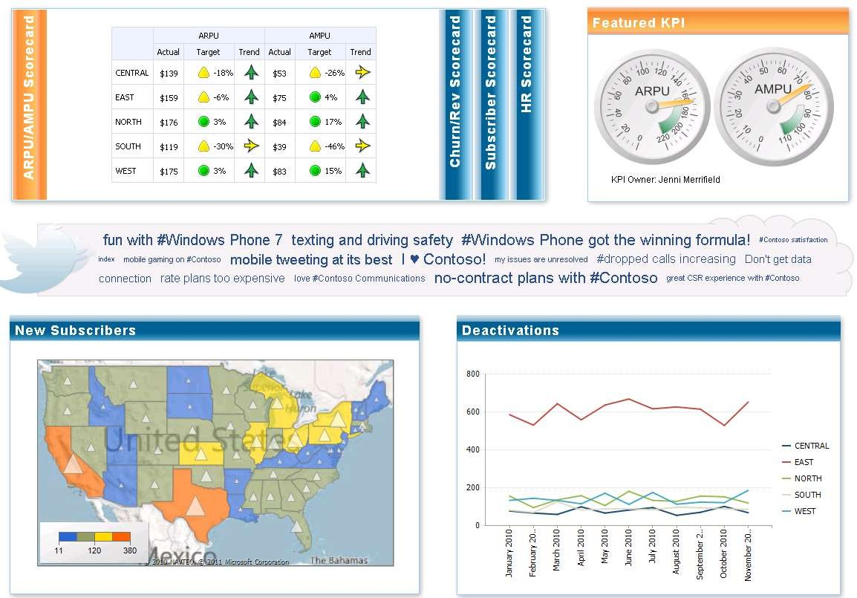

Slide 16
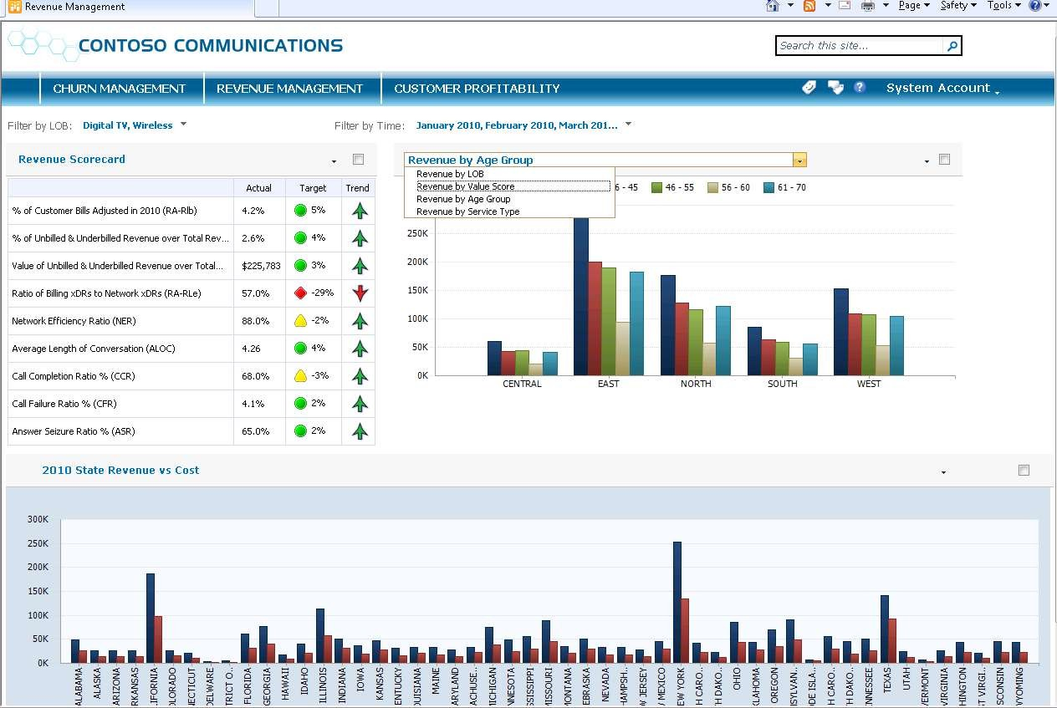

Slide 17
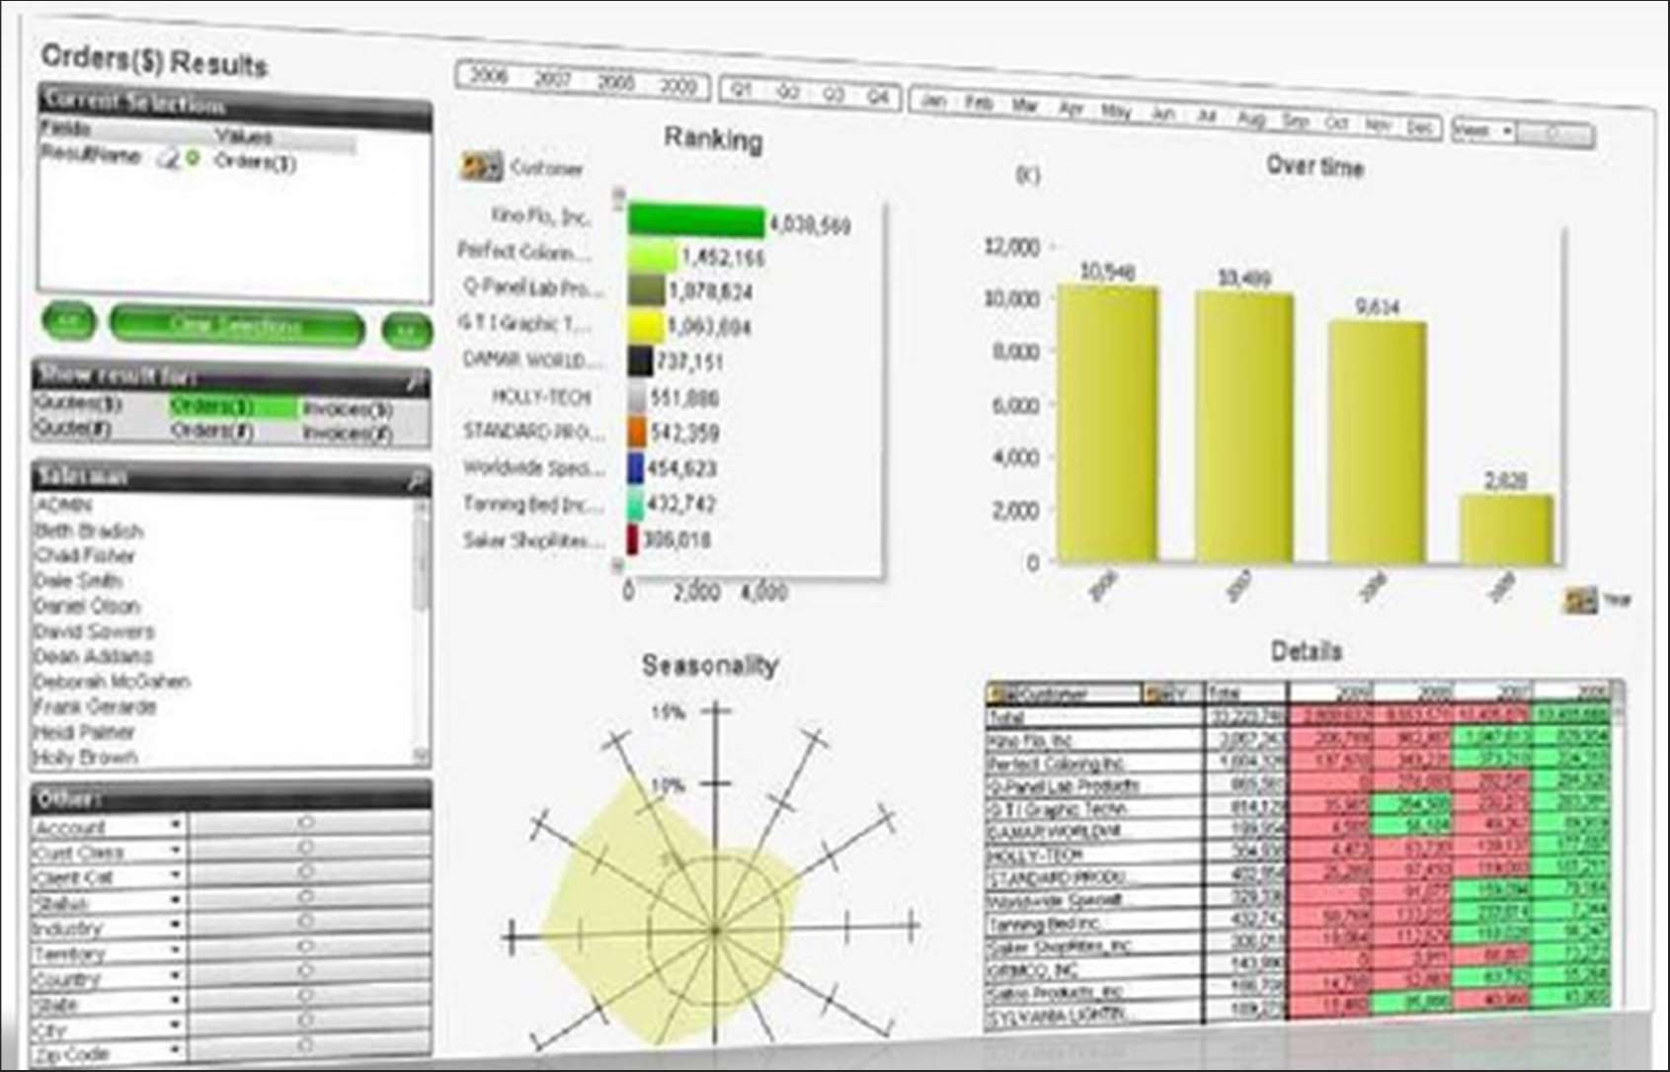

Slide 18
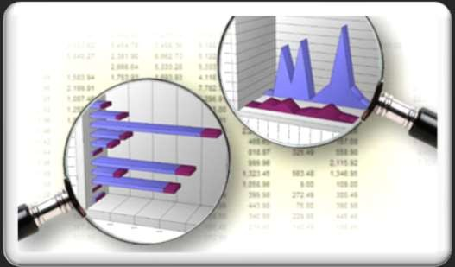
What is Business Intelligencefi
Looking for information?
BI transforms raw Data into valuable Information.
Information can be transformed into knowledge through discovery.

Slide 19
Business Intelligence (BI) is about getting the right information, to the right decision makers, at the right time.

Slide 20
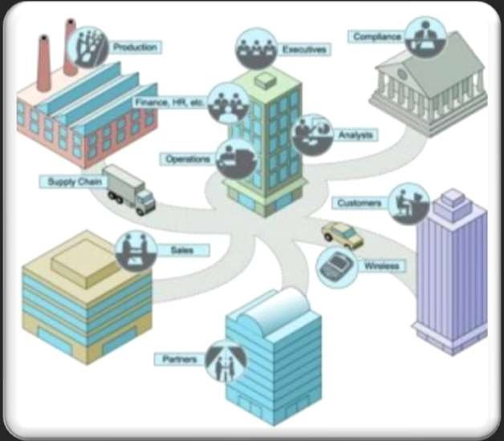
What is Business Intelligencefi
BI is an enterprise-wide platform that supports reporting, analysis and decision making.
BI Leads to:
Fact-based decision making not assumption-based decision making.
“Single version of the truth”

Slide 21
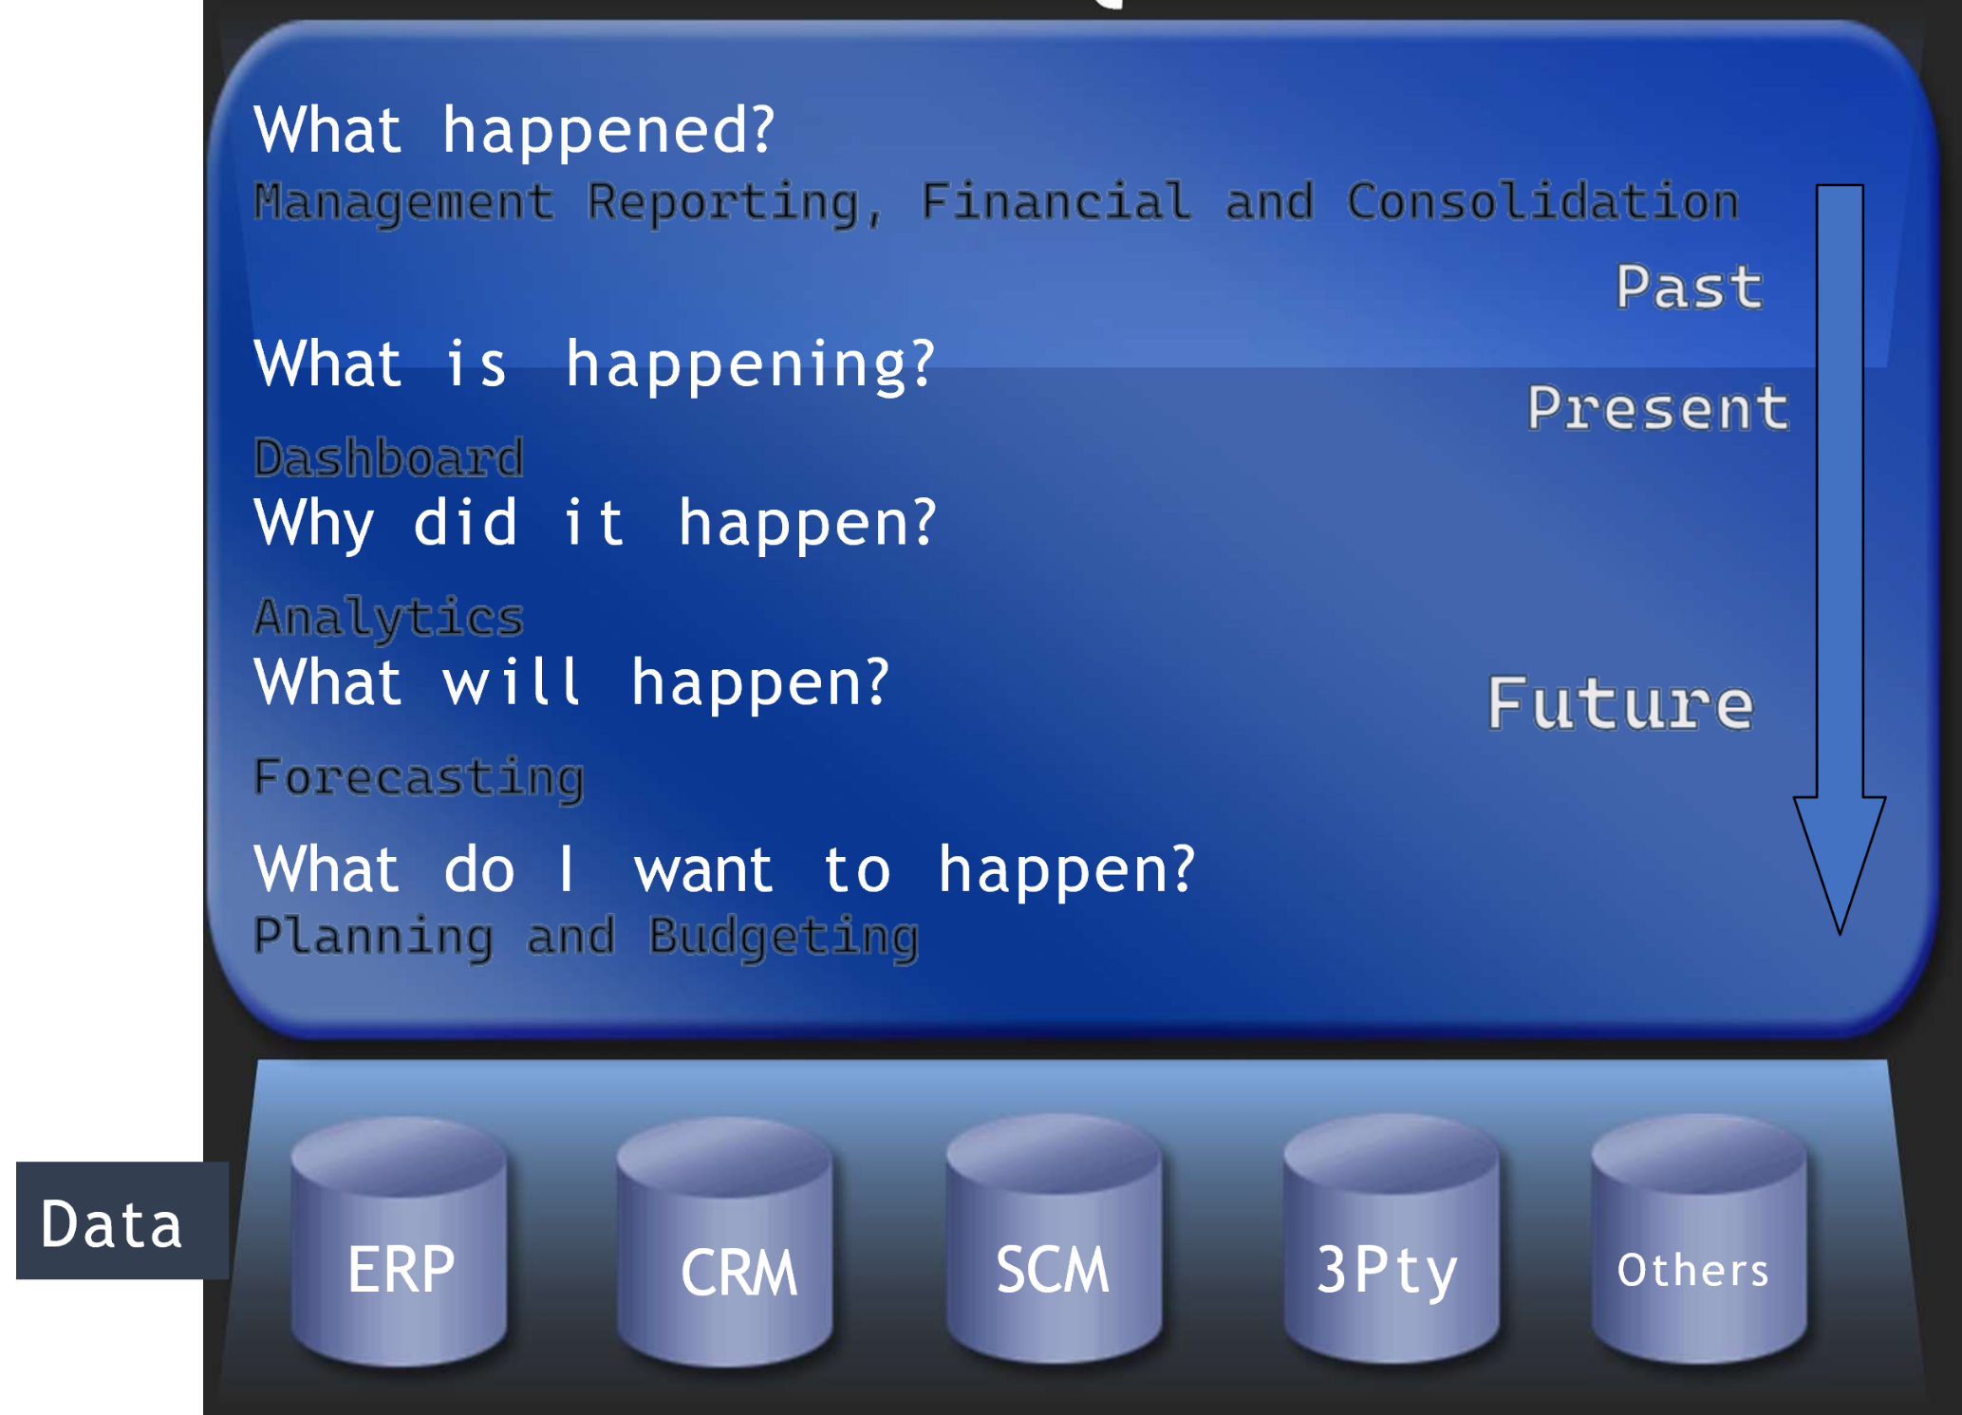
Why BIfi The Five Questions

Slide 22
Benefits..
Give user the means to make better decisions.
Leverage your investment in your legacy systems (e.g. ERP) or data warehouse, it is the best way to get value form existing applications.
Challenge assumption with factual information.
Eliminate report backlog and delays.
Find root causes and take action.
Identify waste resources and reduce cost.
Improve operational efficiency.
Creates organizational language.
Negotiate better contracts with suppliers and customers.
Improve strategies with better marketing analysis.

Slide 23
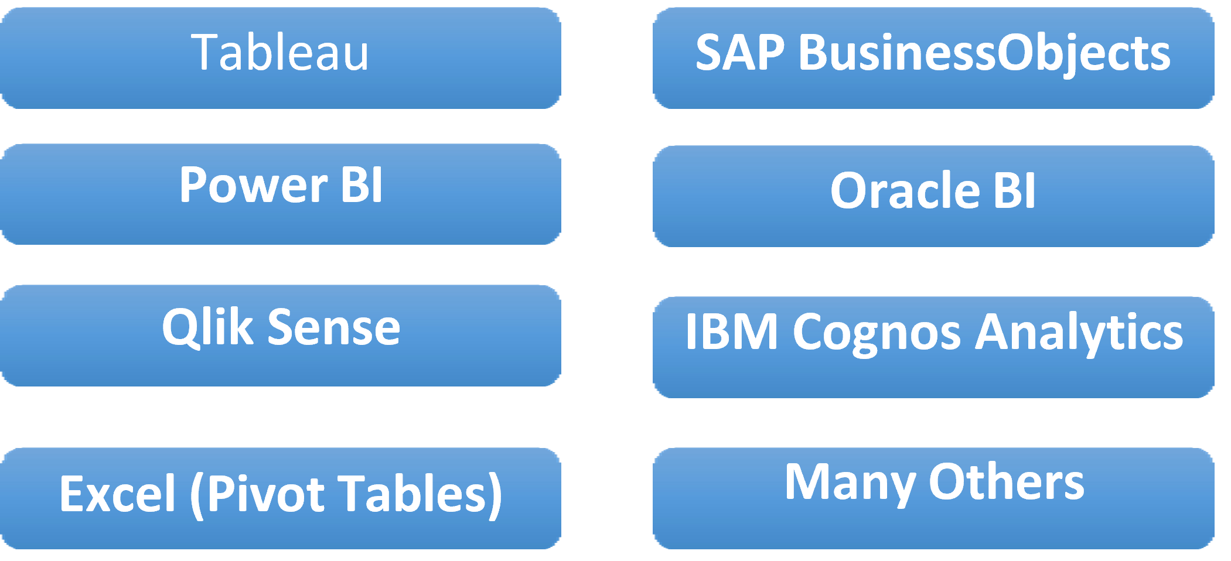
BI Tools

Slide 24
Thank you ☺

