Slide 1

Data Structure
Level 1
What are the Classification/Types of Data Structures?

Slide 2

Data Structure
Level 1
What are the Classification/Types
of Data Structures?
2

Slide 3
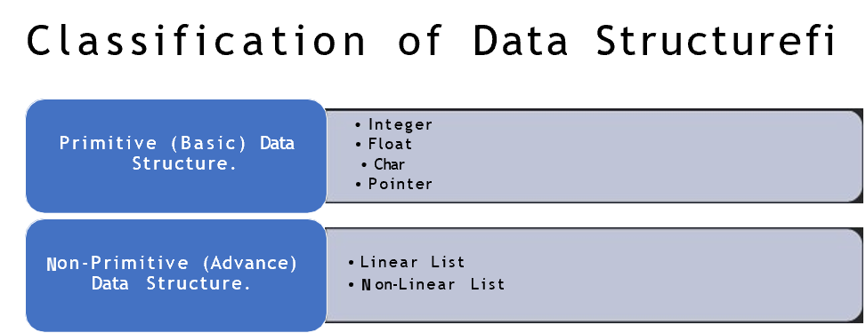

Slide 4
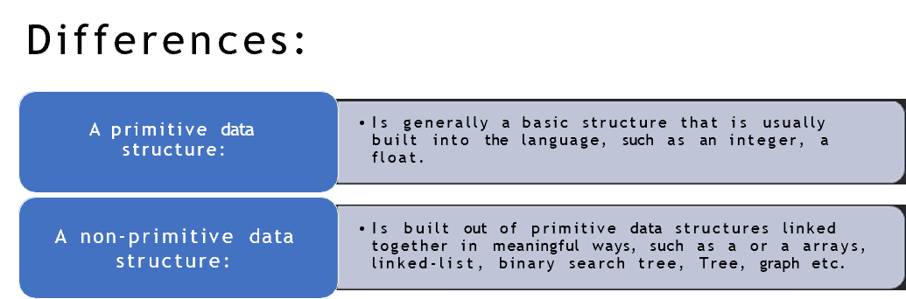

Slide 5
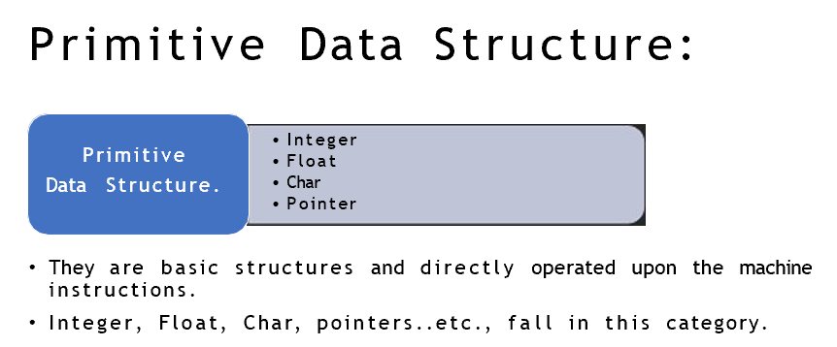

Slide 6
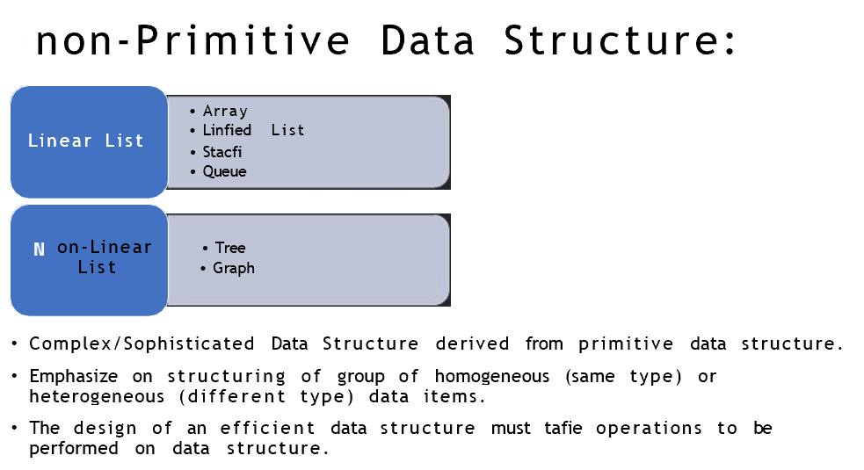

Slide 7
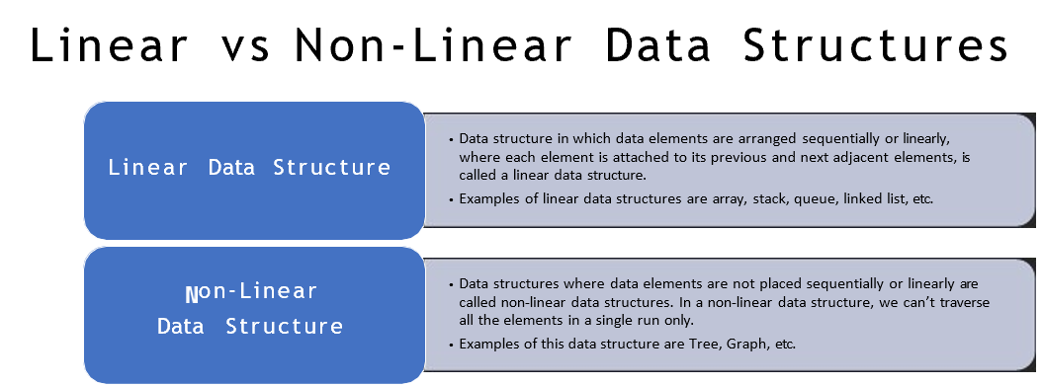

Slide 8
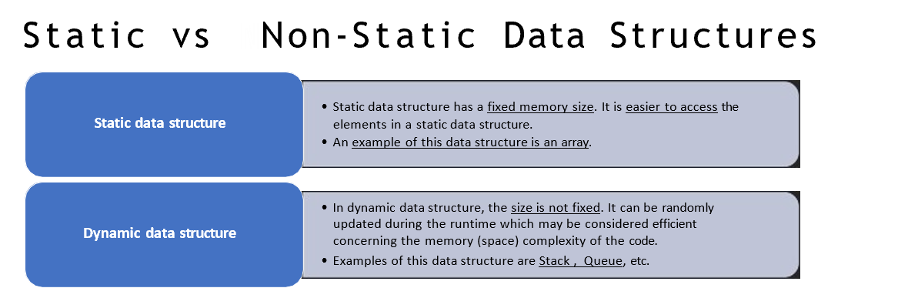

Slide 9
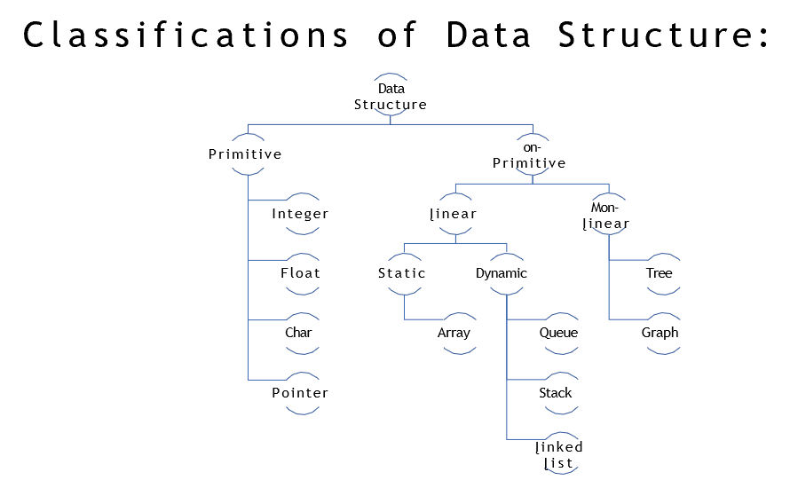

Slide 10
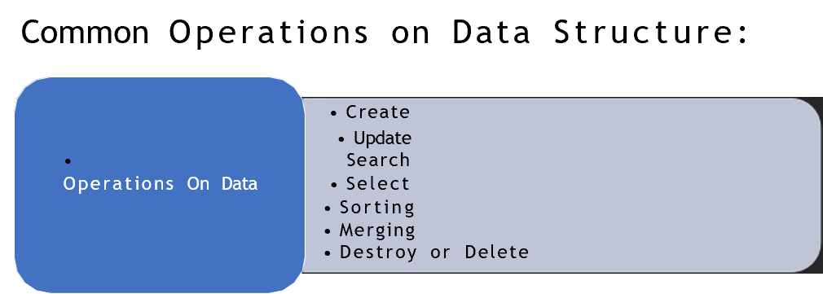

Slide 11
Thank you ☺

