Slide 1

Data Structure
Level 1
Things Affect Program Speed & Efficiency

Slide 2

Data Structure
Level 1
Things Affect Program Speed & Efficiency
2

Slide 3
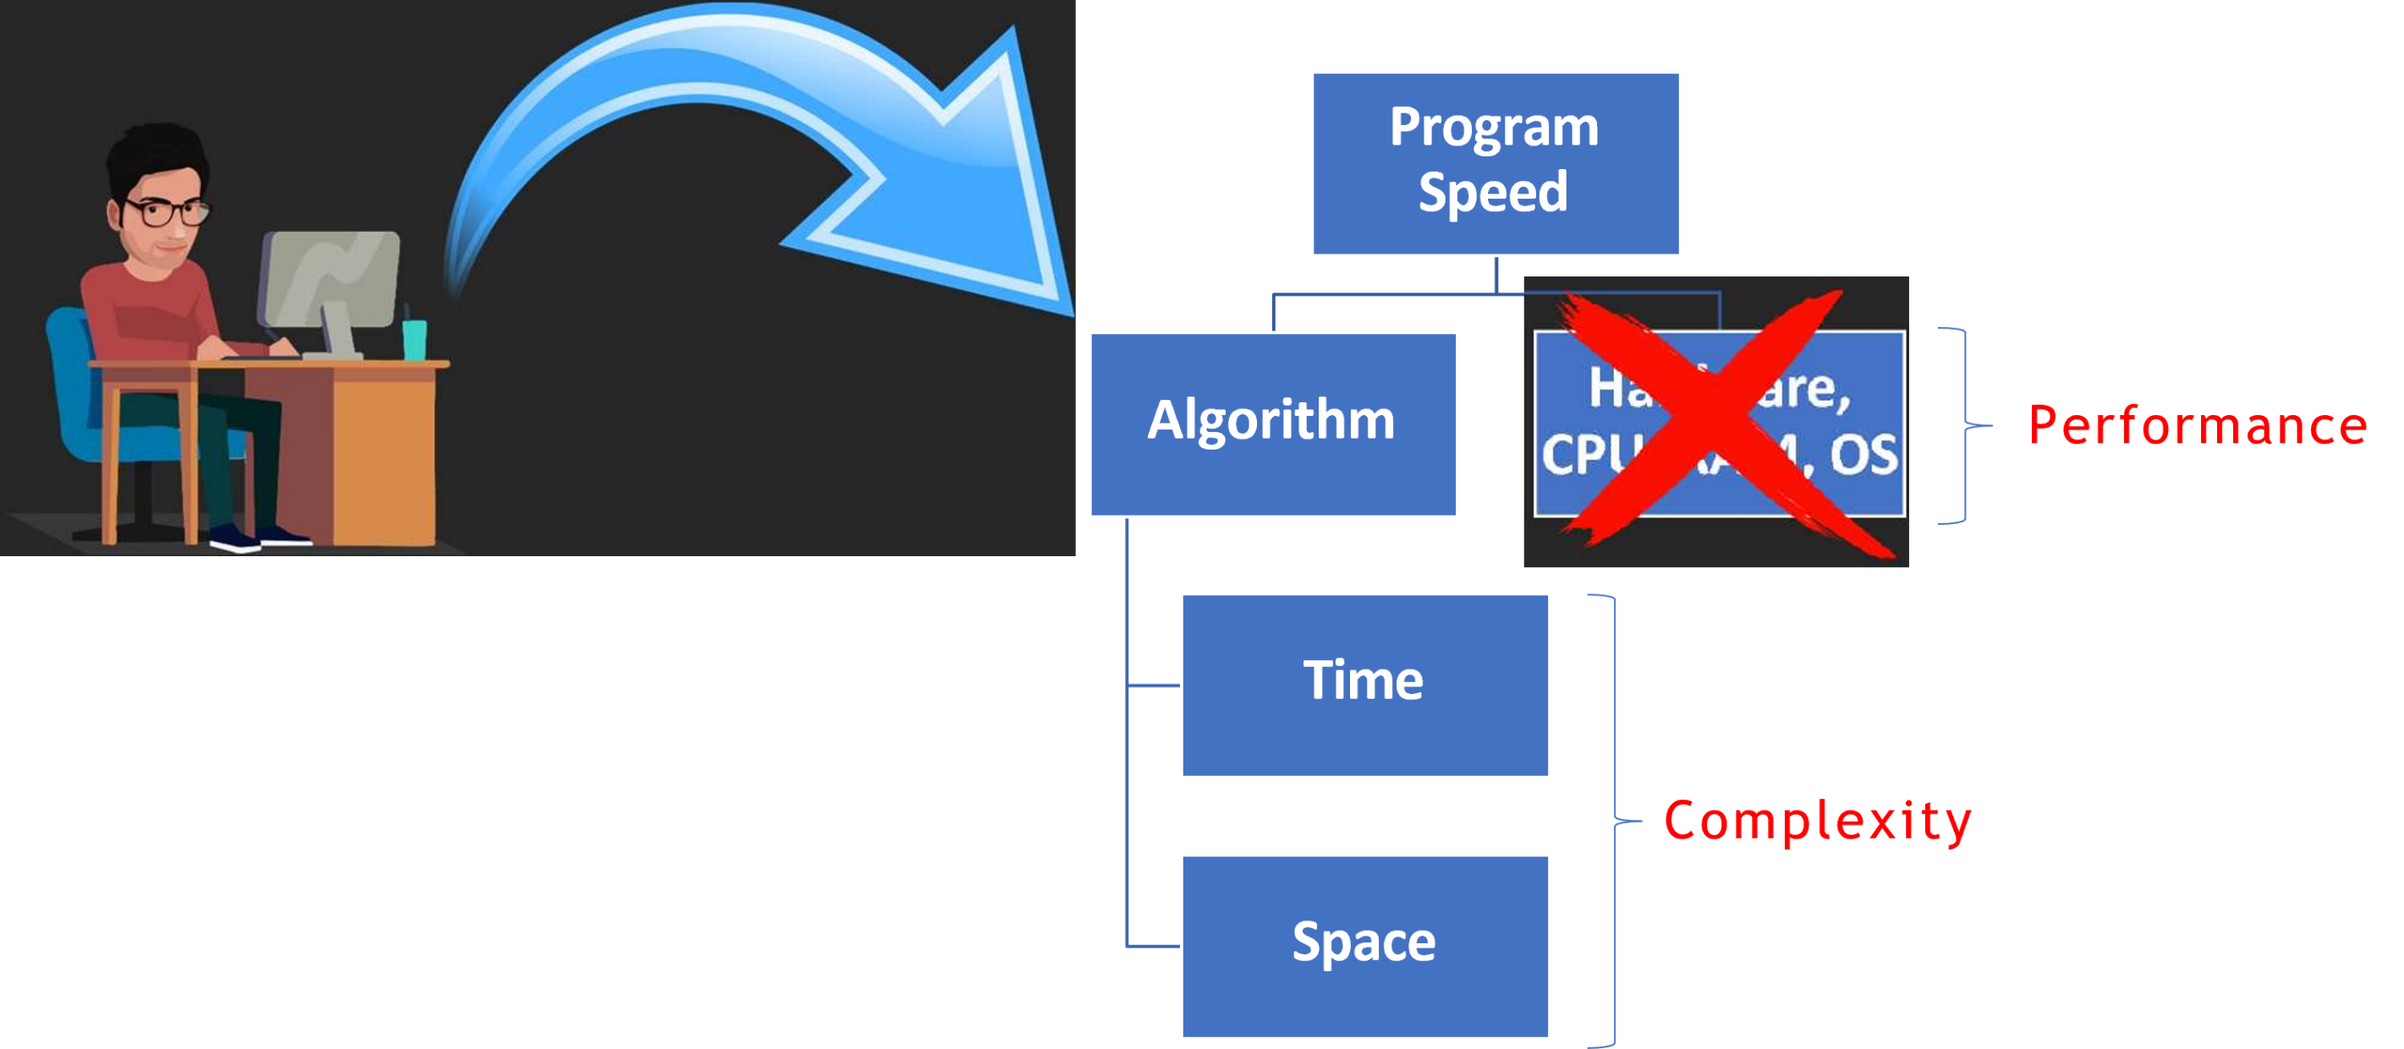
Things Affect Program Speed

Slide 4
Things that affects Speed:
Program Speed Algorithm fi (hardware, OS, and CPU).
Regardless of used algorithm, printing an array[100] items is faster if you run it on a faster computers.
So as a developer it’s not my problem to take care of the hardware.
But it is My Problem to take care of algorithm Therefore we need to focus on Algorithms only on writing code.

Slide 5
Things that affects Speed:
Algorithm Time Space.
So, Time fi Space are things that we should focus on

Slide 6
Thank you ☺

