Slide 1

Data Structure
Level 1
Time & Space Complexity Big O Notation

Slide 2

Data Structure
Level 1
Things affect your program speed
and efficiency?
2

Slide 3
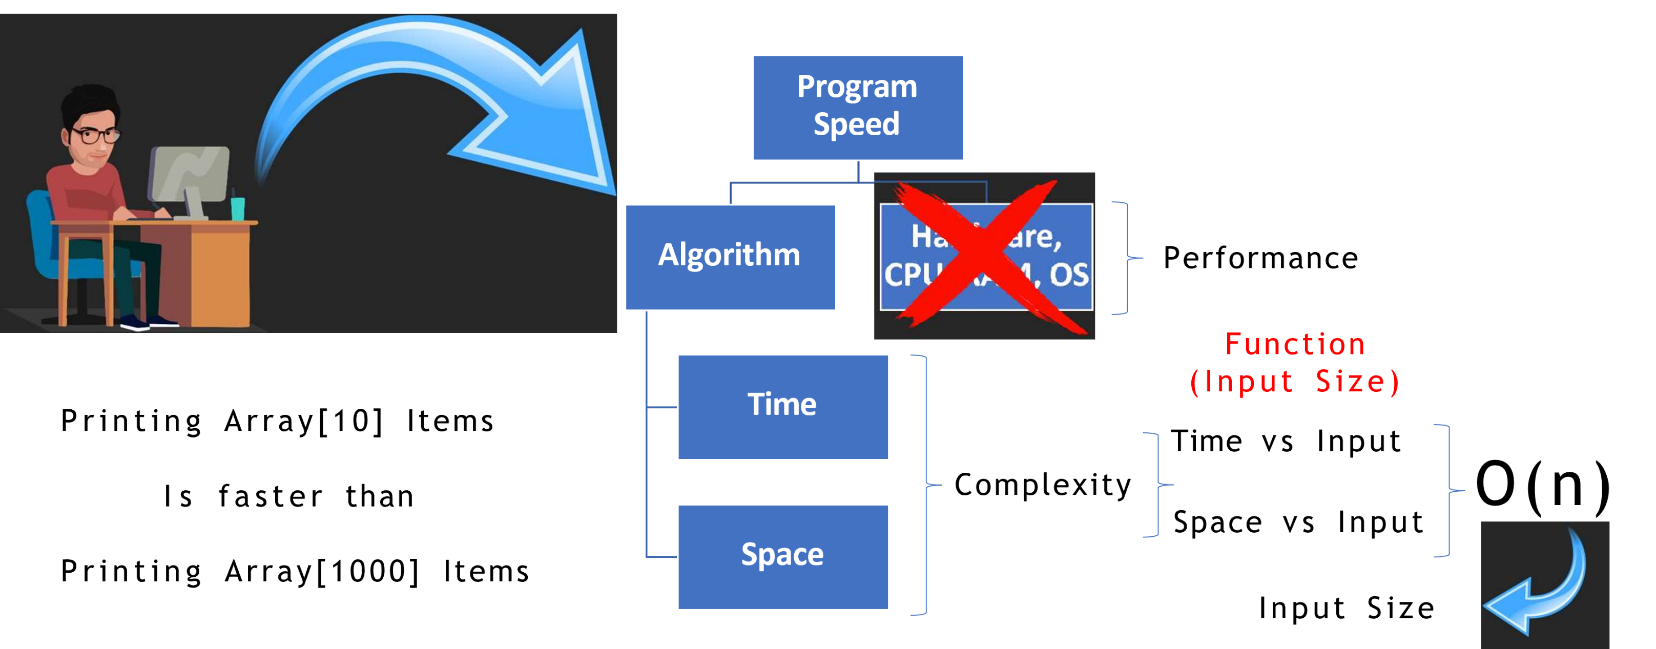
Things Affect Program Speed

Slide 4
Data Structure
Level 1
Big O
2

Slide 5
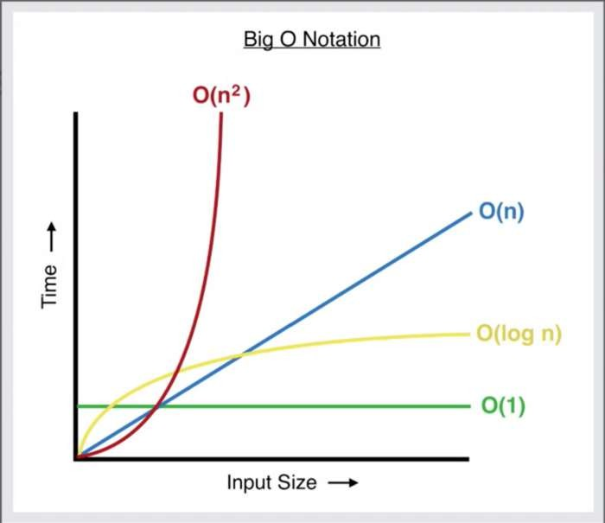
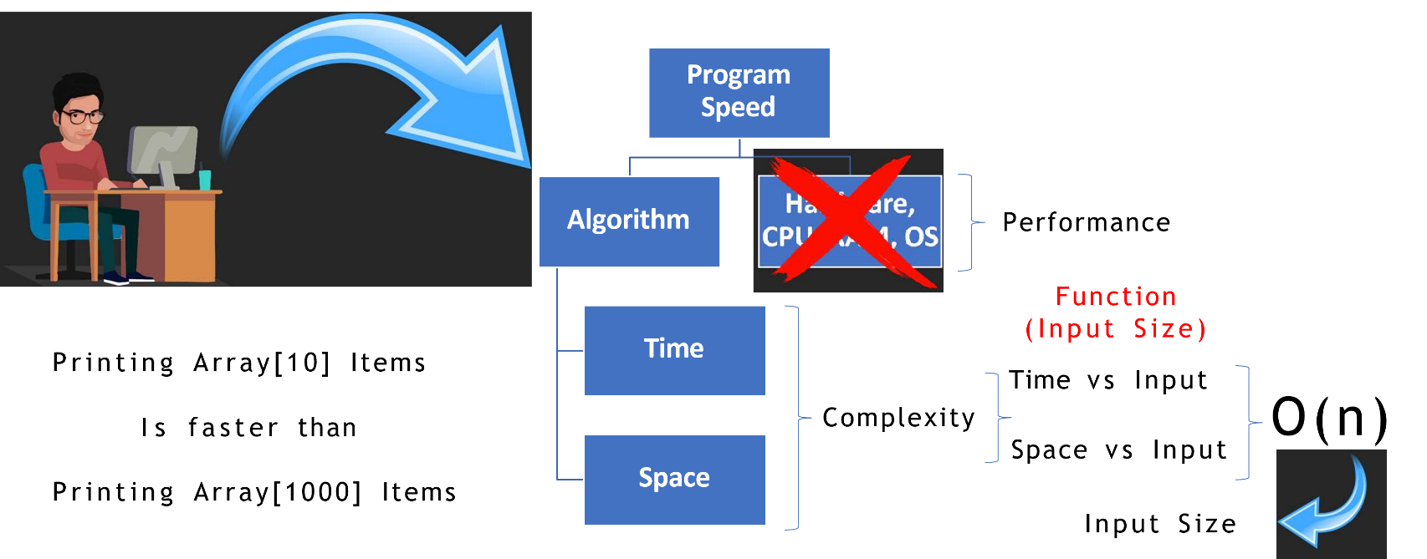
What is Big O?

Slide 6
Data Structure
Level 1
What Big O is NOT?
2

Slide 7
What is Big O is NOT?
Big O is not going to give you an exact answer on how long a piece of code will take to run.
Does not consider the performance of hardware.

Slide 8
Data Structure
Level 1
What is time and space complexity?
2

Slide 9
Time & Space Complexity
An algorithm's time complexity: specifies how long it will take to execute an algorithm as a function of its input size.
Similarly, an algorithm's space complexity: specifies the total amount of
space or memory required to execute an algorithm as a function of the size of the input.

Slide 10
What is BigO Notation
The big-O originally stands for “Order Of“.
Efficiency of Algorithm
Time Factor of Algorithm
Space Complexity of Algorithm
Represented by O(n) where n is the number of Inputs.
Big O, also known as Big O notation, represents an algorithm's worst-case complexity.
It uses algebraic terms to describe the complexity of an algorithm.
Big O defines the runtime required to execute an algorithm, by identifying
how the performance of your algorithm will change as the input size grows.
Relationship between Input Size and Performance.
But it does not tell you the exact time your algorithm's runtime is.
Big O notation measures the efficiency and performance of your algorithm using time and space complexity.
Big O allows us to discuss our code algebraically to get a sense of how quickly it might operate under the strain of large data sets.
with Big O otation, we can look at our algorithm and see that it will take O(n) time to run. Big O otation, written as O(blank), show us how many operations our code will run, and how its runtime grows in comparison to other possible solutions.

Slide 11
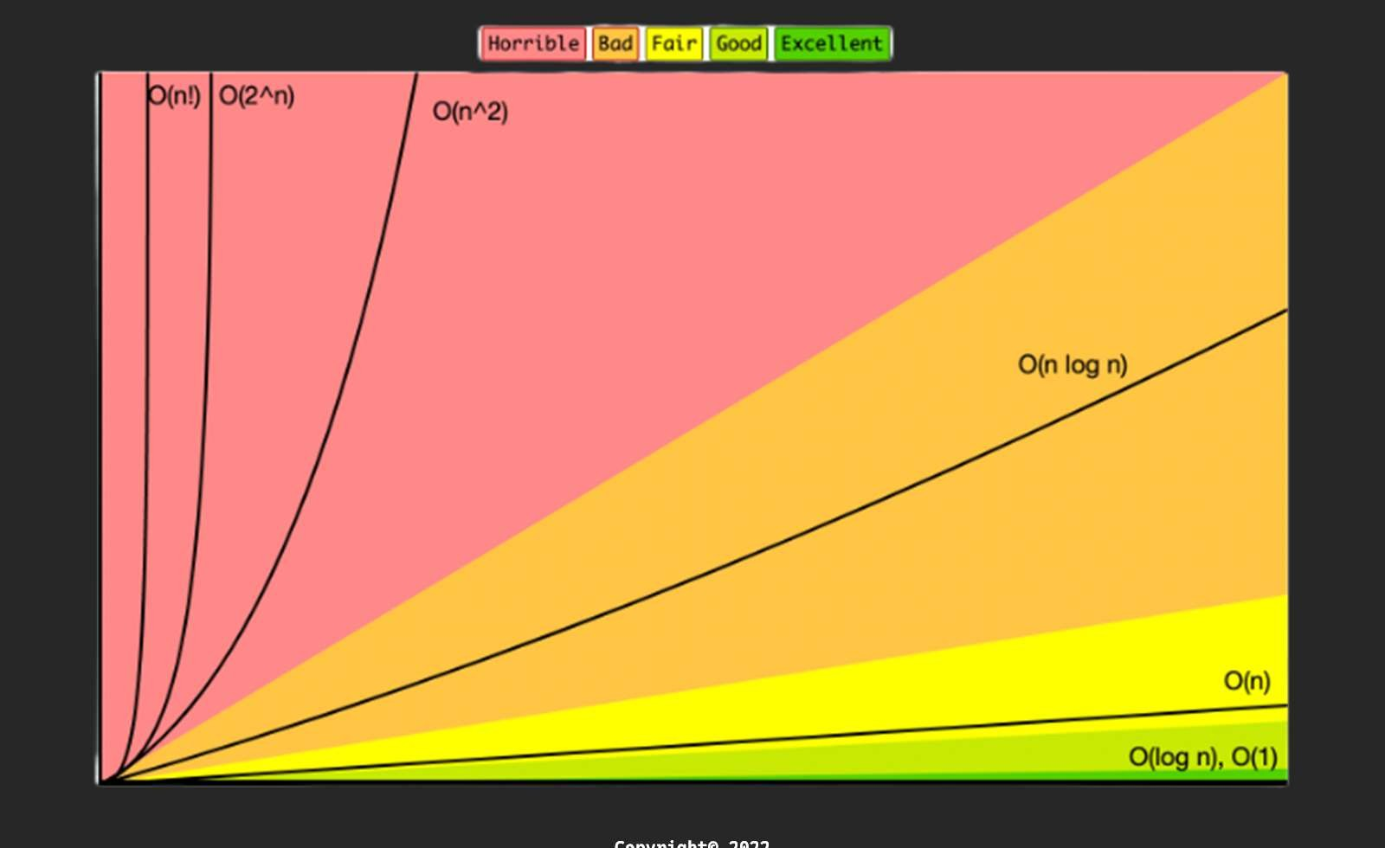
What is BigO

Slide 12
Thank you ☺

