Slide 1

Data Structure
Level 1
Big O(1) : Constant Time Function

Slide 2

Data Structure
Level 1
Complexity of an Algorithm
Big O
O(1)
2

Slide 3
Data Structure
Level 1
Quick Review
2

Slide 4
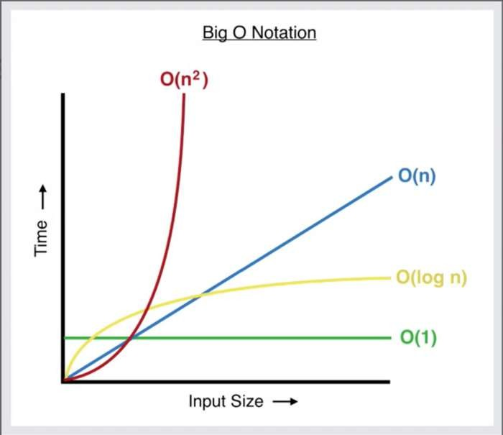
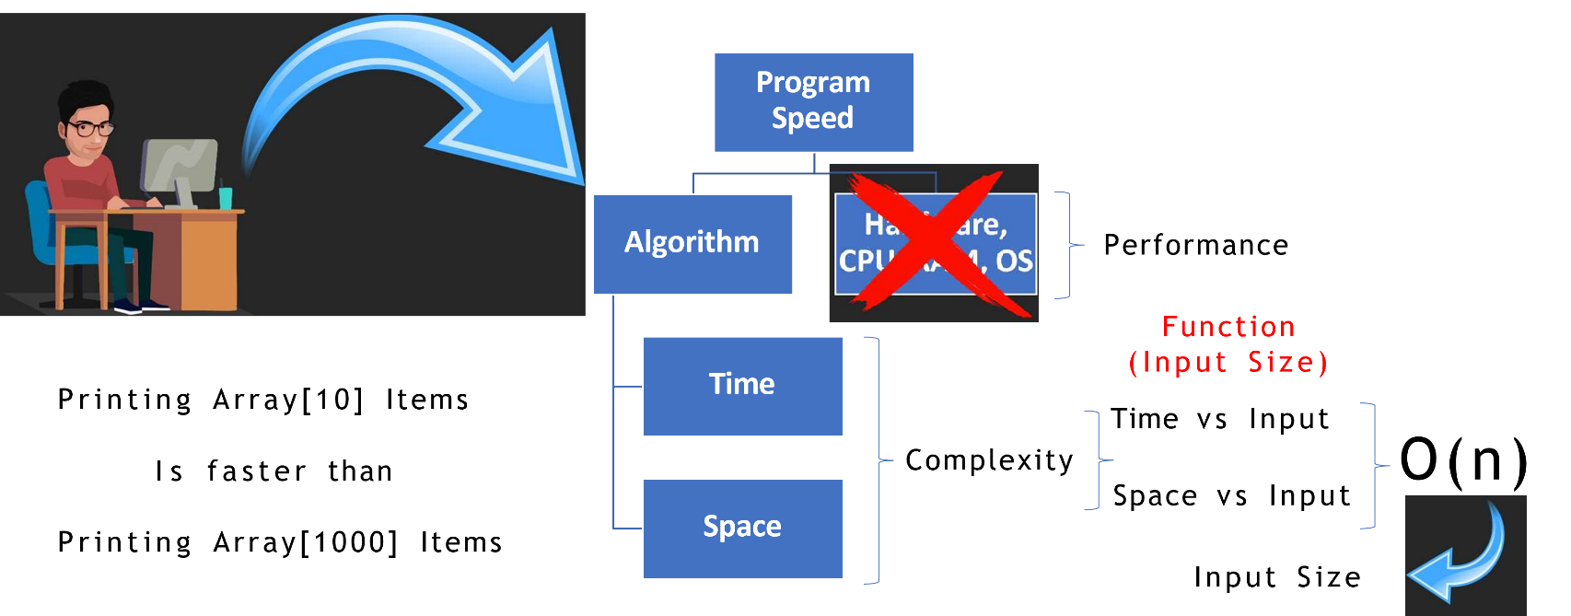
What is Big O?

Slide 5
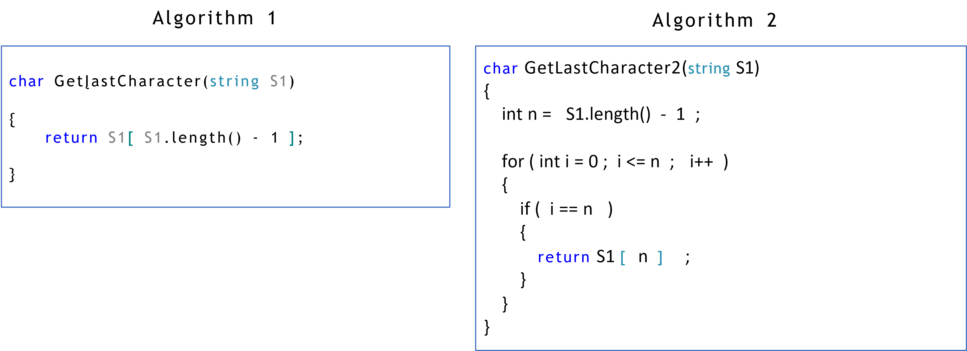
Big O for the following Algoriths:

Slide 6
Data Structure
Level 1
Calculating Algorithm Complexity
O(1)
2

Slide 7
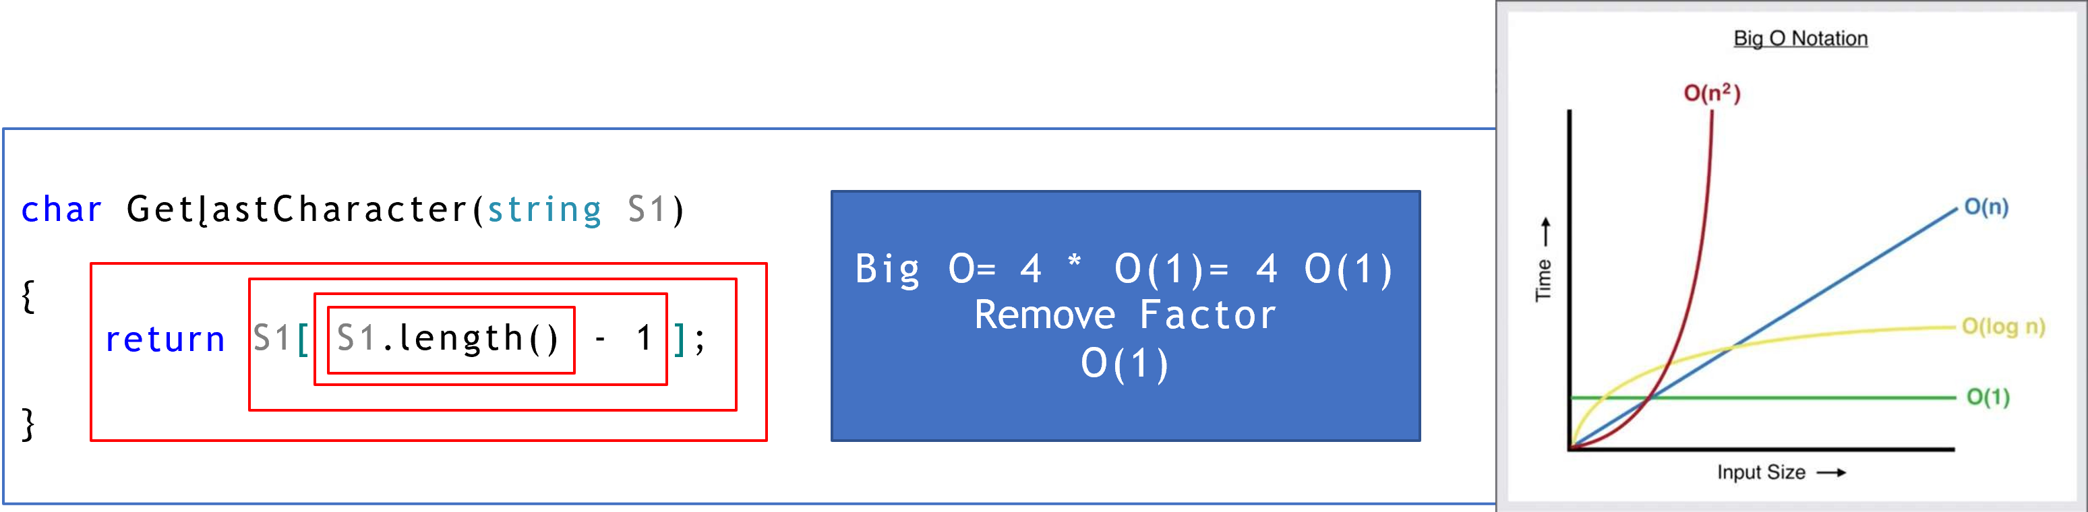
Calculating Algorithm Complexity:
Count the number of steps during execution.
Simplification:
Each step costs the same time.
+,-,return, access array element, … etc.
Number of Steps: 4 Steps, and it will be always 4 steps, it has nothing to do with array size
Constant Time , independent of array size

Slide 8
Thank you ☺

