Slide 1

Data Structure
Level 1
Big O Comparison and Conclusion

Slide 2

Data Structure
Level 1
Big O
Comparison and Conclusion
2

Slide 3
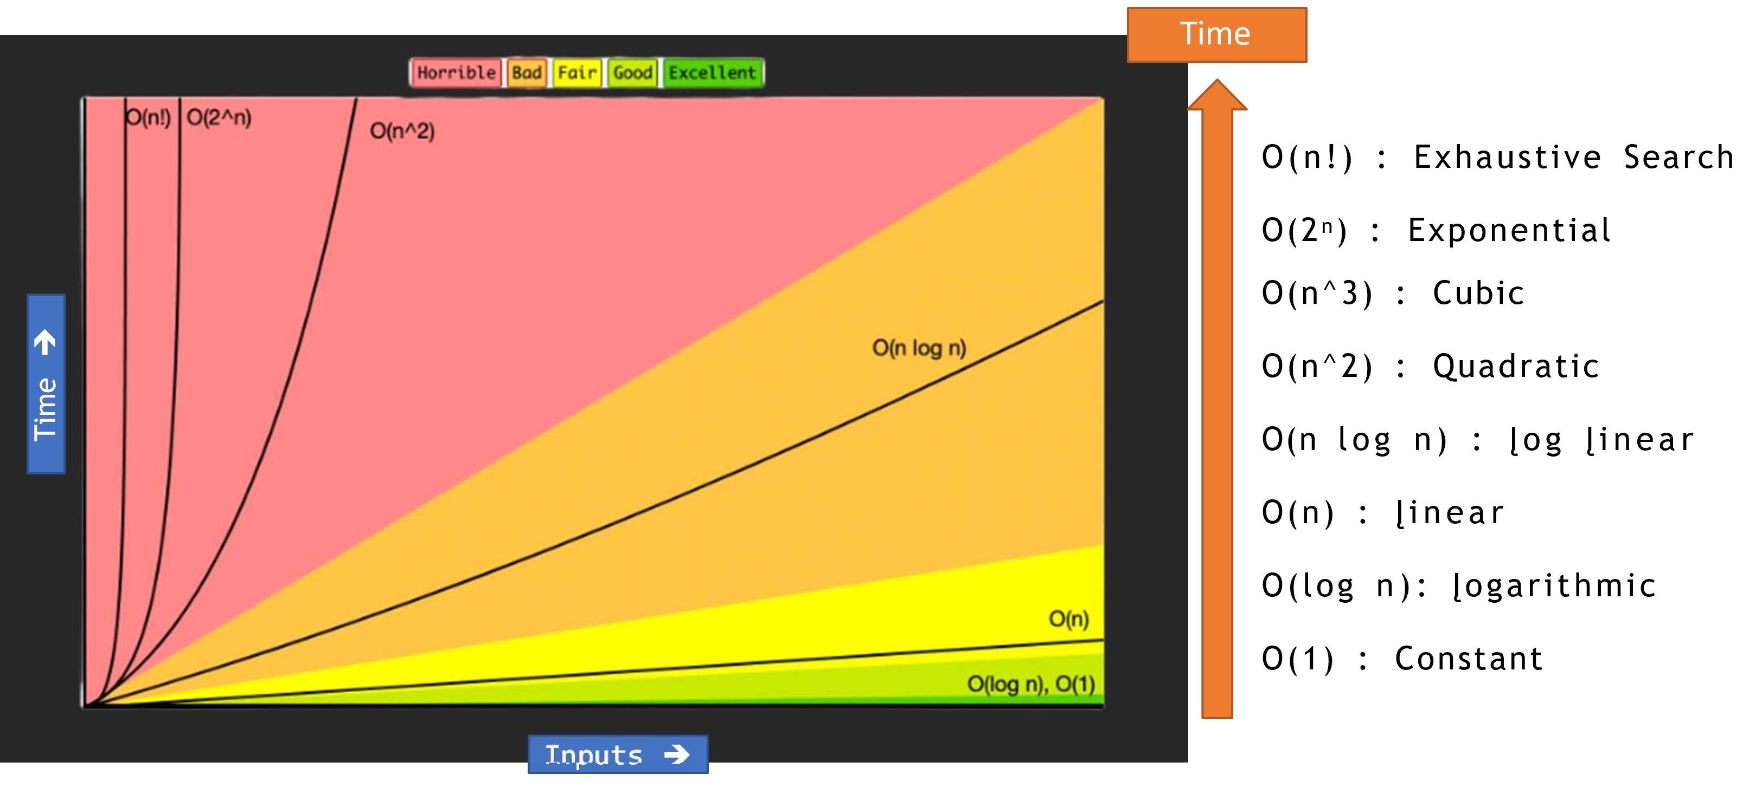
Big O Cheat Chart

Slide 4
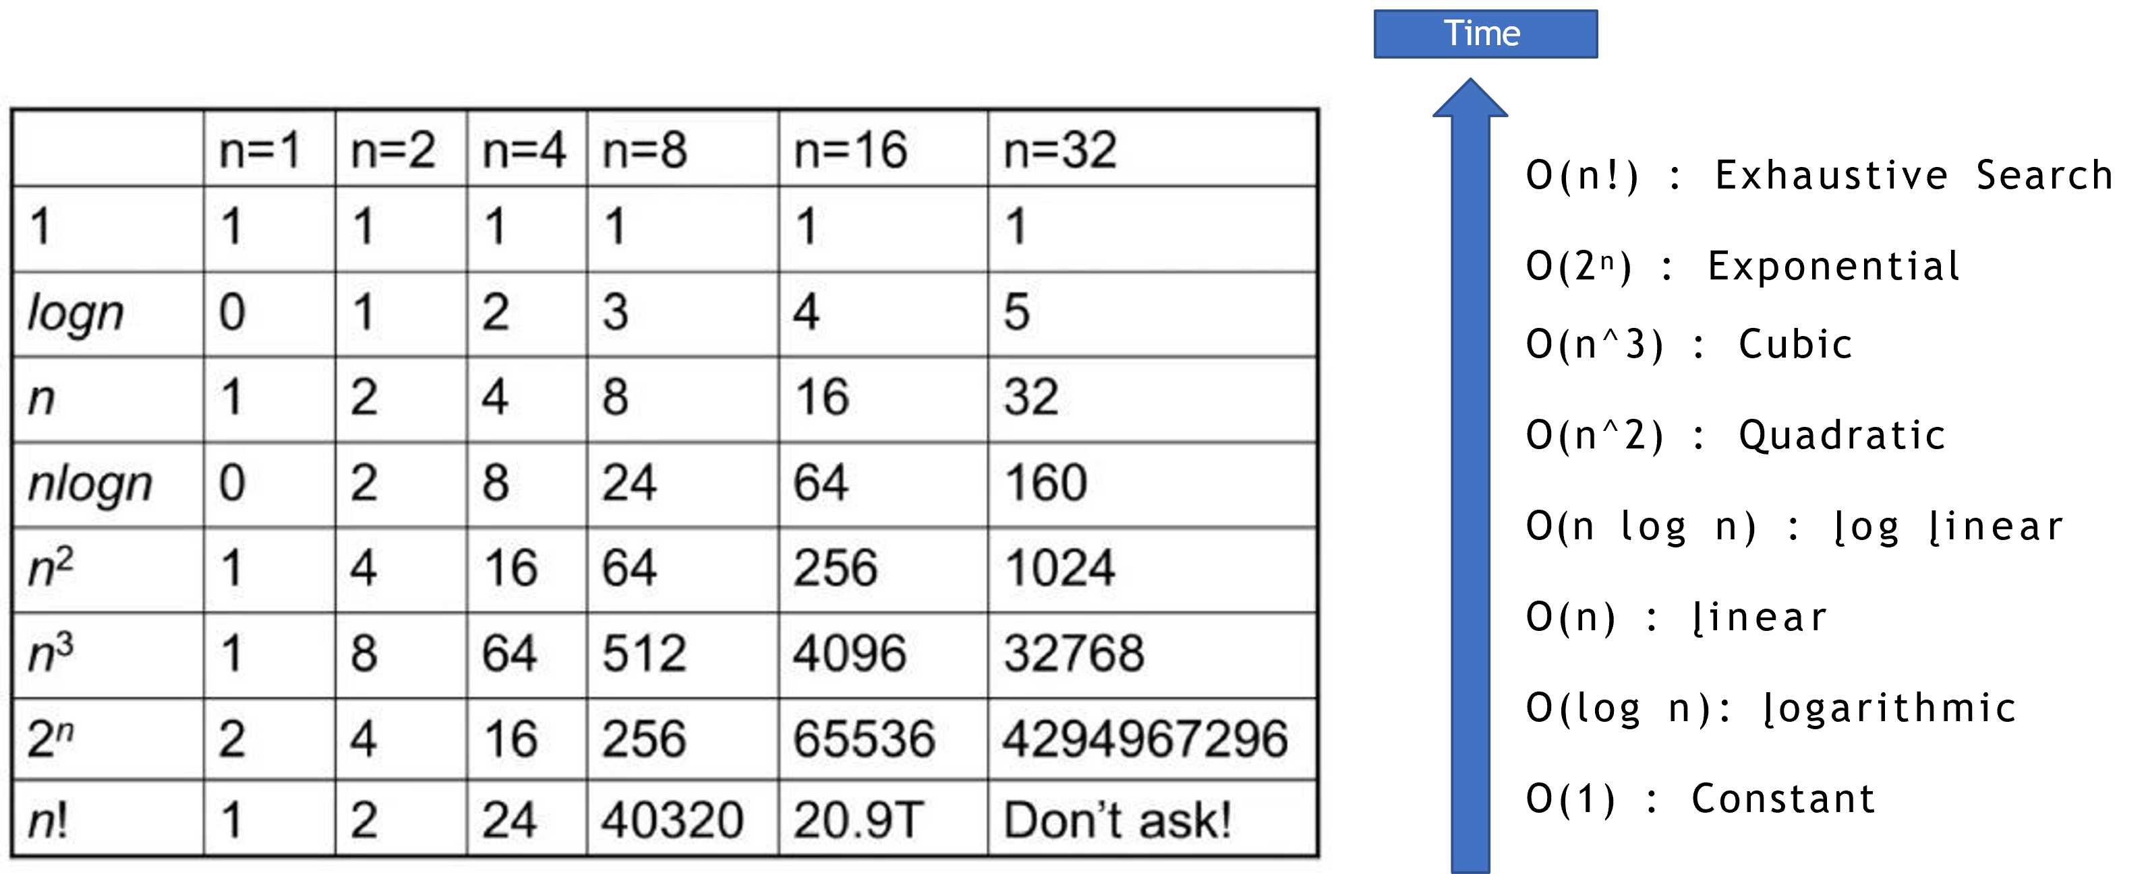
Groth Rate comparison

Slide 5
Always take the worst Big O
F(t) = 10 + O(n) + O(logn) + O(n^2) + O(n^3)
F(t) = O(n^3)

Slide 6
Thank you ☺

